Slide 1
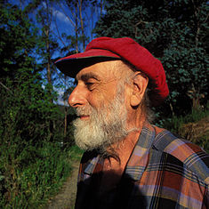
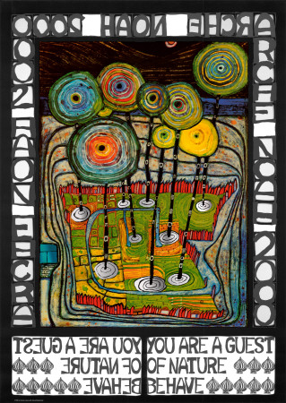
KS3 ART & DESIGN
Year 7
Hundertwasser
Name_______________________________________________
Group______________________________________________

Slide 2
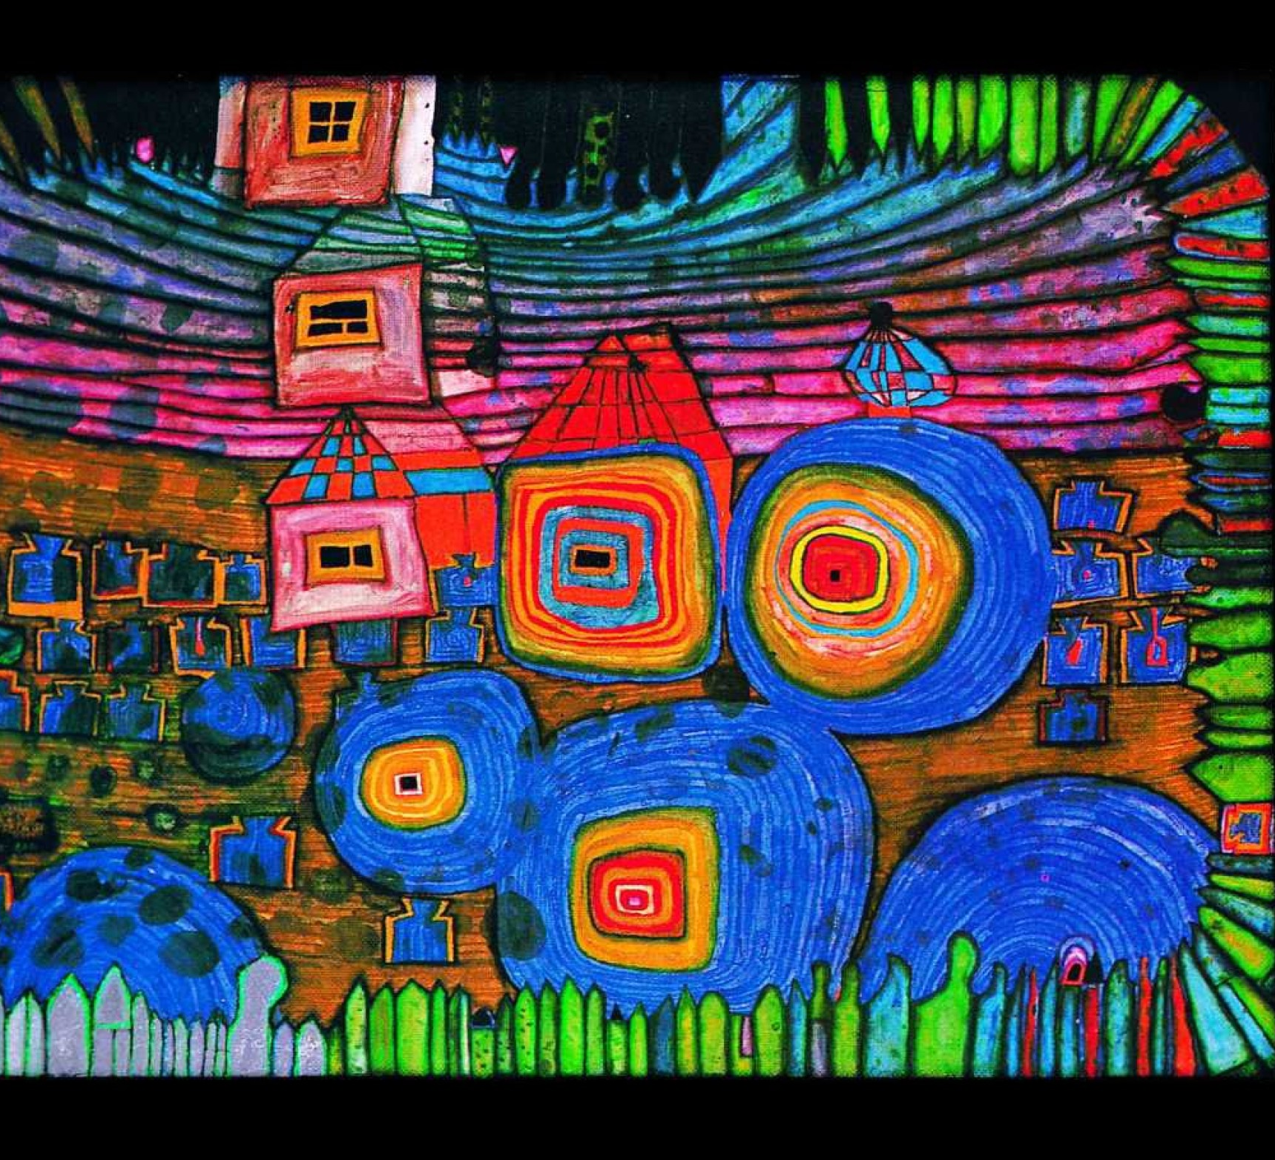
EXAMPLES OF
Hundertwasser’S
WORK

Slide 3
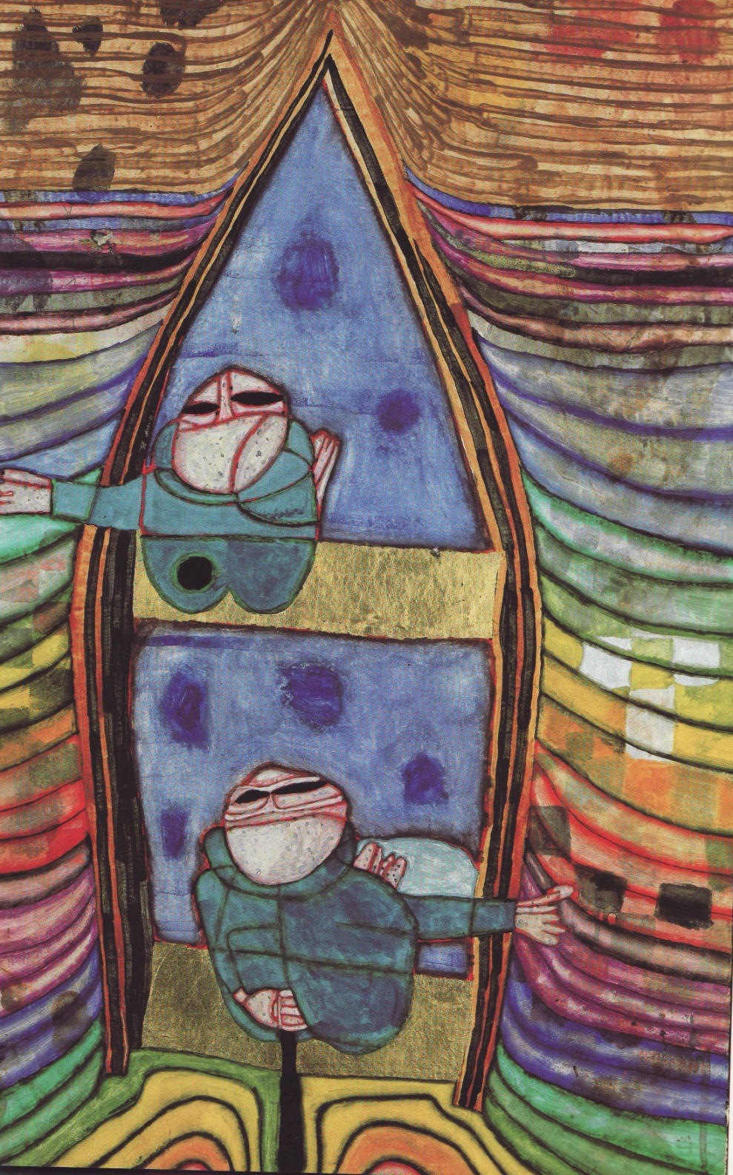

Slide 4
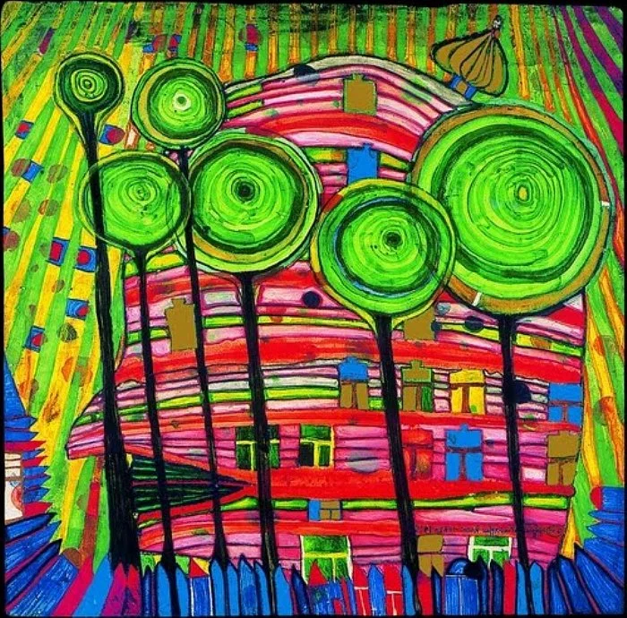
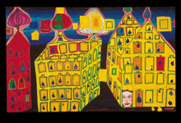

Slide 5
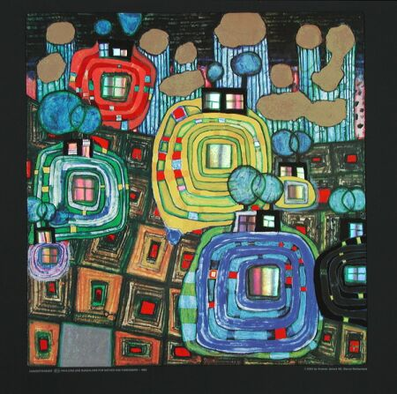
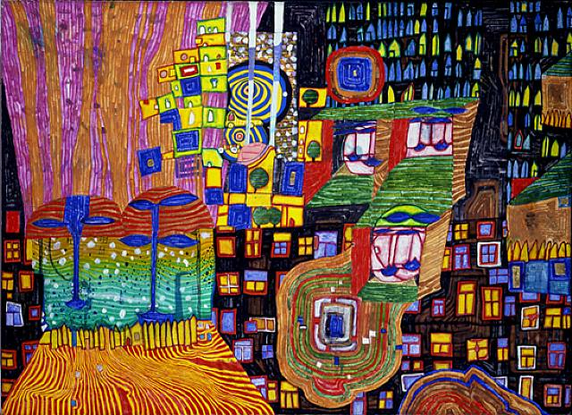
Frederich Hundertwasser
Friedrich Hundertwasser was born in 1928 in Vienna.
He died in 2000 on his way from New Zealand to Europe on board the Queen Elizabeth 2.
Hundertwasser was a Painter, architect, ecologist and visionary.
Hundertwasser once said, “ Beauty is Panacea”.
Which means a remedy for all diseases, evils, or difficulties.
What do you think he meant by that?
…………………………………………………………………………………………………………………………………………………………………………………………………………………………………………………………………………
Hundertwasser noted that there are no straight lines in nature and many of his paintings depicted spirals which he saw everywhere.
List 3 things in nature which have spirals.
_________________________________________________________________________________
Hundertwasser liked bright colours with a dark areas/ backgrounds. What are your favourite colours?
……………………………………………………………………………………………………………………………………………………………………………………………………………………………………………………………………………………

Slide 6
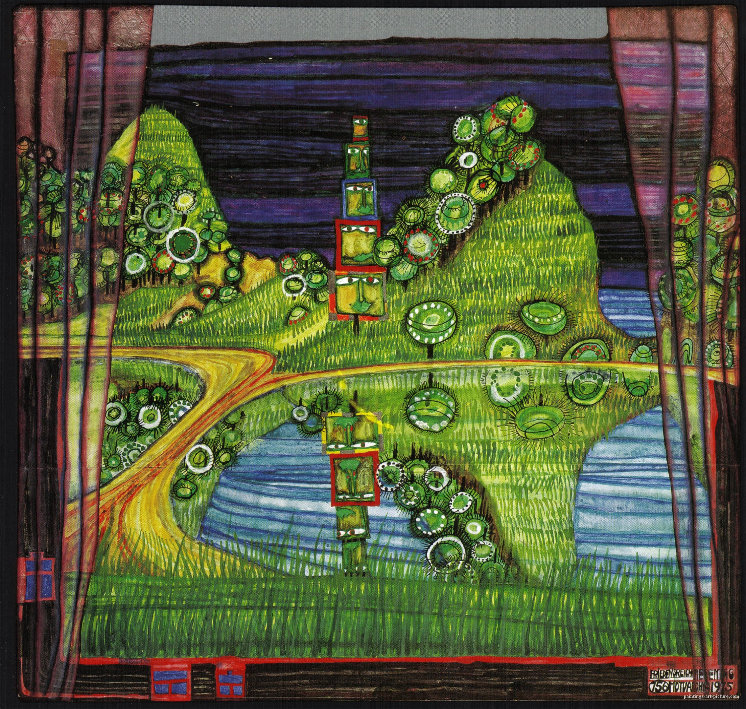
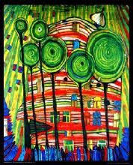
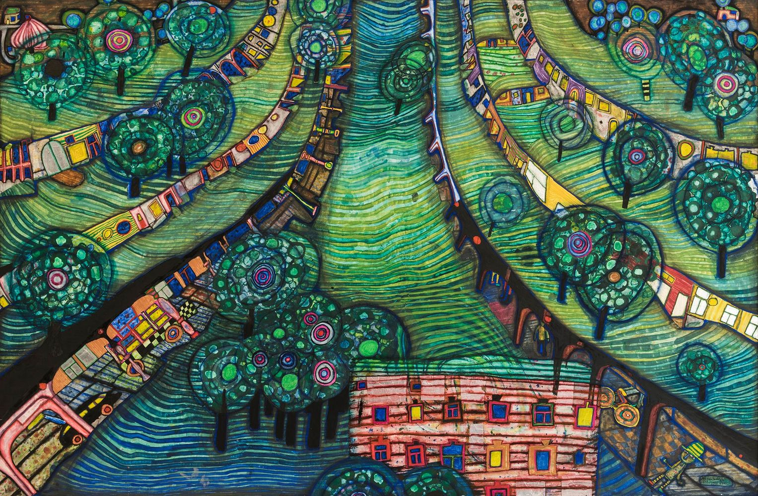

Slide 7
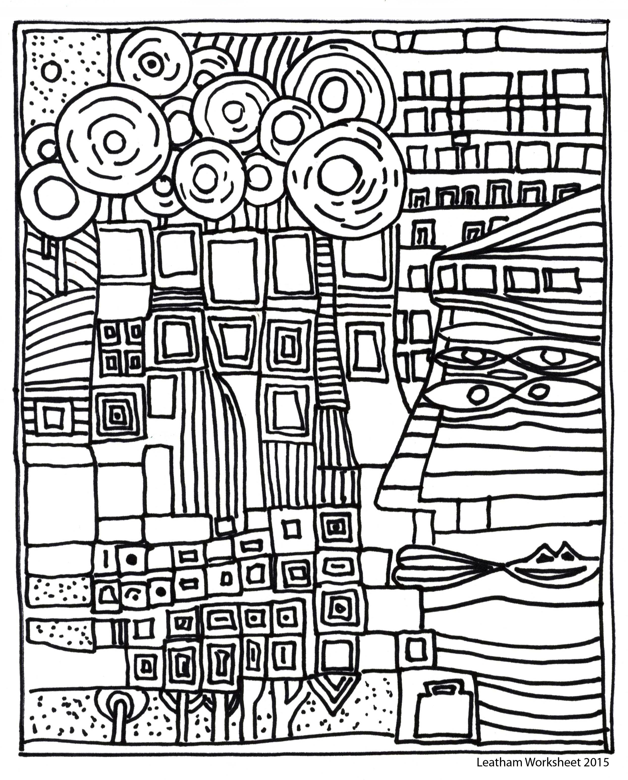
TASK 1
Lets start off simple – add colour with whatever media you have at home to bring this Hundertwasser piece of work to life. Add bright colour and patterns like he did.
Challenge : sketch it out yourself onto a different base

Slide 8
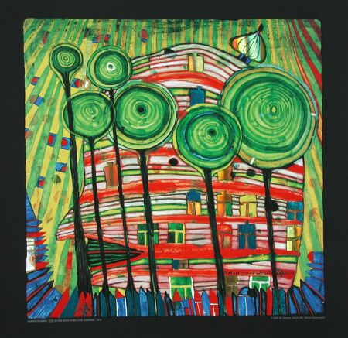
TASK 2 (a)
Lollipop Trees
Have a look at the images on the last page .Hundertwasser often depicted trees like lollipops.
Look out of your window or when you take your daily walk - what simple shapes could trees be represented as? Find three different shapes and draw them here. – add full colour - create the patterns on them that Hundertwasser would have done

Slide 9
TASK 2 (b)
Lollipop Trees
Select one of the tree shapes from your last page. Repeat it any times at different heights. Add a patterned background like Hundertwasser did. Add full colour to your work in whatever media you have at a home.
Need help ? Use the next page
Challenge ; See below
Challenge :After you have sketched out your design could you add some cardboard relief or create the trees in a different media like wool or string ? See what resources do have laying around at home?

Slide 10
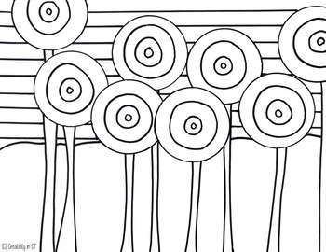
TASK 2 (b)
Lollipop Trees
Add a patterned background like Hundertwasser did to the basic shapes here Add full colour to your work in whatever media you have at a home.

Slide 11
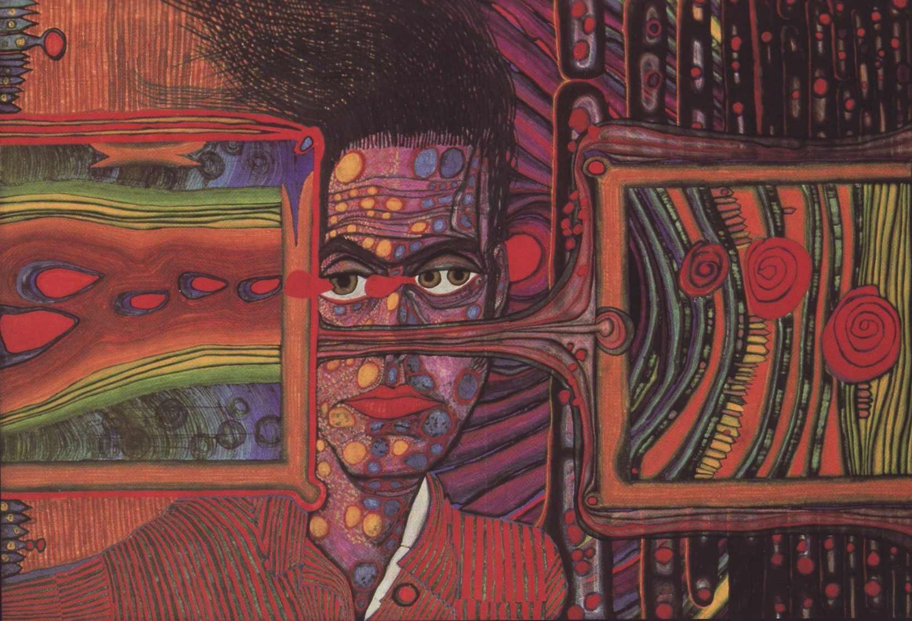
Task 3 + 4 +5
Portrait
On the next few pages there are some examples of his work. You are going to try and create a piece of work in his style. Have a look at following pages and see what you think. Do you like this style of drawing a portrait? Explain why . Discuss this with someone ta home

Slide 12
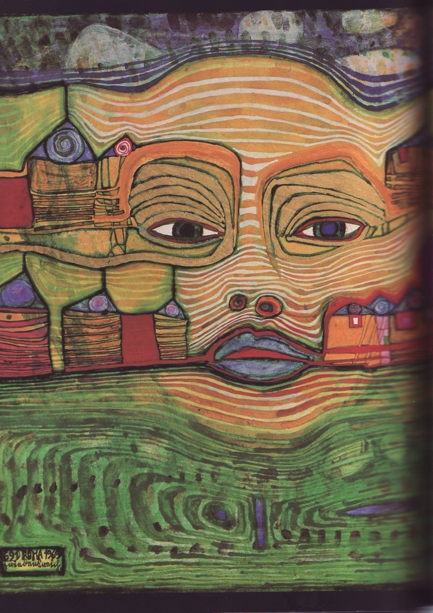

Slide 13
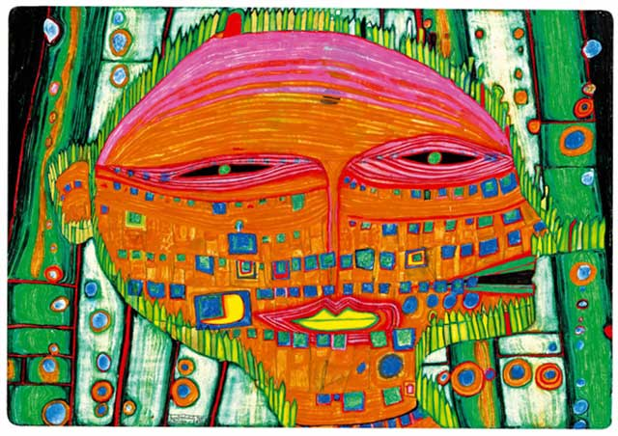

Slide 14
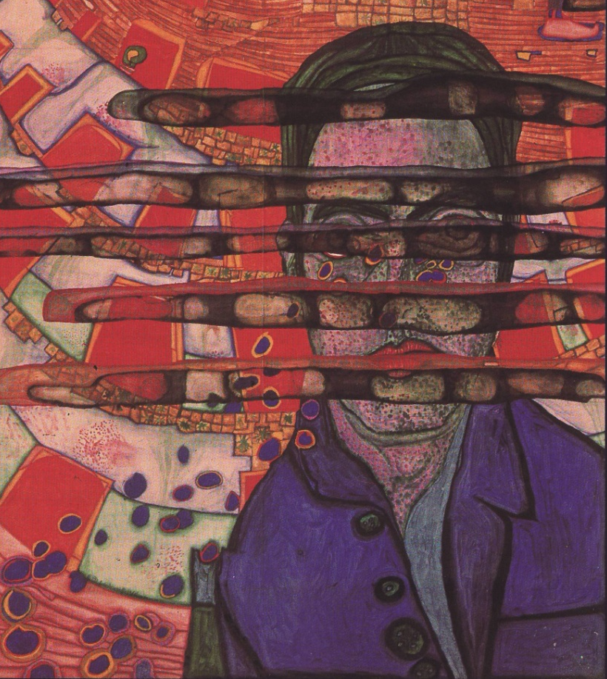

Slide 15
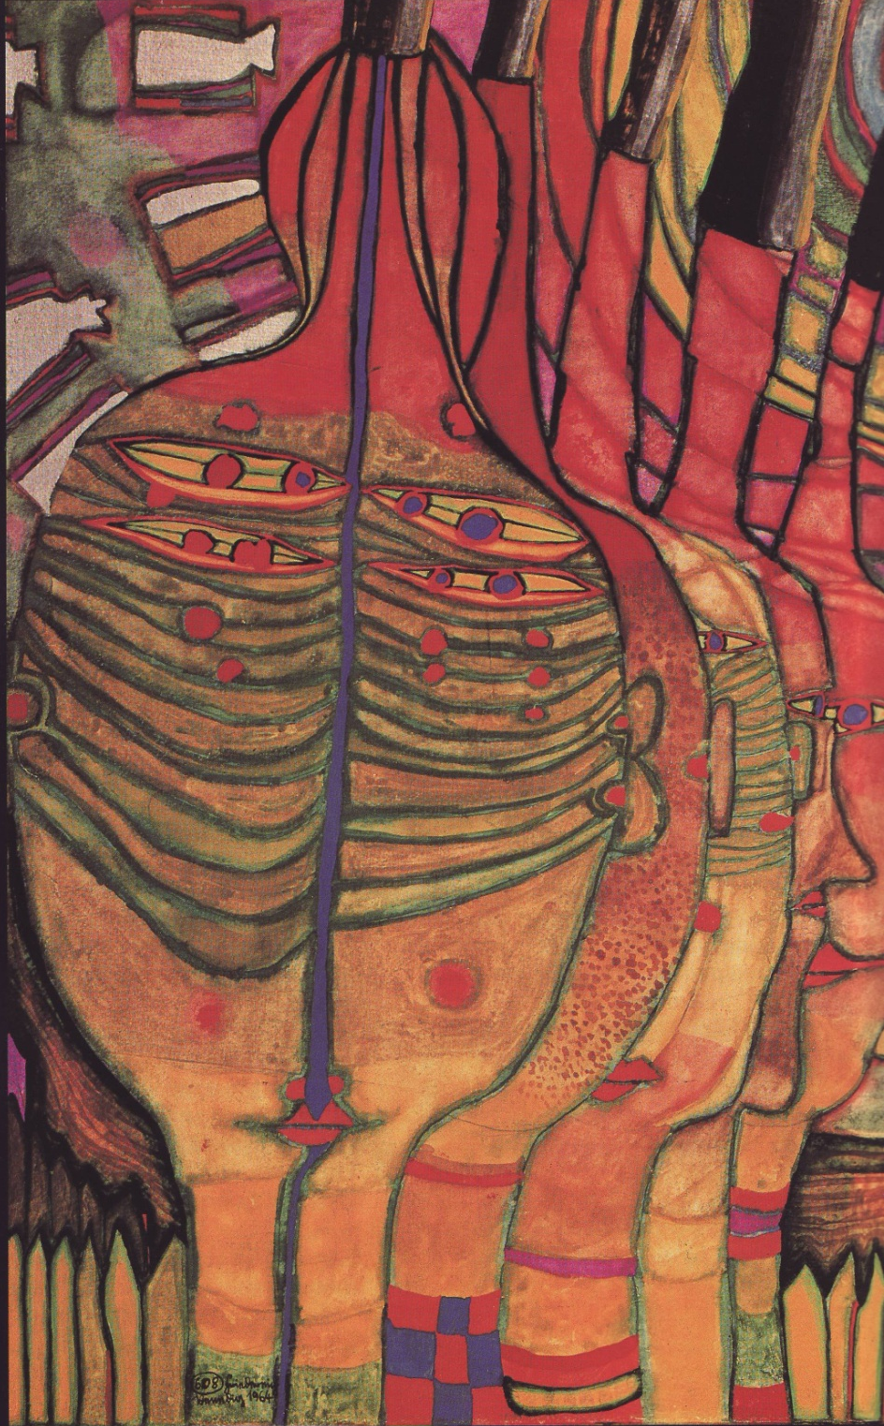

Slide 16
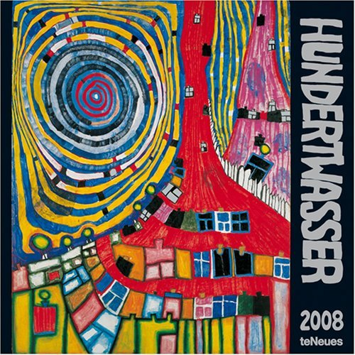
Task 3 + 4+ 5
Portrait
Task 3 (one lesson/ task)
Draw a self portrait or ask a family member to sit so that you can draw them . If you are unsure of the proportions of a face then please see the worksheet on the next page .
Task 4 (one lesson/ task)
Trace through your face on to tracing paper if you have some – or greaseproof paper form the kitchen
Flip image and draw on to A3 paper or any larger paper you have - you can glue two or four smaller ones together if you like - or use the back of some spare wallpaper etc. You can decide
Add in abstract patterns and shapes (like on the opposite image or any that you have seen on his work) on the next few pages there are some examples of what your final outcome may look like. Have a look at these to give you some inspiration
Remember- Draw lightly to make mistakes easy to rub out
Task 5 (one lesson/ task)
Add full colour to your work in whatever media you have available at home - try and use the colours that he would have selected.

Slide 17
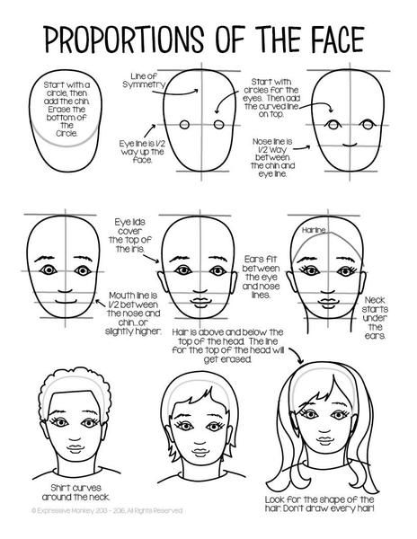

Slide 18
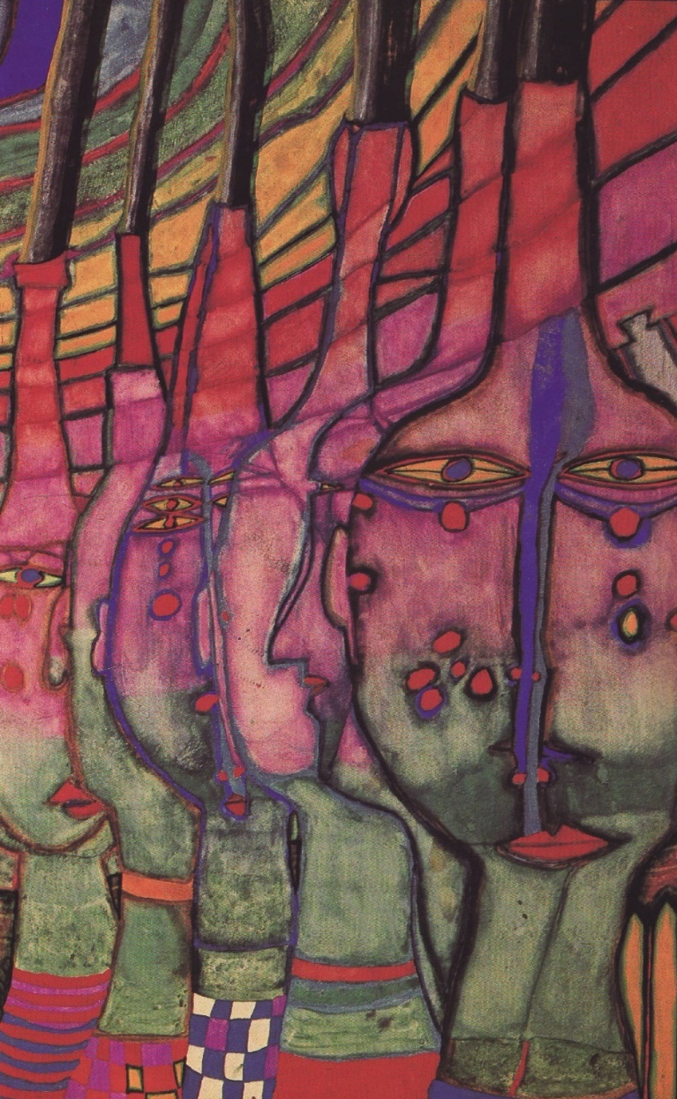
Task 6 Portrait
There are 6 faces.
Can you see the ones which are profile and front view.? See if you can label them on here.
TASK 6
Use your original portrait from the previous task.
Try to create a series of your portraits overlapping like this in a variety of profiles.
Need help : Trace your original portrait and complete 3 front views overlapping
Challenge : Do not trace your portrait , draw free hand and complete at least 6 overlapping views
* Do this is black pen only *

