Slide 1
Where is Italy?
Identify where Italy is
Understand the difference between a political and a physical map
Use different maps to investigate key features in Italy

Slide 2
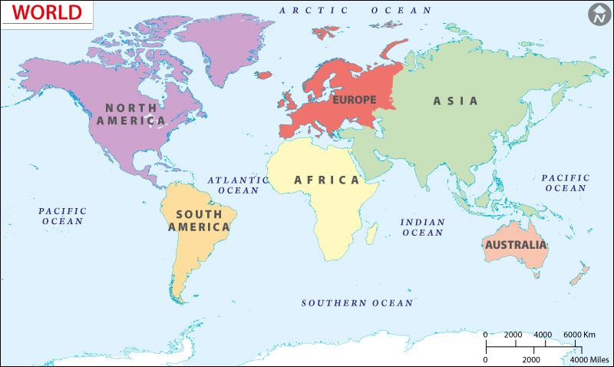
Where is Italy?
Which continent?
Identify where Italy is

Slide 3
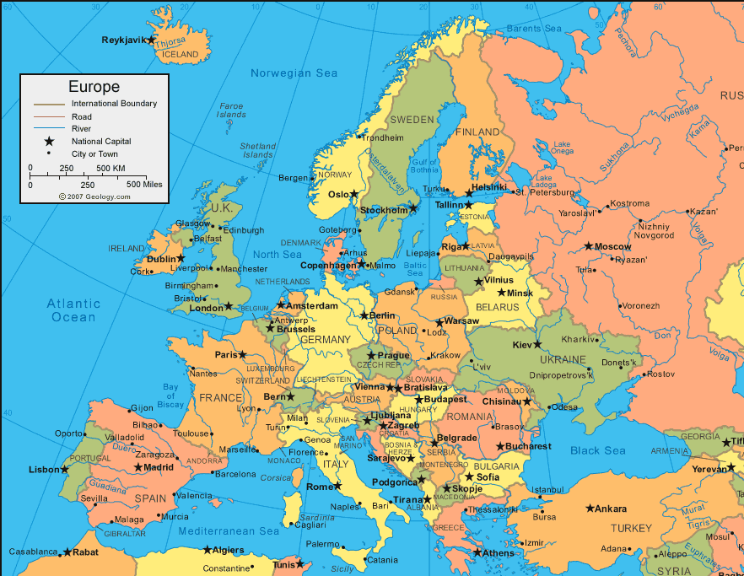
Where in Europe is Italy?
Identify where Italy is

Slide 4
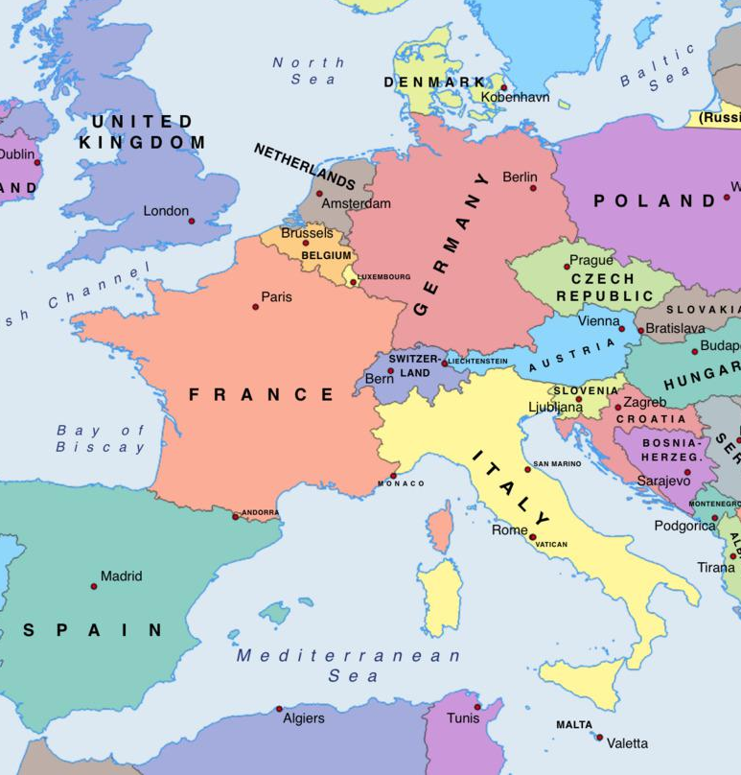
Which countries border Italy? This means they must be touching it. There are 4.
Identify where Italy is

Slide 5
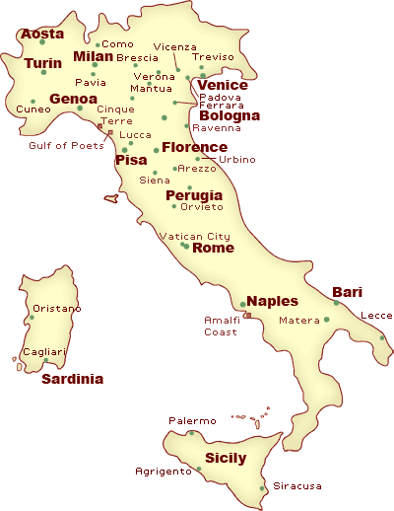
Identify where Italy is
Italy is easy to recognise on any world map, as the country is shaped like a high-heeled boot, as you can see on the map above. It looks like the boot is kicking a ball, which is the Italian island of Sicily

Slide 6
Complete the questions on worksheet 1 by investigating the map!
Don’t forget to use the key to help you…
Use different maps to investigate key features in Italy

Slide 7
Challenge:
What is the difference between the maps on the next two slides?

Slide 8
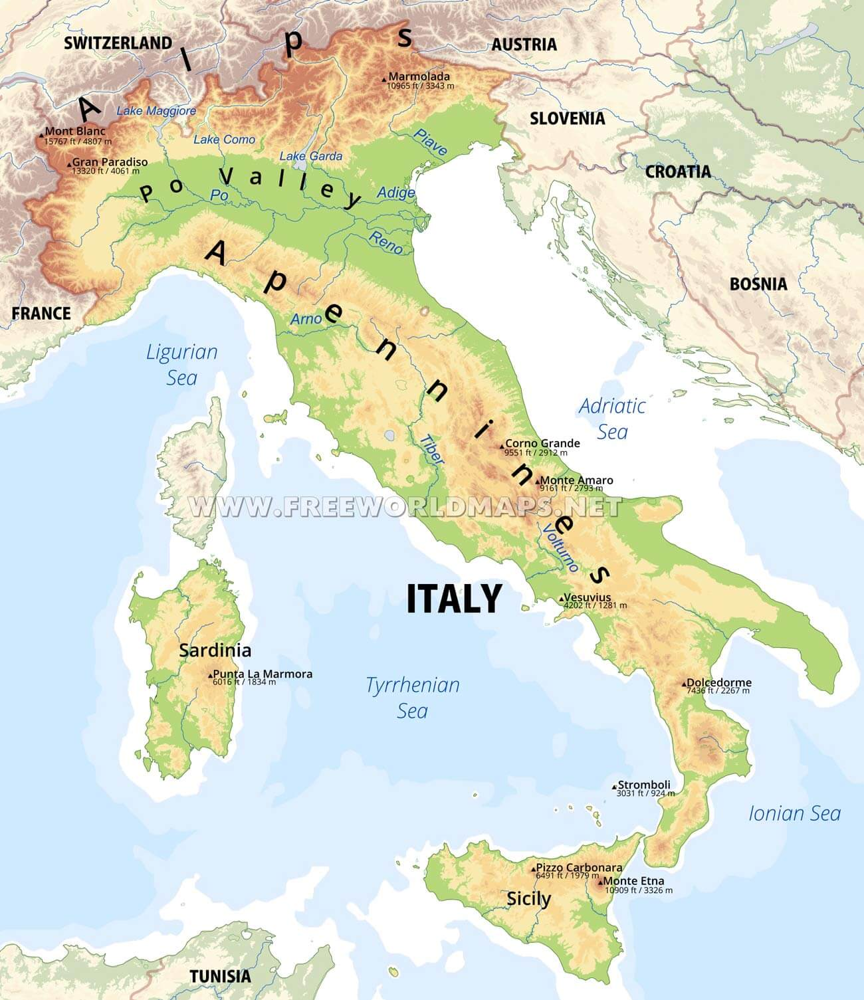

Slide 9
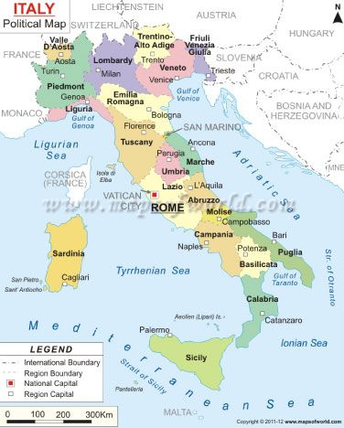

Slide 10
Understand the difference between a political and a physical map
This is a physical map.
A physical map tends to show the physical (natural) features of places. This includes features such as the height of the land (shown by the different colours), the names of seas, the name and location of rivers (the blue lines with a name in italic on top) and the names of some mountain ranges written in large words over the mountain range) and some mountains inside them (usually start with the word mount).

Slide 11
Understand the difference between a political and a physical map
This is a political map.
A political map tends to show the human (man made) features of places. This includes features such as the names of countries, boundaries between countries, the regions of countries (the coloured sections with bold writing) and major cities.

Slide 12
Complete the questions on worksheet 2 by investigating the maps!
Use different maps to investigate key features in Italy

Slide 13
Are the following features likely to be found on a Political or Physical map?

Slide 14
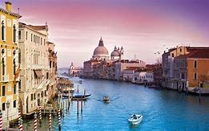
Political or Physical?
If you wanted to find Venice

Slide 15
Political Map
Venice is a city, which is a human (manmade) feature so it would make most sense to use a political map.

Slide 16
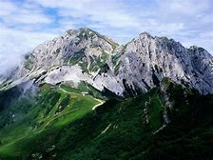
Political or Physical?
If you wanted to find The Alps?

Slide 17
Physical Map
The Alps are a mountain range, which is a physical (natural) feature so it would make most sense to use a physical map.

Slide 18
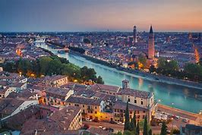
Political or Physical?
If you wanted to find The River Po?

Slide 19
Physical Map
The Po is a river in Italy, which is a physical (natural) feature so it would make most sense to use a physical map.

Slide 20
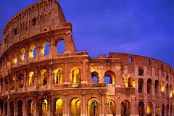
Political or Physical?
If you wanted to find Rome?

Slide 21
Political Map
Rome is the capital city, which is a human (manmade) feature so it would make most sense to use a political map.

Slide 22
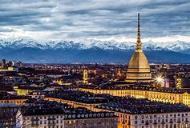
Political or Physical?
Killer question alert!
If you wanted to find this city, but you didn’t know what it was called?

Slide 23
Political AND Physical Map
In the background of the picture you can see a mountain range, so you would need to use a physical map to find out where they are. You would then need to use a political map to find the names of the cities which are near to the mountain ranges!

Slide 24
Now you’ve got all the knowledge you need for this lesson, have a go at the questions on the next slides to test your knowledge…
Write your answers down then use the answers (on the answers PPT) to check if you were right.
If you got one wrong don’t worry- do as we always do and correct it! (yes- you should do this in purple pen at school, but don’t worry if you don’t have one of those, any colour will do!)
Remember you should all do the developing and secure questions. If you are targeted S+, or you would like to challenge yourself, do those questions too!

Slide 25
Test your knowledge: Developing
Which continent is Italy in?
Name the 4 countries which border Italy
What it is Italy shaped like?

Slide 26
Test your knowledge: Secure
4) Describe the difference between a political and a physical map

Slide 27
Test your knowledge: Secure+
5) Name two mountain ranges in Italy
6) Name one river in Italy
7) Name two seas surrounding Italy
8) Name one mountain in Italy
9) Name 3 regions of Italy
10) Name one of Italy’s islands

