Slide 1
When I typed our new topic into google the following 10 images came up.
See if you can tell me what our new topic will be after looking at all of the pictures!

Slide 2
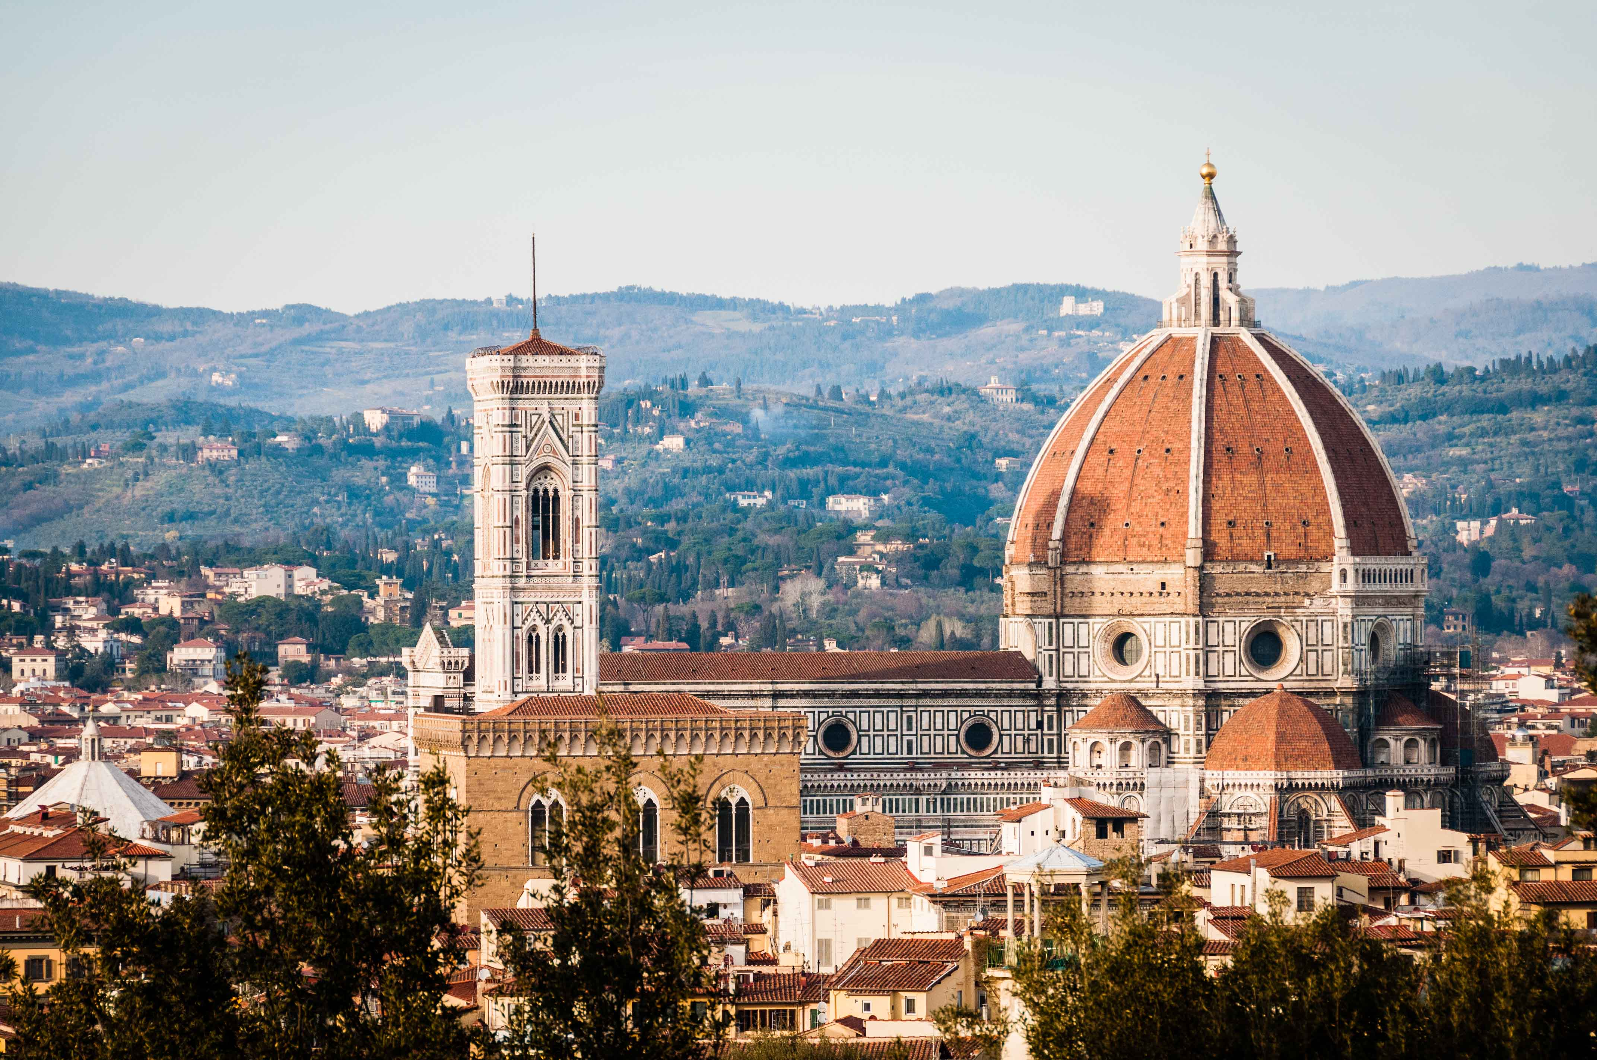

Slide 3
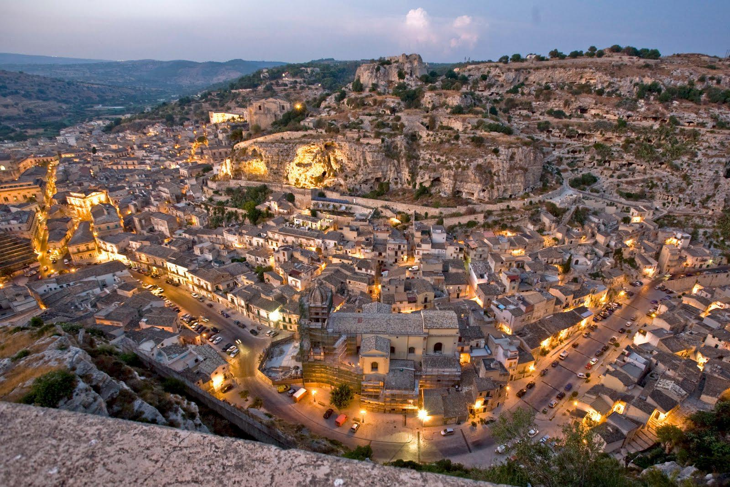

Slide 4
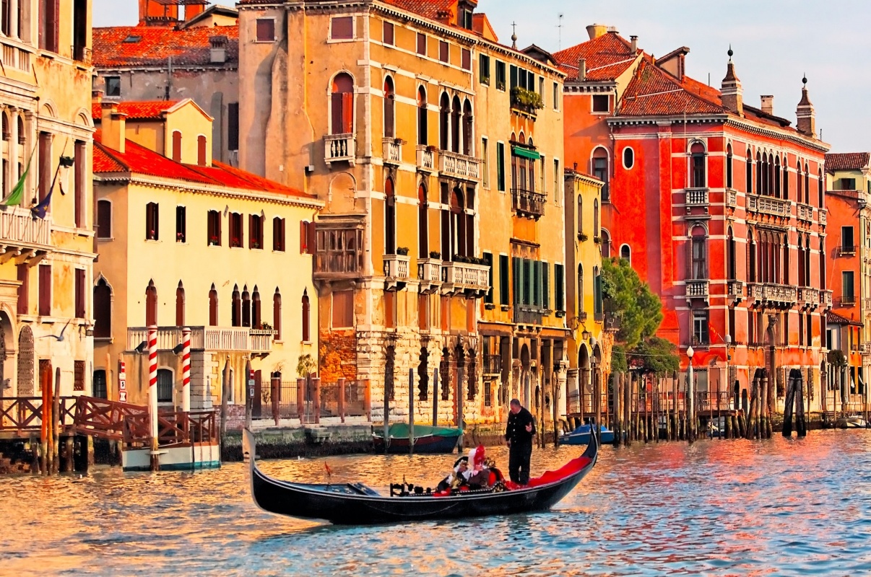

Slide 5
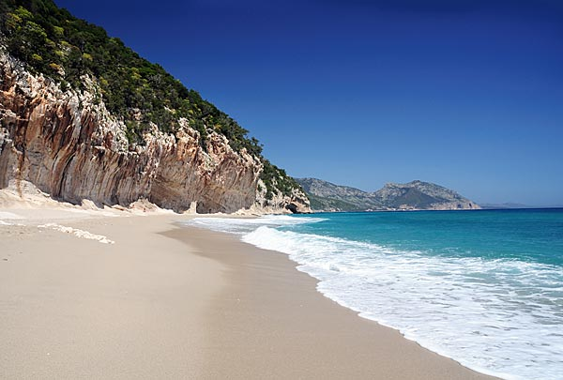

Slide 6
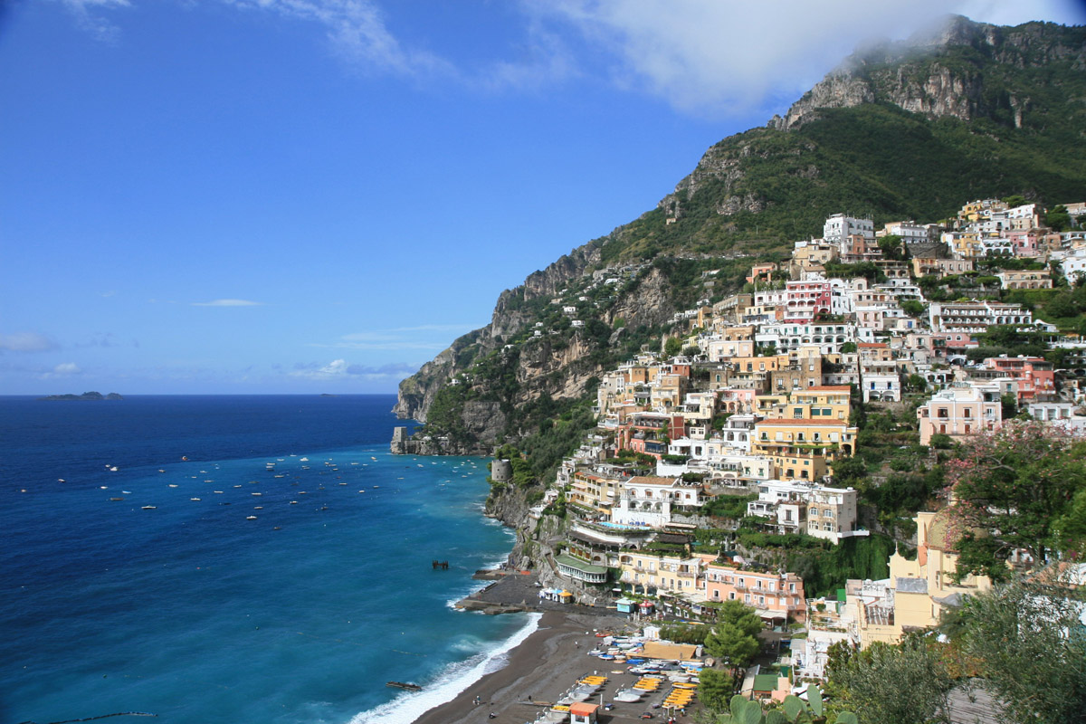

Slide 7
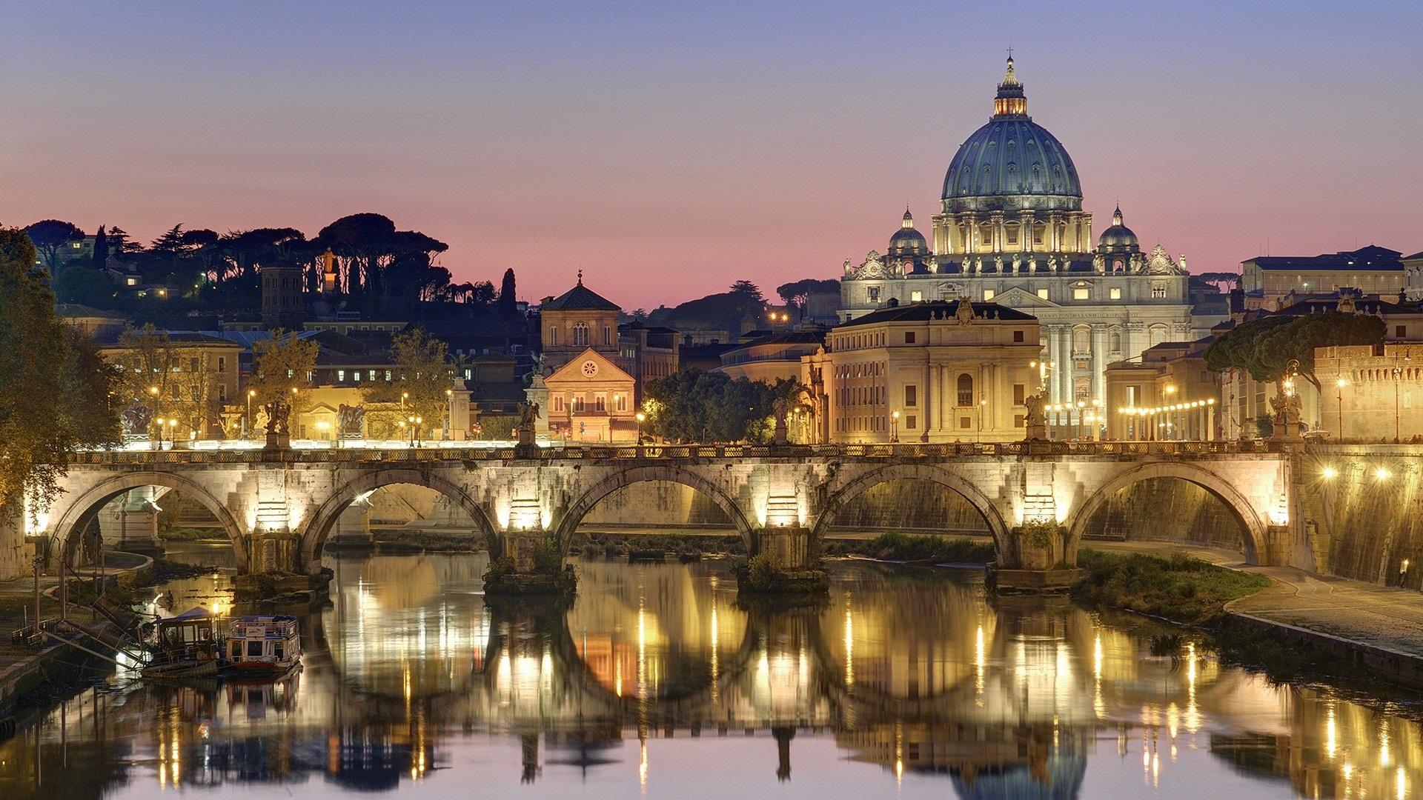

Slide 8
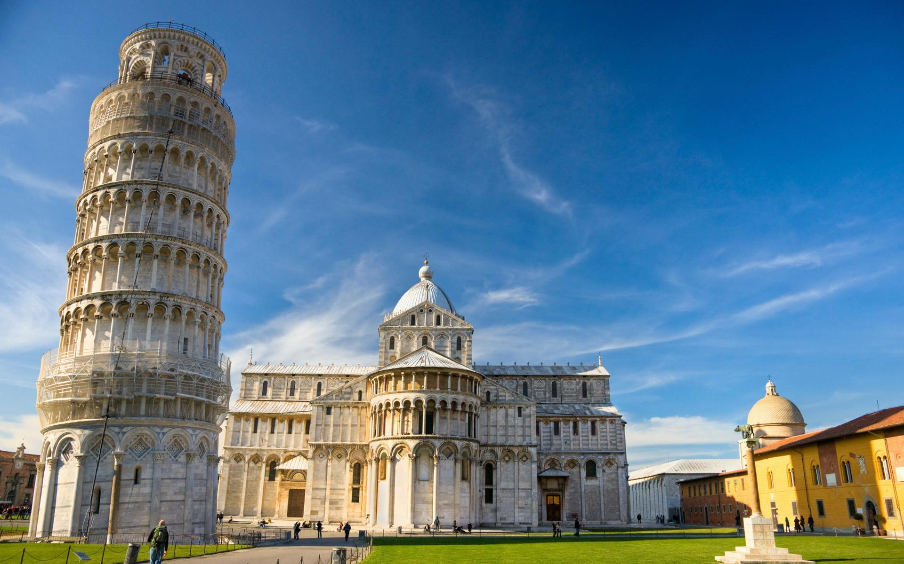

Slide 9
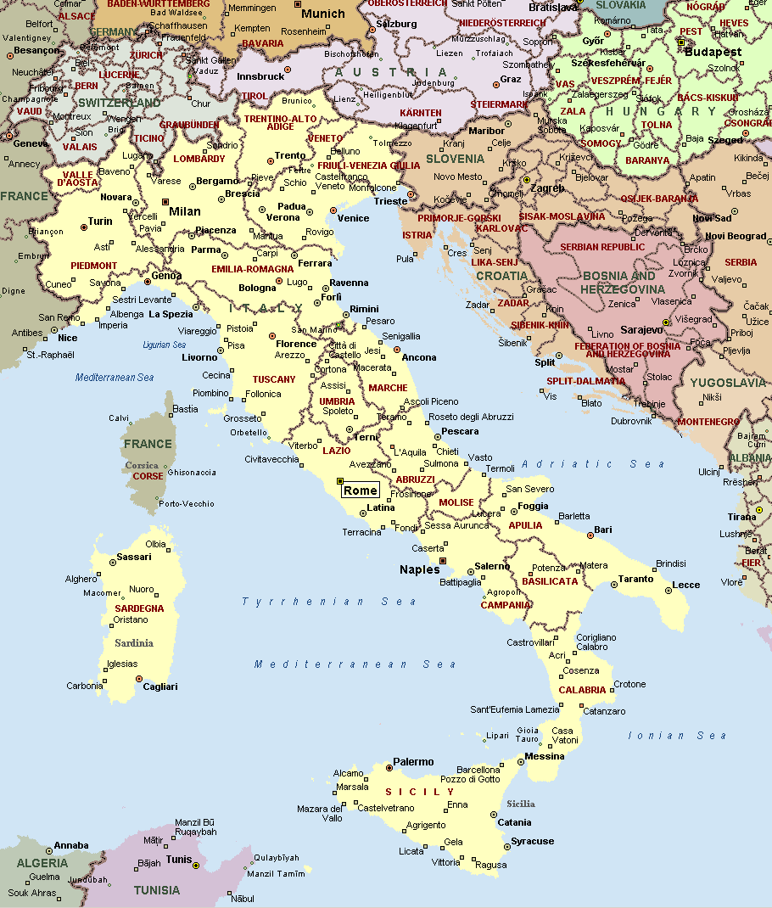

Slide 10


Slide 11
Italy
Identify our new topic and what you already know about it
Understand some new facts about Italy
Investigate some interesting facts about Italy using the internet OR Create a title page to represent this beautiful country

Slide 12
What comes into your mind when you think of Italy? Write as many words as you can…

Slide 13
Now, watch the video and add any new ideas to your list…
https://www.youtube.com/watch?v=m3ZLeV2Rmgo

Slide 14
Investigate some interesting facts about Italy using the internet OR Create a title page to represent this beautiful country
If you have access to the internet, open the worksheet and answer all of the questions using the internet to help you.
You can then check your work using the answers document.
If you don’t have access to the internet, complete the task on the next slide
Of course, you can complete both tasks if you would like an extra challenge!

Slide 15
Option 2:
You are going to create a poster
It should have lots of pictures, words and phrases you think of when you imagine Italy
It must be full of colour
Look at the following images and think about why I used them… You could use them for inspiration too!

Slide 16




