Slide 1

Brompton
Design & Technology
Contents:
  Parts of a bicycle
  Bicycles through the ages
  Acknowledgements
To view extended captions please select ‘Notes Page’ from the view menu

Slide 2
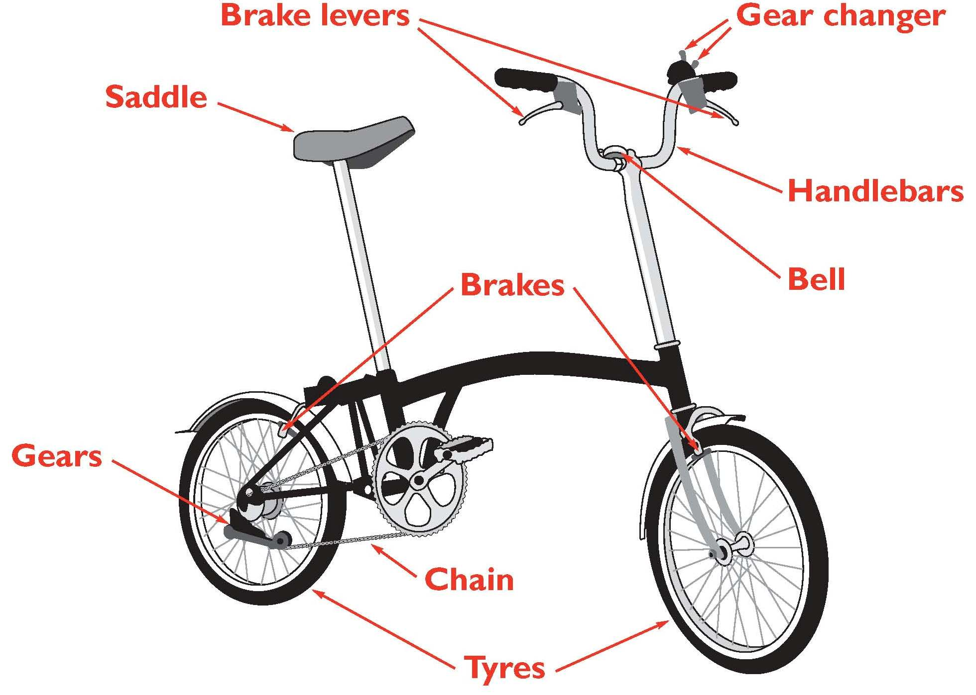
Parts of a bicycle

Slide 3
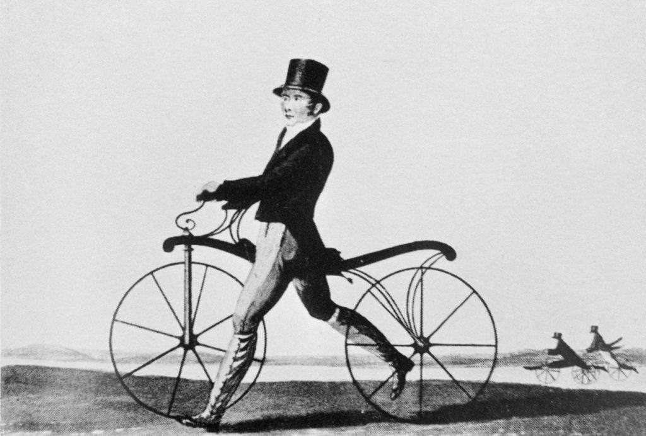
Bicycles through the ages
Denis Johnson's ‘Hobby Horse’, 1819
Notes:
Early bicycle. Engraving of Denis Johnson's Hobby Horse of 1819 being ridden by his son John Johnson. As pedalling and gears had not yet been invented, this early bicycle was propelled by pushing on the ground with the feet. Social etiquette decreed that bicycles were 'un lady-like' for women.

Slide 4
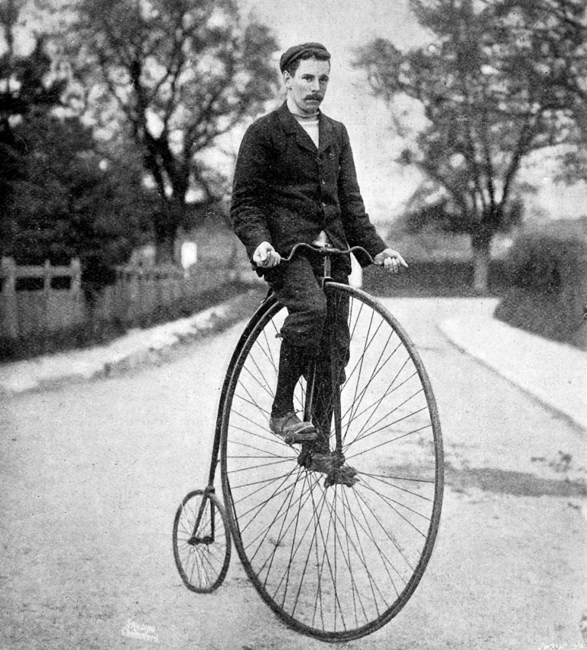
Bicycles through the ages
Photograph of a 'Penny Farthing' or 'Ordinary' bicycle of the 1870's
Notes:
Photograph of a 'Penny Farthing' or 'Ordinary' bicycle of the 1870's, with its rider wearing contemporary cycling clothes. Due to the differences in size between the wheels, the bicycles were known as 'penny farthings'; a penny was a large British coin and the farthing a small one. The front wheel was so large in order to gain sufficient traction when pedalling; gears had not yet been invented.

Slide 5
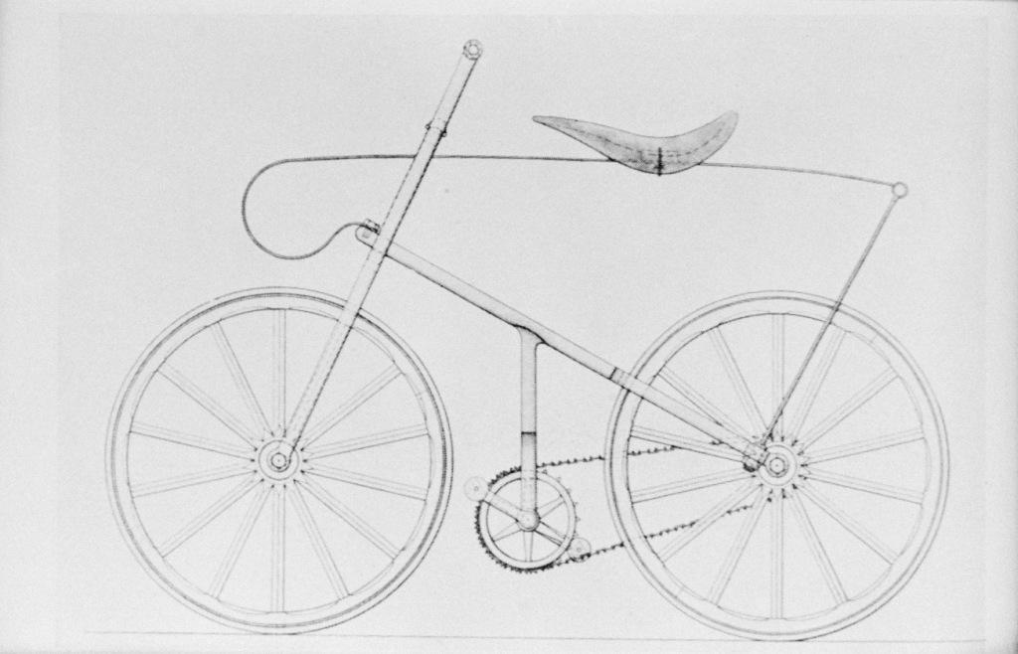
Bicycles through the ages
First chain-driven 'Safety Bicycle' of 1874
Notes:
First chain-driven 'Safety Bicycle' of 1874, illustrated in a 19th century English engraving. Watch and gun makers in Birmingham and Coventry were well equipped to produce these, aided by machine tools of the day.

Slide 6
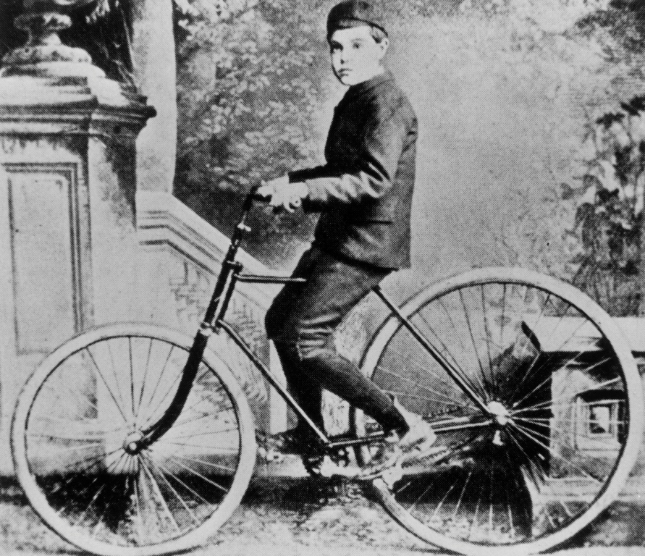
Bicycles through the ages
The first bicycle to be fitted with pneumatic tyres, 1887
Notes:
Dunlop's bicycle. Boy sits on the first bicycle to be fitted with pneumatic tyres. Pneumatic tyres (a rubber tube filled with air) were invented in 1887 by Scotsman John Boyd Dunlop (1840-1921) for use on his son's bicycle. Dunlop received his patent in 1889 and the tyres went into full-scale production in 1890. The extra comfort given by the new invention made cycling a fashionable activity. Photograph of Dunlop's son, also called John.

Slide 7
Bicycles through the ages
Acknowledgements:
Denis Johnson's Hobby Horse, 1819 © Science Photo Library
First chain-driven 'Safety Bicycle‘, 1874 © Science Photo Library
First bicycle to be fitted with pneumatic tyres, 1887 © Science Photo Library
Photograph of a 'Penny Farthing' 1870's © Illustrated London News Ltd/Mary Evans
Published by
Brompton Bicycles Ltd

