Slide 1
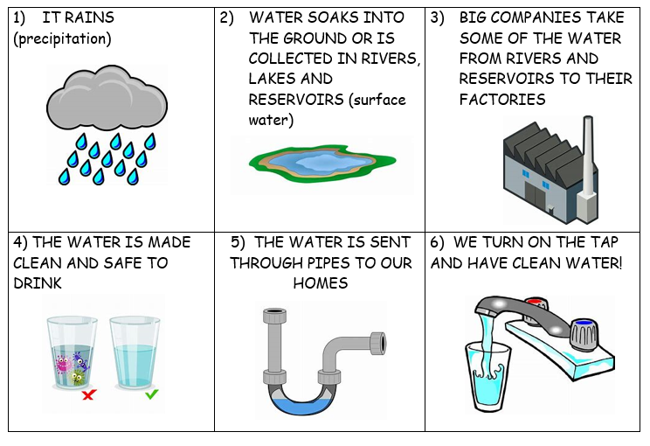
Test your knowledge: Developing
Put these images and statements in the correct order:

Slide 2
Test your knowledge: Secure
Where do the companies who provide us with clean drinking water get their water from? Rivers, lakes and reservoirs.
How many litres of water are cleaned in just one day? 800 million
What is it called when big bits of rubbish, such as leaves, sticks and plastic, are removed from the water? Screening
When the water is put through the process of clarification, what is added to the water to make the bad bits float to the top so they can be removed? Chemicals
The water is then filtered to remove any other little bits which you wouldn’t want to drink. What do they use to filter the water? Sand and gravel
What is it called when the water has chlorine added to it to kill the bacteria that might give us a bad stomach? Disinfection

Slide 3
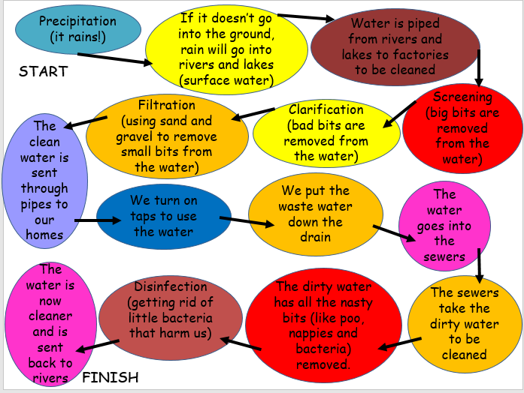
Test your knowledge: Secure
3) Create your own version of the process diagram below. You can make it much shorter by just using key terms to sum up the processes!

Slide 4
Test your knowledge: Secure+
Precipitation
Factories clean the water
The clean water is sent to our homes
We use the water, make it dirty, and send it down our drains
The drains take the water to the sewers
The sewers take the dirty water to be cleaned. The clean water is sent back to the rivers and seas.
The sun evaporates the water from the rivers and seas. It travels up where it cools and condenses to create clouds.
Diagram:

Slide 5
Test your knowledge: Secure+
Explanation:
When it rains, the rain water makes it’s way to the rivers and lakes. Some of the water from rivers and lakes is taken by factories to be cleaned so that it is safe for us to drink. The clean water is piped into our homes where we use it and then put it down our drains when it is dirty. Our drains take the dirty water through the sewers to be cleaned. When it has been cleaned it is sent back to the rivers and lakes. When the water is in rivers and lakes it will be evaporated by the sun and turned into water vapour. The vapour will travel high, cool and condense which will create clouds. The clouds will eventually become full and burst, making it rain. The whole process will then start again. This means it is a huge cycle!

