Slide 1
How do we get clean drinking water?
Identify how water gets to and leaves our home
Understand how water is treated to make it safe to drink
Apply what you learn today to your knowledge of the water cycle

Slide 2
Where does the water in our taps come from?
How do we know it is safe to drink?
How do we know it is clean enough to wash in?

Slide 3
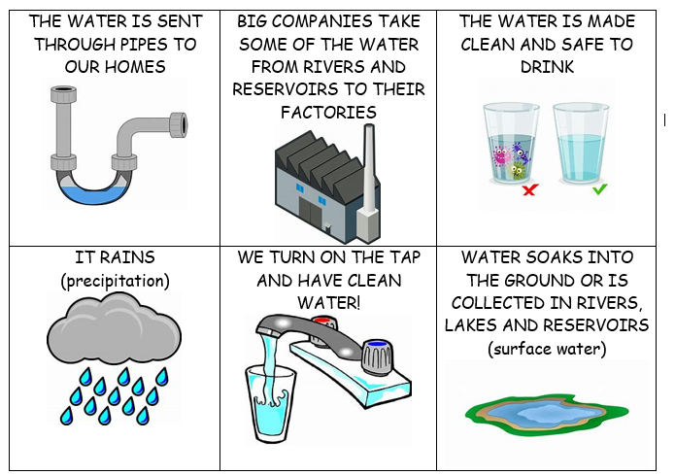
Identify how water gets to and leaves our home
Look at the six images below and see if you can put them into a sensible order to show how water gets to our homes…
Understand how water is treated to make it safe to drink

Slide 4
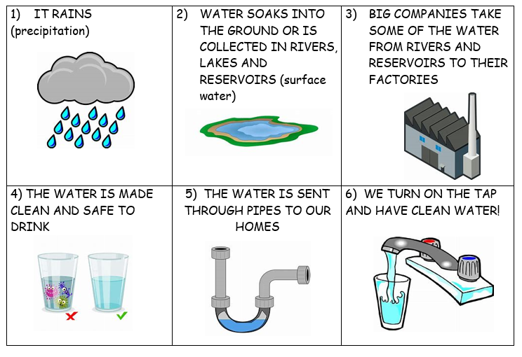
Identify how water gets to and leaves our home
Did you put them in the correct order like this?
Understand how water is treated to make it safe to drink

Slide 5

Identify how water gets to and leaves our home
Watch the video about ‘The Water Treatment Works’ and think about the following questions:
Where do the companies who provide us with clean drinking water get their water from?
How many litres of water are cleaned in just one day?
What is it called when big bits of rubbish, such as leaves, sticks and plastic, are removed from the water?
When the water is put through the process of clarification, what is added to the water to make the bad bits float to the top so they can be removed?
The water is then filtered to remove any other little bits which you wouldn’t want to drink. What do they use to filter the water?
What is it called when the water has chlorine added to it to kill the bacteria that might give us a bad stomach?
Understand how water is treated to make it safe to drink

Slide 6
Identify how water gets to and leaves our home
Watch the video about where our dirty water goes and think about the following:
Where does your dirty water go to?
What happens to it?
Understand how water is treated to make it safe to drink

Slide 7
Understand how water is treated to make it safe to drink
So, as you can see water goes through a lot of processes in order to make it safe for us to drink. Look carefully at the next slide to make sure you remember all the things which happen to our water…

Slide 8
Precipitation (it rains!)
If it doesn’t go into the ground, rain will go into rivers and lakes (surface water)
Water is piped from rivers and lakes to factories to be cleaned
START
Screening (big bits are removed from the water)
Filtration
(using sand and gravel to remove small bits from the water)
Clarification
(bad bits are removed from the water)
The clean water is sent through pipes to our homes
We put the waste water down the drain
We turn on taps to use the water
The water goes into the sewers
The water is now cleaner and is sent back to rivers
The dirty water has all the nasty bits (like poo, nappies and bacteria) removed.
Disinfection
(getting rid of little bacteria that harm us)
The sewers take the dirty water to be cleaned
FINISH

Slide 9
Apply what you learn today to your knowledge of the water cycle
At the moment we’ve thought about what happens after it rains, how we use the water and then how it gets sent back to the rivers and seas.
BUT, how could we start thinking about all of these processes as a cycle (something that always repeats in the same order)?
Think about what you learnt about the water cycle last lesson and how this could help link the start and finish of the processes on the last slide…

Slide 10
Precipitation
Factories clean the water
The clean water is sent to our homes
We use the water, make it dirty, and send it down our drains
The drains take the water to the sewers
The sewers take the dirty water to be cleaned. The clean water is sent back to the rivers and seas.
The sun evaporates the water from the rivers and seas. It travels up where it cools and condenses to create clouds.
Apply what you learn today to your knowledge of the water cycle

Slide 11
Now you’ve got all the knowledge you need for this lesson, have a go at the questions on the next slides to test your knowledge…
Write your answers down then use the answers (on the answers PPT) to check if you were right.
If you got one wrong don’t worry- do as we always do and correct it! (yes- you should do this in purple pen at school, but don’t worry if you don’t have one of those, any colour will do!)
Remember you should all do the developing and secure questions. If you are targeted S+, or you would like to challenge yourself, do those questions too!

Slide 12
Test your knowledge: Developing
Put these images and statements in the correct order:

Slide 13
Test your knowledge: Secure
2) Answer the following questions (watch the video again if you need to)
Where do the companies who provide us with clean drinking water get their water from?
How many litres of water are cleaned in just one day?
What is it called when big bits of rubbish, such as leaves, sticks and plastic, are removed from the water?
When the water is put through the process of clarification, what is added to the water to make the bad bits float to the top so they can be removed?
The water is then filtered to remove any other little bits which you wouldn’t want to drink. What do they use to filter the water?
What is it called when the water has chlorine added to it to kill the bacteria that might give us a bad stomach?

Slide 14
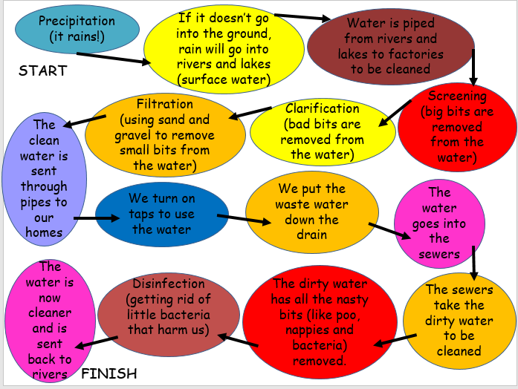
Test your knowledge: Secure
3) Create your own version of the process diagram below. You can make it much shorter by just using key terms to sum up the processes!

Slide 15
Test your knowledge: Secure+
4) Explain how you could apply your knowledge of the water cycle to turn the processes you’ve just describe into a cycle (something that always repeats in the same order).
You can explain in words or you could draw out the cycle- it’s up to you!

