Slide 1


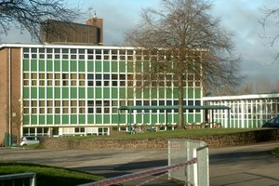

Year 4 & Year 6
2021
Time for a new school!

Slide 2


Slide 3

Getting to know our teachers….

Slide 4
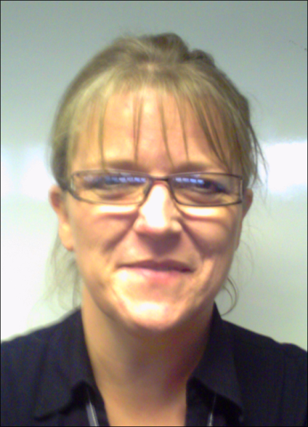
Our Principal - Mrs Farr

Slide 5

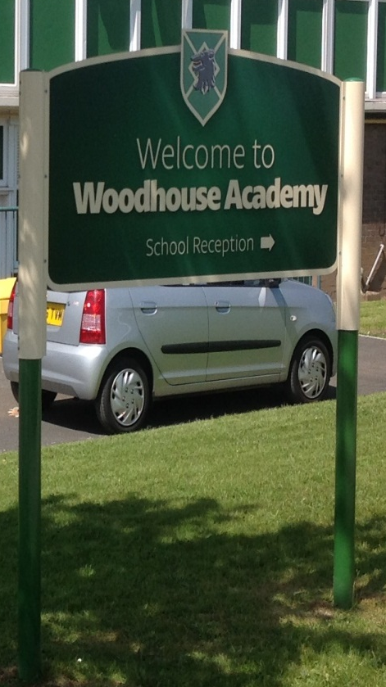
Getting to know our school…
On the next few slides there are pictures of key places and things that we think may well be very different from your current school…take a look . What do you think is different or are some things maybe the same?

Slide 6
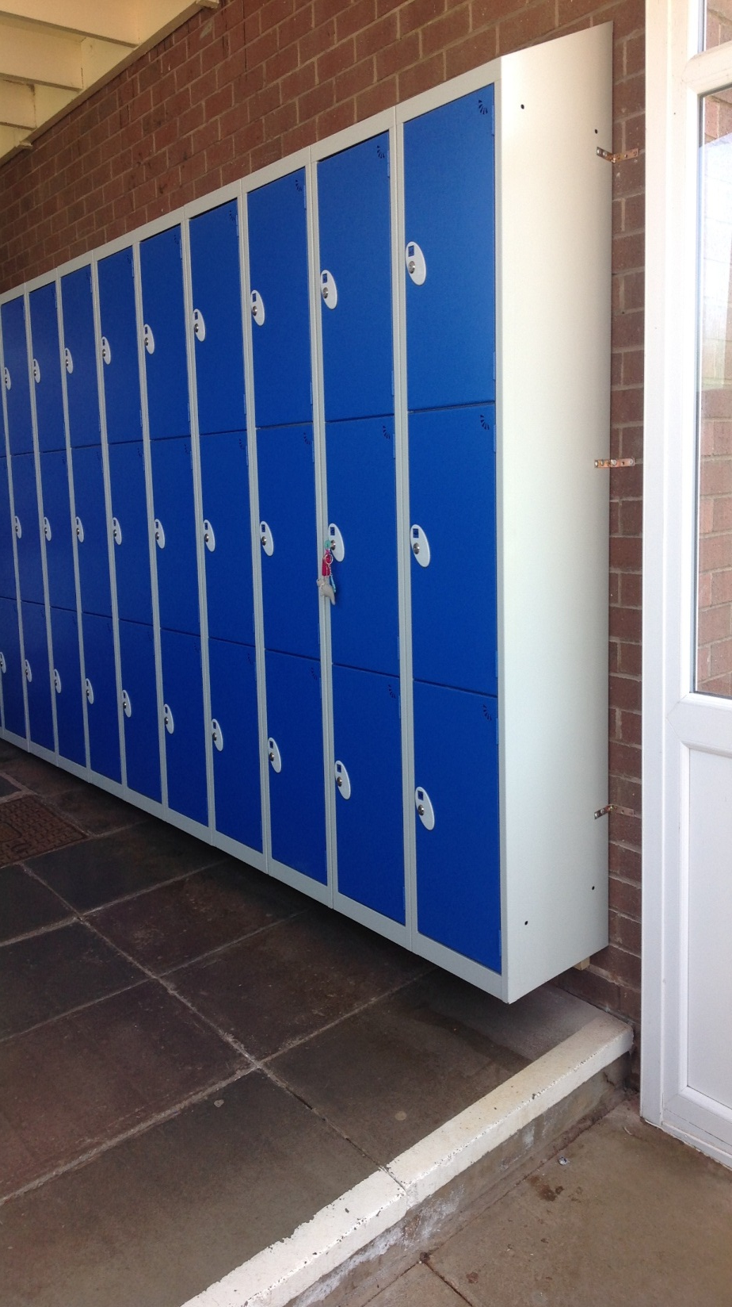
Your own locker…

Slide 7
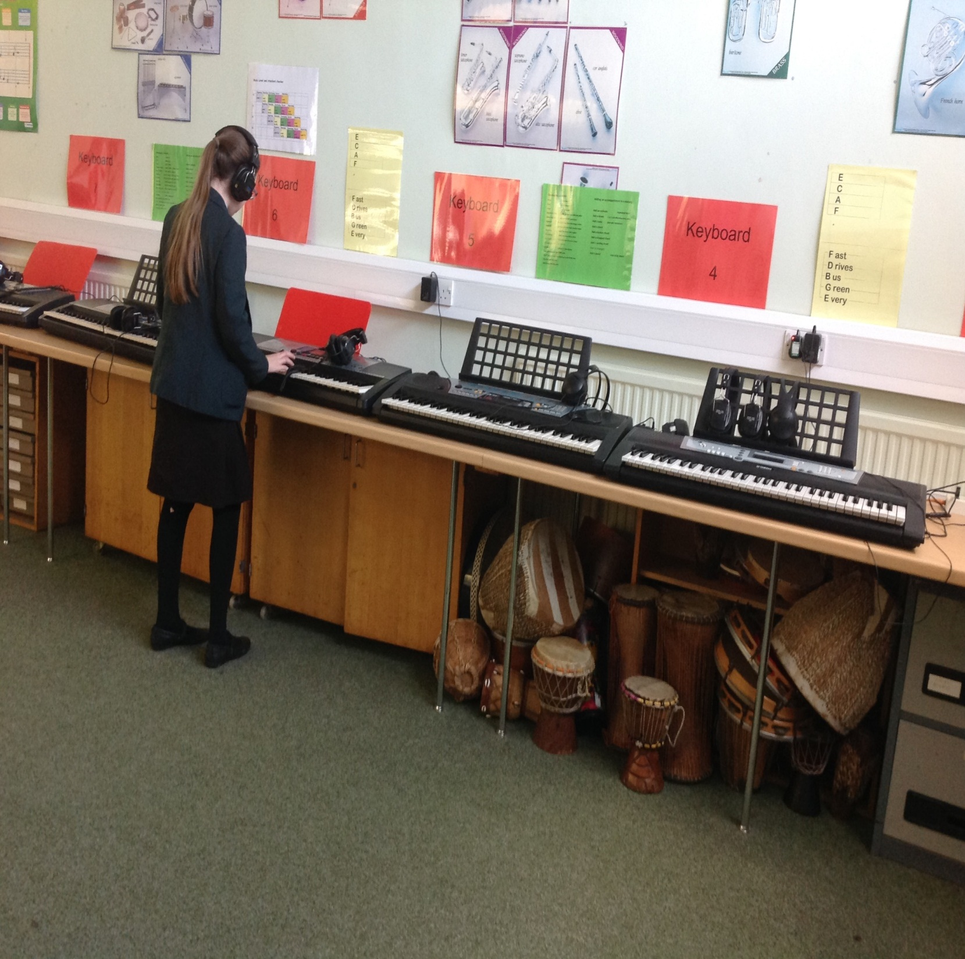
The music room
A huge space dedicated to music only. Lots of instruments for you to master and to compose some lovely melody's.

Slide 8
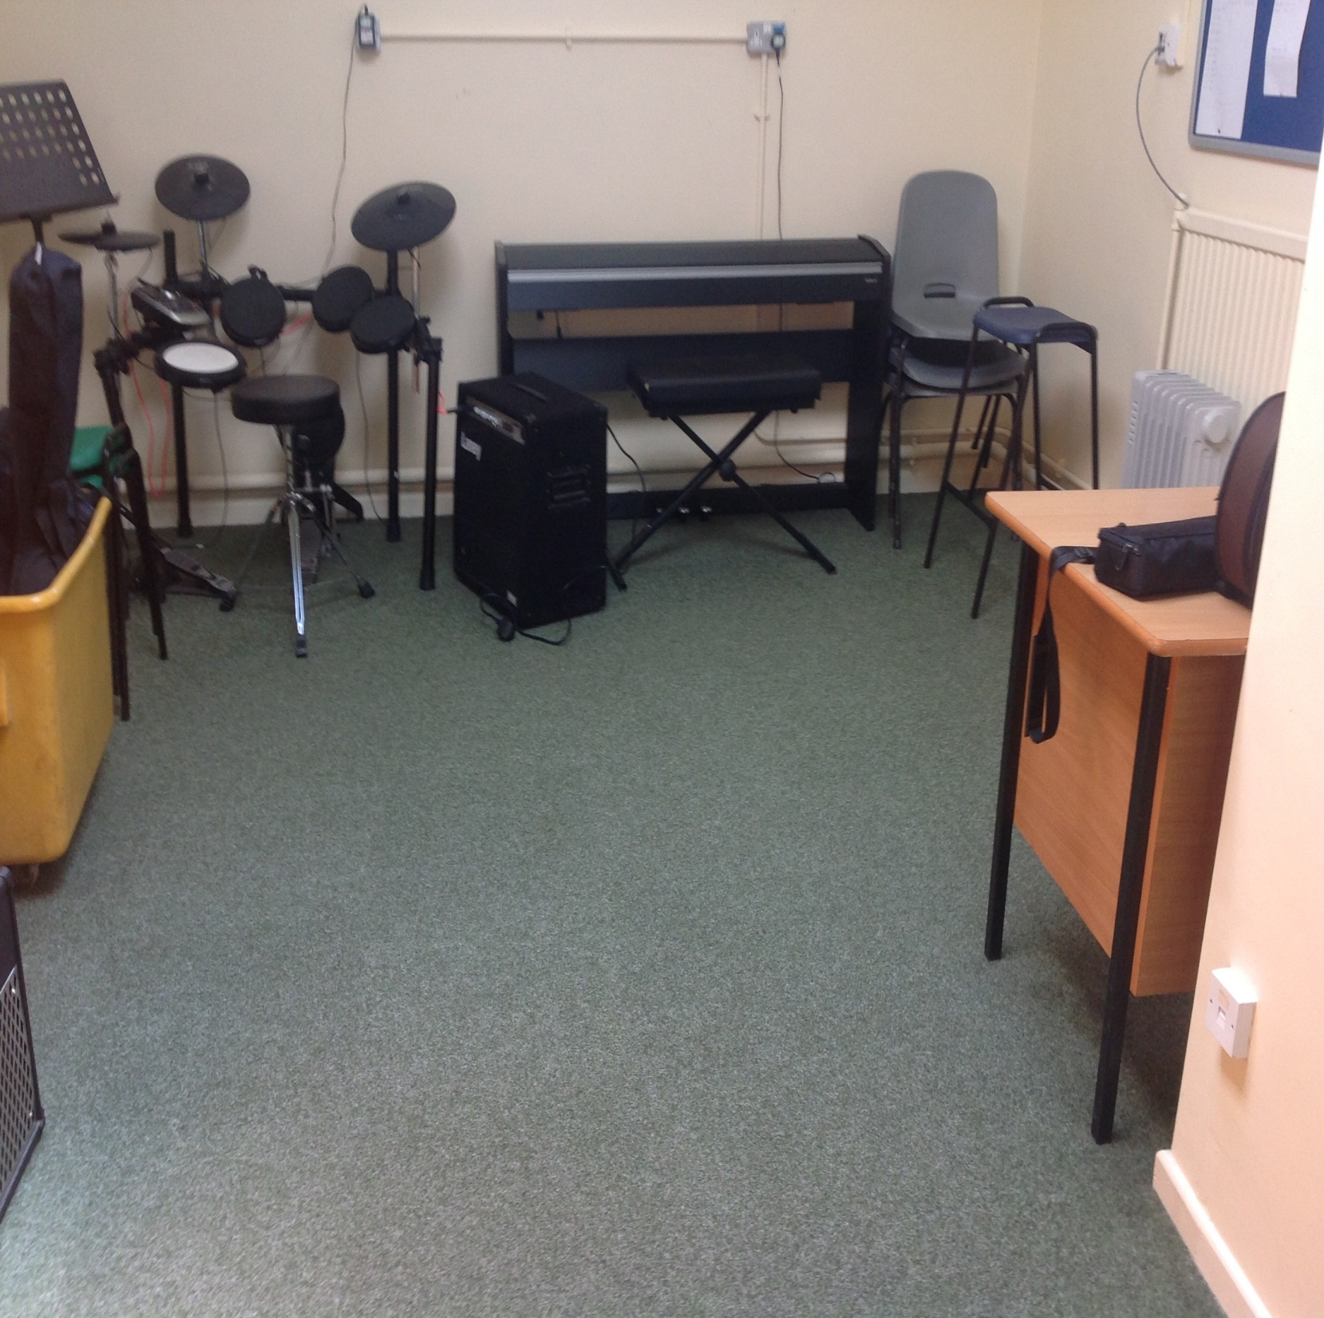
Music lessons
This is the room that the outside music teachers help those registered to wok through the music grades…which instrument would you like to learn ?….flute….drums….violin….

Slide 9
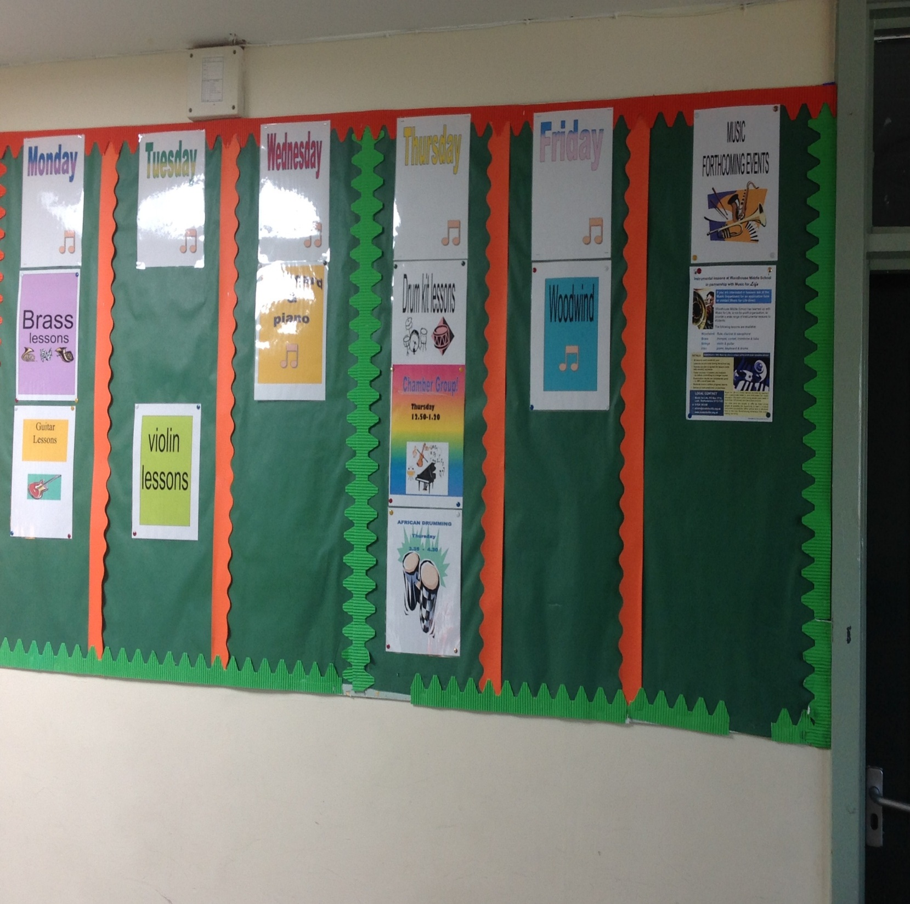
Music groups and concerts
Here is the timetable of clubs you may wish to get involved in

Slide 10
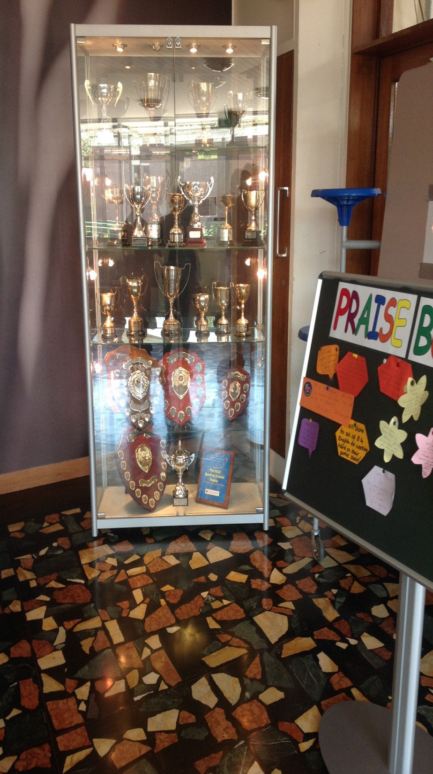
Sporting competitions
Look at all those trophy's ….you could be part of one of the winning teams here at Woodhouse Academy

Slide 11
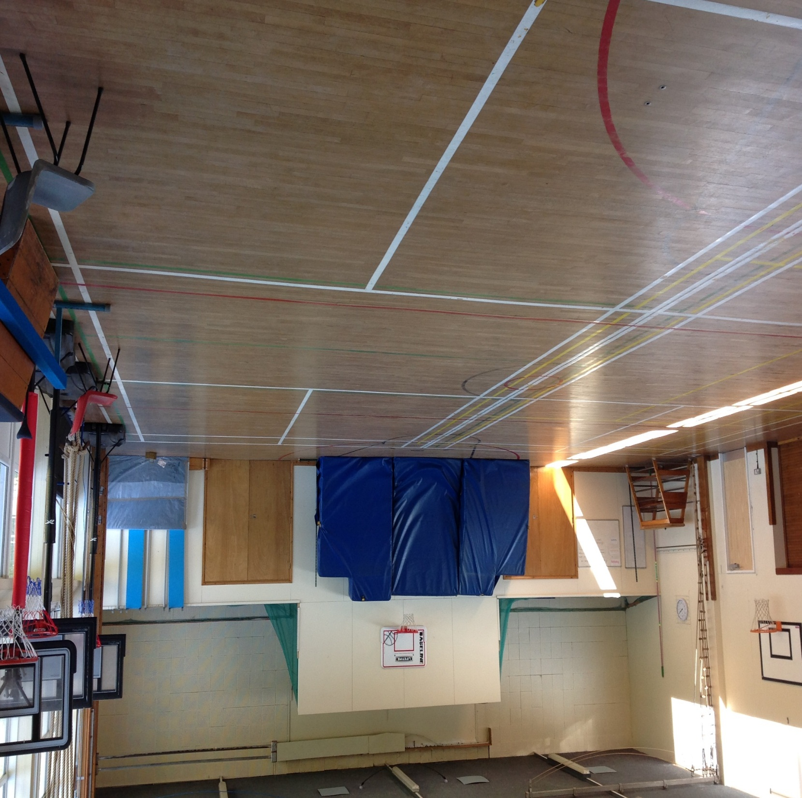
The sports hall
You can learn to play basketball, badminton, or perfect your handstands in gymnastics or maybe even set a new sports record in the high jump event…..

Slide 12
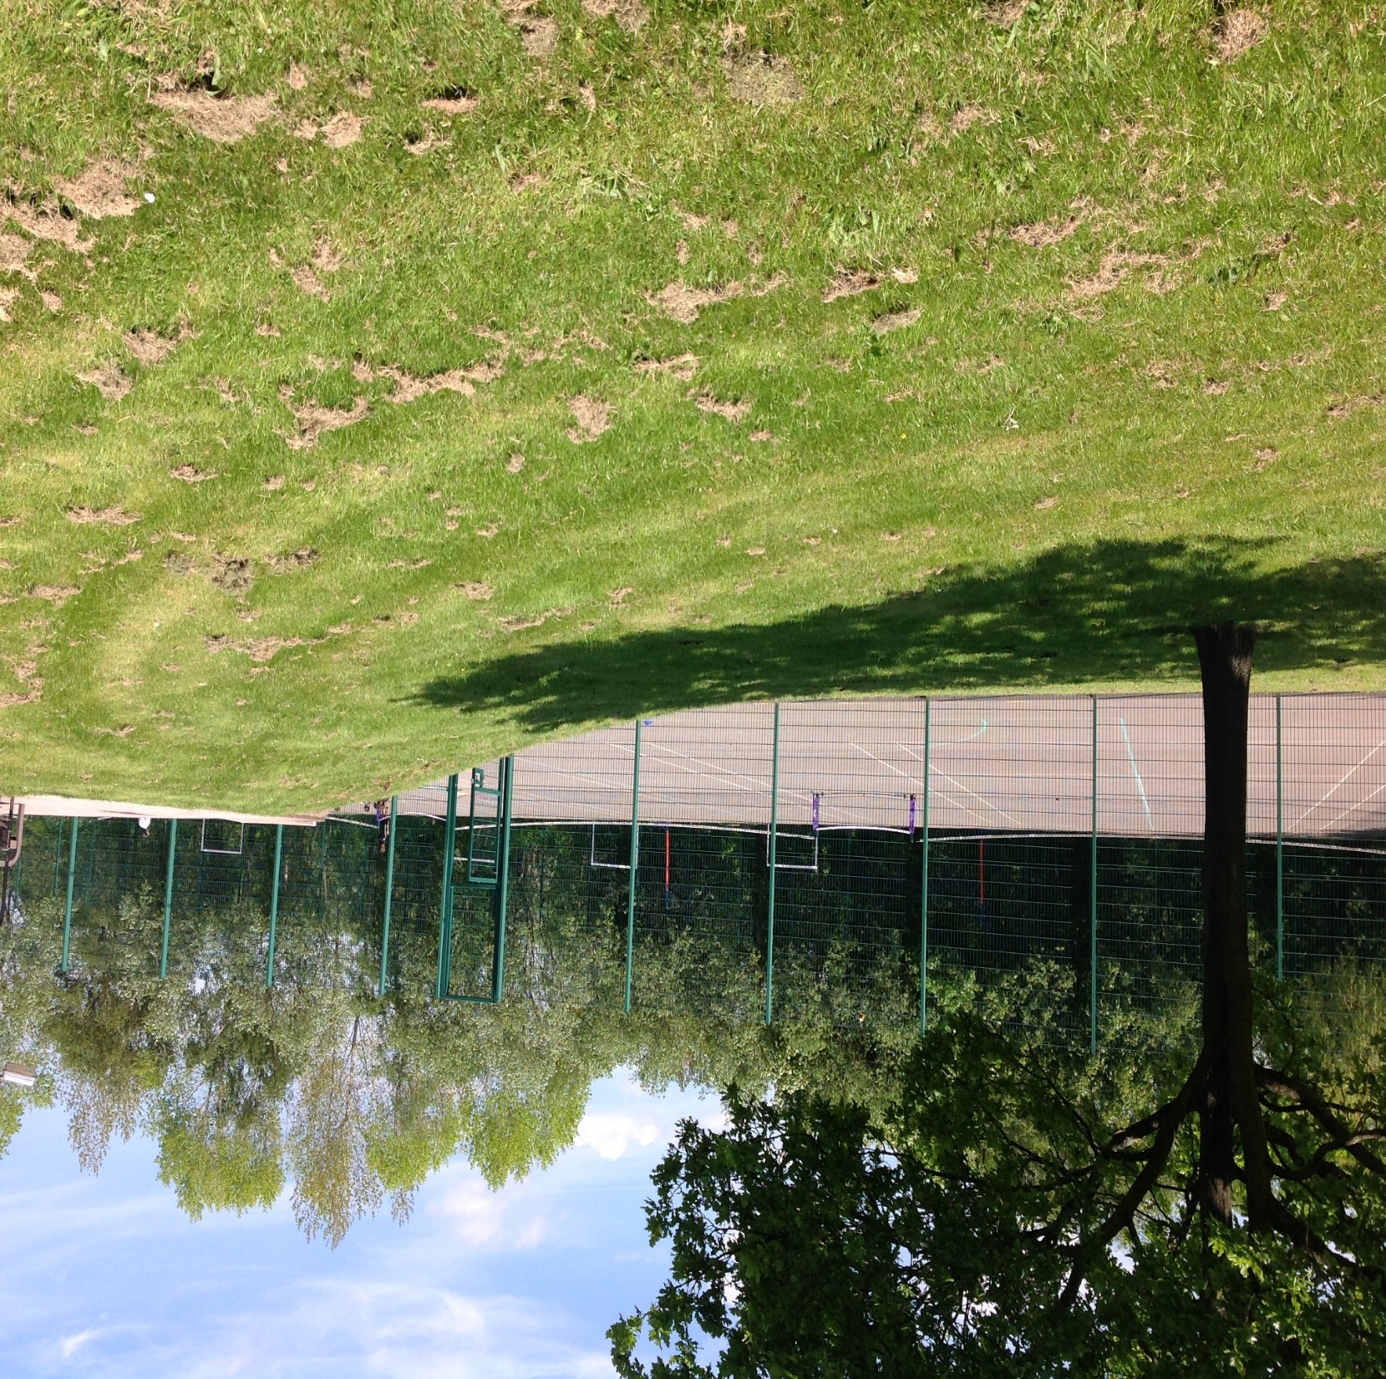
So much outside space
4 tennis courts , outside basketball courts , football areas with goals…..all for you to use .

Slide 13
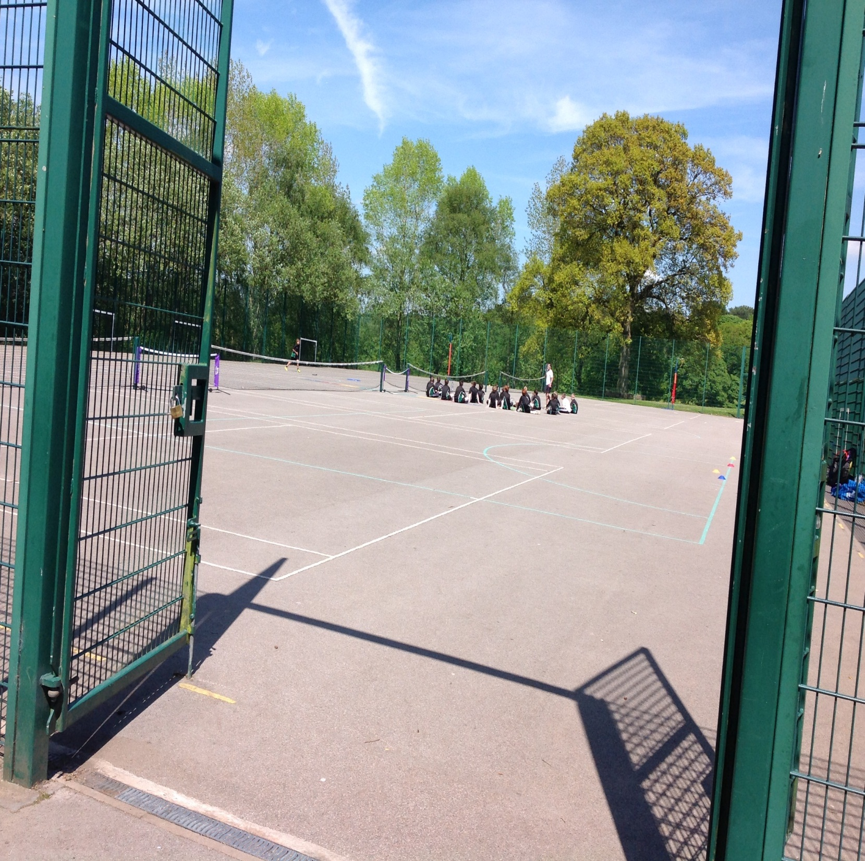
The playground

Slide 14
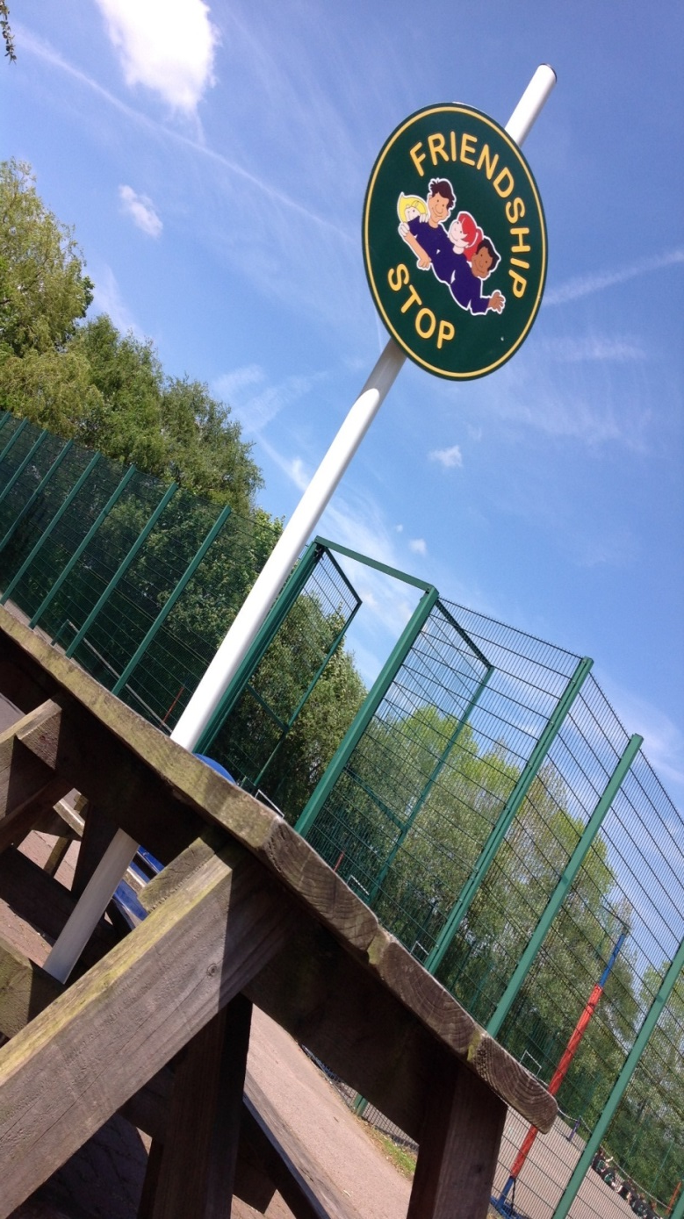
Friendship stop
You should never be alone.
There will always be someone at the friendship stop to offer advice , help and a friendly smile and listening ear.

Slide 15
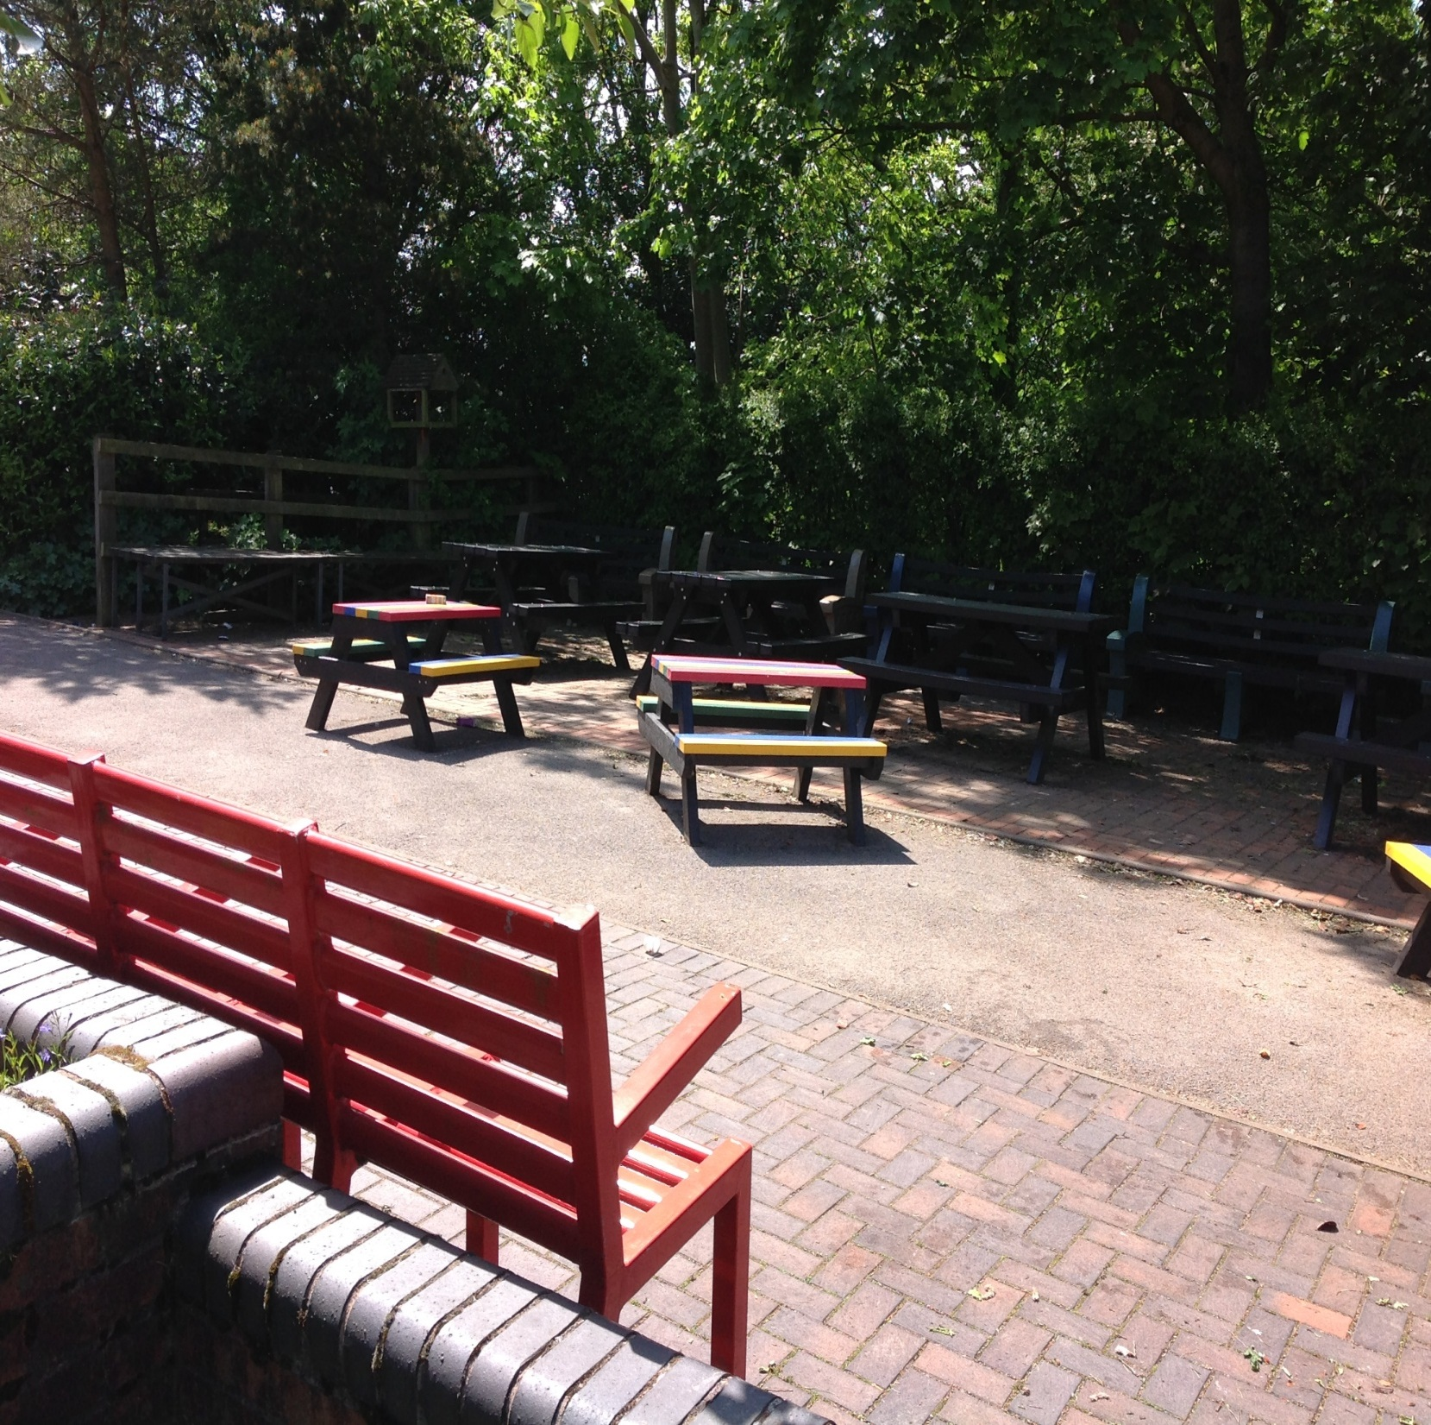
The quiet area
Here no one is allowed to run around - here you have an opportunity to sit and chat quietly with your friends, eat your lunch, and relax and enjoy your break time.

Slide 16
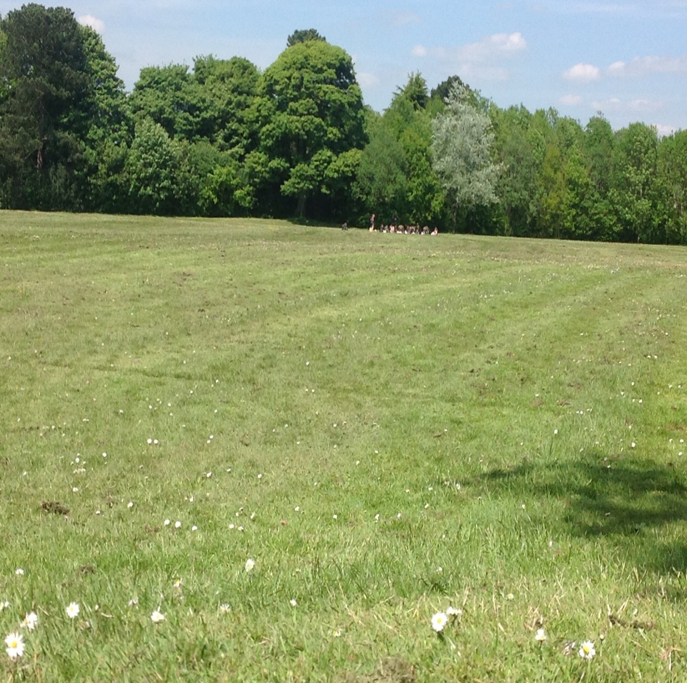
The field
The most perfect area in the summer to spend your lunchtime, having fun with your friends to enjoy the space let off some steam.
Perfect space for your PE lessons too. Football, Rugby and Rounders pitches and 400m athletics track with a long and triple jump track too.

Slide 17
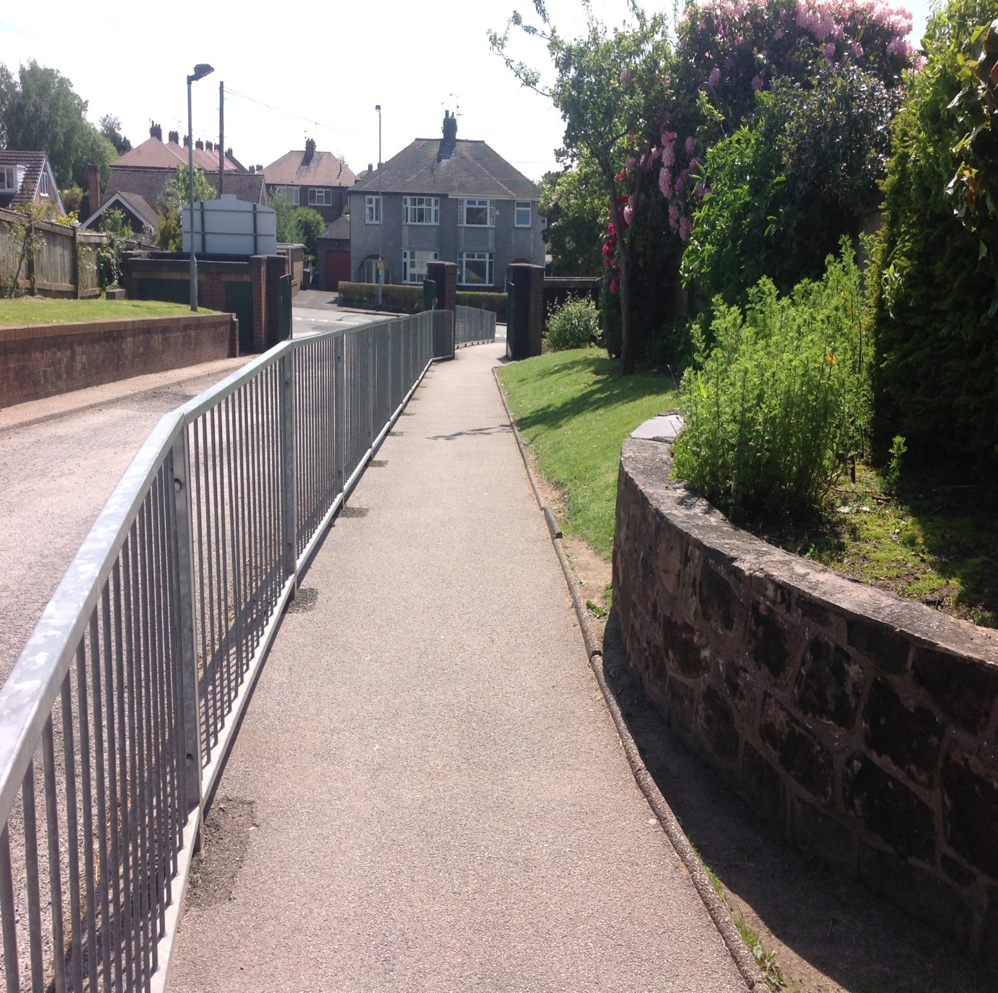
The school drive
Just on the road side at the end of this path is where you will say goodbye to your parents/ carers and independently walk yourself into school…..maybe a little scary the first time , but very soon it will seem like you have never not done it!

Slide 18
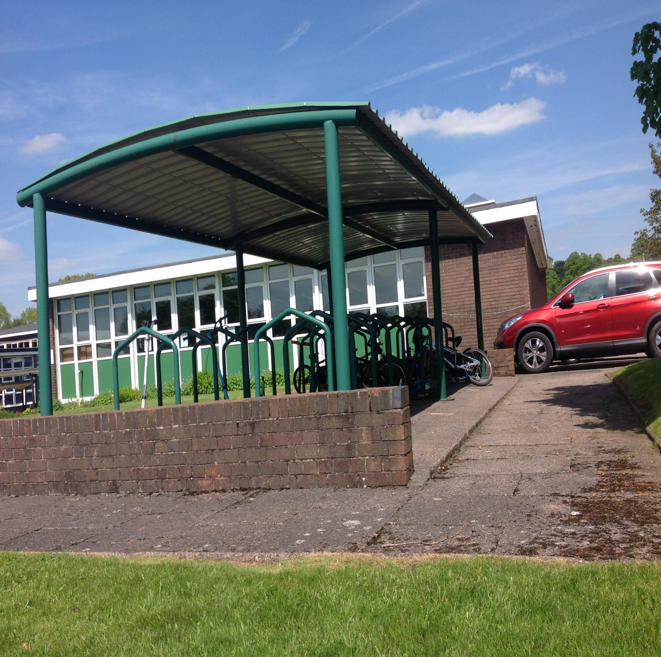

The bike sheds
For those that wish to cycle of scoot to school - you will park them here. Don’t forget your helmets and you will need to have passed your bike ability course too.

Slide 19
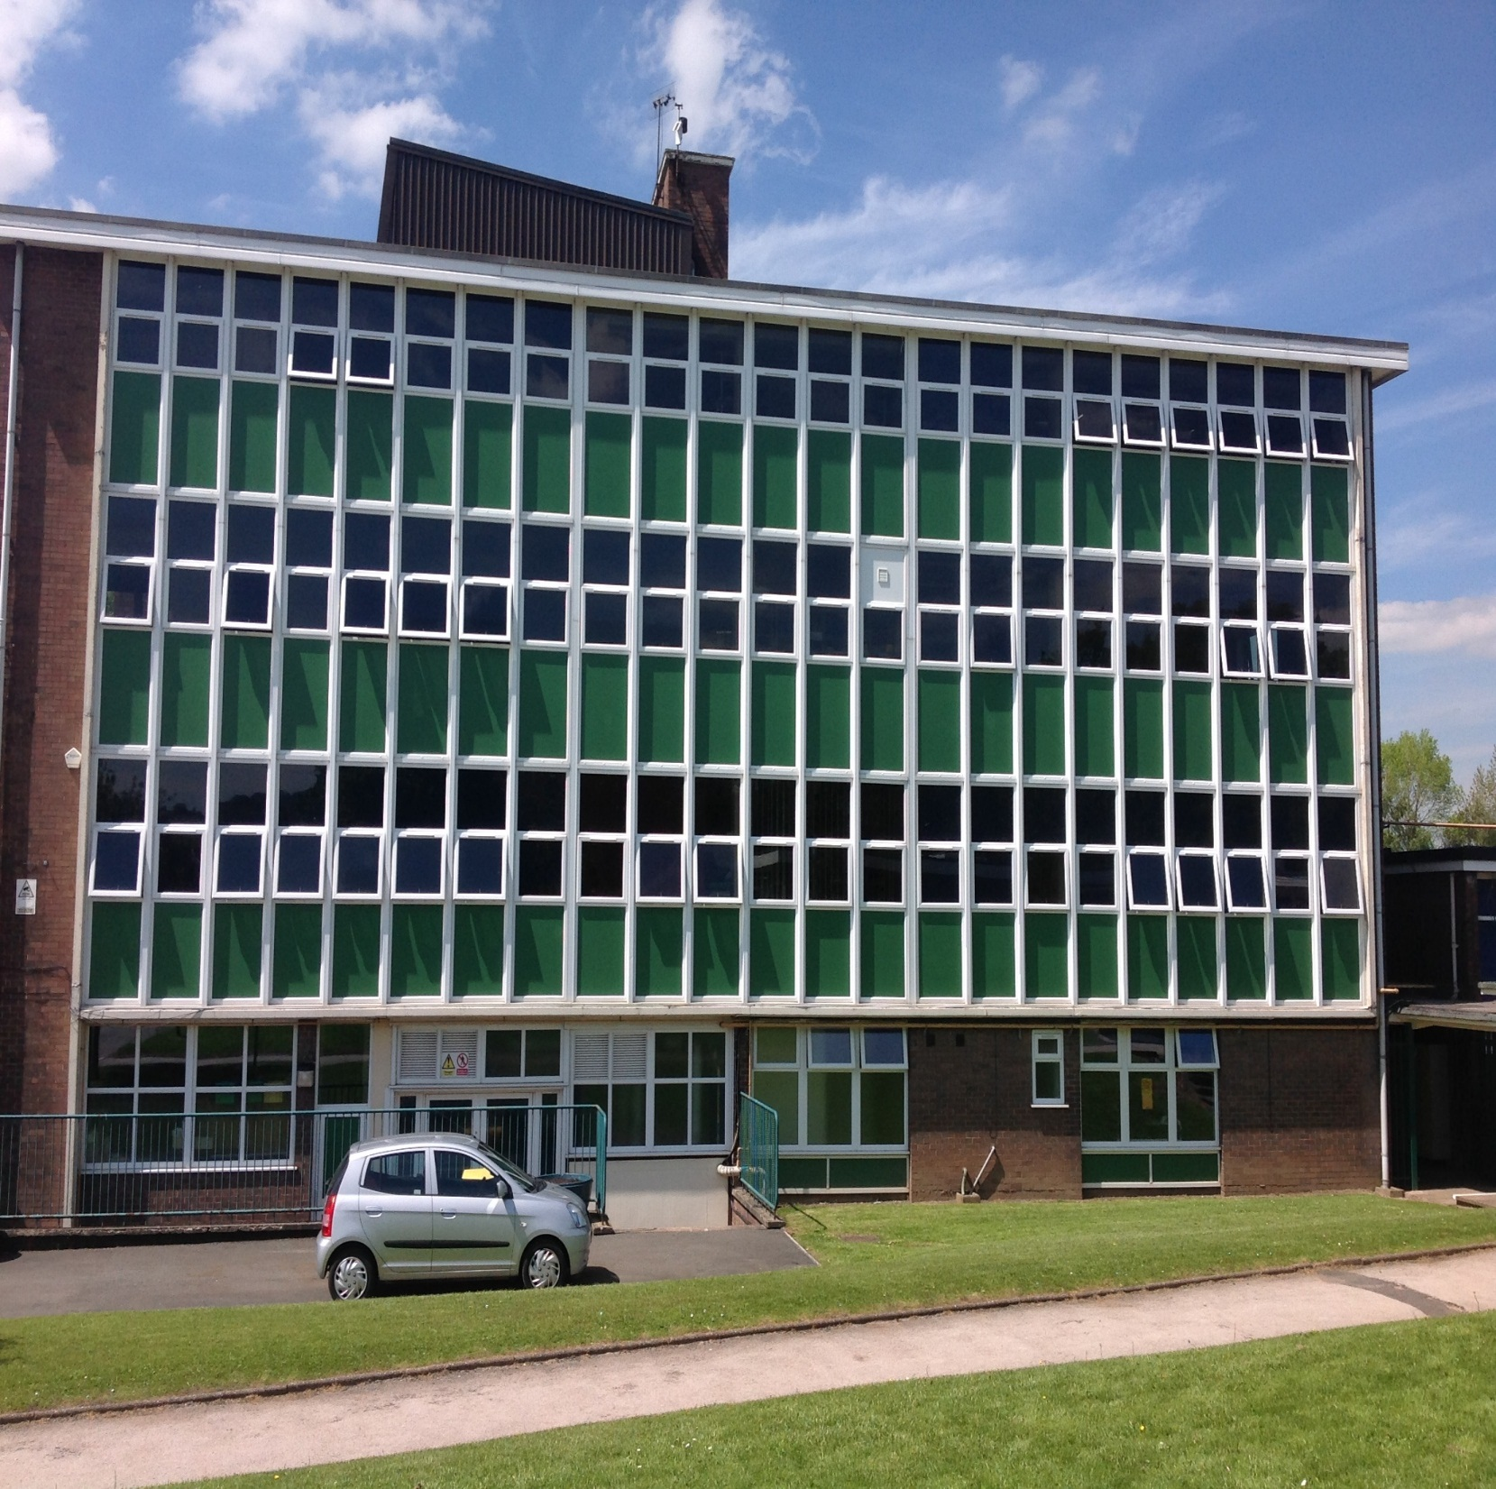
The tower block
Lots of classrooms here – which ones do you think you might learn in ?

Slide 20
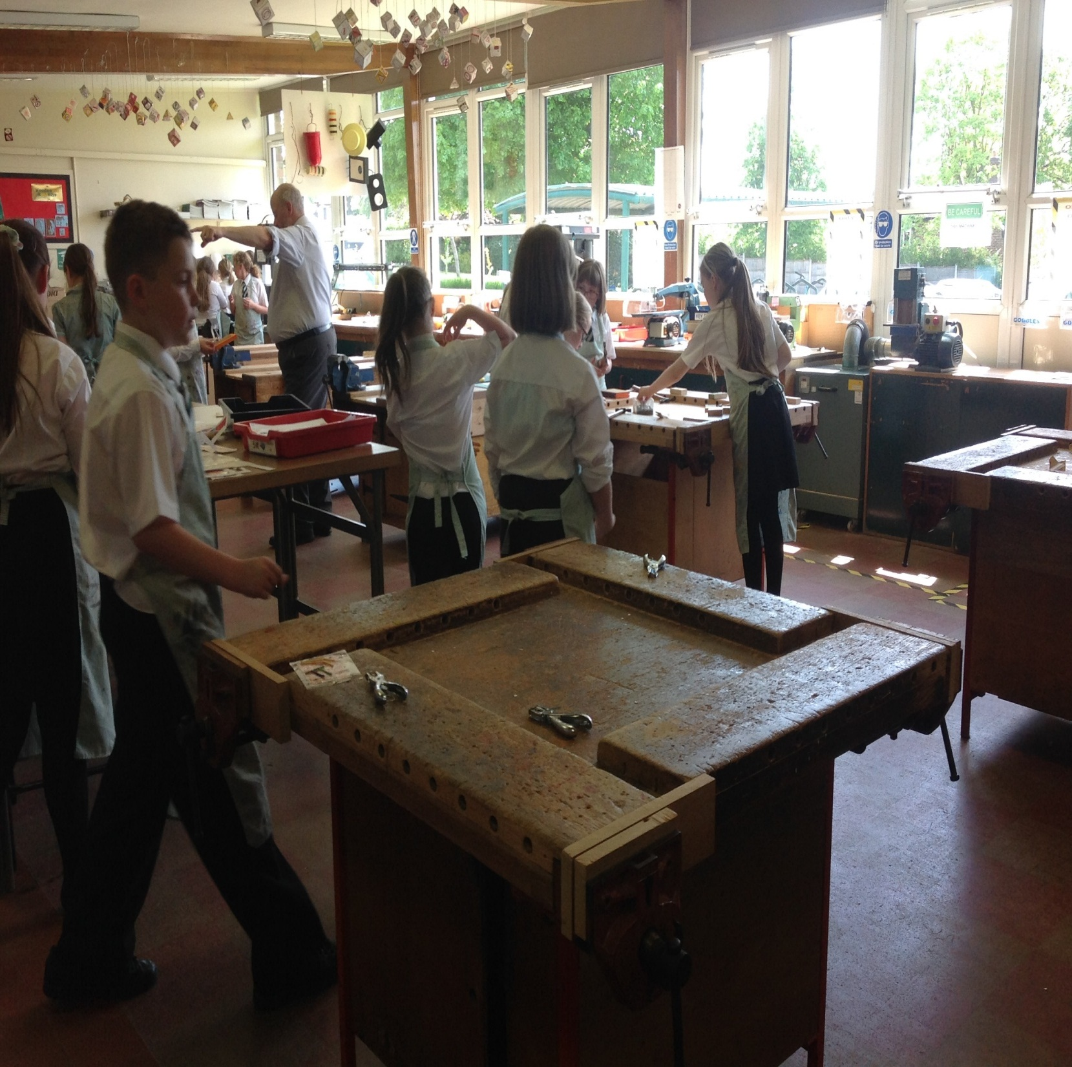
The design and technology room
Here you will learn many new skills and create many creations

Slide 21
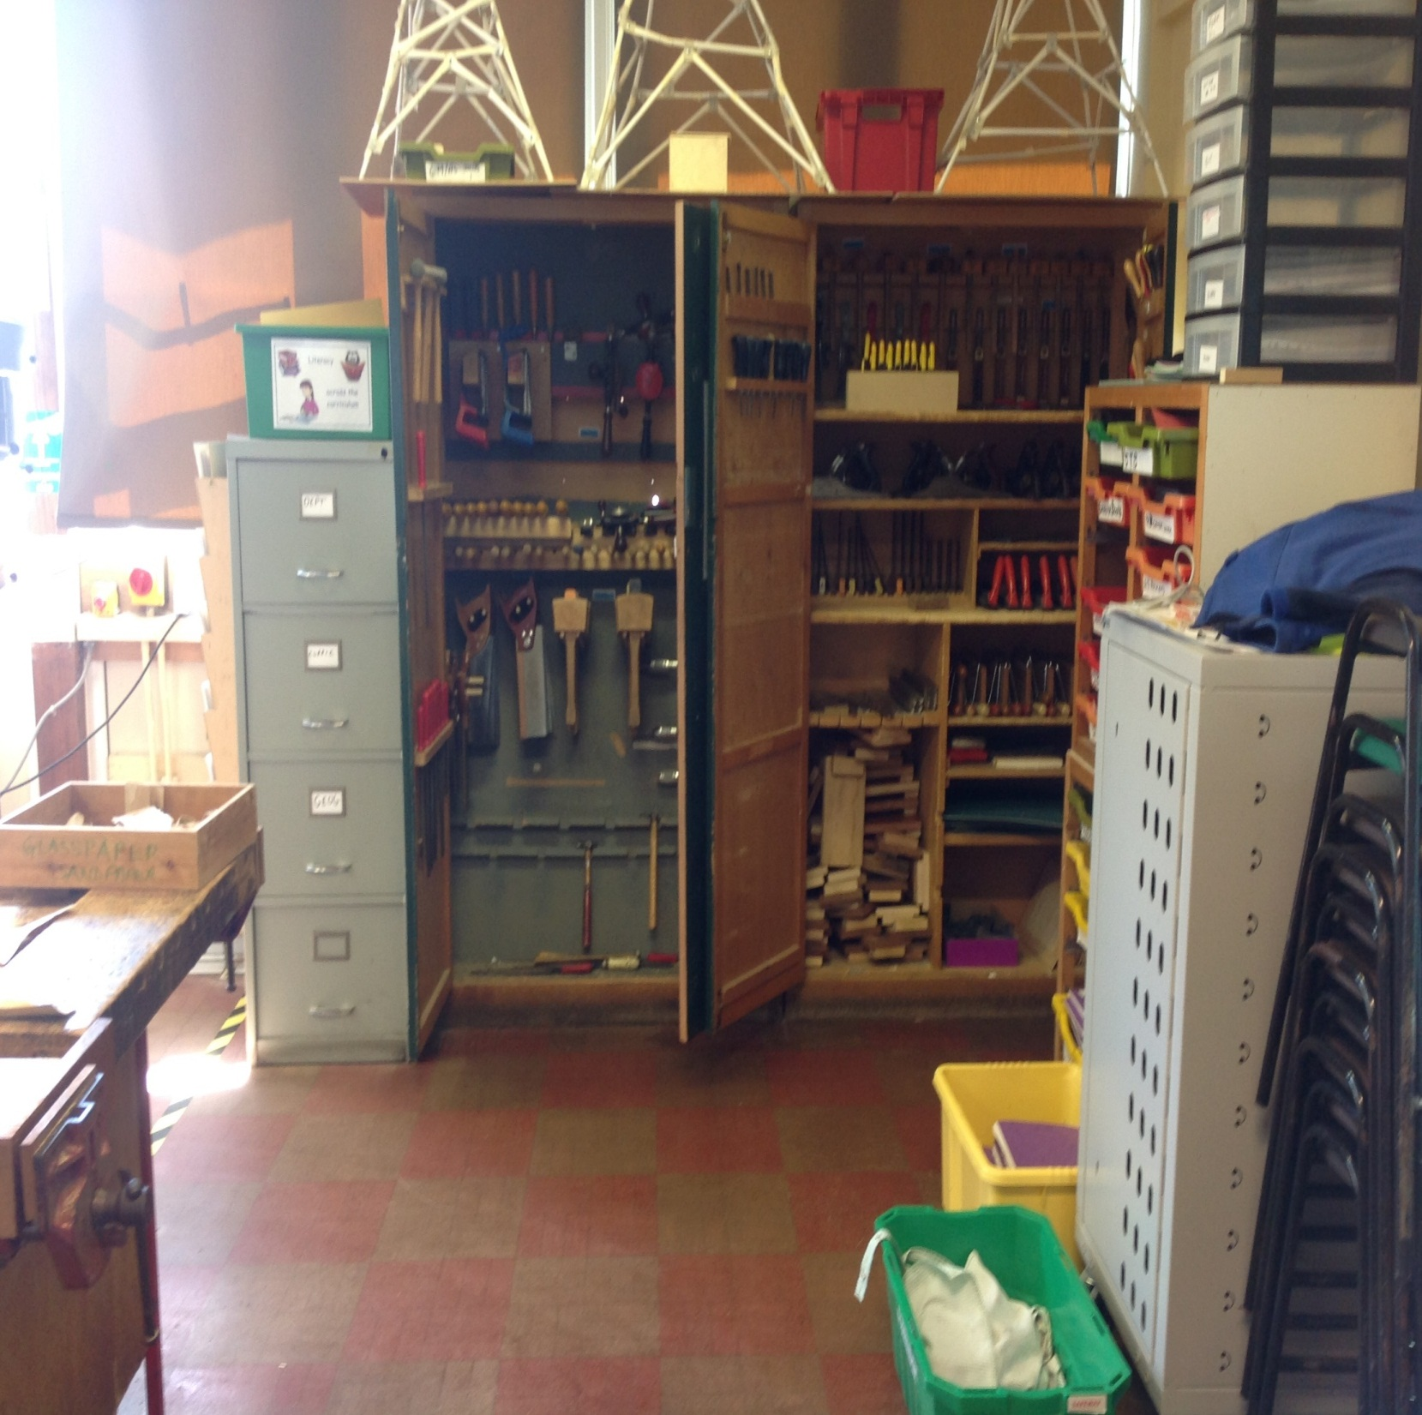
D&T lessons
How many tools can you see ? How many can you name How many have you already used ?

Slide 22
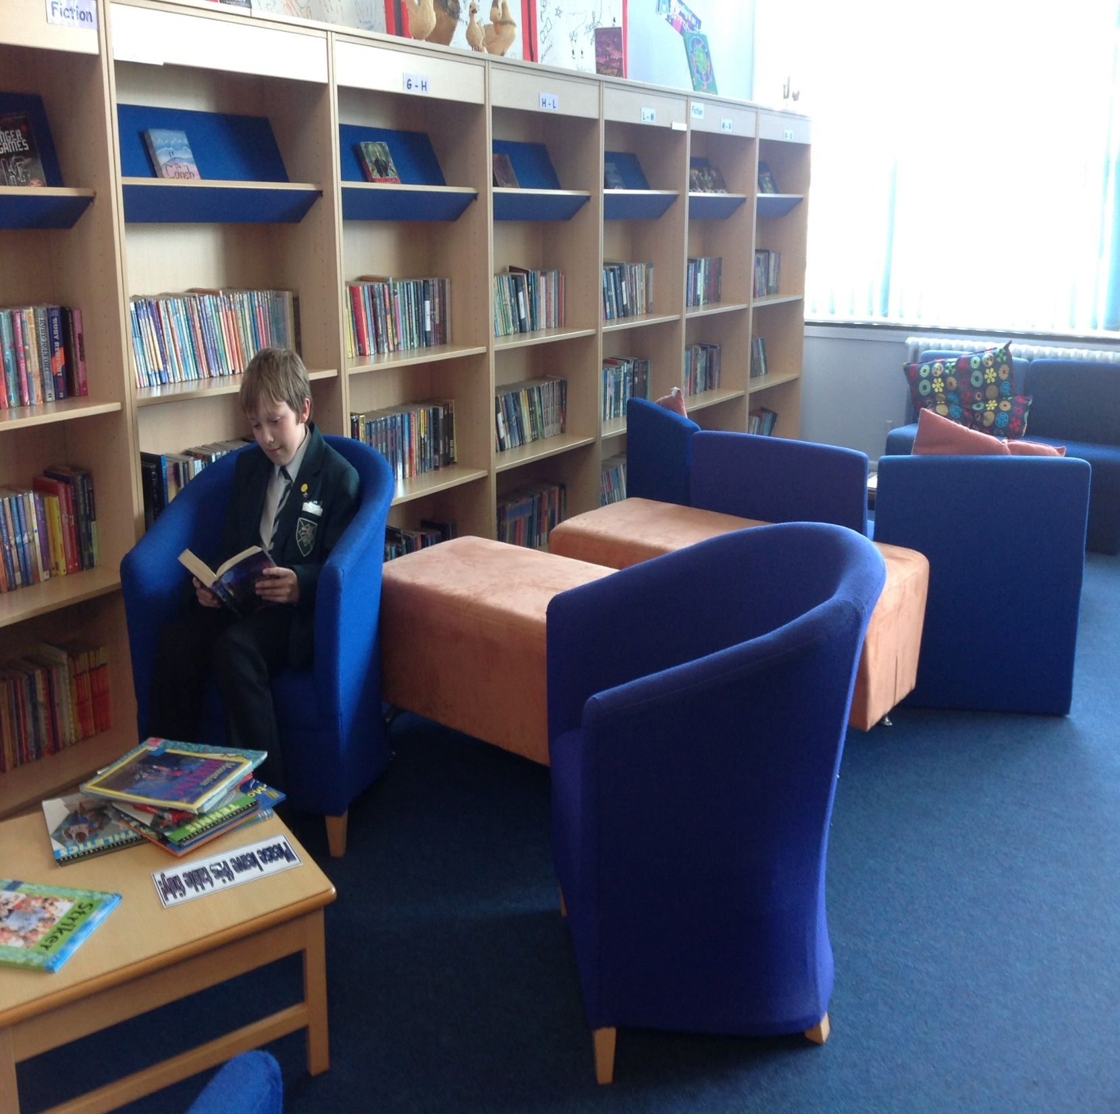
The library

Slide 23
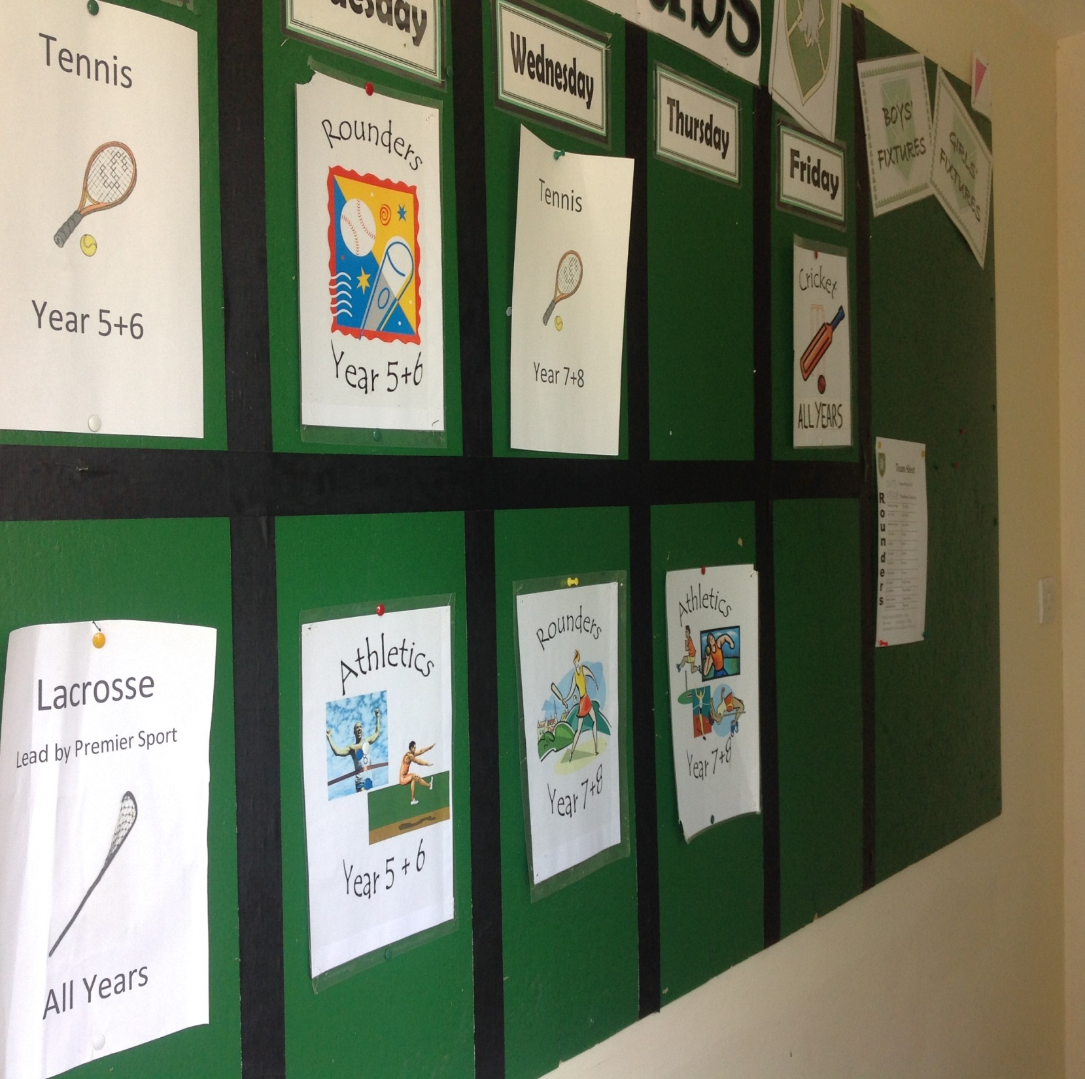
Sports extra- curricular activities – there’s always something for everyone – which clubs will you get involved in ?

Slide 24

Getting to know our pupils and helpers…

Slide 25


Who will help me ?
Prefects – A team of pupils in year 8 who will happily help , especially at break time and lunchtimes. They will have this badge and a different ties to yours.
Peer Mentors– A team of pupils in year 7. Dedicated to helping you and you alone . You will see these pupil A LOT when you first start at Woodhouse.

Slide 26
How can I help myself and others ? All the things you may wish to get involved in
Eco warrior Rep
School Council Rep
Sports Council Rep
Clubs :-
      Sports
      Music
      Drama
      Craft
      Food/ Cooking

