Slide 1
Posters and Merchandising
Posters are widely used to promote a product or event.
They need to attract peoples attention.
They are cheap to produce and can be displayed in lots of places.
Posters contain a mixture of graphics and information.

Slide 2
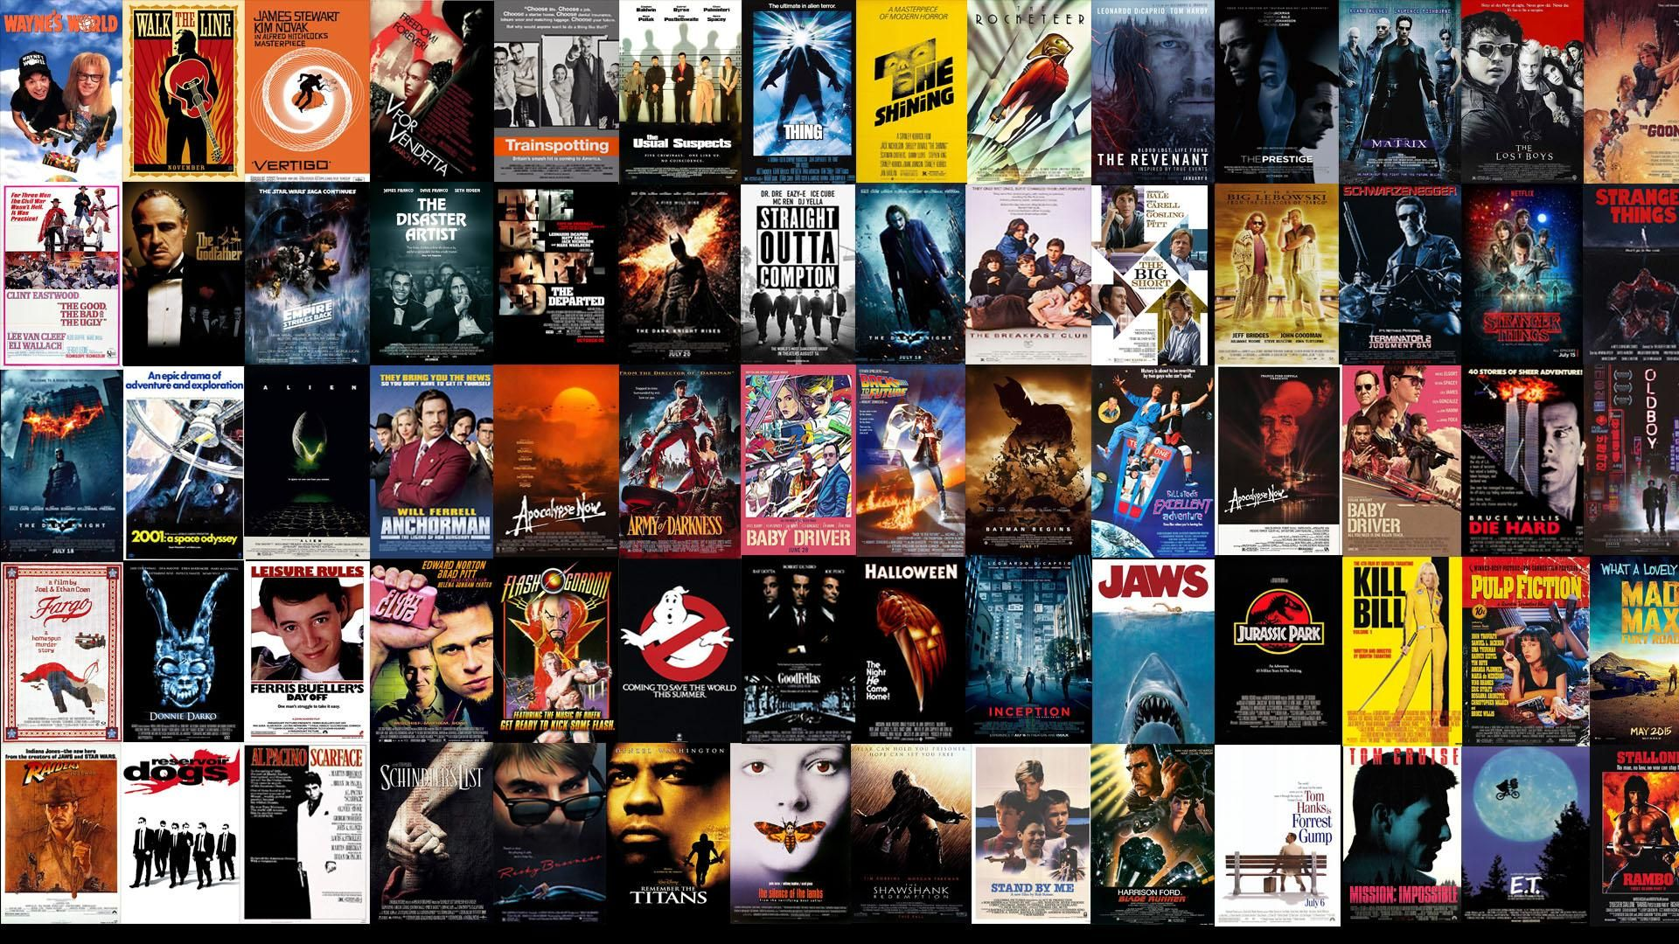

Slide 3
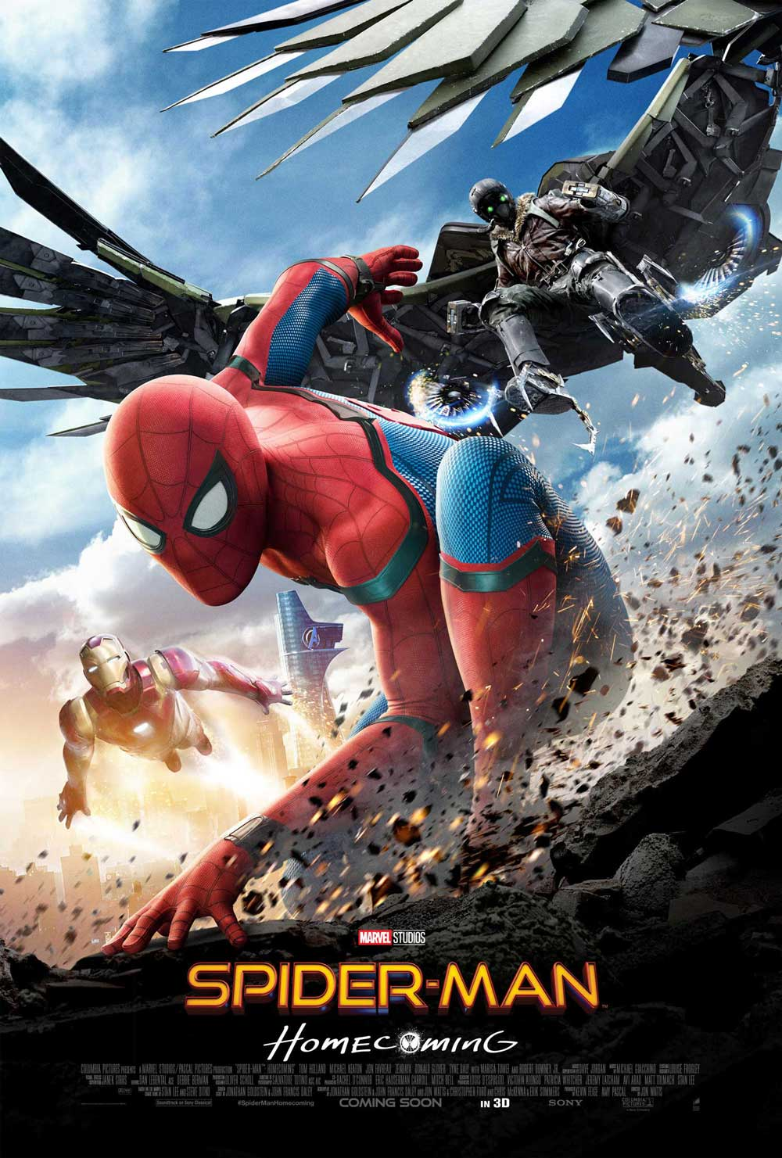
A new superhero film is coming out later this year.
Design a poster advertising the new movie.
Create a film title
Use clear font for the title and information.
Use images and font to make your poster stand out and attract people to it.
Use colour in an impactful way.

Slide 4
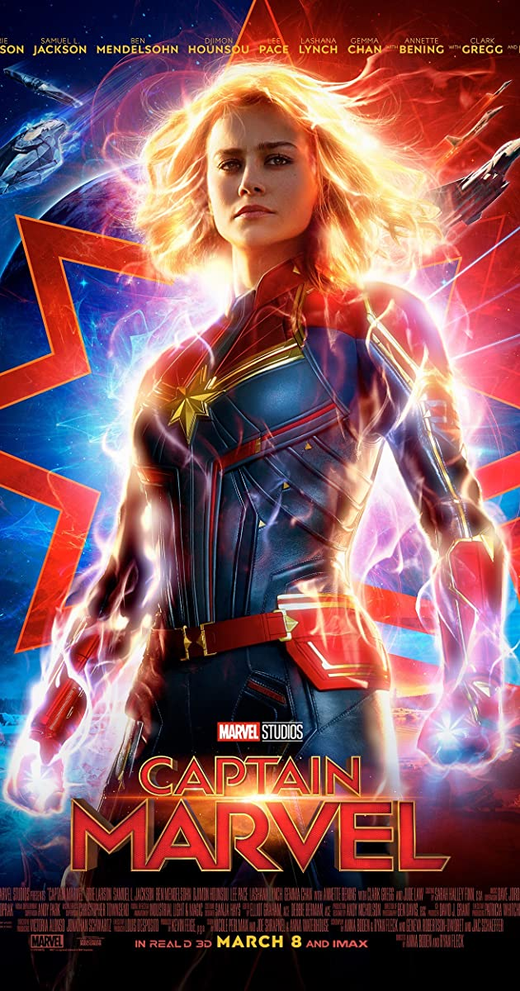
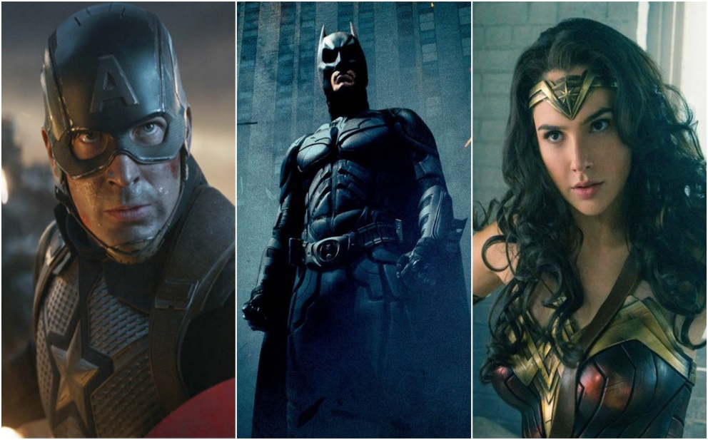
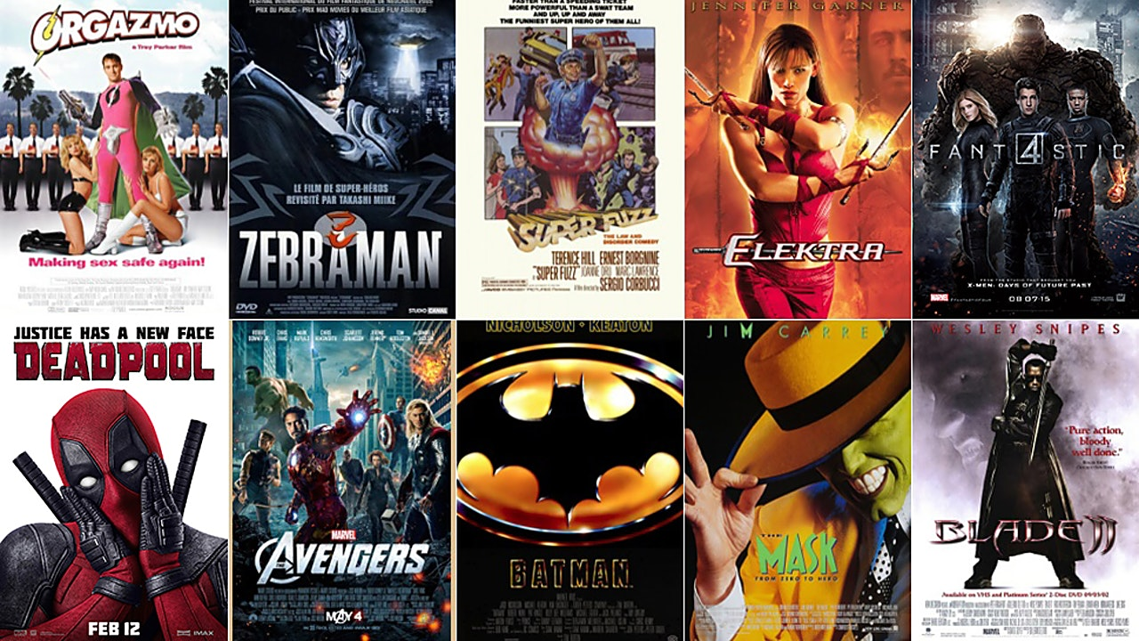
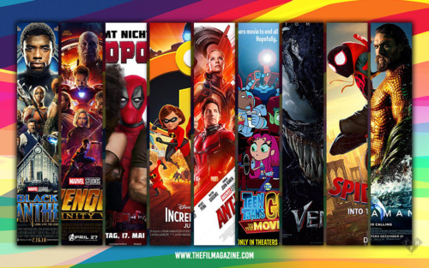


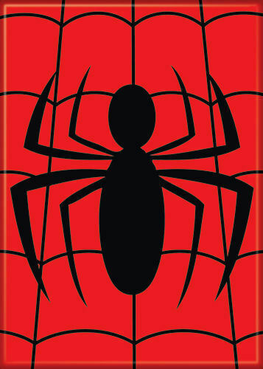

Slide 5

