Slide 1

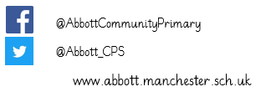

Year 3 Newsletter
Summer 2 2026
Dear parents/carers,
Welcome back to our final half term of the year! I hope you all had a restful holiday. I am excited to see the progress that the children will continue to make over our final half term together.
The children were better at remembering to bring their reading books in daily, but this could certainly improve. It is so
important that you are encouraging your child to read regularly – signing their records daily.
PE days are Thursdays and Fridays. We request that on these days children come to school in their PE kits.
PE kits should be a plain white/black T-shirt, plain black shorts or joggers and a pair of sports trainers.
I can answer any quick questions at the door but if you have anything more in depth you want to discuss, then please ring the school so that we can arrange time for this.
Kind regards,
Miss Harvey
www.abbott.manchester.sch.uk/class/class-3

Slide 2
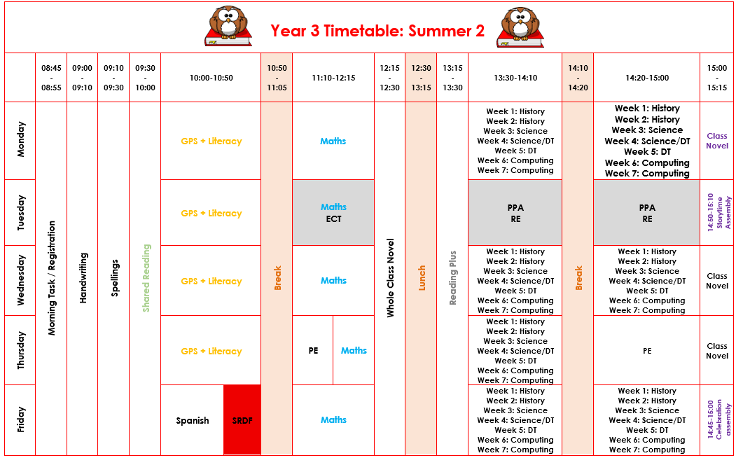
Class Timetable

Slide 3
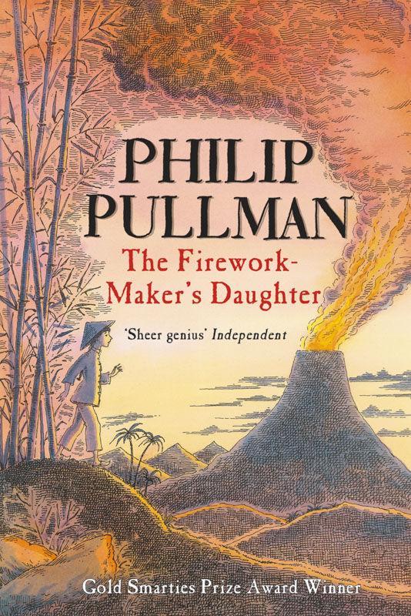

Curriculum Overview
Maths
Unit 12 - Money
Add and subtract amounts of money to give change, using both £ and p in practical contexts.
Unit 13 – Time
Tell and write the time from an analogue
clock, including using Roman numerals
from I to XII, and 12-hour and 24-hour
clocks.
Unit 14 - Angles and properties of Shapes
Recognise angles as a property of shape or a
description of a turn.
Unit 15 - Statistics
Science
Light
To recognise we need light in order to see things and that dark is the absence of light
Light is reflected from surfaces
Recognise that light from the sun can be dangerous and that there are ways to protect your eyes.
Recognise that shadows are formed when light from a source is blocked by an opaque object.
Find patterns in the way that the shadows change.
English
The Firework Maker’s Daughter
• Story retell from a
character’s point of view
• Information text
• Instructions
Computing
Simulations
Graphing

Slide 4
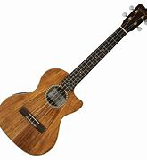
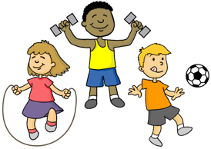
History
‘How do artefacts help us
understand the lives of people in Iron Age Britain?’
Identify and describe the common features of the archaeological remains of Iron Age hill forts found around Britain today.
Suggest how an Iron Age hill fort might have appeared when first constructed, giving reasons to justify the choice of features which have been included.
Describe the main features of an Iron Age roundhouse and identify and suggest reasons for the purpose of artefacts found within them.
DT
‘Packaging’
- To investigate a range of packaging.
- To be able to construct nets for 3-D shape packages.
- To explore the use of graphics on packaging.
- To be able to design a packaging box for a particular purpose.
RHE
Relationship
education
Music
PE
Every Thursday and Friday
PE kits should be worn on these days

Slide 5


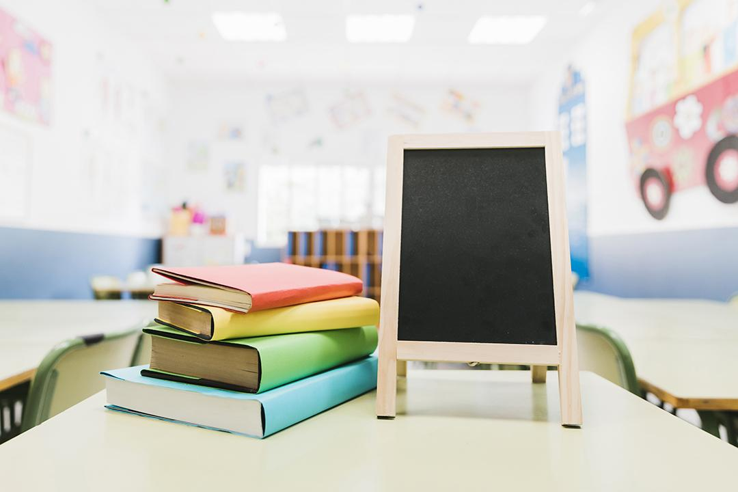
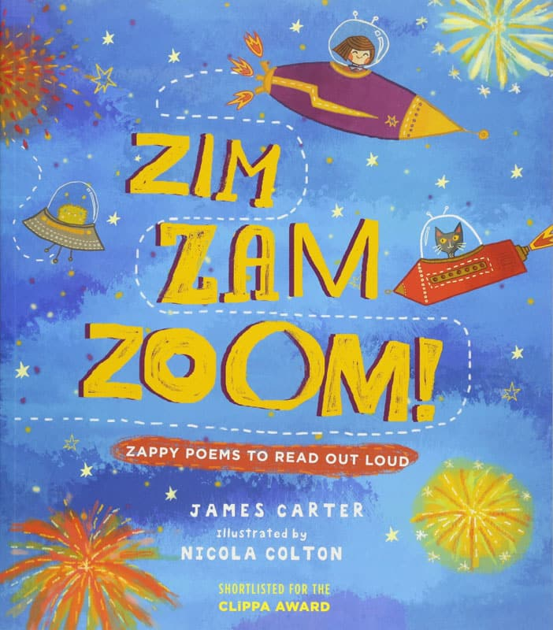
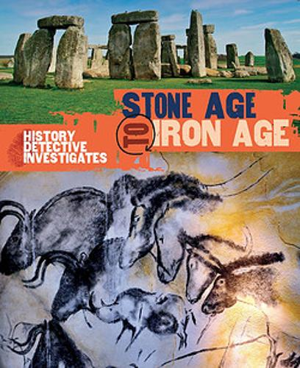
Reading
Children will continue to have independent reading books to take home and they will continue to access the school library. Reading books can be changed ANY day, as needed.
To further support independent reading for pleasure, take a look at the suggestions below that are linked to the topics and authors we are focusing on this half term:
Notes:
Each half term you will add suggested books or authors. On the History planning there is a page of suggested texts already

Slide 6

Home Learning
Reading is a main priority – the children should be reading their books every night and recording in their records daily.
Children also have access to online learning platforms that can be used at home.
Notes:
Ks1/2 only need to print this page.

