Slide 1
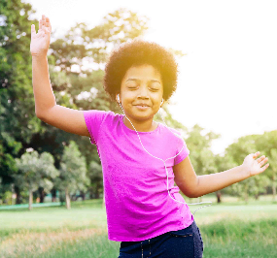

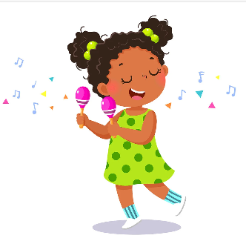
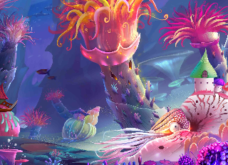
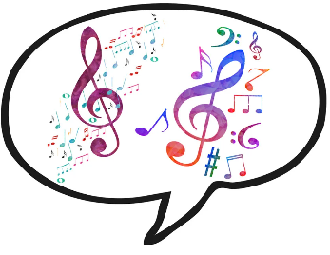

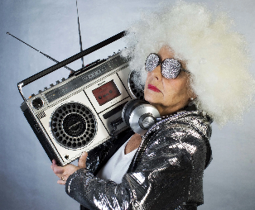
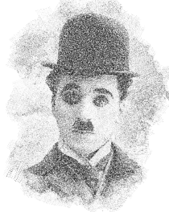
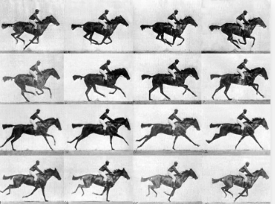
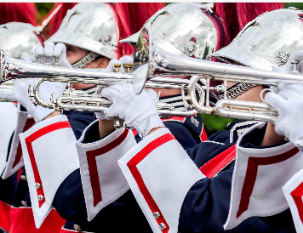




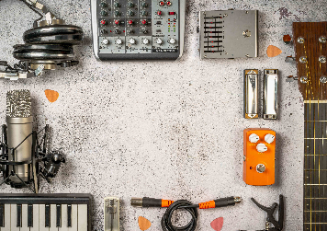
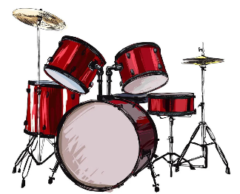

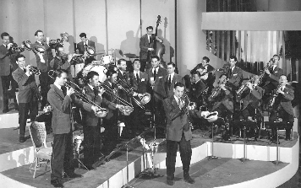


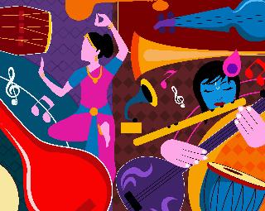
Expressive Arts and Design
Make up a simple accompaniment using percussion instruments.
Make up new lyrics and vocal sounds for different kinds of transports.
Improvise music with different instruments following a conductor.
Sing an action song with changes in speed.
Menu song, Colonel Hathi’s march, Magical musical aquarium.
Experiment with sounds (timbre)
Play instruments on the beat.
Listen to and move in time to the song.
Compose music to march to using tuned and untuned percussion.
Dancing and drawing, Cat and Mouse, Come dance with me.
Create musical phrases from new word rhythms that children invent.
Sing either part of a call-and-response song.
Develop an awareness of duration and the ability to move slowly to music.
Tony Chestnut, Carnival of animals and Composing music inspired by birdsong
Compose call-and-response music.
Listen with increased concentration to sounds/music and respond by talking about them.
Invent simple patterns using voices, body percussion and then instruments.
Grandma rap, Orawa and Trains
Learning a clapping game that shows the rhythm.
Improvise and compose, structuring short musical ideas to form a larger piece.
Begin to understand duration and rhythm notation.
Learn about the musical terms crescendo, diminuendo, accelerando, ritenuto.
Year One
Year Two
Swing-a-long with Shostakovich, Charlie Chaplin and Tanczymy labada.
Create action patterns in 2 – and 3-time.
Listen and move, stepping a variety of rhythm patterns.
Compose a soundtrack to a clip of a silent film.
Understand and use notes of different pitch.
Listen to traditional and composed music from Poland.
EYFS
Football, Dawn and Musical conversations
Compose musical sound effects and short sequences of sounds.
Create, interpret and perform simple graphic scores.
Global pentatonics, The horse in motion and Favourite song
Improvise and create pentatonic patterns.
Compare music extracts and understand that the pentatonic scale features in lots of music traditions and cultures.
Create and follow a score.
Watch a film and analyse it in a musical context.
The doot doot song, Fanfare for the common man and Spain
Listen and carefully identify similarities and differences between acoustic guitar styles.
Improvise and compose, exploring how timbre, dynamic and texture can be used for impact in a fanfare.
Invent a melody.
Play repeating rhythmic patterns.
Year Three and four
Latin dance, ‘March’ from The Nutcracker and From a railway carriage.
Compose a 4-beat rhythm pattern to play during instrumental sections.
Play a one-note part contributing to the chords accompanying the verses.
Develop a sense of beat and rhythmic pattern through movement.
Explore ways to create word-based pieces of music.
I’ve been to Harlem, Nao chariya de/Mingulay boat song
Sing a call-and-response song in groups, holding long notes confidently.
Begin to develop an understanding and appreciation of music from different musical traditions.
Compose a simple song using symmetry to develop a melody, structure and rhythmic accompaniment.
Cycle A
This little light of mine, The Pink Panther theme and Composing with colour.
Sing in a Gospel style with expression and dynamics.
Improvise and compose, creating atmospheric music for a scene.
Create short sounds inspired by colours and shapes.
Year Three and four
Just three notes, Samba with Sergio and Fly with the stars.
Invent simple patterns using rhythms.
Perform vocal percussion as part of a group.
Respond to and recognize crotchets and quavers and make up rhythms.
Sing solo or in a pair in call-and-response style.
Cycle B
Race! Exploring identity through song and Ame sau vala tara bal.
Structure ideas into a full soundtrack.
Understand different ways that rhymes work in songs.
Create a rhythmic piece for drums and percussion instruments.
Wider opportunities
Children will be learning an instrument and performing as a class orchestra.
Hey, Mr Miller, Shadows and Composing for protest!
Listen to historical recordings of big band swing and describe features of the music using music vocabulary.
Create a shadow movement piece in response to music.
Create their own song lyrics.
Fit their lyrics to a pulse, creating a chant.
Dona nobis pacem, You to me are everything and Twinkle variations.
Compose an 8-bar piece on percussion.
Sing a chorus in two-part harming with dancing on the beat.
Use music vocabulary and knowledge to discuss similarities and differences.
Year Five
Year Six
What shall we do with the drunken sailor?, Why we sing and Introduction to song writing
Compose body percussion patterns to accompany a sea shanty.
Develop and practise techniques for singing and performing in a Gospel style.
Create fragments of songs that can develop into fully fledged songs.
Recognise individual instruments and voices by ear.
Madina tun nabi, Building a groove and Epoca
Sing a song in two parts with expression and an understanding of its origins.
Listen and copy back simple rhythmic and melodic patterns.
Identify drum patterns, basslines and riffs and play them using body percussion and voices.
Upton Westlea Primary School Curriculum Road Map – Music

