Slide 1
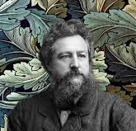

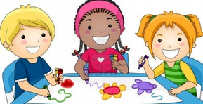

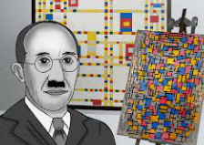
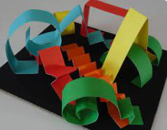
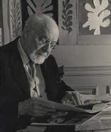
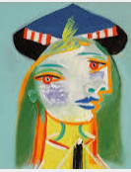
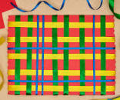

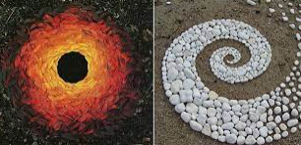
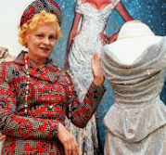
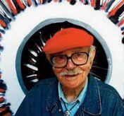
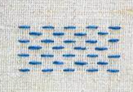
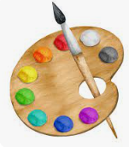
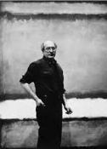
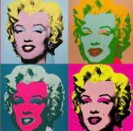
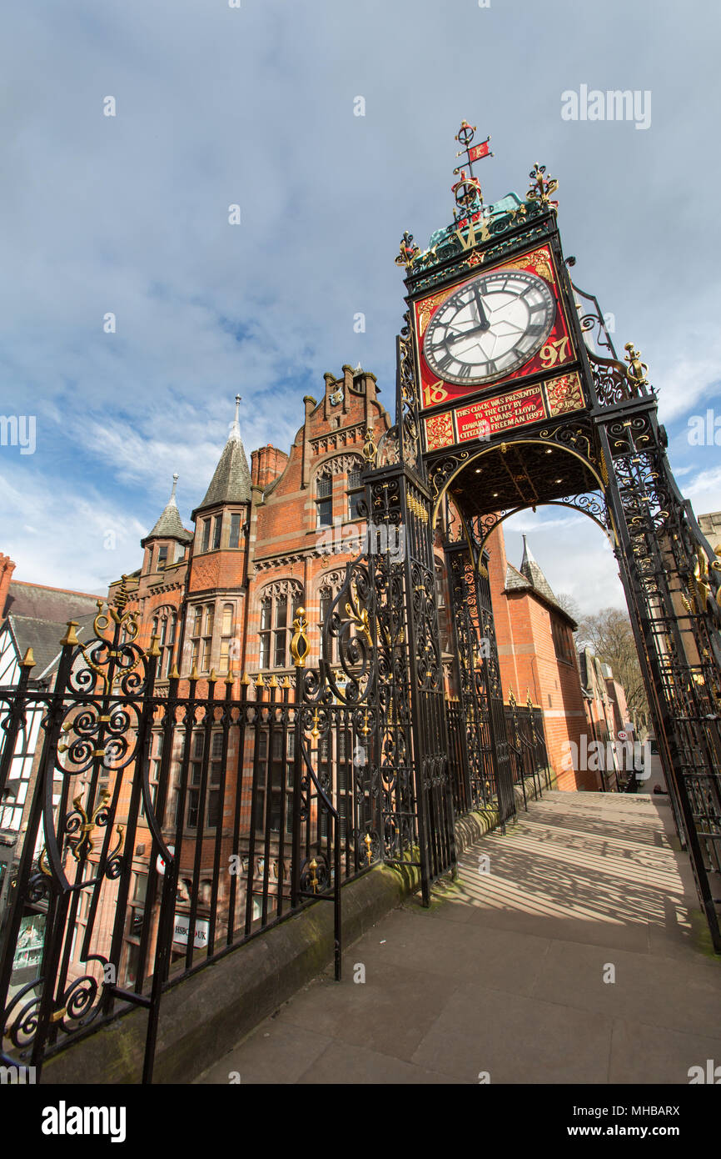
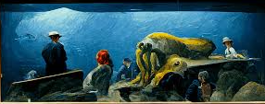
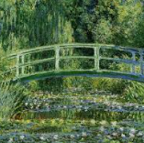
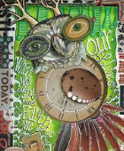
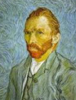
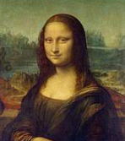

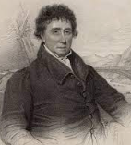
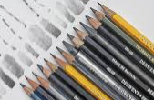
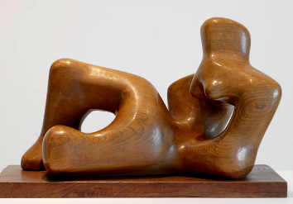

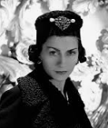
Expressive Arts and Design
Art is taught through the area of Expressive Arts and Design and encourages children to express themselves and develop their imagination, creativity and skills to use different materials to design and make.
Artist: Piet Mondrian
Artist: Henri Matisse
Drawing
Designer: William Morris
Painting
Artist: Pablo Picasso
Artist: Andy Goldsworthy
Sculpture
Year One
Year Two
EYFS
Collage
Craft maker – Clare Youngs
Textiles – Weaving and Stitching
Printing - Collagraph
Year 3/4 cycle B
Collage
Sculpture
Designer: Dame Vivienne
Westwood
Artist: Sir Terry Frost
Textiles - Sewing
Painting
Drawing
Year 3/4 cycle A
Artist: Edward Hopper
Artist: Andy Warhol
Printing
Architect John Douglas
Artist: Mark Rothko
Architect: Thomas Telford
Sculpture
Textiles
Printing
Artist: Vincent van Gogh
Collage
Artist: Leonardo da Vinci
Designer:
Coco Chanel
Year Five
Year Six
Artist: Monet
Artist: Teesha Moore
Drawing
Artist: Henry Moore
Upton Westlea Primary School Curriculum Road Map - Art

