Slide 1





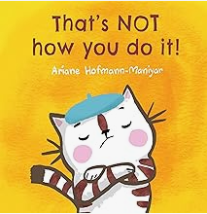




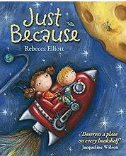







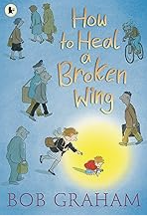

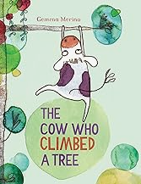

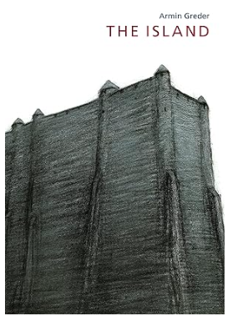



Personal, Social and Emotional Development
SCARF – What makes me special, Similarities and differences, Celebrating differences, Keeping my body safe, Looking after things, Keeping healthy, Life stages.
No Outsiders – You Choose, Red Rockets and Rainbow Jelly, Blue Chameleon, The Family Book.
Autumn Term
SCARF – Feelings and getting help, Classroom rules and being a good friend. Recognising, valuing and celebrating difference, Developing respect and accepting others. Bullying and getting help.
No Outsiders – Elmer, Ten Little Pirates.
Summer Term
SCARF – Growth mindset, Healthy eating, Hygiene and health, Cooperation.
Getting help, Becoming independent, My body parts, Taking care of self and others.
Autumn Term
SCARF – Bullying and teasing, Our school rules about bullying, Being a good friend, Feelings and self-regulation
No Outsiders – The Great Big Book of Families and What the Jackdaw Saw.
Spring Term
SCARF - Safe and unsafe secrets, Appropriate touch, Medicine Safety, Cooperation, Self-regulation, Online Safety, Looking after money – saving and spending.
No Outsiders – The Odd Egg and Blown Away.
Year One
Year Two
Summer Term
SCARF – Growth mindset, Looking after my body, Hygiene and health, Exercise and sleep, Life cycles, Dealing with loss, Being supportive, Growing and changing, Privacy.
No Outsiders – The First Slodge and Just Because.
EYFS
Spring Term
SCARF – How are feelings can keep us safe, Safe and unsafe touches, Medicine safety, Sleep. Taking care of things.
No Outsiders – That’s not how you do it, Max the Champion.
Spring Term
SCARF – Managing risks, Decision-making skills, Drugs and their risks, Staying safe online, Skills we need to develop as we grow up, Helping and being helped, Looking after the environment, Managing money.
No Outsiders – We’re all wonders.
Year
Three- Four
Cycle B
Summer Term
SCARF – Keeping myself healthy and well, Celebrating and developing my skills, Developing empathy,, Keeping safe, Safe and unsafe secrets.
No Outsiders – Two Monsters and Beegu.
Year 3 RSE – Naming body parts (male and female differences), types of relationships, personal space.
Year 4 RSE – growing and changing, what s puberty? Puberty changes and reproductions.
Autumn Term
SCARF – Rules and their purpose, Cooperation, Friendship including respectful relationships, Coping with lose, Recognising and respecting diversity, Being respectful and tolerant, My Community.
No Outsiders – The Hueys in the new jumper, This is our house.
Summer Term
SCARF – Growing independence and taking responsibility, Keeping myself healthy, Media awareness and safety, My Community, Managing difficult feelings, Managing change, How my feelings help keeping safe, Getting help.
No Outsiders – The cow who climbed a tree and And Tango Makes Three.
Autumn Term
SCARF – Assertiveness, Cooperation, Safe/unsafe touches, Positive relationships, Recognising and celebrating difference, Recognising and reflecting on prejudice-based bullying, Understanding Bystander behaviour, Gender stereotyping.
No Outsiders – My Princess Boy and Leaf.
Spring Term
SCARF – Understanding emotional needs, Staying safe online, Drugs: norms and risks, Understanding media bias including social media, Caring: communities and the environment, Earning and saving money, Understanding democracy.
No Outsiders – The Island.
Summer Term
SCARF – Aspirations and goal setting, Managing risk, Looking after my mental health, Coping with changes, Keeping safe, Body image, Sex education, Self-esteem.
No Outsiders – Dreams of Freedom and The Thing.
Our school use the SCARF Scheme and No Outsiders.
Year Five
Year Six
Autumn Term
SCARF – Feelings, Friendship skills including compromise, Assertive skills, Cooperation, Recognising emotional needs, Recognising and celebrating difference, Influence and pressure of social media.
No Outsiders – Where the poppies grow now and Rose Blanche.
Spring Term
SCARF – Managing risk, including online safety, Norms around use of legal drugs, Decision making skills, Rights and responsibilities including health, Making difference, Decisions about lending, borrowing and spending
No Outsiders – How to heal a broken wing.
Upton Westlea Primary School Curriculum Road Map - PSHE

