Slide 1
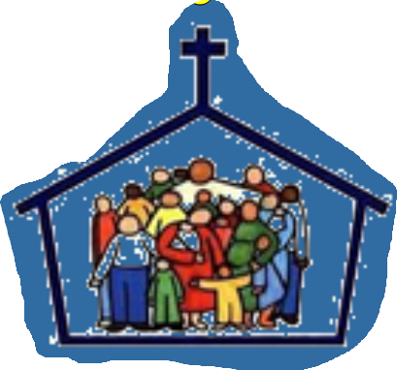

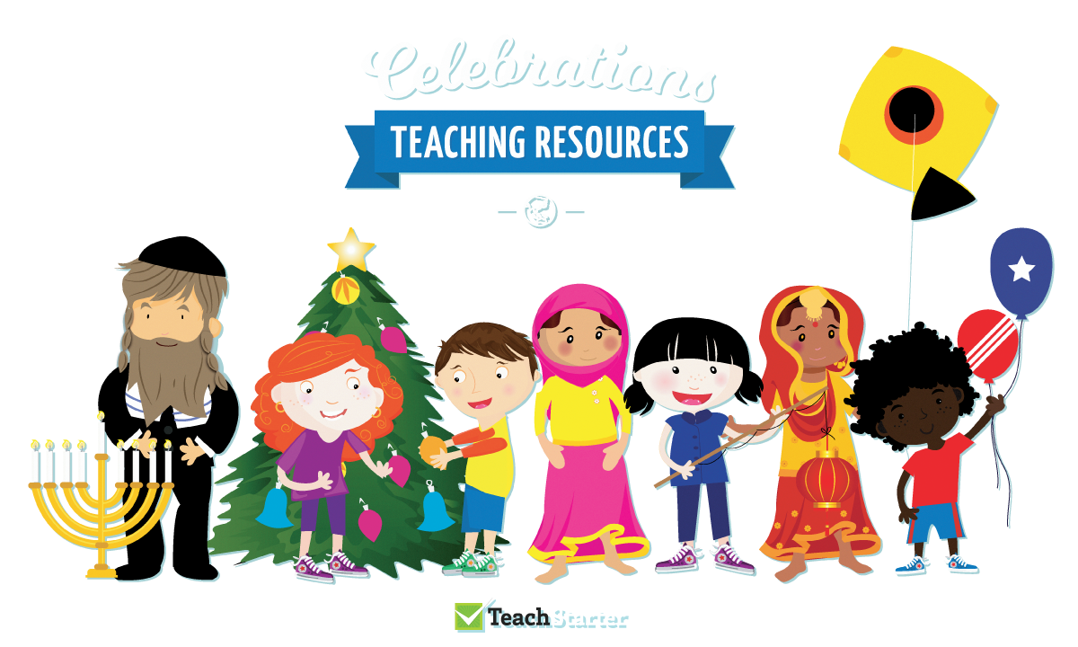
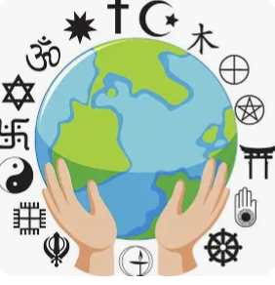

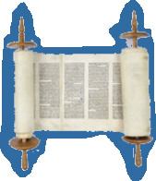
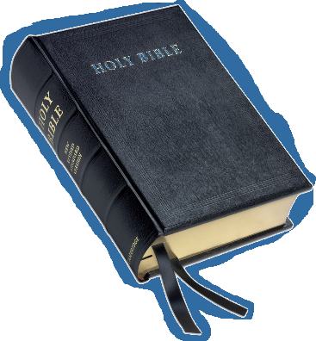

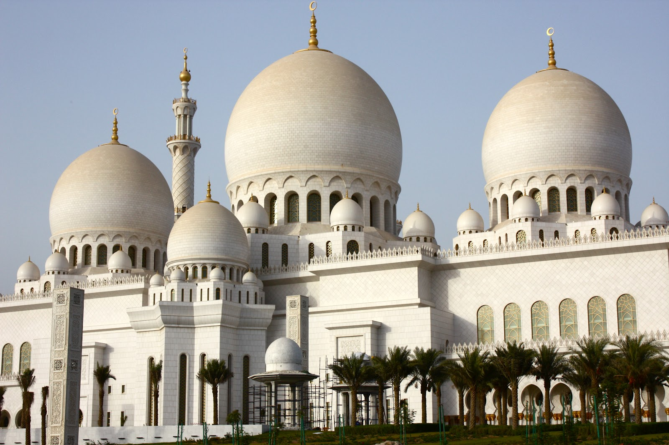
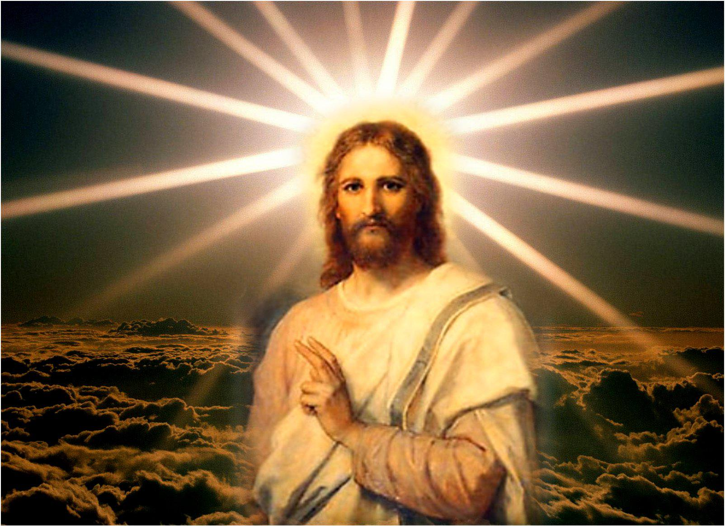
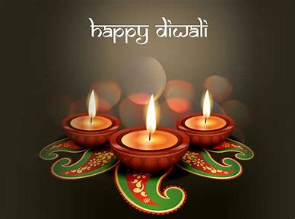

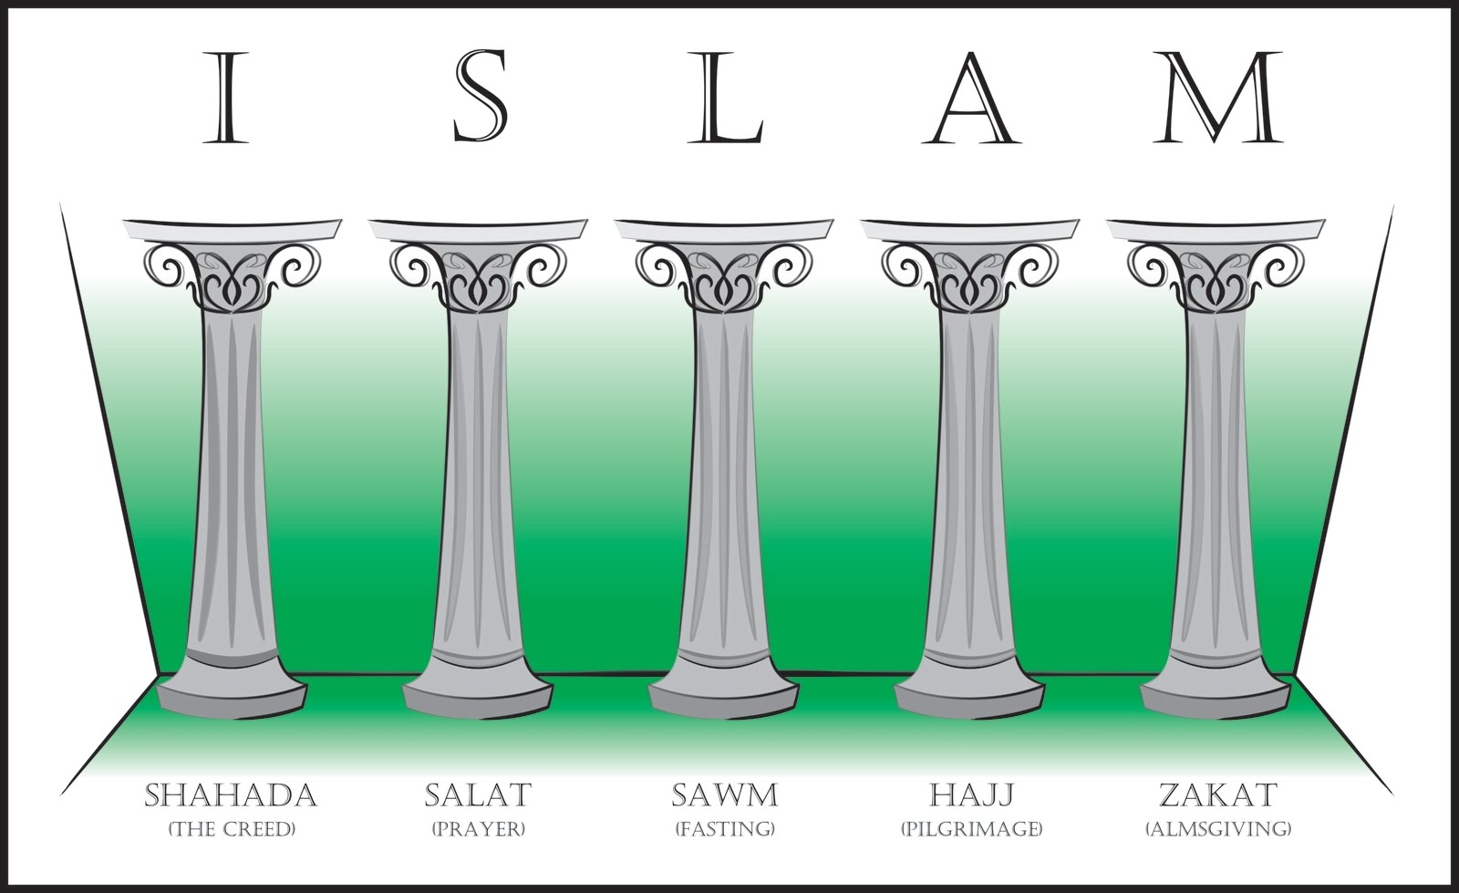
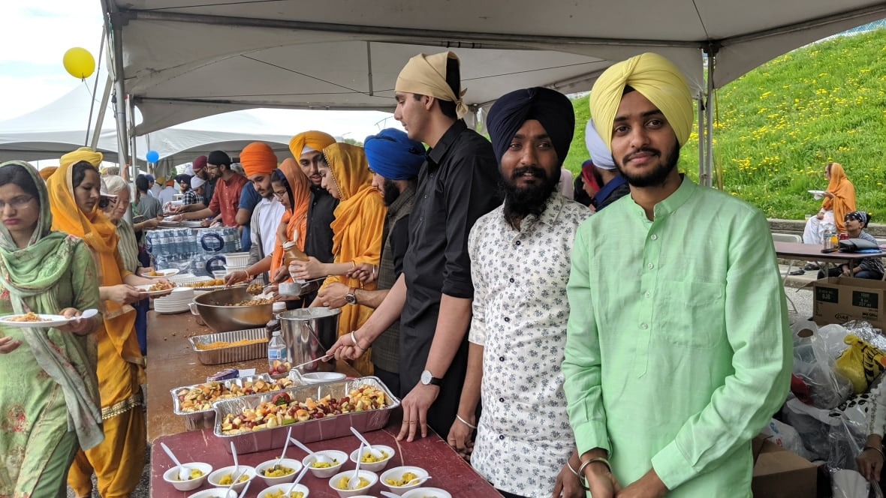
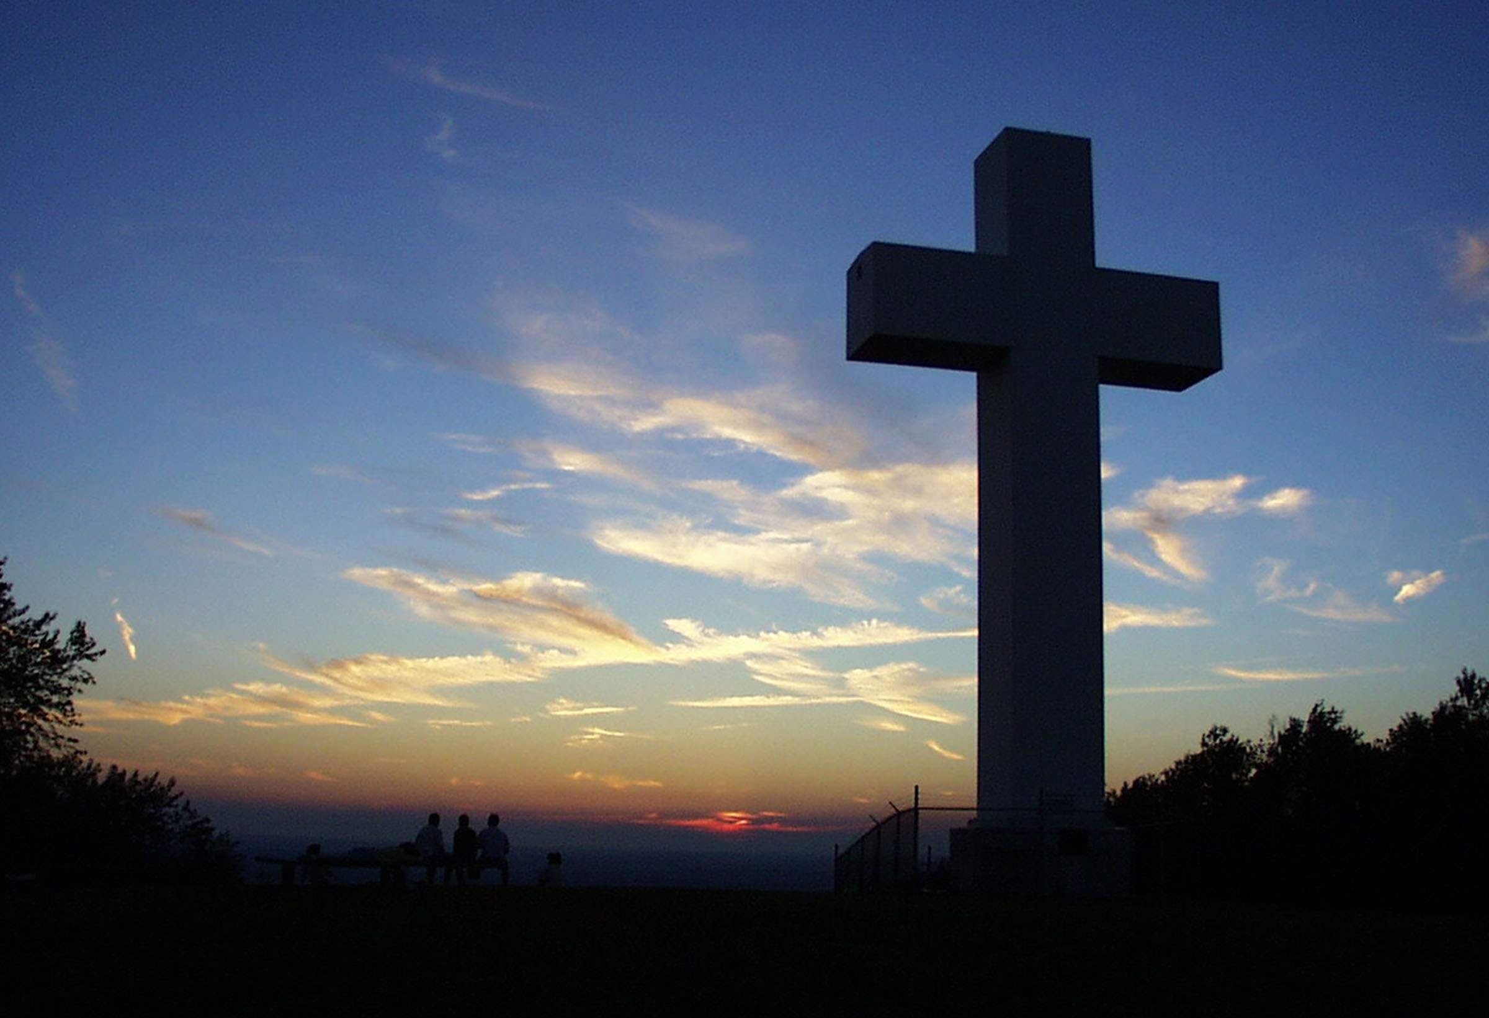
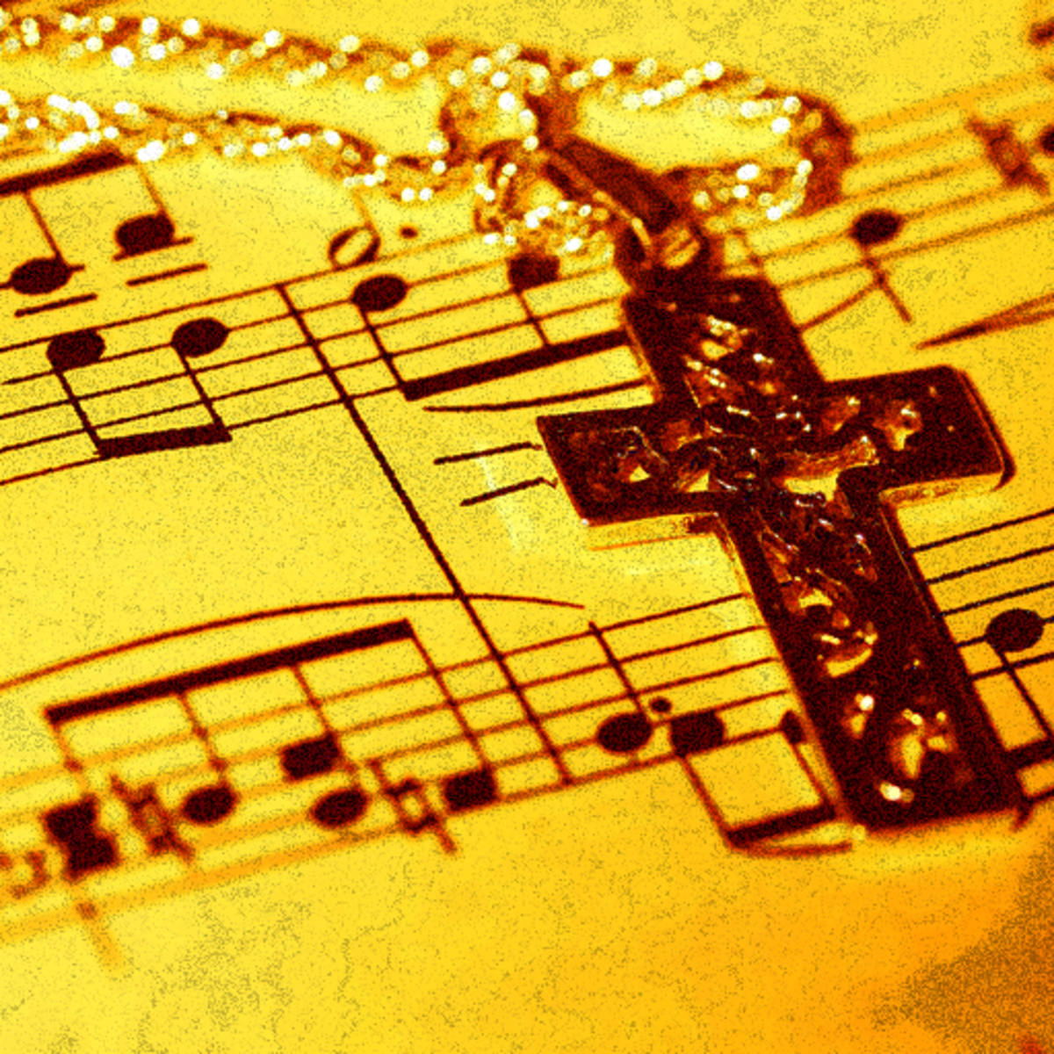
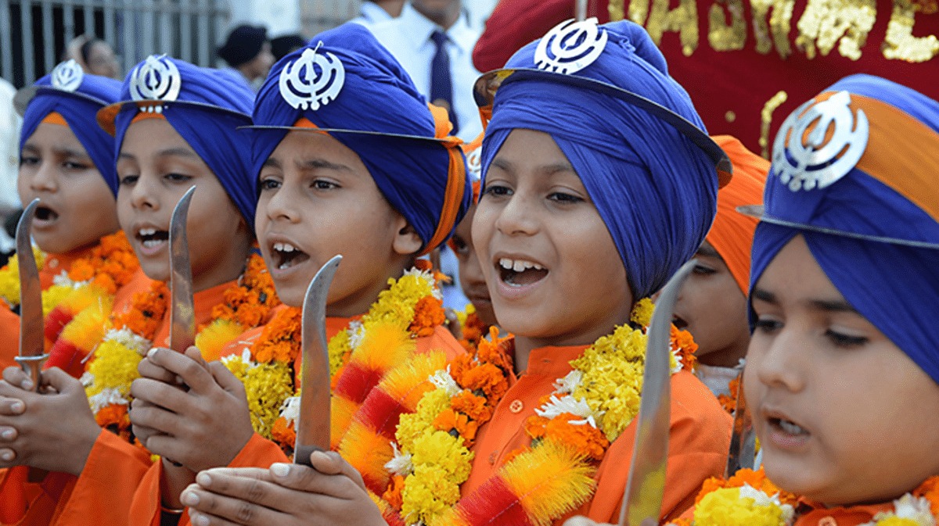
Children engage in activities based on significant religious events throughout the year e.g. Christmas, Eid, Chinese New Year, Easter, Diwali.
Christianity
What does it mean to belong?
Why is Christmas celebrated by Christians?
Worldviews
How do people with different and similar worldviews believe the world began and how should we look after it?
Islam
What do Muslims believe about Allah and Muhammad (PBUH) ?
How do Muslims express new beginnings?
Judaism
What do Jews believe about God?
How do Jews show faith through practices and celebrations?
Christianity
Why is the Bible a special book for Christians?
Who was Jesus and why is he important to Christians today? (includes Easter)
Year One
Year Two
EYFS
Humanism
What do Humanists believe a good life is about?
Christianity
How can the Bible help a Christian with their way of life?
What do I think about Jesus and how is he portrayed in art around the world?
What is my point of view about God and why do people have faith?
Hinduism
What does a Hindu believe about God and how is Diwali celebrated?
Islam
What do Muslims believe happened on ‘The Night of Power’ and how do they worship?
Year
Three-Four
Cycle A
Hinduism
How do Hindus view God and how is Diwali celebrated?
Worldviews
What does it mean to live in a religiously diverse world?
What do religious and non-religious worldviews believe about equality, justice and fairness?
Christianity
Are Humanists and Christian ideas about science conflicting or complementary? Does the Big Bang Theory disprove the Genesis account of Creation?
What are some of the differences and similarities within Christianity locally and globally? What can we learn from religious buildings and music?
Year Five
Christianity
Which concepts do we find hard to understand in Christianity?
How and why do Christians worship?
Sikhism
How do Sikhs worship?
Year Six
Islam
Why are the Five Pillars important to Muslims?
How is the Muslim way of life expressed at home and in the community?
Sikhism
How are the values of community and equality shown through the Sikh way of life?
Upton Westlea Primary School Curriculum Road Map – RE and Worldviews

