Slide 1



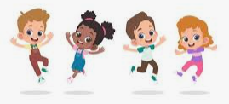






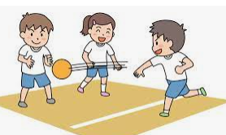

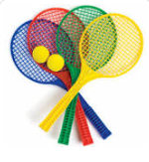


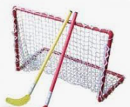

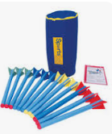
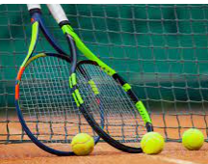


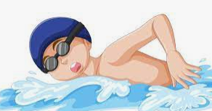
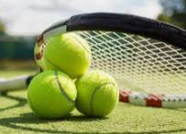
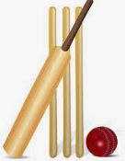

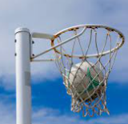
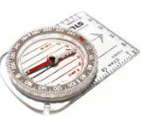
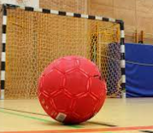


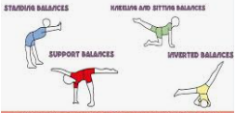
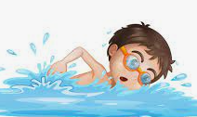

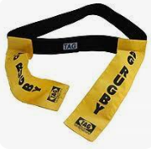

Physical Development
Over the course of the year the children will be covering the following units:
Walking, Hands, High, Low, Under and Over, Moving, Jumping and Games for Understanding. In continuous provision the children have opportunities to refine their gross and fine motor skills.
Autumn Term
Autumn 1 – Health and Wellbeing and Running.
Autumn 2 – Hands 1 and Body parts.
Summer Term
Summer 1 – Jumping and Team Building.
Summer 2 – Rackets, Bats and Balls and Games for Understanding.
Autumn Term
Autumn 1 – Dodging 1 and Team Building.
Autumn 2 – Hands 1 and Dance (Water).
Spring Term
Spring 1 – Feet 1 and Gymnastics (Linking).
Spring 2 – Hands 2 and Gymnastics (Pathways).
Year One
Year Two
EYFS
Summer Term
Summer 1 – Jumping 1 and Rackets, Bats and Balls.
Summer 2 – Games for Understanding and Chester FC Football.
Spring Term
Spring 1 – Feet 1 and Dance (The Zoo).
Spring 2 – Gymnastics (Wide, Narrow, Curled) and Hands 2.
Spring Term
Spring 1 –Gymnastics (Levels and Direction Y4) and Dance (Wild Animals Y3)
Spring 2 –Problem Solving (OAA Y4) and Dance (Cats Y4).
Autumn Term
Autumn 1 – Game Sense – Net and Wall (Yr 3) and Hockey (Yr 3)
Autumn 2 – Orienteering (OAA Y3) and Gymnastics (Symmetry and AsymmetryY4)
Summer Term
Summer 1 – Athletics (Throwing and Jumping Yr 3) and Game Sense Net and Wall (Yr 4)
Summer 2 – Athletics (Yr4) and Hockey (Yr4)
Year
Three- Four
Cycle A
Spring Term
Spring 1 – Tennis and Handball
Spring 2 – Athletics and Tag Rugby.
Summer Term
Summer 1 – Cricket and Rounders
Summer 2 – Football and Orienteering
Summer Term
Summer 1 –Dance (The Circus) and Athletics.
Summer 2 –Football and Rounders.
Autumn Term
Autumn 1 - Hockey and Gymnastics (Matching & Mirroring).
Autumn 2 – Dance (Prejudice and Discrimination) and Netball.
Year Five
Year Six
Autumn Term
Autumn 1 – Netball and Tennis.
Autumn 2 – Tag Rugby and Handball.
Spring Term
Spring 1 –Gymnastics (Counter Balance and Counter Tension) and Cricket.
Spring 2 – Orienteering and Hockey
Upton Westlea Primary School Curriculum Road Map – Physical Education

