Slide 1


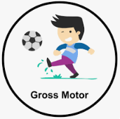
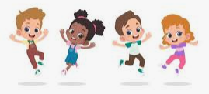



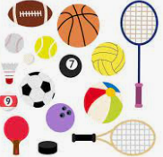

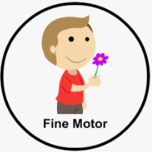
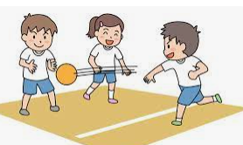

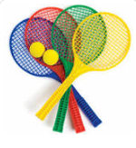


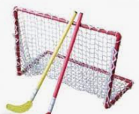

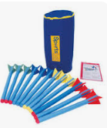
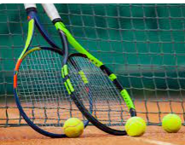


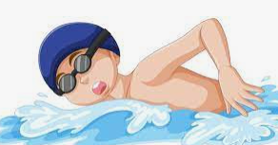
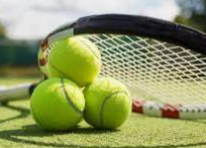
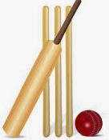

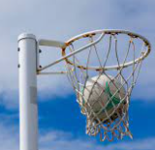
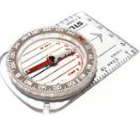
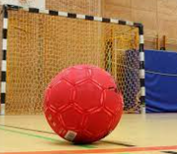

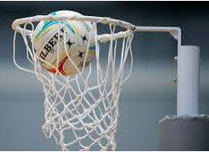
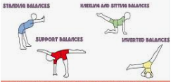
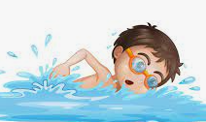

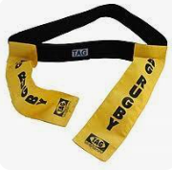

Physical Development
Over the course of the year the children will be covering the following units:
Walking, Hands, High, Low, Under and Over, Moving, Jumping and Games for Understanding. In continuous provision the children have opportunities to refine their gross and fine motor skills.
Autumn Term
Autumn 1 – Health and Wellbeing and Running.
Autumn 2 – Hands 1 and Body parts.
Summer Term
Summer 1 – Jumping and Feet 1.
Summer 2 – Rackets, Bats and Balls and Games for Understanding.
Autumn Term
Autumn 1 – Dodging 1 and Team Building.
Autumn 2 – Hands 1 and Dance (Water).
Spring Term
Spring 1 – Feet 1 and Gymnastics (Linking).
Spring 2 – Hands 2 and Gymnastics (Pathways).
Year One
Year Two
EYFS
Summer Term
Summer 1 – Jumping 1 and Rackets, Bats and Balls.
Summer 2 – Games for Understanding and Chester FC Football.
Spring Term
Spring 1 – Team Building and Dance (The Zoo).
Spring 2 – Gymnastics (Wide, Narrow, Curled) and Hands 2.
Spring Term
Spring 1 –Gymnastics (Bridges Y4) and Dance (Weather Y3)
Spring 2 –Communications and Tactics (OAA Y4) and Dance (Space Y4).
Autumn Term
Autumn 1 – Game Sense – Invasion (Yr 3) and Rounders (Yr 3)
Autumn 2 – Challenging Collaboration (OAA Y3) and Gymnastics (Canon and Unison Y4)
Summer Term
Summer 1 – Athletics (Throwing and Jumping Yr 4) and Game Sense Invasion (Yr 4)
Summer 2 – Athletics (Yr3) and Rounders (Yr4)
Year
Three- Four
Cycle A
Spring Term
Spring 1 – Tennis and Handball
Spring 2 – Athletics and Tag Rugby.
Summer Term
Summer 1 – Cricket and Rounders
Summer 2 – Football and Orienteering
Summer Term
Summer 1 –Orienteering and Athletics.
Summer 2 –Football and Rounders.
Autumn Term
Autumn 1 - Hockey and Gymnastics (Matching & Mirroring).
Autumn 2 – Dance (Prejudice and Discrimination) and Netball.
Year Five
Year Six
Autumn Term
Autumn 1 – Netball and Tennis.
Autumn 2 – Tag Rugby and Handball.
Spring Term
Spring 1 –Gymnastics (Counter Balance and Counter Tension) and Cricket.
Spring 2 –Dance (The Circus) and Hockey
Upton Westlea Primary School Curriculum Road Map – Physical Education

