Slide 1

11 B4 11
(11 memorable, enriching experiences before the age of 11)
Upton Westlea Primary School

Slide 2

Rationale
At Upton Westlea Primary School we believe that all children should have the chance to experience certain ‘essential childhood experiences’.
These opportunities form part of the explicit and ‘hidden’ school curriculum and are planned for throughout the year whenever possible through lessons and enrichment opportunities.
(See our termly Enrichment Maps)

Slide 3
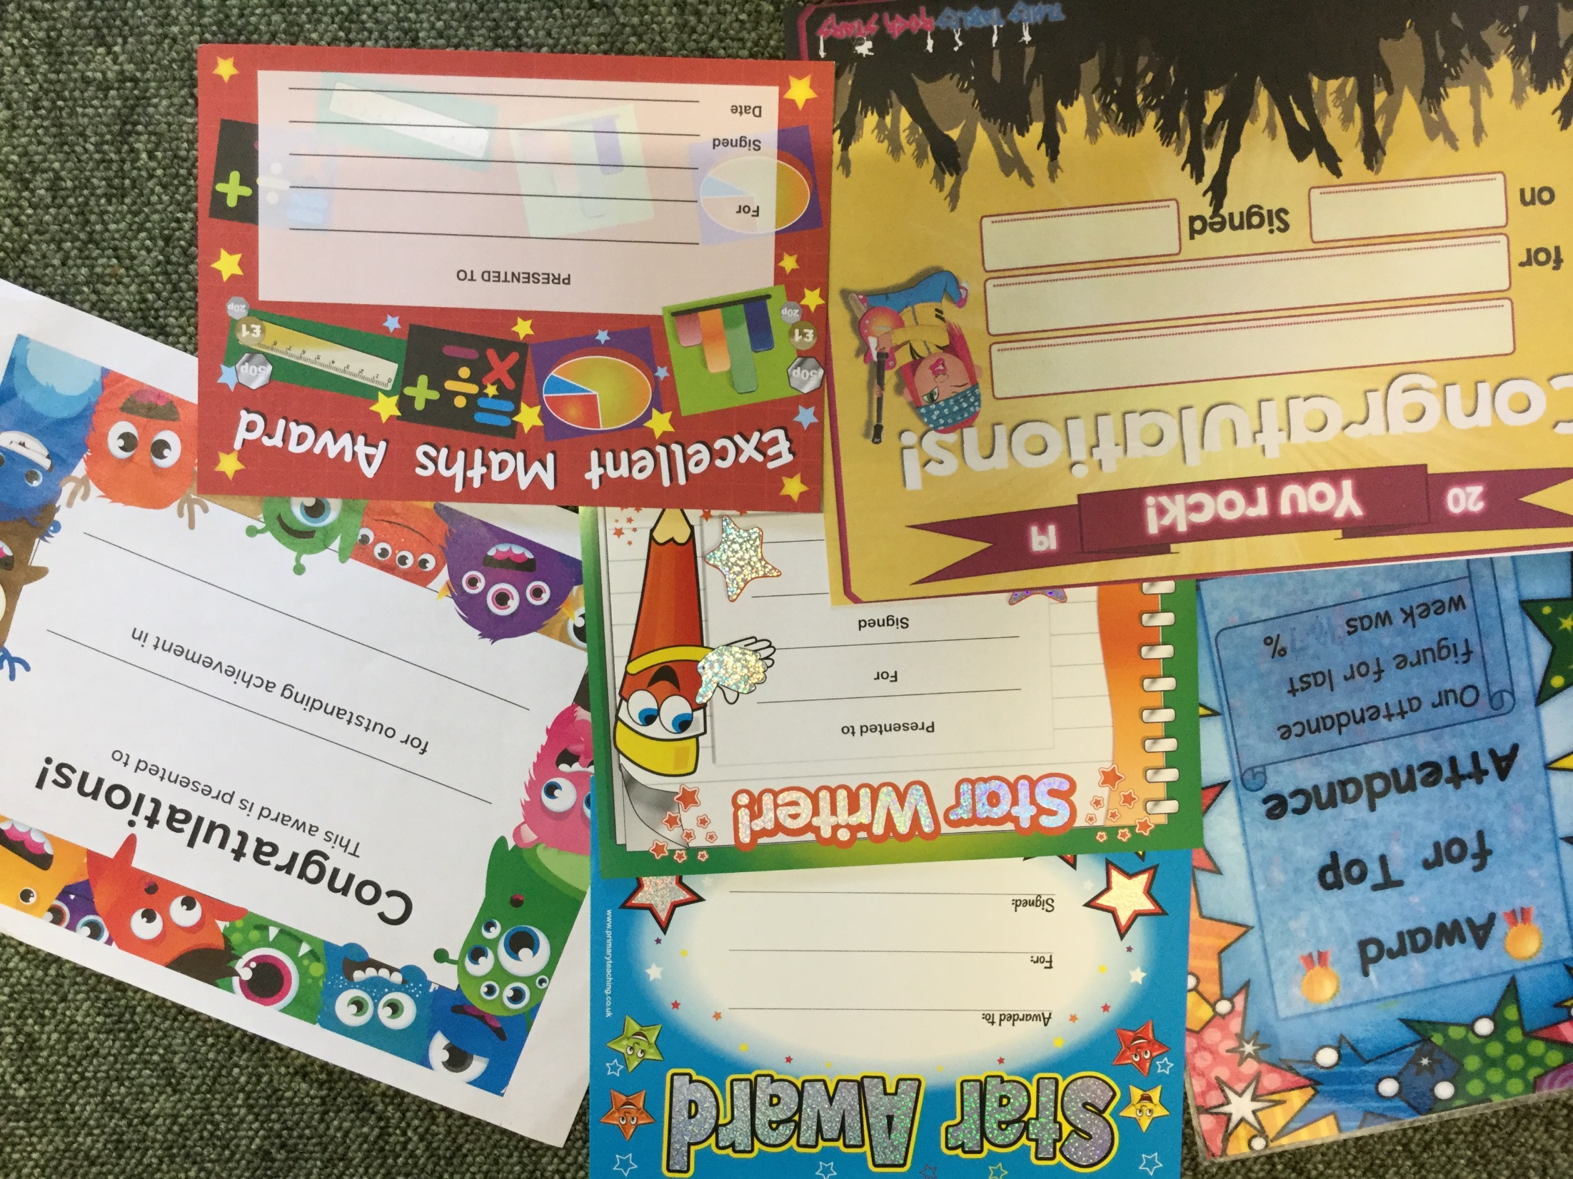
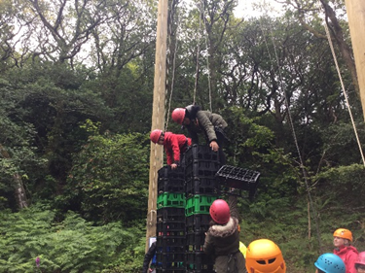
During your time at Upton Westlea you will have the chance to ……..
Be a Hero, by taking a risk, trying new challenges, gaining certificates for achievements …..

Slide 4
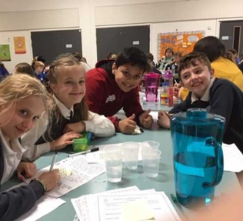
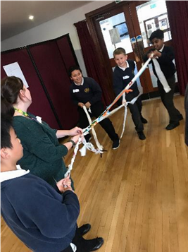
During your time at Upton Westlea you will have the chance to ……..
Be a Decision-maker and confident citizen, by contributing to debates, being a school Eco-Rep or School Councillor, developing an enterprising idea.

Slide 5
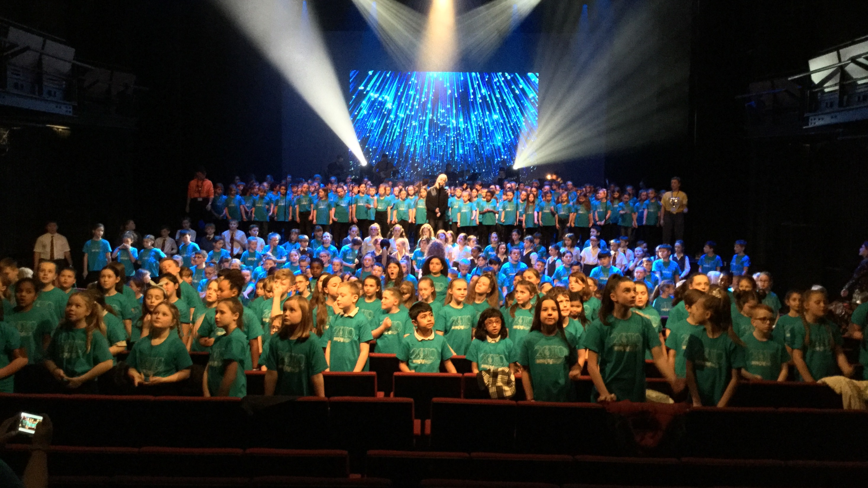
During your time at Upton Westlea you will have the chance to ….
Be a culture-buff, by visiting the Theatre, Museum, Art Gallery, Religious building …

Slide 6
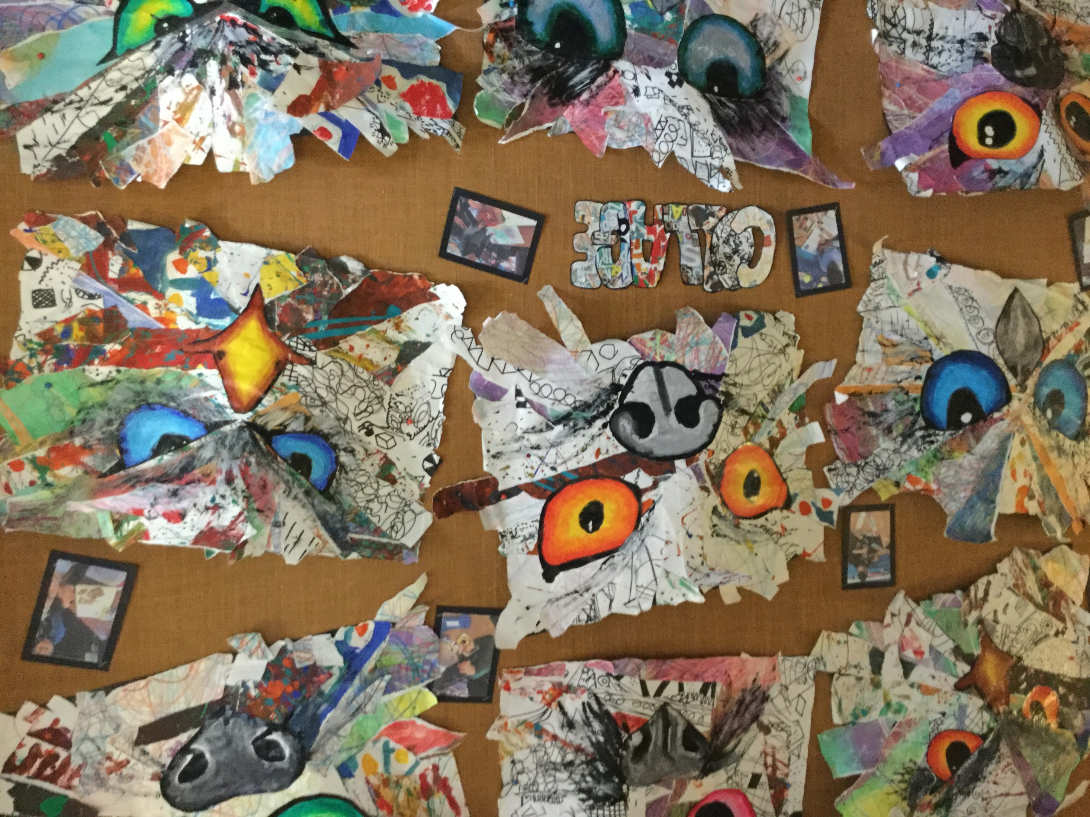
During your time at Upton Westlea you will have the chance to …..
Be a creator, by cooking, making art, dancing, playing a musical instrument, singing, writing ….

Slide 7
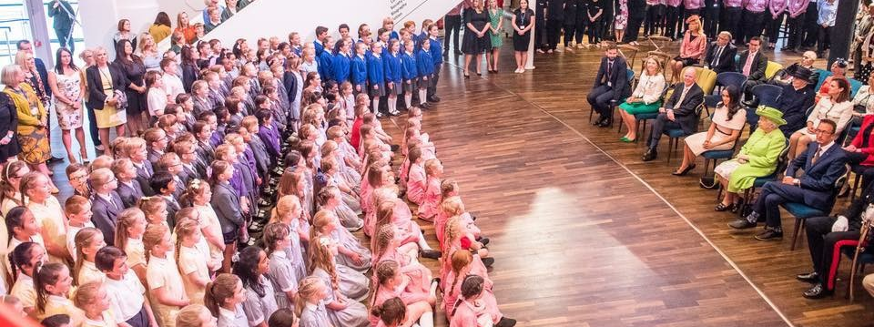
During your time at Upton Westlea you will have the chance to …..
Be a show off! By being part of a Production, Musical Event, Sporting Event …

Slide 8
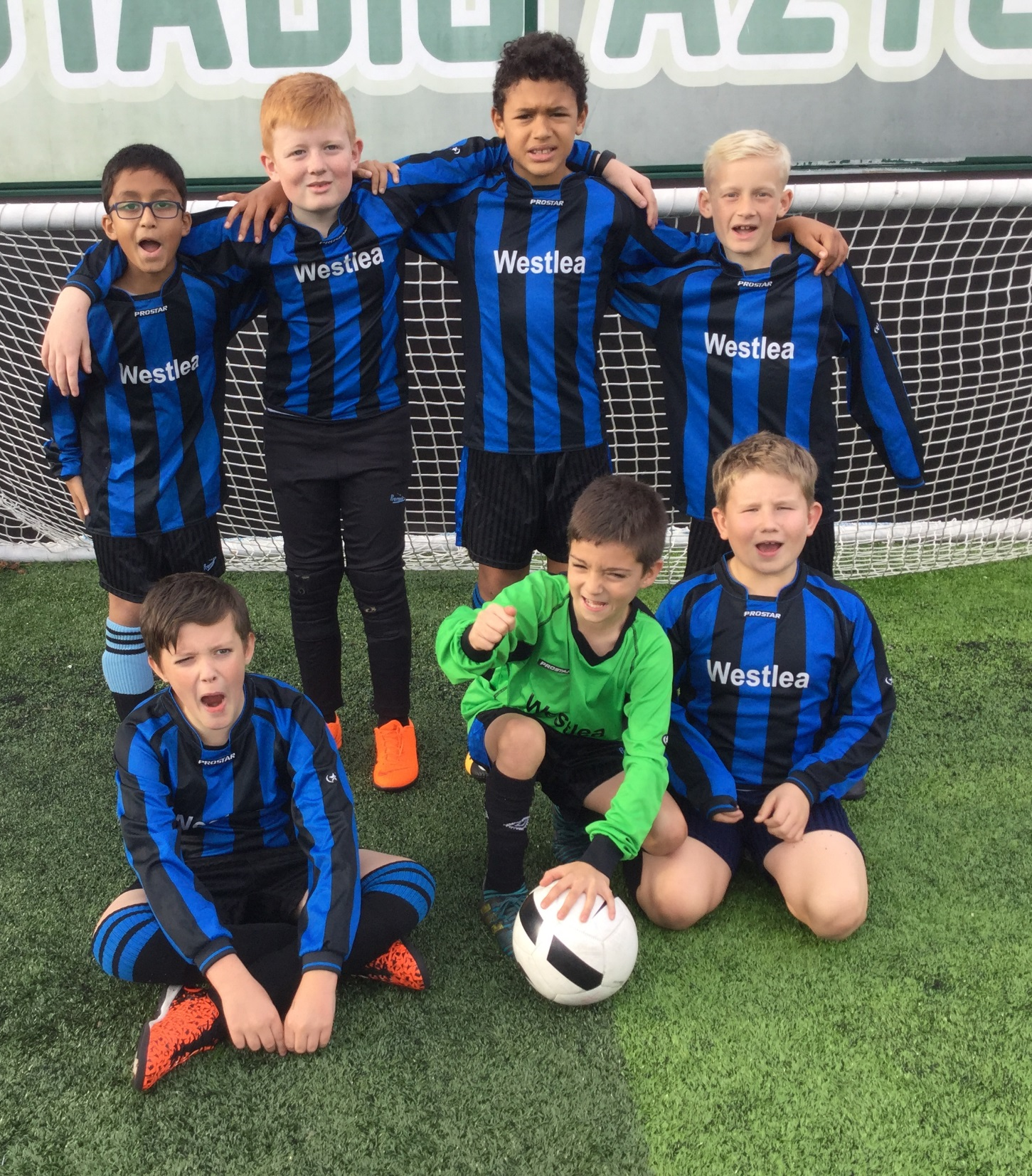
During your time at Upton Westlea you will have the chance to …
Be a joiner-inner, by being part of a school club, representing the school, helping out ….

Slide 9
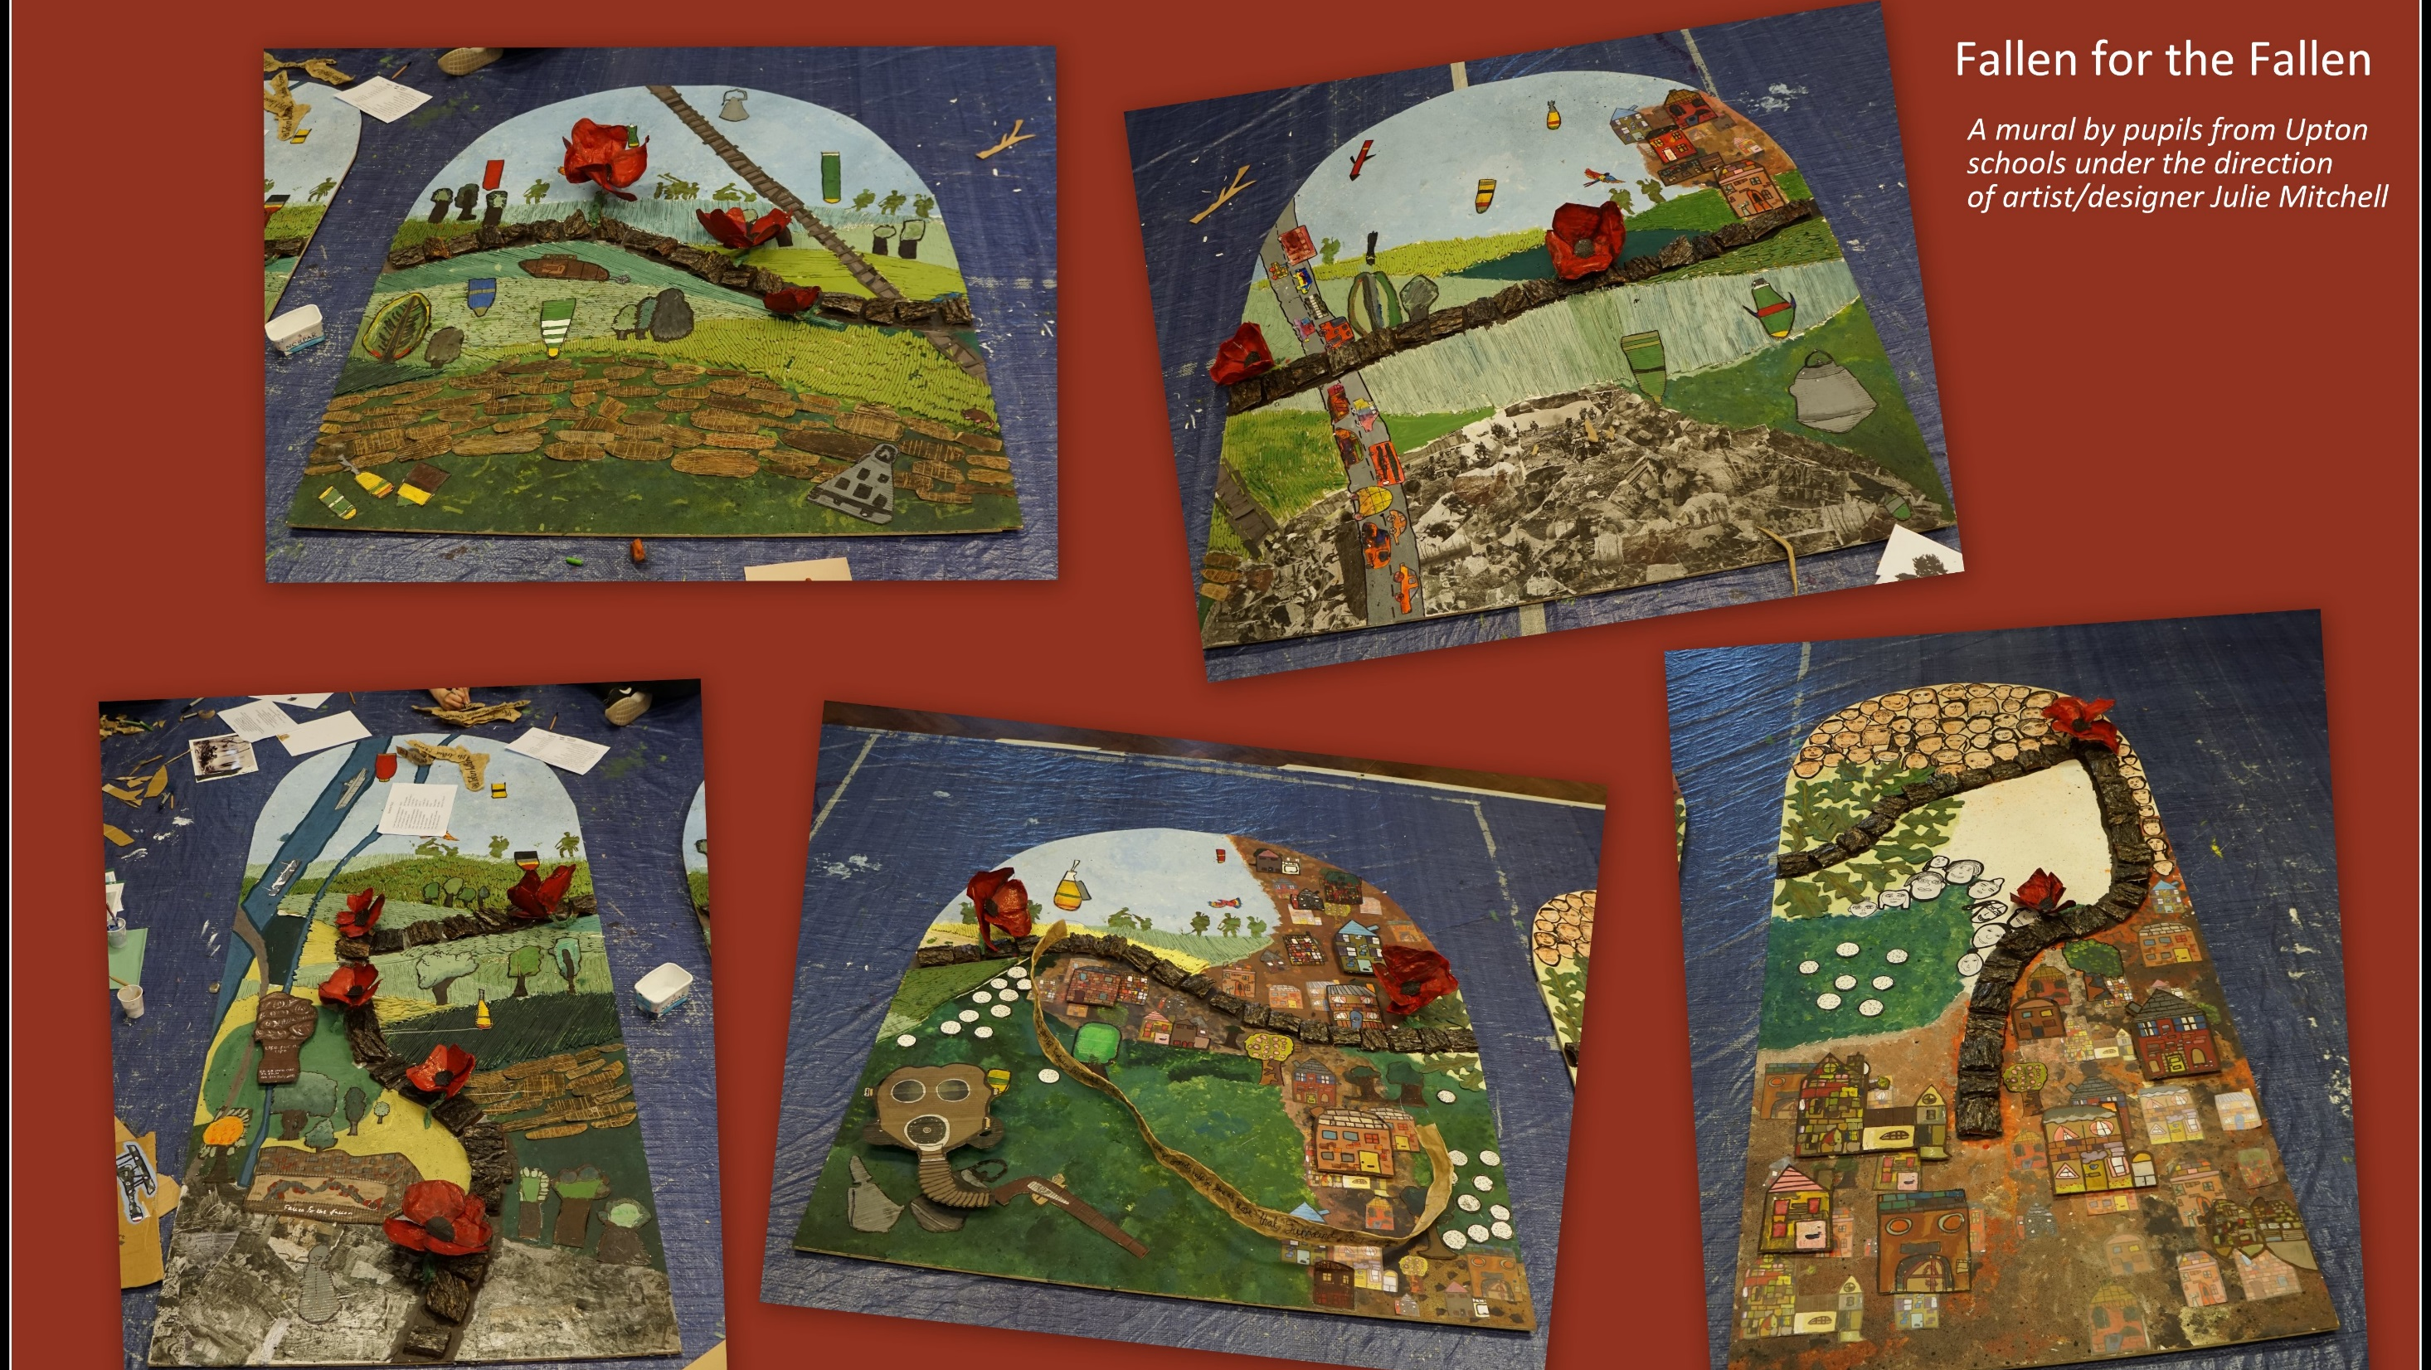
During your time at Upton Westlea you will have the chance to …..
Be Aware, by understanding & responding to current events, being a reporter, celebrating important occasions ….

Slide 10
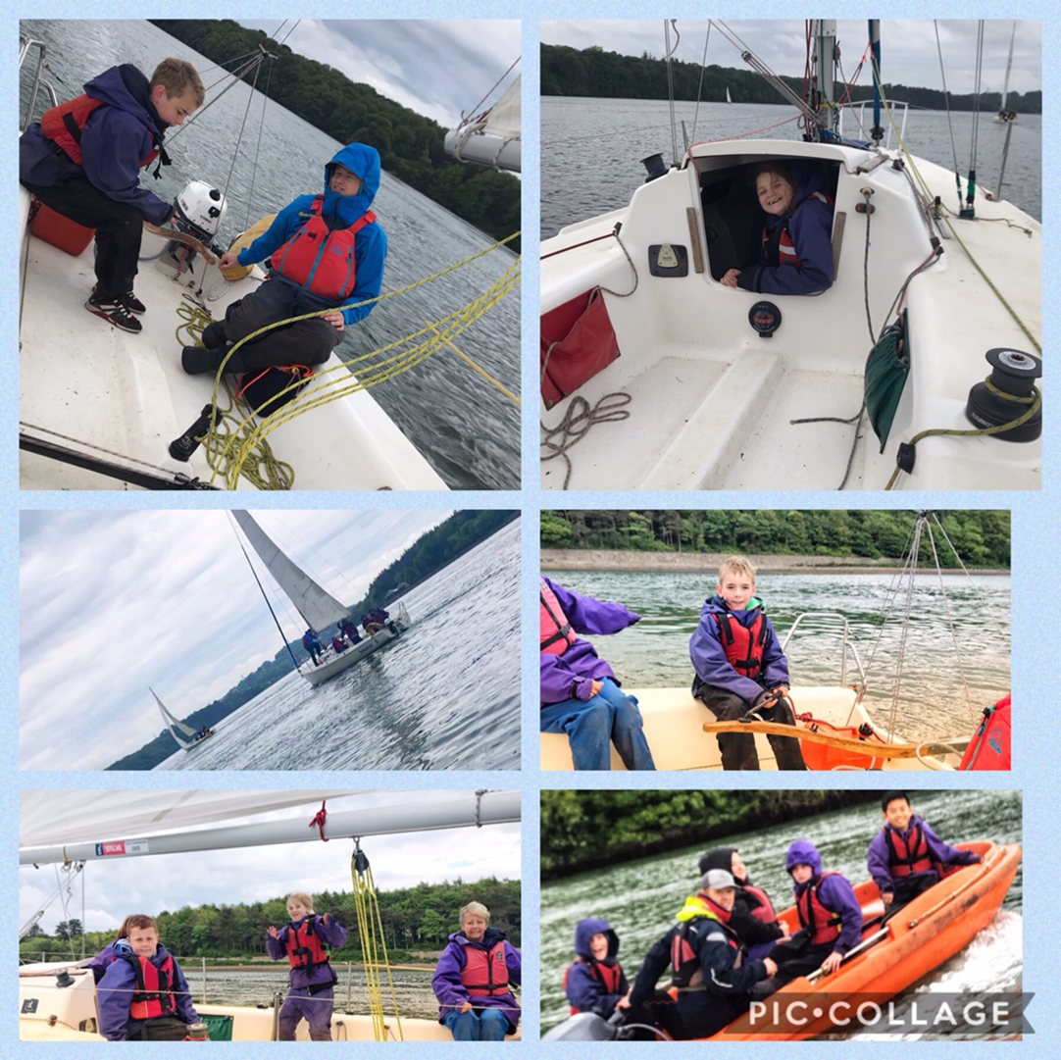
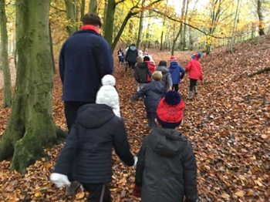
During your time at Upton Westlea you will have the chance to …
Be an Explorer, by investigating outside, visiting places near and far (and may-be staying there) ..

Slide 11

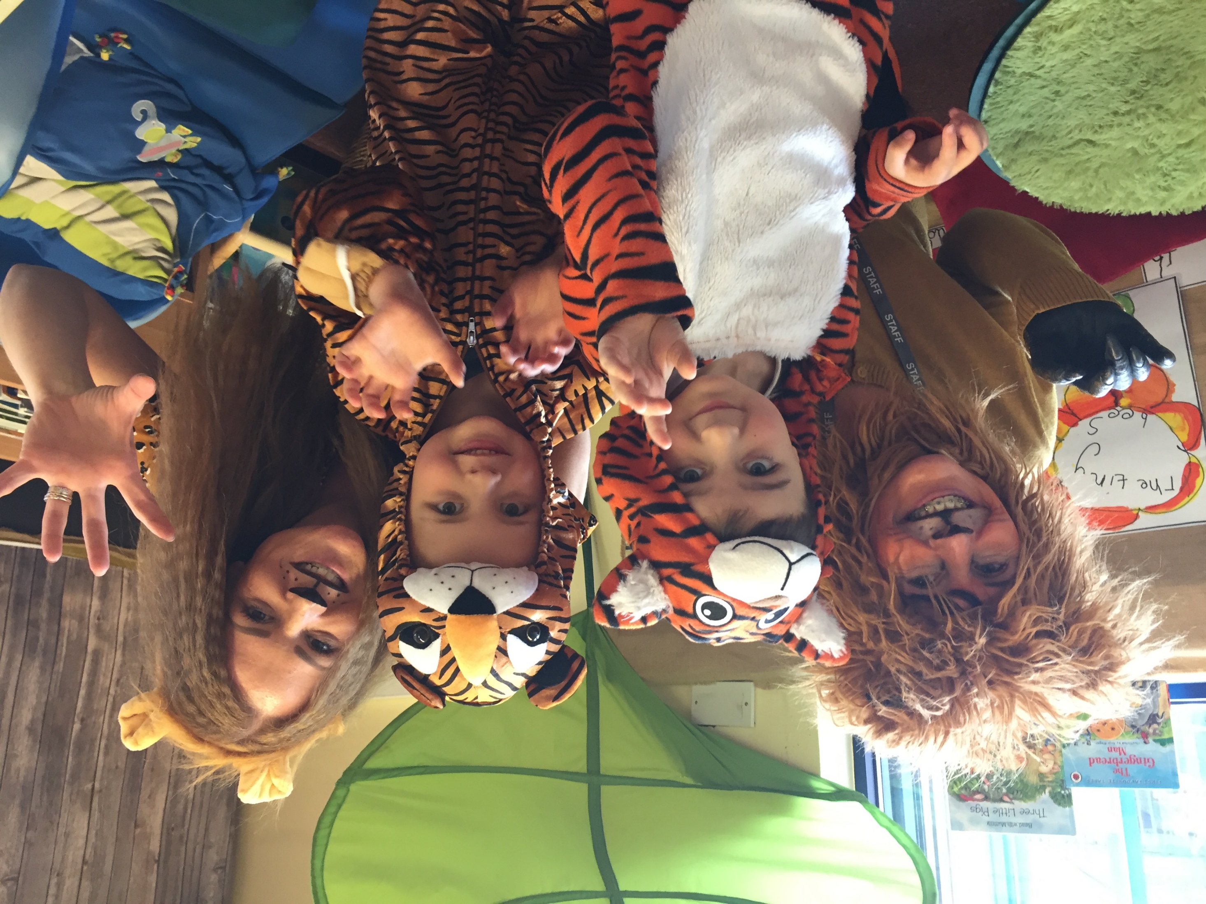
During your time at Upton Westlea you will have the chance to …
Be Nature-smart, by gardening, weather-watching, learning in and about different environments, learning about animals …

Slide 12
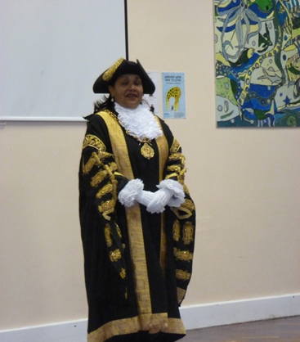
During your time at Upton Westlea you will have the chance to …..
Be Inspired, by meeting different people …

Slide 13
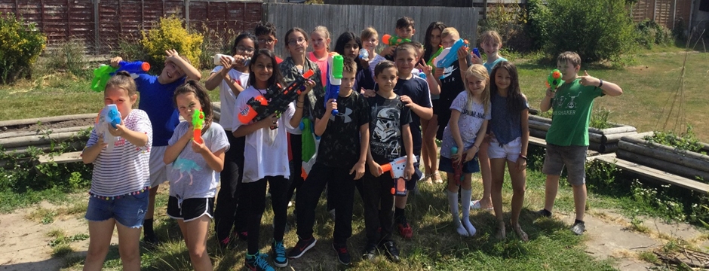
During your time at Upton Westlea you will have the chance to …
Be a child! By playing, making friends, co-operating, having good manners, making a mess, being uninhibited ….

Slide 14
Feedback:

