Slide 1


Promoting resilience in children
For more information about the original creator of this training content, please see…
Creative Education
PookyKnightsmith.com
Youtube.com/pookyh
@PookyH

Slide 2
Introduction
What is resilience?
We all need resilience. It has been defined as the ability to recover quickly from adversity (tough times) and the ability to carry on when faced with challenges. Good resilience is shown when we are able to adapt with emotional and behavioral flexibility when demands are placed on us. Resilience is therefore key to enjoying and engaging in school as well as supporting well-being.
We believe it is a key characteristic of mentally healthy individuals.
Why might children lack resilience?
If they do not experience strong supporting relationships and experiences from the 4ps (see below)
How can you help?
Parents play a key role (as identified by Pooky, the author of the original presentation) in promoting and strengthening resilience in their children. Other factors are peers, problem solving and passion (the 4ps).

Slide 3
The 4 Ps…
Parents
Over the next few slides, I will explain how each of these protective factors can help to build, support and maintain resilience in children.
Peers
Problem-solving
Passion

Slide 4

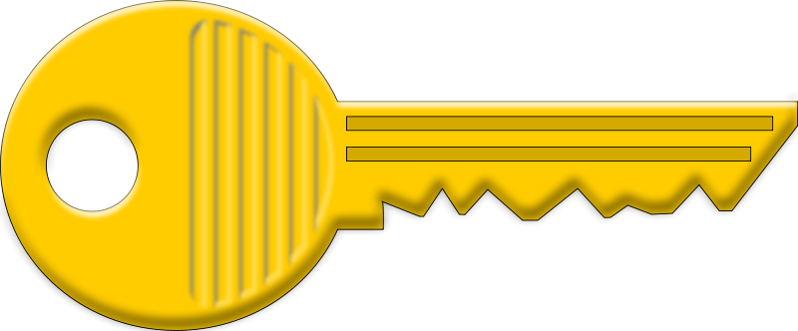
Parents
A nurturing, caring, rule-enforcing relationship with a parent, carer or adult figure.
In order to build the resilience of a child, the supporting adult can:
Offer a warm and nurturing environment that is physically and emotionally safe.
Spend quality time with your child and being fully present in the moment.
Provide clear and predictable guidance for your child consistently across situations and with other adults in the home. Structures and clear rules help to set boundaries for your child. It is shown that children will thrive with these types of boundaries as they know what is expected of them and that you will keep them safe because you are in control. Even when they cross those boundaries, a child’s sense of safety remains in place because rules are communicated clearly and are consistent.
Encourage and support participation in leisure activities by providing the means to access new experiences.
Act as a role model that the young person can look up to by taking the lead on sleep, diet, exercise.
Incite goals and inspire ambition so your child can look towards who they may be in the future.
A strong positive relationship

Slide 5
What may lead to a lack of resilience?
The environment may not support that basic need of safety.
Rules and structures in the home are not clear or consistent.
Children’s behaviour might not have any boundaries.
No quality time spent together between a trusted adult and a child.
A child never experiences something out of their comfort zone in a safe way.
The child does not see a role model with regards to healthy living.

Slide 6
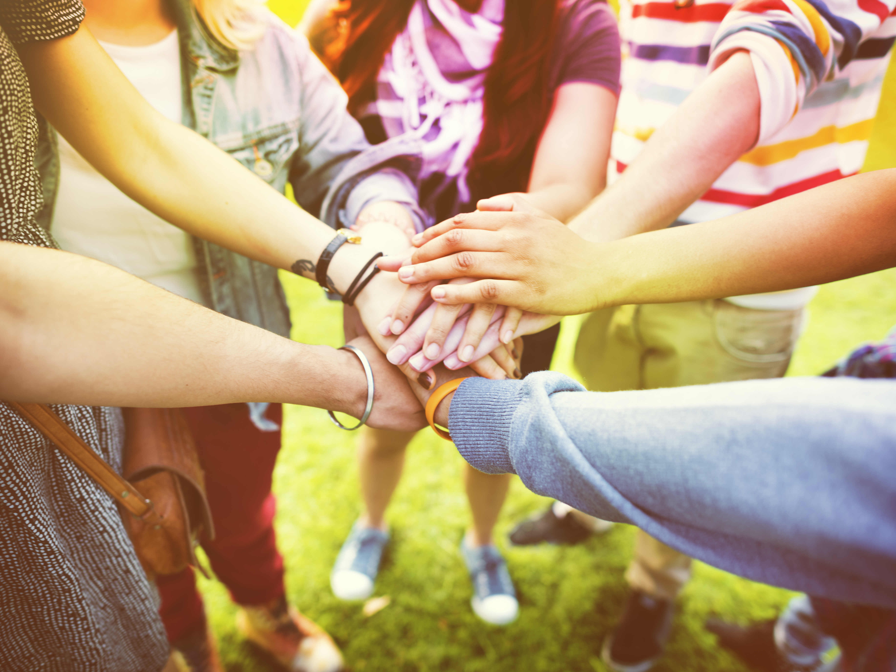
Peers
Social connectedness with a supportive peer group
Positive peer relationships are when a child:
Feels a sense of belonging and acceptance.
Identifies with a group, sharing likes, dislikes and opinions and this helps them to feel connected through their similar thinking.
Feels supported and respected and reciprocates these feelings within their peer group.
Has a few high-quality friendships rather than many superficial friendships.
This can include an online connection which some children find is an easier way to build friendships.
A social support group feels like our tribe

Slide 7
What may lead to a lack of resilience?
A child struggles to find a group of peers to identify with through similar interests and beliefs.
A child is unable to or not supported to access new opportunities to make friends.
When a young person is encouraged to leave a negative tribe then they should be supported to replace the shared beliefs and connectivity that will have been lost with a more positive social group.
The young person’s supportive circle has a negative influence on their beliefs and behaviour.

Slide 8
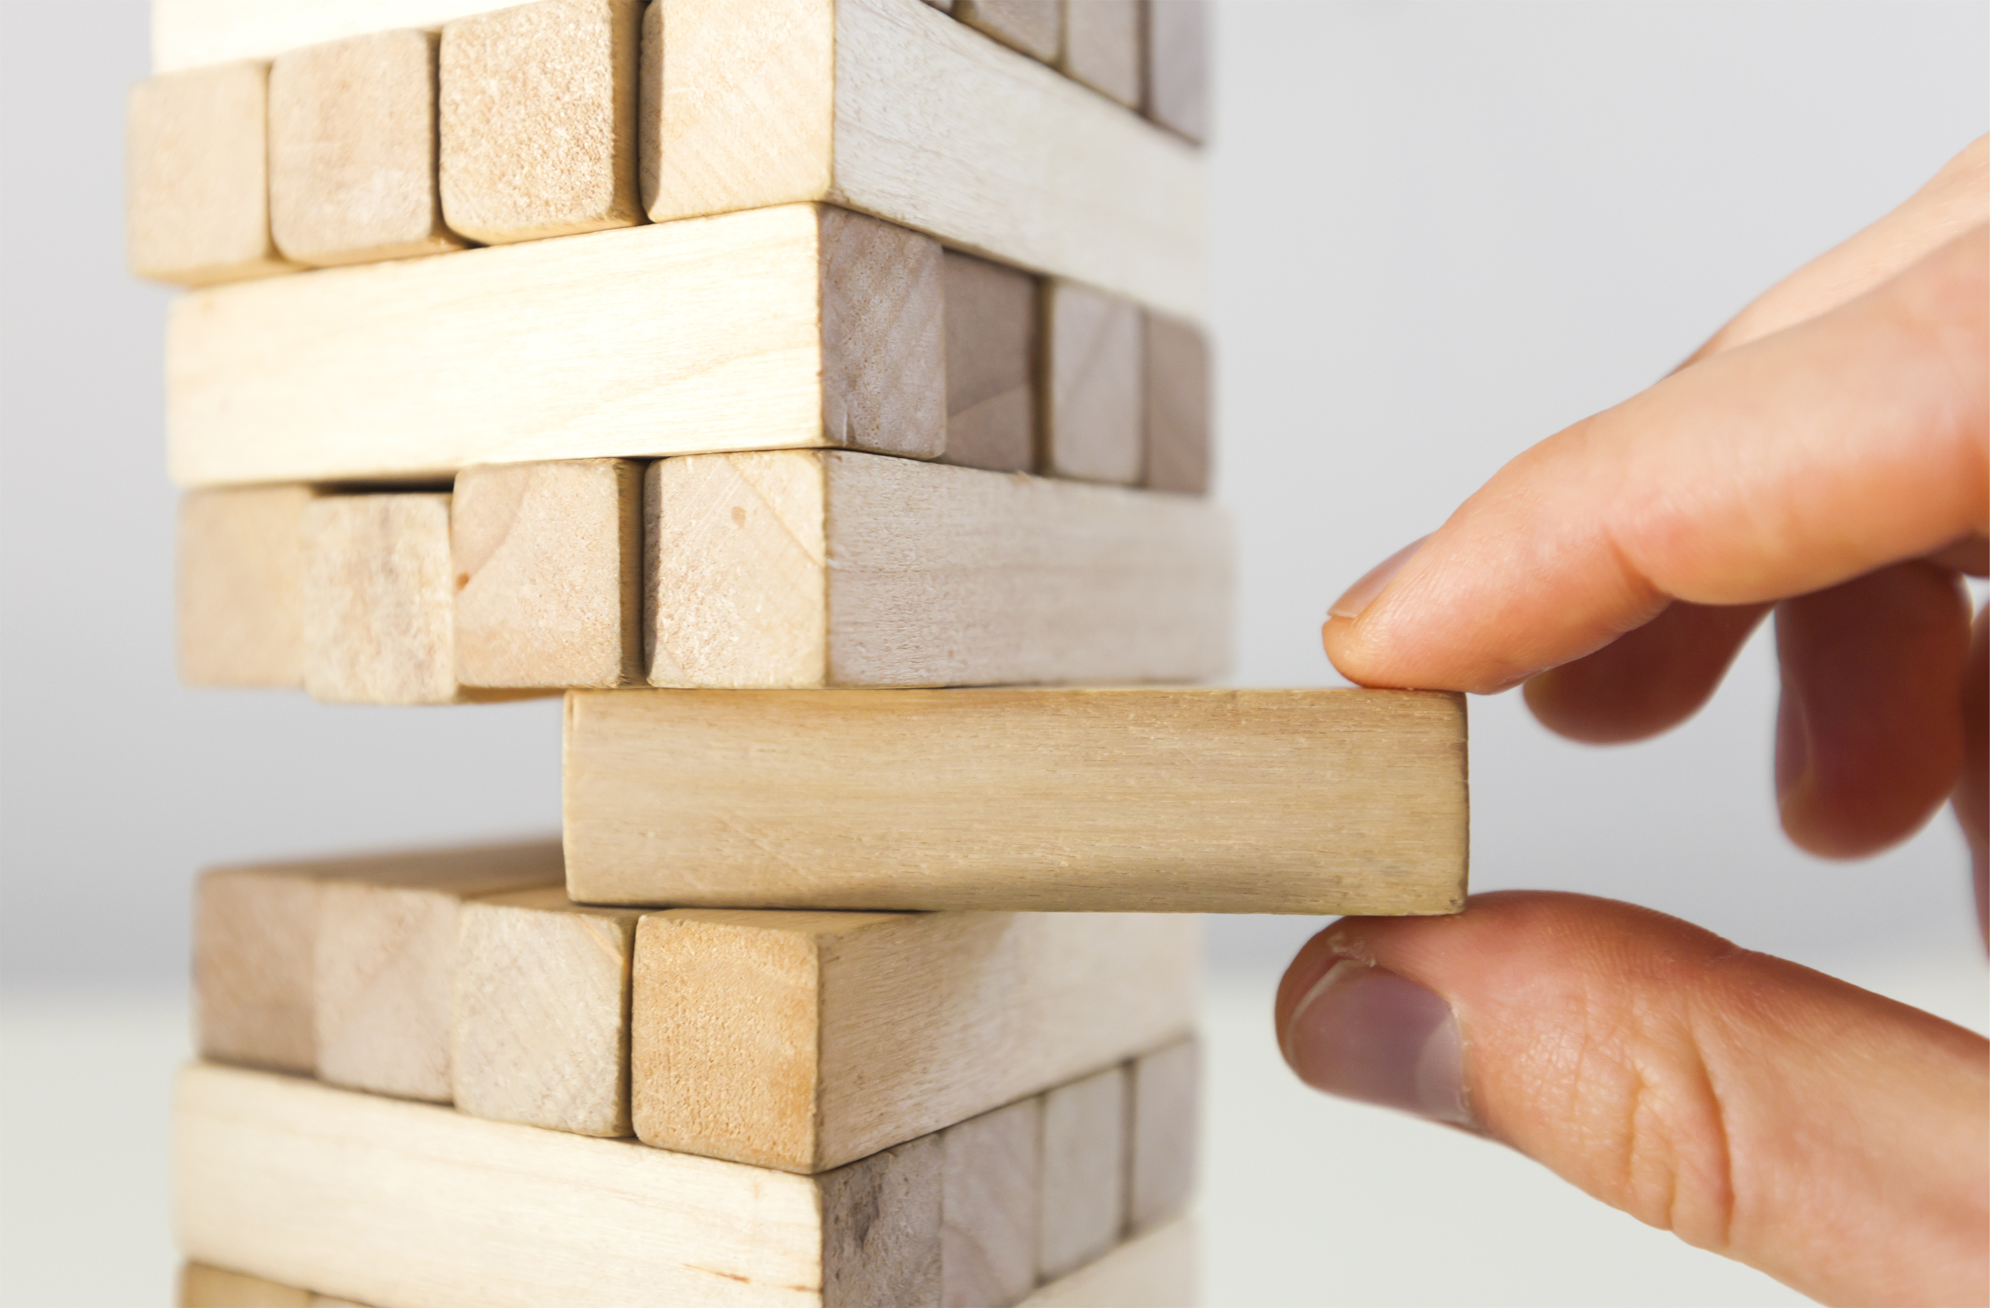
Problem-solving
The ability to problem-solve and communicate can moderate risk factors
When children can work through and discuss their problems then they are able to seek the help they need to overcome things that are difficult for them.
In order to develop problem solving skills, children need to experience some level of adversity throughout their lives. This may be tackling that bigger slide at the park, listening to and trying a new maths activity at school or joining a club that they have not tried before.
If children do not have problem-solving skills, they are less resilient to challenges and less able to deal with the feelings of not being able to do something or less able to seek help when it is needed.
Problem solving skills transfer across lots of challenges and can be taught everyday.
It is important for adults to respond in the correct way when children seek help.
Have a bank of skills to work through problems and seek help when needed.

Slide 9
What may lead to a lack of resilience?
A child has not been allowed to develop problem solving skills of their own perhaps due to lack of varied, challenging experiences.
The response to a child seeking help has not allowed the child to see how and learn how a problem has been resolved.
Age-appropriate risks have not been presented to the child as they were growing up.

Slide 10
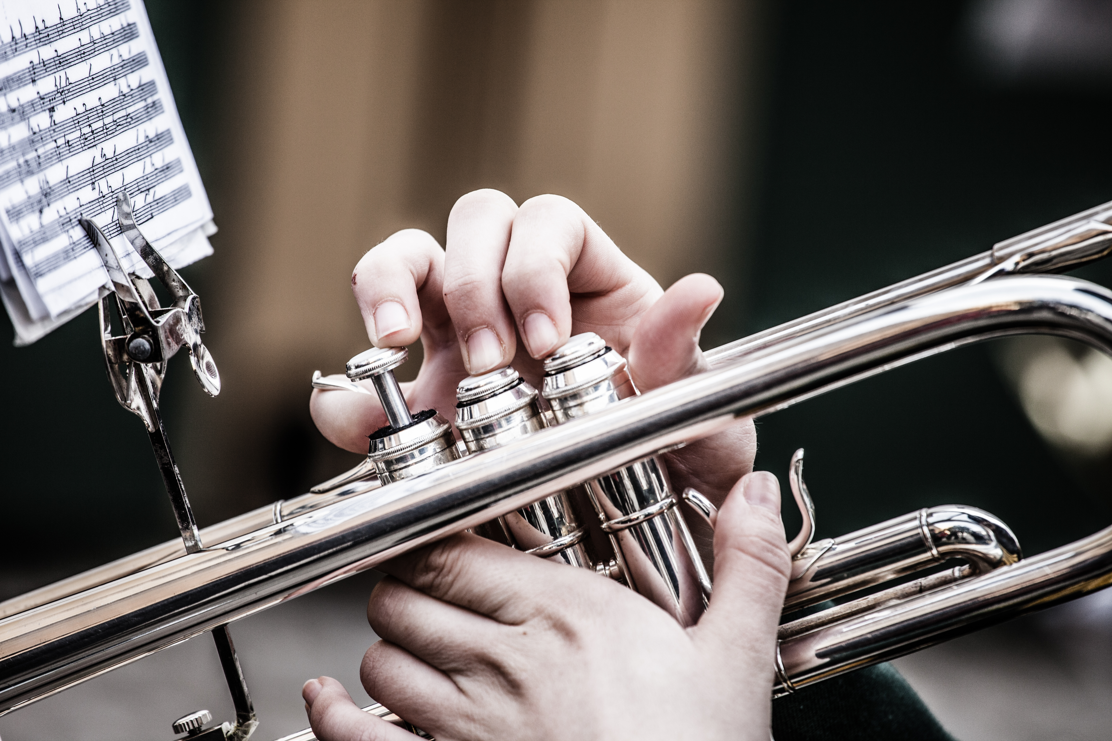
Passion
An interest, hobby or skill that the child highly values in themselves
Children have to have something that is theirs to build self-esteem and self-worth. We find our place in this world and know that we can contribute with our skills.
A hobby can be a coping strategy to manage worry and stress.
It will be part of who we are and something that we can show off and be proud of.
Hobbies or interests can link in with our peers which is another key factor to building resilience.
We help foster passion by teaching skills to children, talking about their interests and becoming more interested in what they value as well as helping a child to explore something if they are interested in it.

Slide 11
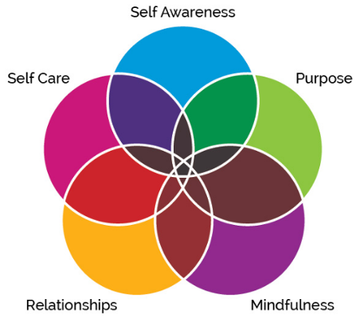
4 questions
Does your child have…
a supportive relationship with a trusted adult?
quality relationships with a group of friends?
good problem-solving skills?
an interest, hobby or skill?

Slide 12
