Slide 1
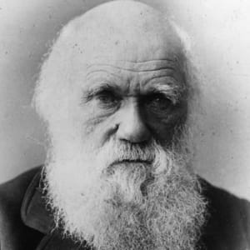

Vocabulary
English
In English, we are using the book ‘Jemmy Button’ and ‘The Island.’ The children will have the opportunity to write a discussion, letters and diary entries.
Computing
In Computing, we will be learning about computer programming specifically variables in a game using Scratch.
PSHE
In PSHE, we will be learning about rights and respect.
environment
emerge
flourish
terrain
evolution
endemic
extinction
natural selection
colony/colonise
temperature
variety
existence
accommodate
seamount
Science
In Science, we will be studying evolution and inheritance. The children will learn about how things have changed over time and how fossils provide information. They will also learn how offspring can vary and how animals have adapted to live in different environments.
Music
In Music, we will be exploring musical notation and consider how music teaches us about our community.
PE
In PE, we will be focussing on tag rugby and athletics.
Year 6 Spring 2
Maths
In Maths, we will be studying: area and perimeter and geometry. There will also be extra revision on previously covered topics. We will also continue to work on arithmetic skills.
End point
Children will have a deeper understanding of the concept of evolution and be able to raise questions and discuss ideas around this topic such as natural selection.
Art
In Art, our focus will be collage with a focus on the Merz movement.

