Slide 1
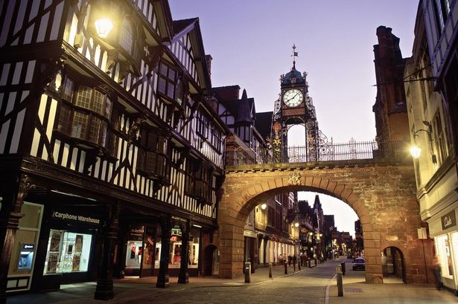

Vocabulary
English
In English, we are using the book ‘The Selfish Giant’ by Oscar Wilde to write a classic narrative.
Art
In Art, our focus will be paint and the study of colour through the seasons. This will include a study of Vincent Van Gogh.
Music
In Music, we will be working on a 3 part round called Dona Nobis Pacem.
community
determined
population
familiar
privilege
accommodation
urban
location
facilities
historic
accessible
services
CBD
rejuvenate
trespasser
Computing
In Computing, we will be creating media through 3D modelling using Tinkercad.
Year 6 Spring 1
RE
Are Humanistis and Christian ideas about science conflicting or complementary?
Science
In Science, we will be studying electricity and circuits. We will be learning how to change the brightness of a lamp or the volume of a buzzer. We will recognise and use symbols in circuits.
PSHE
In PSHE, we are using the book The Island by Armin Greder. We will also consider how to keep safe.
DT
In DT, we will be using Tinkercad (computer- aided design) to design an adventure playground.
Geography
In Geography, we will be completing some geography fieldwork based in Chester.
Maths
In Maths, we will be studying: perimeter and area, percentages, measures, ratio and proportion, algebra, triangles and angles. We will also continue to work on arithmetic skills.
PE
In PE, we will be focussing on handball and tennis.

