Slide 1


Eden Class
Meeting
2025 - 2026

Slide 2
Welcome to Eden…
Eden is our 15 place resourced provision at Upton Westlea for children with a
diagnosis of Autism, also known as ASC or ASD.
These children form part of the mainstream class numbers.
  Children can be integrated into mainstream when we can ensure their success and positive wellbeing.
Places within Eden are allocated by the SEN assessment and monitoring team at
Cheshire West and Chester.
All children who are allocated a place have a diagnosis and a EHCP (Education Health and Care Plan).

Slide 3
Useful things to know:
Snack money - £1.50 per week.
Forest school – Every Tuesday starting 9/9/25
    £2 donation per half term.
    Warm clothes.
    Waterproof coat.
    Hat and gloves when needed.
    Change of clothes.
PE sessions – Every Monday and Friday.
Label all clothing.
Key dates for Eden will be sent home.

Slide 4
Staff
Mrs Field – Class Teacher
Mr Ellinson – Forest School Teacher Tuesday a.m.
Mrs Carline – Teaching Assistant.
Mrs Gerrard – Teaching Assistant.
Mrs Gittins – Teaching Assistant.
Mrs Broadbent – Teaching Assistant.
Mrs Fenton – Teaching Assistant

Slide 5
How do we support children in Eden?
Children with Autism need to see a reason for complying.
Working for approach.
      Choosing time.
      Mini motivators.
A highly predictable routine.
High levels of visual clues – This can be objects of reference,
photographic or symbolic visuals. This is dependent on the age
and stage of the child.
An environment that is not over stimulating.
Sensory Processing considerations.

Slide 6

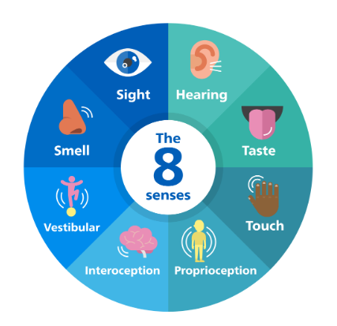
How do we meet the needs of the children in Eden?
Meeting sensory needs:
    Alerting Activities, Organising Activities and Calming Activities to meet the needs of the 8 senses.
    Sensory Circuit.
    Seat based sensory support.
Therapeutic learning:
    Horse Riding.
    Forest School.
    Art.
Personalised learning:
  EHCP prioritised – 4 areas of need.
  Prioritising interests.

Slide 7
How do we support children in Eden?
Children are taught at their own level. We do this by:
    Grouping children according to their needs.
    Prioritise the outcomes within the EHCP.
    Personalised Learning plan.
      4 Areas of need:
        Communication and Interaction.
        Cognition and Learning.
        Social Emotional and Mental Health
        Sensory and Physical.
    Working together to achieve those targets.

Slide 8
Groups
The class is currently split into 4 groups:
  Seedlings.
  Little Acorns.
  Mini Oaks.
  Mighty Oaks.
Children are placed into groups according to their age and stage, but will potentially cross into different groups according to their needs within any given particular session.
E.g A child may be a Mini Oak and sit with this group at morning challenge, but will receive their English teaching within the Little Acorn group.

Slide 9
How do we support children in Eden?
Small group work.
1:1
Integration into mainstream.
Supporting individual sensory needs.
Working together – Home – School.

Slide 10
How do we support children in Eden?
The curriculum:
  Core subjects and foundation subjects (a broad and balanced curriculum).
    See class web page for details on timetables.
    Upton Westlea Primary School: Eden - ASC resourced provision
  EYFS – What it looks like in Eden and why.
  Phonics and Early Reading Little Wandle is utilised, but a bespoke approach is taken.
  Learning for pleasure
  Using a multi sensory approach, children are taught in small groups, 1:1 or 1:2 at various points in the day.
  Personalised learning: Pupil Passport, Personalised Learning Plan and personal target setting.
Any Questions?

