Slide 1
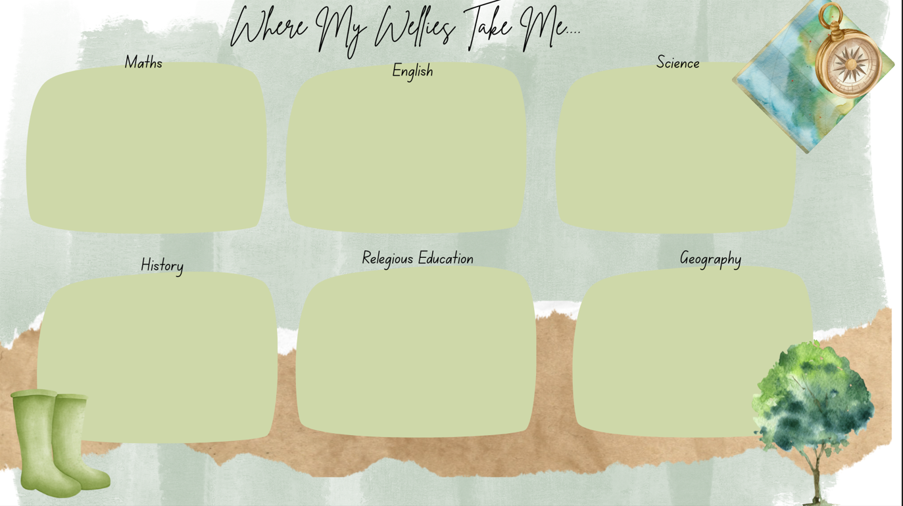


Place Value
Comparing, ordering and rounding numbers
Four Operations
+ - x
Performance Poetry
Michael Rosen – Chocolate
First Person Recount as Leon from
Leon and the Place in Between
Forces
Push and Pull, Friction,
Magnetic Pull and Force
States of Matter
Solids – Liquids – Gases
Religious Education
Great Britain
Who are we?
Identifying human and physical features of Britain with particular reference to rivers
Prehistory
Od Stone Age to New Stone Age
How did Britain change during the periods of the Old Stone Age and New Stone Age?​
Kingdom of God
How does Jesus Change Lives?
People of God
Important Values
Jesus light of the World

Slide 2

Trip to Weaver Hall Museum Northwich
Experience the Stone Age
Mindfulness
Game Sense
Dance
Problem Solving
On these days we will immerse ourselves in the subject of DT, Art and Computing.
Looking at the work of Monet and the impressionist movement
Understanding primary colours, shades and techniques to then recreate a Monet
Understanding Bridges
Identifying how bridges are strengthened, build a variety of bridges including a Truss Bridge from wood using tools and joins.
Year 3 - creating a stop go animation
Year 4 – creating a Podcast, recording and editing audio.

Slide 3
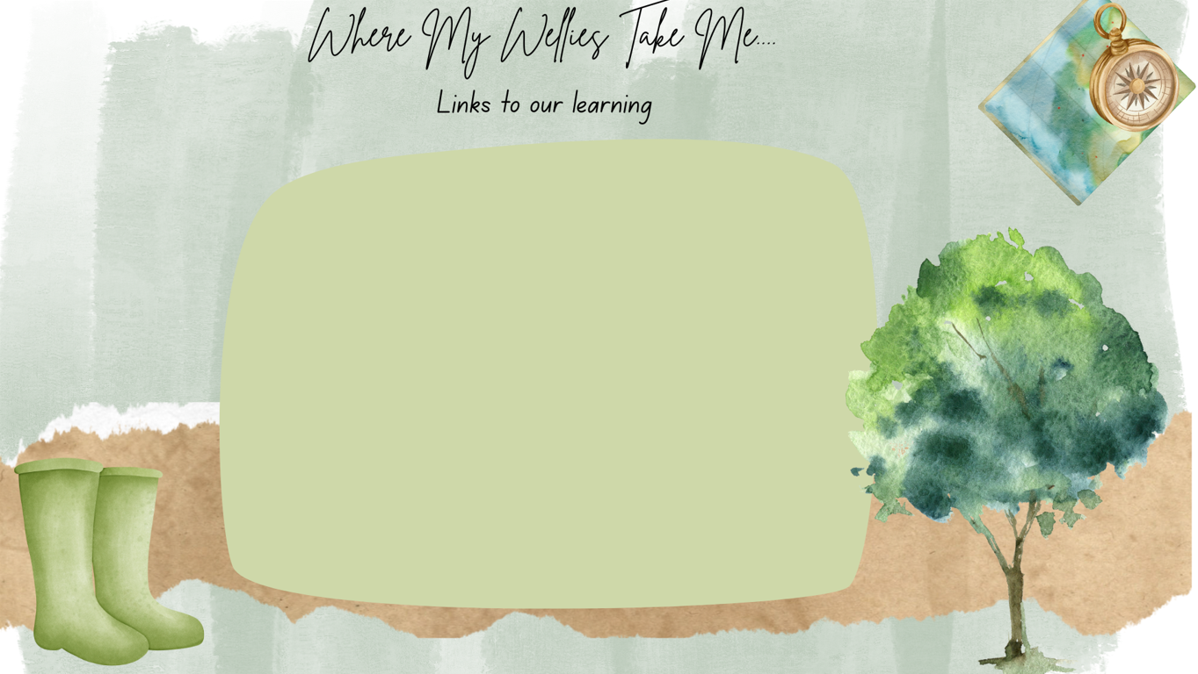
Many resources are available on line
Remember to utilise the excellent Read Theory and TT Rockstars Apps that your children have their own personal account for learning! This is independent learning but please support their focus.
Other Apps
https://www.topmarks.co.uk/maths-games/hit-the-button
Excellent for number bonds, doubles, times tables!
https://www.bbc.co.uk/bitesize/articles/z7mjmbk
BBC bitesize has lots of resources in a safe environment – check them out!
Instagram Year 3 Lewis Carroll
Year 4 Cressida Cowell

