Slide 1

Welcome to
Nursery & Reception
September 2025

Slide 2
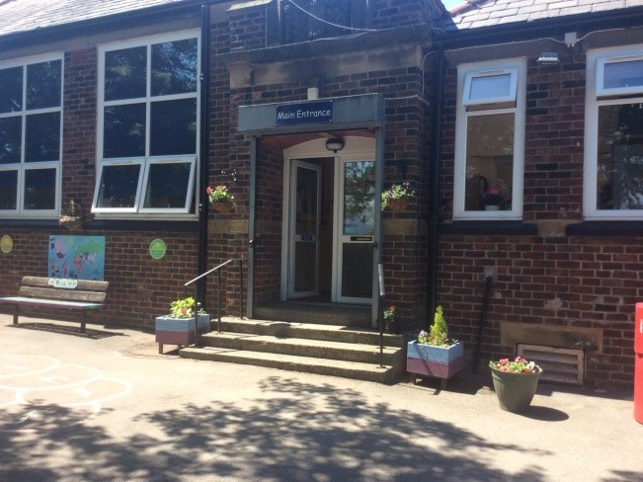
The School Day
Nursery
Arrive 08:45 am – 08:55 am
15 hours morning session 9 am – 12 pm
30 hours morning session 9 am – 11:45 am
Lunchtime 11:45 am – 1 pm
Afternoon session 1 pm- 3 pm
Leave at 3 pm
Reception
Arrive 08:45 am – 08:55 am
Morning session 8.55 am – 12pm
Lunchtime 12pm – 12:45 pm
Afternoon session 12:45 pm - 3:10 pm.
Leave at 3:10 pm

Slide 3

Snack
Nursery
Reception
We ask for a donation of £5 per half term (£30 for the year.) This pays for snacks such as breadsticks, toast, yoghurts.
Each child receives a piece of fruit daily.
Milk is available (free for children under 5).
Children can bring a water bottle with them each day and this should be labelled with their name.
Children are provided with free fruit for snack.
Milk is available (free for children under 5).
Children can bring a water bottle with them each day and this should be labelled with their name.
Children in Reception DO NOT need to bring any other food to school for snack.

Slide 4
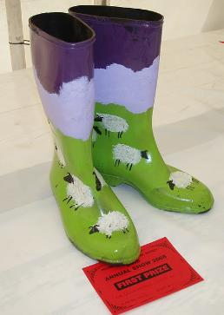
What to Bring
Nursery
Reception
Spare labelled clothes in a bag. A few sets please, including socks.
Wellies.
Outdoor clothing that is appropriate for the weather.
Water bottle.
Spare clothes.
Wellies.
Outdoor clothing that is appropriate for the weather.
P.E. Kit.
Water bottle.
Book bag.
Please ensure that all belongings are labelled and that your child knows what belongs to them.

Slide 5

Communication
Everyone will be given a log in code for seesaw. Please register as soon as you receive this.
(Returning Nursery children will need to reregister with new code.)
Class letters, homework, important class messages will be posted on seesaw.
Parents and carers will be able to post pictures, videos and notes - “wow moments”
Please keep seesaw as a tool for us to share children’s achievements and not general messages.
Should you need to tell us something about your child for example, they are tired due to trouble sleeping please tell the adult at the door.

Slide 6
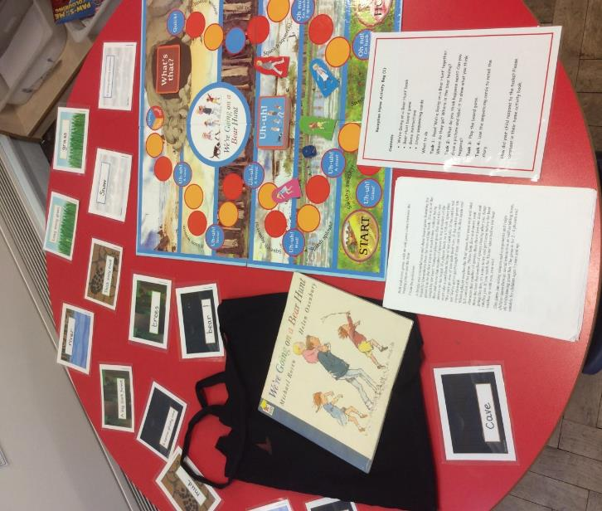
Learning at Home
Nursery
Weekly seesaw activities, these may simply be challenges such as practicing new skills or a task to complete.
Reading books and Reading Records
Books to be read at least 3 times a week at home
Home Activity Bags or ‘Think Equal’ tasks.
To be brought back on set days.
Keep an eye on seesaw
Reception

Slide 7
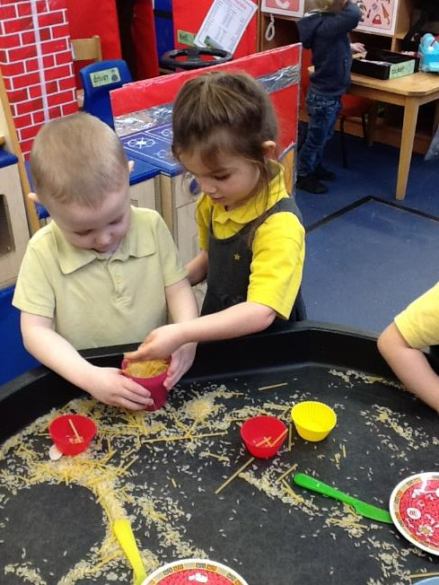
Learning in EYFS
Learning in the EYFS is play based.
Children learn through a combination of adult focused and child-initiated activities.
Learning happens both indoors and outdoors.
Activities are carefully planned following children’s interests, next steps and alongside a chosen theme.

Slide 8
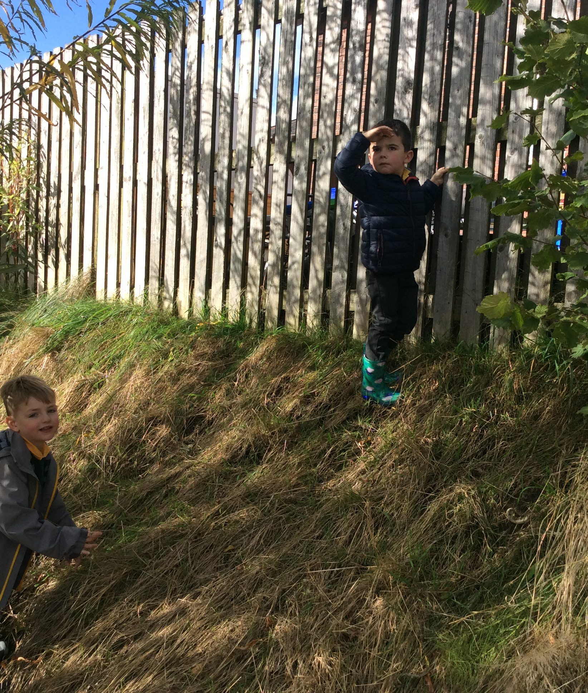
Forest School
Children need a pair of wellies to be kept in school.
School provide suits.
All weathers.

Slide 9
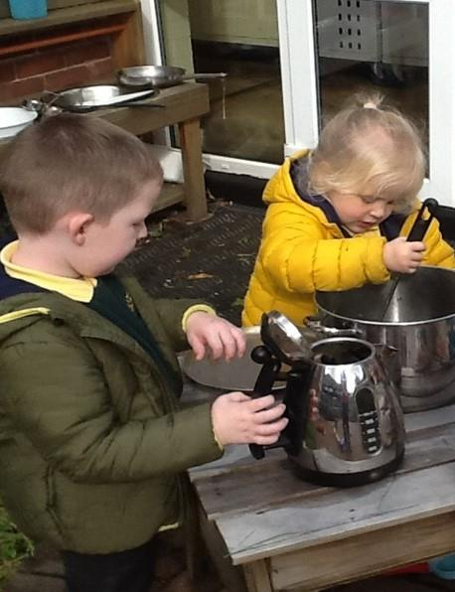
Nursery Readiness
We would like children to be able to use the toilet independently.
Manage hygiene needs e.g. handwashing, blow nose with a tissue and put it in the bin.
Put on their coat.
Change shoes to wellies and back.
Ask a grown up for help when needed.
Use a knife, fork and spoon.
Drinking from a cup.
Be able to open their
water bottle.

Slide 10
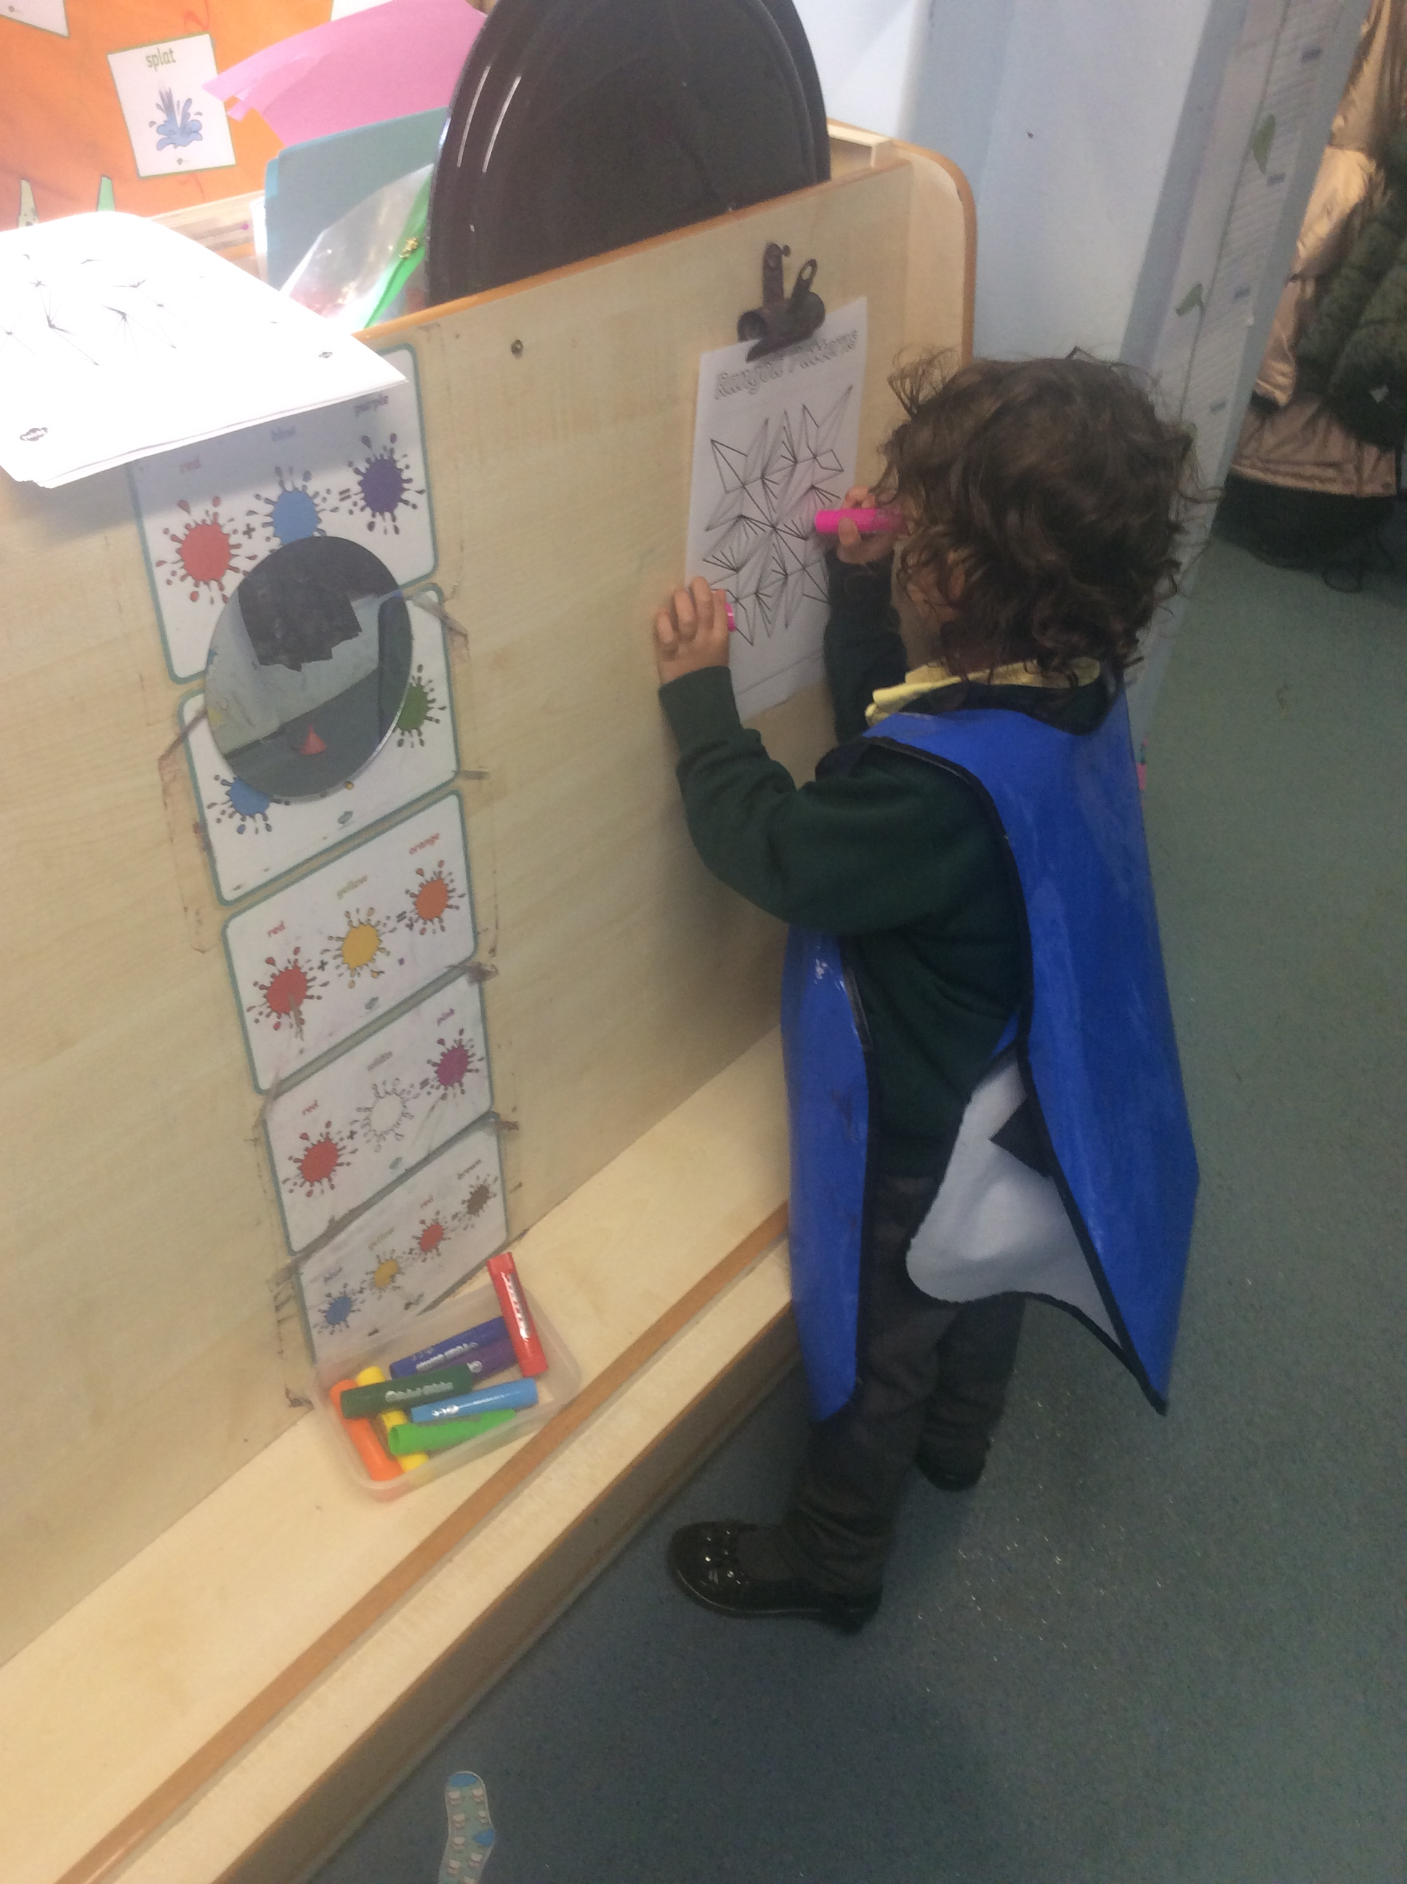
Reception Readiness
Able to recognise and write their own name.
Get dressed and undressed independently including socks and shoes, the children will need to do this for their PE sessions.
Fasten a coat this includes zips and buttons.
Follow a series of instructions.
Use a knife, fork and spoon competently.
To know who they can ask for help.

Slide 11
Independence
Throughout both Nursery and Reception we will be focusing on children developing their independence.
This goes beyond the ability to use the toilet or to get dressed.
We will be encouraging all the children to ‘have a go’ this builds resilience and provides a sense of achievement.
You can help at home by:
Encouraging them to help tidy away their toys and put their rubbish in the bin.
Carrying their own bag and water bottle to school.
Walking to school rather than using the buggy.
Retrieving things they want at home for themselves.
We understand sometimes life is hectic and busy but planning that little extra time for children to grow their independence is so valuable.

Slide 12
Reception
Baseline Assessment
The children will complete a Baseline Assessment on entry to Reception.
Assessment completed during the children’s first few weeks in Reception.
This is a statutory assessment from September 2021.
Short task-based assessment that looks at children’s literacy, maths and communication and language skills as they enter Reception.
The purpose of the assessment is to measure children’s progress from the start to the end of their time in primary school.

Slide 13
Communication and Language
There has been a decline in early language skills nationally, because of this it has become a high priority for us in school.
There are simple things that you can do to support your child:
Not using a dummy.
Sharing a book everyday.
Limiting screen time.
Encouraging questions.
Having conversations.
Singing songs and nursery rhymes.

Slide 14
Shonette Bason
“A child needs 50 words by the time they are two and 300 by three. Within their time in Nursery they need to grow their vocabulary by 3700 words! In Reception another 5000!
Early Years should never be quiet.”

Slide 15
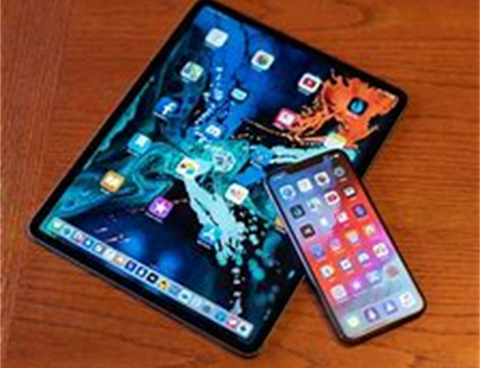
Technology
Children now have access to a wide range of technology.
It can be very easy for young children to click on something inappropriate and this can be represented in their play.
Please be mindful of age ratings on games and video clips etc.
Use Kids YouTube where possible.
Supervise children when they are using technology such as iPads, games consoles, mobile phones etc.
Always set parental settings on devices and apps.
Remember the importance of play!

Slide 16

Early Years Curriculum
Messy Play
We are very creative in EYFS and with that often comes mess.
If your child comes home with mud, paint or glue on their hands, and often faces, it is a sign they have had great fun and important learning has taken place.
We apologise in advance for any uniform that needs a good wash at the end of the day!

Slide 17
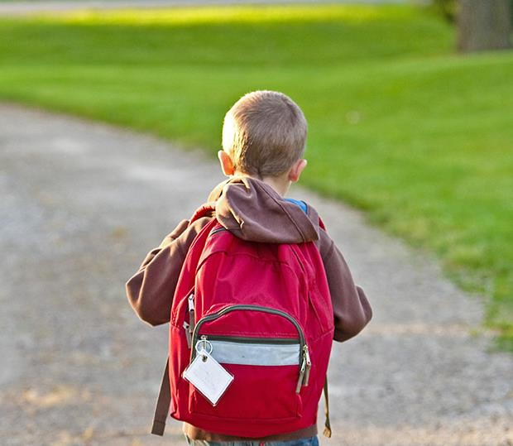
Thank You!
EYFS Team

