Slide 1

Welcome to year 3

Slide 2
Welcome to year 3
Mrs Coulter teaches Monday – Wednesday and Miss Docherty teaches on Thursday and Friday.
Mrs Pallister and Mrs Cox are the Teaching Assistants supporting year 3.

Slide 3
Welcome to year 3
Homework will be given out Fridays to be returned the following Wednesday.
Homework will include spellings (Weekly ) with English and maths alternately.
If not completed your child will be asked to complete at Wednesday break.
Homework will be a paper copy.
Any problems with homework tell Miss Docherty or Mrs Coulter at any time.

Slide 4
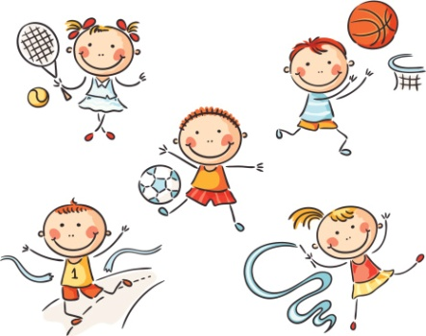
Welcome to year 3
PE will be on Wednesday and Friday.
Please make sure you have a full PE kit for both days including a jumper as some of the PE sessions will be outside.

Slide 5

Welcome to year 3
In year 3 your child will need to read at least 3 times a week, and you need to record this in your reading record.
It is ok for your child to occasionally record in their reading record.
It’s lovely to hear which books you have liked reading.

Slide 6
Topics included in year 3
 | Term 1A | Term 1B | Term 2A | Term 2B | Term 3A | Term 3B
Umbrella Theme | ME, MYSELF AND I | WHAT A WONDERFUL WORLD! | DISCOVERY DETECTIVES | TIME TRAVELLERS | AMAZING ANIMALS | LOCATION, LOCATION, LOCATION
Class Theme | How far can you throw your shadow? | What makes the earth angry? | Can you feel the force? | Who first lived in Britain? | What are the ‘Bear’ necessities of life? | How has Greece changed over time?
In year 3 the children learn Spanish with a Spanish teacher on Tuesday morning.
We will also do recorders on Thursday afternoon this term.

Slide 7

Notes:
At Livingstone we have a school street. Every morning and afternoon the bottom of Old Brow to the school is closed to vehicles, making it safer for our children to walk, wheel or scoot to and from school and preventing congestion at the gates.
Our school street relies on volunteers – parents, grandparents and friends – who spend 30 minutes a week helping to keep their kids and their friends healthy and safe. If we don’t get more volunteers, we won’t be able to keep it running.
Can you spare half an hour to help? You’ll get training, there’s free childcare at Littlestones if you’re dropping off / picking up, and it’s a great way to get to know the school and other parents and carers too.

Slide 8
Welcome to year 3
Any questions

