Slide 1
Teach reading: change lives
Parent workshop: Phonics and early reading in Reception, Phase 2
(Autumn 1)
Notes:
For this presentation, you will need to download and print out the following resources and information for parents:
Phase 2 grapheme information sheet – Autumn 1
the parent handout ‘Your child’s reading journey – Reception Autumn term’
the Phase 2 and 3 grapheme mat
the Little Wandle Progression overview
‘Phase 2 tricky words: Reception Autumn term – Information for parents and carers’ – or parents can access this in the ‘For parents’ area of the Little Wandle website.
You will need a flipchart and access to the Little Wandle and Collins websites.
You may also wish to have a copy of the Little Wandle Glossary to hand (in Getting started/Teaching).

Slide 2

Phonics

Slide 3

Little Wandle Letters and Sounds Revised
Our school has chosen
Little Wandle Letters and Sounds Revised as our Systematic Synthetic Phonics (SSP) programme to teach early reading and spelling.
Notes:
Slide purpose:
To inform parents that all schools must teach phonics in Reception, but explain your school's choice of SSP
Suggested script:
The National Curriculum specifies that all schools must teach children to read using phonics in Reception.
Read the slide.

Slide 4
Phonics is:
making connections between the sounds of our spoken words and the letters that are used to write them down.
Notes:
Slide purpose:
To provide a simple definition of phonics
Suggested script:
So what is phonics?
Read the slide.
It sounds complicated but it really isn’t!
Let's learn some important words that will help you understand phonics ...

Slide 5
Terminology
Phoneme
Blend
Grapheme
Segment
Digraph
Trigraph
Notes:
Slide purpose:
To give simple definitions of key terminology
Notes:
Explain what each word means – use the Glossary to help.

Slide 6


In the Autumn term we teach phase 2
Notes:
Slide purpose:
To provide an overview of the Phase 2 sounds
Suggested script:
We usually teach four new sounds a week and have a review lesson on a Friday.
You will get a list of the sounds that we are learning to have at home. This will help you with letter formation (handwriting) and pronunciation.
Give the Phase 2 grapheme information sheet for Autumn 1 to parents.

Slide 7
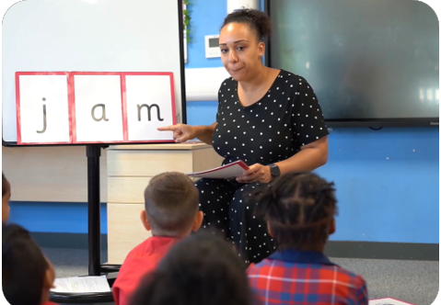
We teach blending so your child learns to read
Teacher-led blending is taught throughout Phase 2.
Our aim to is to teach every child to blend by Christmas.
We will inform you if your child needs additional practice.
Notes:
Slide purpose:
To introduce blending
Suggested script:
Teacher-led blending is teaching children how to blend, directed and demonstrated by the teacher.
It is repeated daily in the Autumn term.

Slide 8

Blending to read words
Notes:
Slide purpose:
To provide an overview of blending
Suggested script:
Some children learn to blend really quickly, and others take a little longer.
If your child is finding it difficult, ask your child’s teacher for ways to help at home – playing blending games at home is so helpful!
Show parents the ‘How we teach blending’ video from ‘For parents’ area of the website: https://www.littlewandlelettersandsounds.org.uk/resources/for-parents/

Slide 9
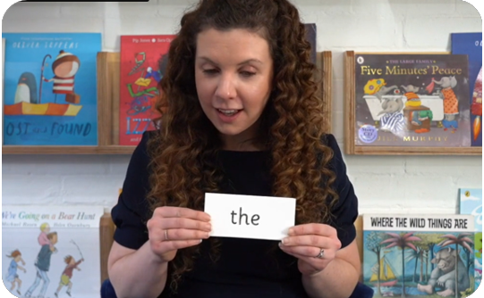
Tricky words
These words have unusual spellings e.g. he, the, was.
They are taught in a systematic way.
Children are now learning to read the Phase 2 tricky words: is, I, the, put, pull, full, as, and, has, his, her, go, no, to, into, she, push, he, of, we, me, be.
Notes:
Slide purpose:
To introduce tricky words
Notes:
Read the slide.
You may wish to give parents a copy of the document ‘Phase 2 tricky words: Reception Autumn term – Information for parents and carers'.

Slide 10
Reading and spelling

Slide 11
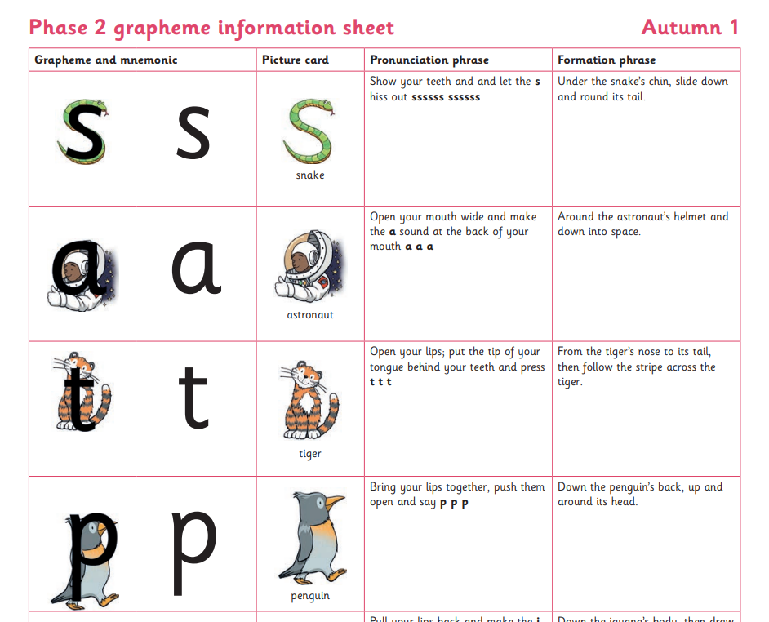

Spelling
Your child will be taught how to spell simple words, using the graphemes they have been taught.
They will practise the correct formation of letters.
They will also have handwriting lessons.
If your child is writing at home,
e.g. their name, please correct
letter formation
Notes:
Slide purpose:
To introduce spelling
Notes:
Read the slide.
Hand out the Phase 2 grapheme information sheet for Autumn 1, which includes the formation phrases.

Slide 12

How do we teach spelling?
Say the word.
Segment the sounds.
Count the sounds.
Write them down.
Notes:
Slide purpose:
To provide an overview of spelling
Notes:
Model the process above on a flipchart for the parents to see.
Show the process with a Phase 2 word, e.g. pin, dig, hug.

Slide 13

Reading
timetabled three times a week
taught by a trained teacher/teaching assistant
taught in small groups
assessed daily
Formally assessed every 6 weeks
Notes:
Slide purpose:
To introduce decodable books
Suggested script:
The children read the same book three times in a week.
The first time we work on decoding (sounding out) the words, the second time we work on prosody which is reading with expression – making the book sound more interesting with our story-teller voice or our David Attenborough voice – and the third time we look at comprehension.
We read the books three times at school because we want to develop the fluency.
The more children see words, the more they begin to read them automatically without having to sound them out.

Slide 14
Reading at home

Slide 15



Books going home
Notes:
Slide purpose:
To introduce the process and format for reading at home
Suggested script:
As well as the ‘learning to read’ book that your child will bring home they will also bring home a book for sharing with you.
This shared book is SO important. This is how we are going to give them the WILL to read.
Please read with your child as often as you can – at least once a day if possible.

Slide 16
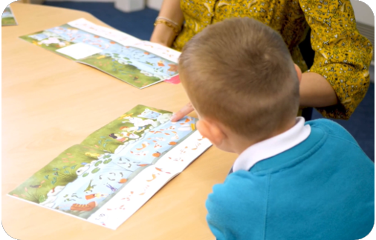
Reading a wordless books
Wordless books are invaluable as they teach reading behaviours and early reading skills to children who are not blending – yet!
Talk about the pictures.
Point to the images in the circles and find them on the page.
Encourage your child to make links from the book to their experiences.
Practise blending – e.g. find the d-o-g
Notes:
Slide purpose:
To give guidance on reading wordless books at home
Notes:
Read the slide.

Slide 17
Listening to your child read their phonics book
Your child should be able to read their book without your help.
If they find a word tricky, encourage them to sound it and support them to blend it.
Talk about the book and celebrate their success.
Notes:
Slide purpose:
To give guidance on reading the decodable book at home
Notes
Read the slide.

Slide 18
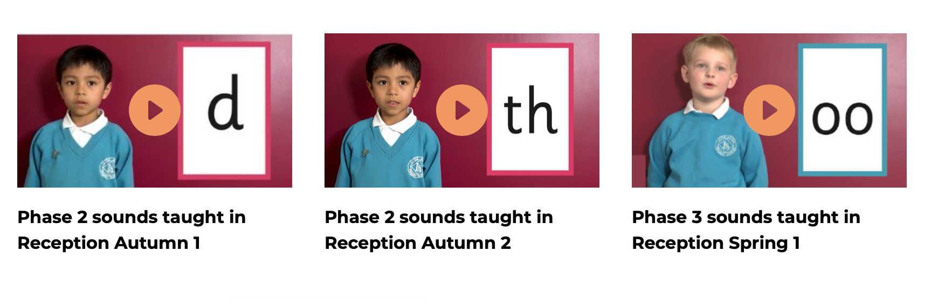
Supporting your child with phonics
Notes:
Slide purpose:
To give guidance on supporting phonics learning at home
Suggested script:
It is really important that you pronounce the sounds correctly at home if you are supporting your child.
Use the videos we saw earlier for support.

