Slide 1


Meet the Teacher
Indigo Class
Pear Tree
Primary School
Thursday 17th September 2026 5pm
‘Being Our Best Selves’

Slide 2
Meet the Year 5 Team
Pear Tree
Primary School
Mrs O'Connor- Class Teacher
Mrs Boughey- Class TA
PPA Cover (Monday pm)- Mrs Barker
‘Being Our Best Selves’

Slide 3
What the Children Need:
Pear Tree
Primary School
Water bottle
Snack
Waterproof Coat
Reading diary & book (from home or chosen from our Class library)
Snack money/healthy snack (nut free)
Pencil cases (we will provide stationery when needed)
*Jewellery - stud earrings.
‘Being Our Best Selves’

Slide 4
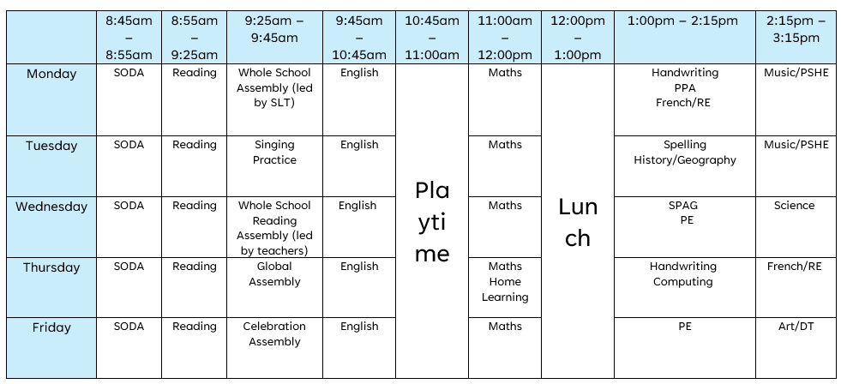
Routine:
Pear Tree
Primary School
‘Being Our Best Selves’

Slide 5

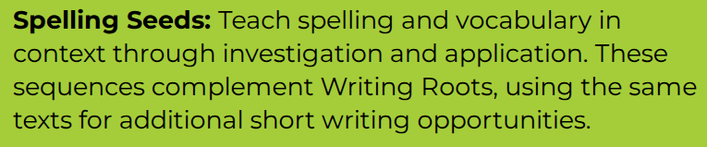

Spelling
Pear Tree
Primary School
One lesson per week using an 'investigate-practise-apply' structure.
First lesson focuses on statutory spellings- linked to the class writing text (Writing Root).
Following two lessons cover spelling objectives, but again link to the class writing text.
Spellingframe- links to objective covered in class.
‘Being Our Best Selves’

Slide 6
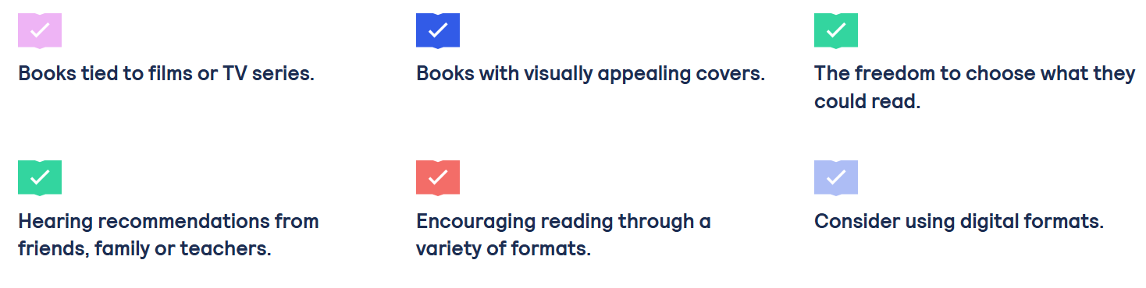
Reading
Pear Tree
Primary School
Reading Expectations:
Regular and consistent reading at home. We still encourage 'shared reading experiences' for Year Five children. Reading stamina and fluency is still a key skill.
Children to regularly fill in their own reading diaries- page number reached, but also a comment about the story, characters, a section they've enjoyed, a new word they have learnt. Diaries are checked every Friday.
Reading for pleasure
(National Literacy
Trust).
Reader Teacher
Books For Topics
‘Being Our Best Selves’

Slide 7





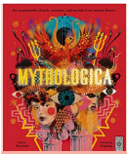

Reading & Writing
Pear Tree
Primary School
Writing Roots
Based on teach through a text pedagogy engaging children to write with a clear audience and purpose. Usually, a three-week sequence giving the children the opportunity to write in a variety of genres. Then ending with a 'published' piece of writing.
Literacy Leaves
Daily reading comprehension with sequenced activities that guide children through whole books, creating critical readers. We will be using novels, poetry collections, and high-quality non-fiction books connected to Writing Roots through Literary Themes
‘Being Our Best Selves’

Slide 8
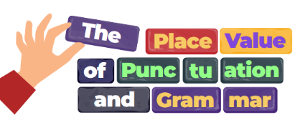
PVPG
Pear Tree
Primary School
This year, through our work with Grammarsaurus, children in Year 1 to Year 6 will learn the Place Value of Punctuation and Grammar (PVPG) — an approach that focuses on the foundations of writing: grammar and punctuation.
Year 5 have started this and will complete it by half term.
‘Being Our Best Selves’

Slide 9


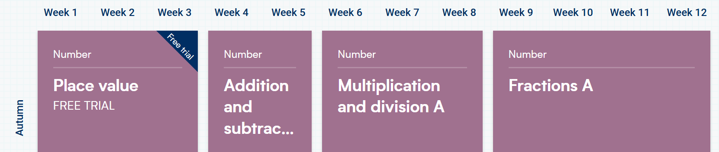
Maths
Pear Tree
Primary School
Daily Maths lesson.
Daily retrieval activities.
White Rose Maths:
‘Being Our Best Selves’

Slide 10
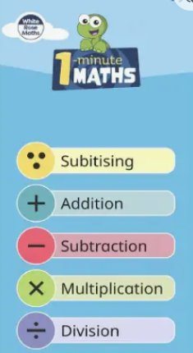
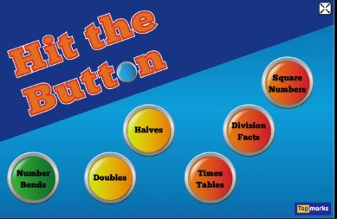
Homework
Pear Tree
Primary School
Handed out every Thursday.
Generally, English and Maths (consolidate learning).
Read, read, read.
Arithmetic practise.
Don't make it a battle...
‘Being Our Best Selves’

Slide 11
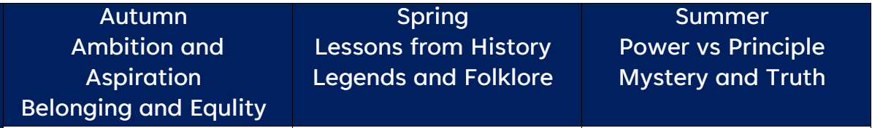


Topics & Trips
Pear Tree
Primary School
‘Being Our Best Selves’

Slide 12
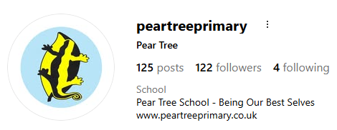
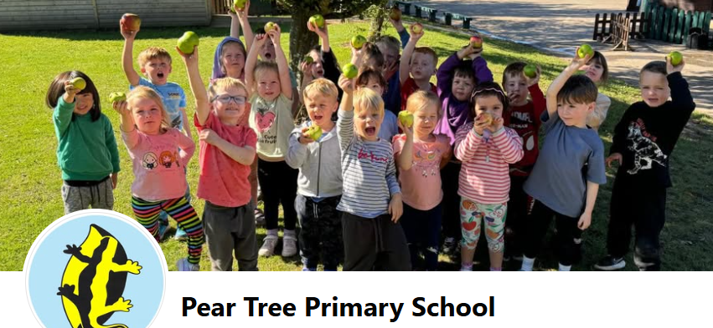
Communication
Pear Tree
Primary School
Partnership- we want to work together as a home-school partnership.
Open door policy- please come in and discuss any issues.
Emails – please send to admin
Social media – Facebook page, Instagram
Website - www.peartreeprimary.co.uk
Weekly Class email – Indigo's email will be sent home on a Friday.
‘Being Our Best Selves’

Slide 13
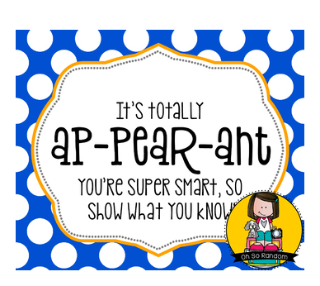


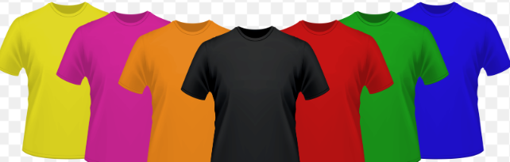

Rewards & Sanctions
Pear Tree
Primary School
Be ready, be respectful, be safe
River Points
Pear of the week
Pears
1 – 2 – 3
‘Being Our Best Selves’

Slide 14


Wellbeing
Pear Tree
Primary School
ELSA
Nurture
KiVA
My Happy Mind
Calm Club
Buddies
‘Being Our Best Selves’

Slide 15
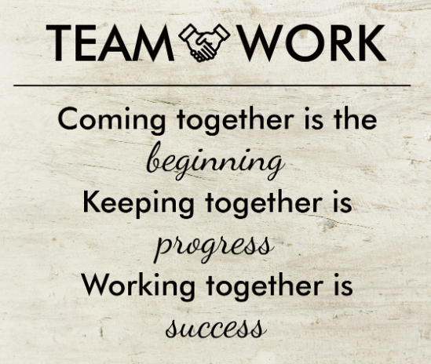
Pear Tree
Primary School
How can you support your child?
‘Being Our Best Selves’

