Slide 1


Meet the Teacher
Yellow Class
Pear Tree
Primary School
5pm Tuesday 15th September
‘Being Our Best Selves’

Slide 2
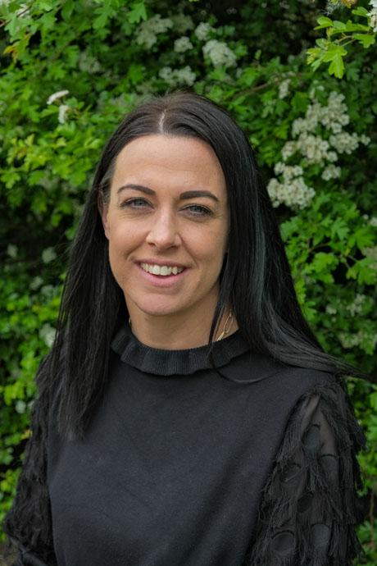
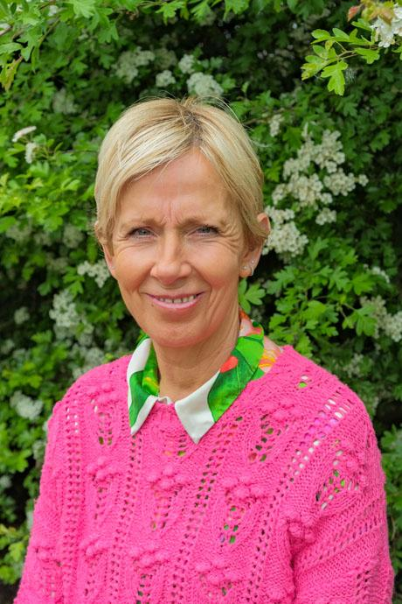
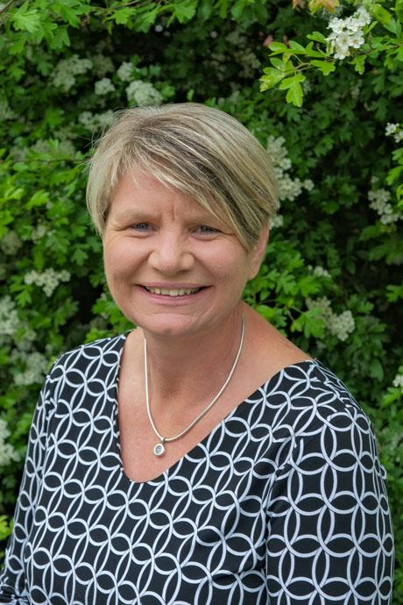
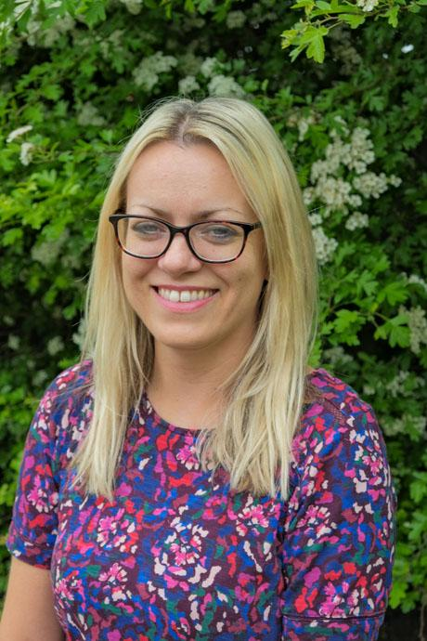
Meet the Year 2 Team
Pear Tree
Primary School
Mrs Somers,
Yellow Class Teacher
Mrs Howard,
Teaching Assistant
(Not Monday)
Miss Sketchley,
Teaching Assistant
Mrs Barker & Miss Oakley
Friday Afternoons
‘Being Our Best Selves’

Slide 3
What the Children Need:
Pear Tree
Primary School
Water bottle Snack
Coats
Reading diaries & Little Wandle books
Snack money/healthy snack (nut free)
A 'can do' attitude
‘Being Our Best Selves’
Notes:
Named
Snack nut free please, as suitable to be eaten in a small window of time
Coats waterproof and named
Reading diaries – written in by staff when heard read, even if its 1 page, or a shared read please document it. Even better chn to write it in if you sign.
Toast – 25p a round of toast!

Slide 4
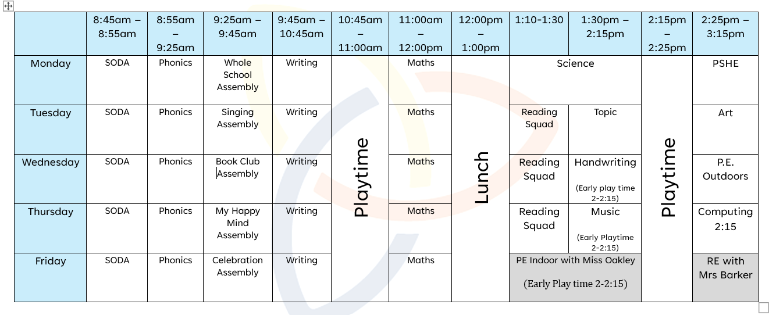
Our Weekly Routine
Pear Tree
Primary School
‘Being Our Best Selves’
Notes:
Phonics, English, Maths, Assembly in the morning.
Reading Squads, Wider curricukum in the afternoon
PE – Wednesday and Friday unless informed otherewise
Outdoor Learning unit – will send communication about this later in the year

Slide 5
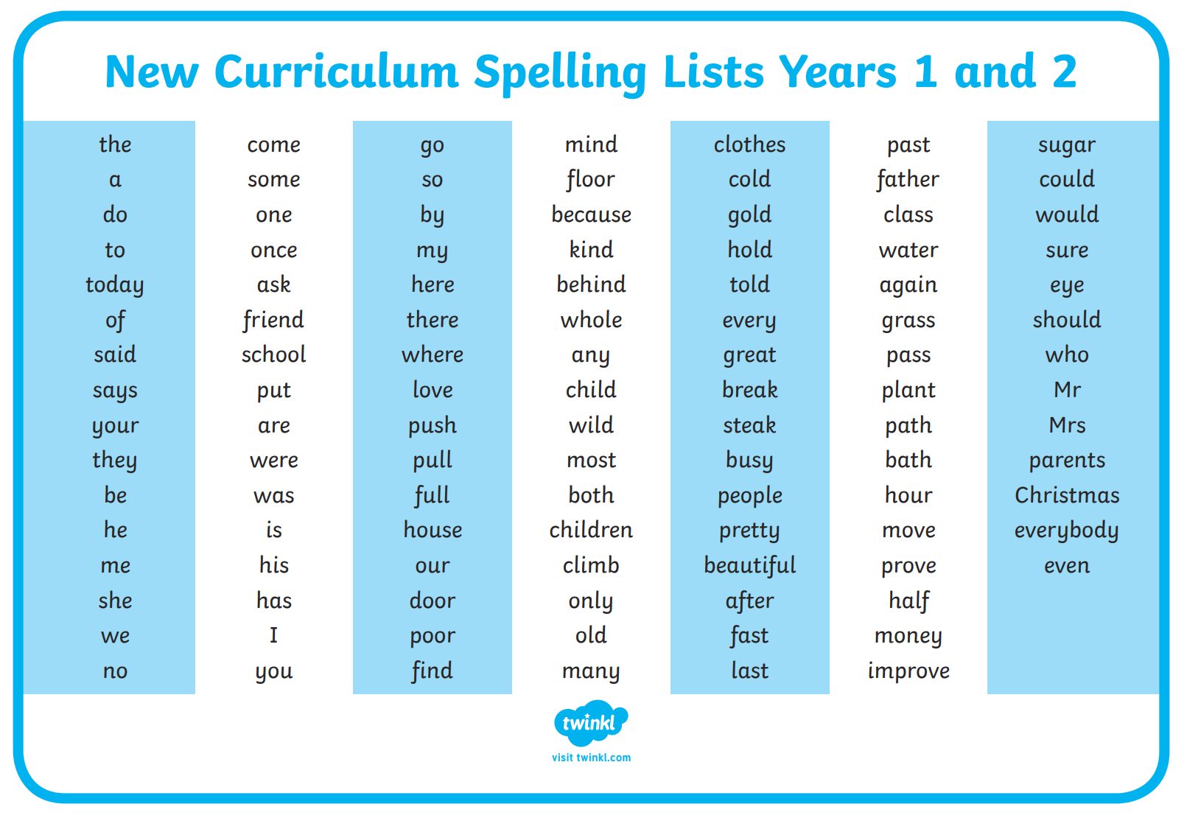
Spelling/Phonics
Pear Tree
Primary School
Little Wandle Spelling programme –robust, systematic approach
Statutory word list – useful to have at home
for incidental writing opportunities
‘Being Our Best Selves’
Notes:
Daily
Routine led
Securing Year 1 knowledge before teaching the Year 2 programme

Slide 6
Reading
Pear Tree
Primary School
Read 5 times a week at home and get a sticker on bookmarks
Reading in class - Whole Class Phonics, Little Wandle reading squads, Individual Reading, Paired Reading
If children are reading ‘banded’ books then they are responsible for changing their own books, with gentle reminders as needed.
If on the Little Wandle programme they will get changed weekly on a Thursday.
A book for ‘sharing’ is chosen from the library each Friday
Recommended reads
‘Being Our Best Selves’
Notes:
Importance of reading stamina and fluency no matter your child’s level
Substantial offering due to accessing the wider curriculum,

Slide 7

Reading & Writing
Pear Tree
Primary School
Reading Leaves – books you will cover, how the sessions work, skills
Writing Roots - books you will cover, how the sessions work, connection between reading & writing
Writing focuses:
Each unit is 3 weeks long – two over a half term.
Writing journeys are led by the book and cover progressive and repetitive skills
Continue to punctuate accurately
Use different sentences types is a big focus - ? ! .
Making writing exciting for the reader –this will come through having a really good understanding of how stories work.
Writing in different genres and for different purposes
*New to Autumn Term 2026 – Whole school unit & Sentence structure focus.
‘Being Our Best Selves’

Slide 8
Maths
Pear Tree
Primary School
White Rose Programme
Concrete, Pictorial, Abstract approach
Daily lesson – 1 hour lessons
Chunked by experts into a series of progressive ‘units’ which allows for
repetition and challenge
Each unit varies in length
Use of manipulatives for support
Opportunities in each lesson for challenge
Recommended - One minute Maths App designed by White Rose Maths
Supplementing ideas for home – Numbots/TTRS
‘Being Our Best Selves’

Slide 9

Maths
Pear Tree
Primary School
Must have a solid basis in mental arithmetic
Times tables 2,5,10, 3's and related division facts
Problem solving - links so closely to reading comprehension – what is the question asking you to do.
Numbots– log in is in diary
‘Being Our Best Selves’

Slide 10
Homework
Pear Tree
Primary School
Thematic project work to enrichen curriculum learning.
Little Wandle reading daily
‘Being Our Best Selves’

Slide 11
Topics & Trips
Pear Tree
Primary School
KS1 Christmas Pantomime – Lyceum
Summer 2 – Nantwich Museum trip (The Great Fire of Nantwich)
Summer 1– Burwardsley 1 night residential – End of April
Letters will get emailed out
Payments through Parent Pay app (advance notice given)
‘Being Our Best Selves’

Slide 12
Communication
Pear Tree
Primary School
Partnership
Use of reading diaries or email– to admin email or call.
Social media – new facebook page, Instagram
Website page
Newsletter
Weekly emailed update and look ahead
‘Being Our Best Selves’

Slide 13
Rewards & Sanctions
Pear Tree
Primary School
School rules: Be ready, be respectful, be safe
River Family Points
1 – 2 – 3
Pear of the Week Friday assemblies linked to the focus introduced in assemblies on Monday)
leads to afternoon tea with Mrs C
Class Pears (8 to be earnt across the half term then a whole class agreed reward)
Spotted Cards
‘Being Our Best Selves’

Slide 14
Wellbeing
Pear Tree
Primary School
ELSA
KiVA
My Happy Mind weekly and weekly assemblies
Calm Club access at lunch times
Calm areas in classroom
New sensory room
Concerns:
Speak to class teacher in first instance
SENCO – Mrs Zatrakova is back!
Senior Mental Health Lead – Mrs Casey
‘Being Our Best Selves’

Slide 15
Pear Tree
Primary School
How can you support your child?
Working together approach
Daily reading
Fostering independence
Encouragement – use the weekly email to discuss their learning.
Trust
‘Being Our Best Selves’

