Slide 1


Meet the Teacher
Yellow Class
Pear Tree
Primary School
5pm Tuesday 9th September
‘Being Our Best Selves’

Slide 2
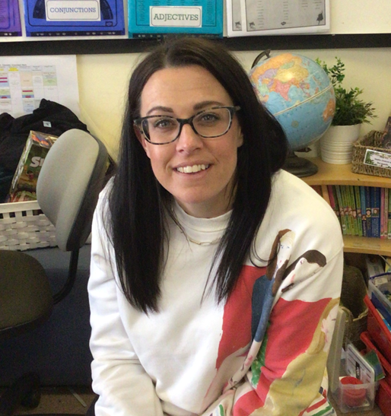
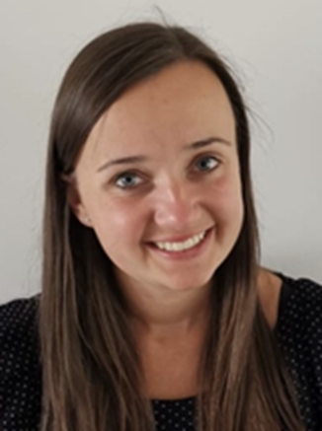
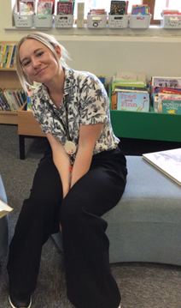
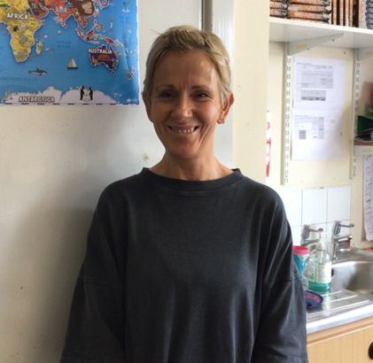
Meet the Year 2 Team
Pear Tree
Primary School
Mrs Somers,
Yellow Class Teacher
Mrs Zatrakova,
SENCo & Yellow Class Monday afternoon Teacher
Mrs Beeston,
Teaching Assistant
Mrs Howard,
Teaching Assistant
(Not Monday)
‘Being Our Best Selves’

Slide 3
What the Children Need:
Pear Tree
Primary School
Water bottle
Snack
Coats
Reading diaries & books
Snack money/healthy snack (nut free)
‘Being Our Best Selves’
Notes:
Named
Snack nut free please, as suitable to be eaten in a small window of time
Coats waterproof and named
Reading diaries – written in by staff when heard read, even if its 1 page, or a shared read please document it. Even better chn to write it in if you sign.
Toast – new steamlined, simpler system, 25p a round of toast!

Slide 4
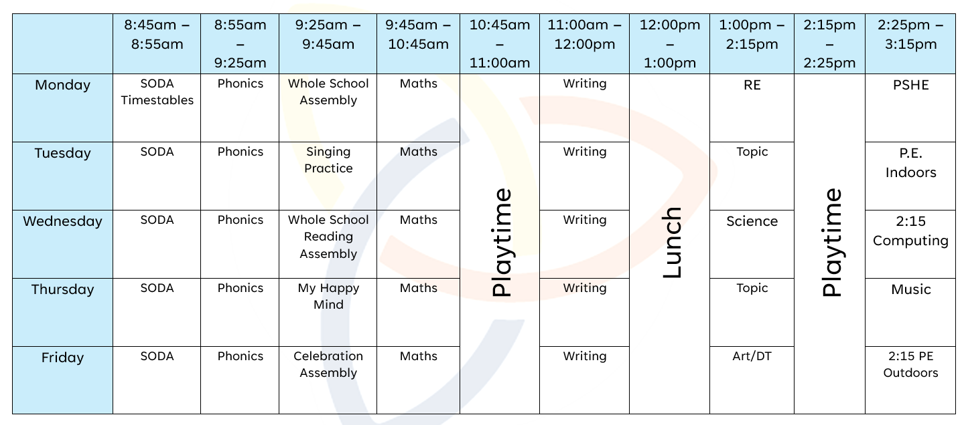
Our Weekly Routine
Pear Tree
Primary School
‘Being Our Best Selves’
Notes:
Spelling, English, Maths, Mental Maths, guided reading and phonics in the morning.
Topic in the afternoon and whole class reading
PE – Tuesday and Friday
Outdoor Learning and Swimming– a text/email will go home when it’s our ‘block’ usually a full half term

Slide 5
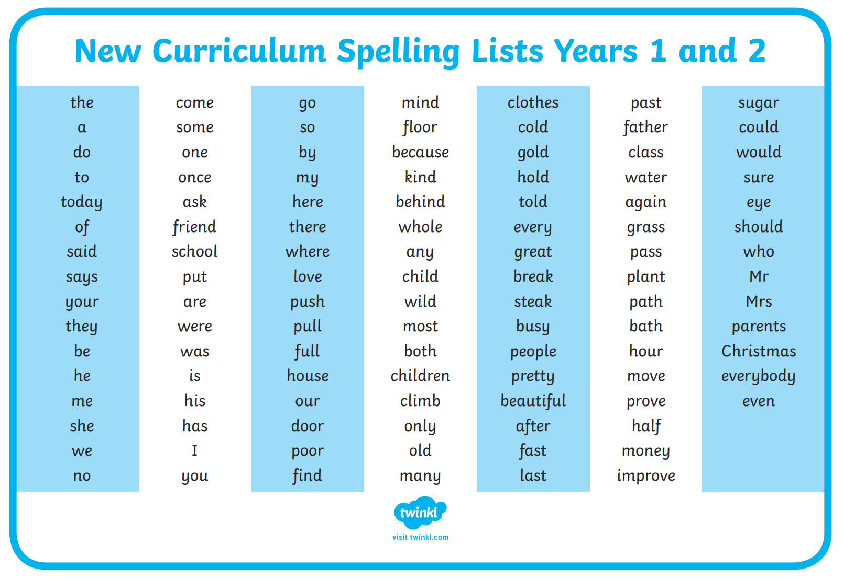
Spelling/Phonics
Pear Tree
Primary School
Little Wandle Spelling programme
Statutory word list – useful to have at home
for incidental writing opportunities
‘Being Our Best Selves’

Slide 6
Reading
Pear Tree
Primary School
Read 5 times a week at home and get a sticker on a bookmark– move up the ‘stars’
Reading in class – Guided Reading, Whole Class Reading, Individual Reading, Paired Reading
If children are reading banded books then they are responsible for changing their own books.
If on Little Wandle they will get changed weekly – as in Orange Class
A book for sharing is chosen from the library each Friday
Recommended reads
‘Being Our Best Selves’
Notes:
Importance of reading stamina and fluency no matter your child’s level

Slide 7
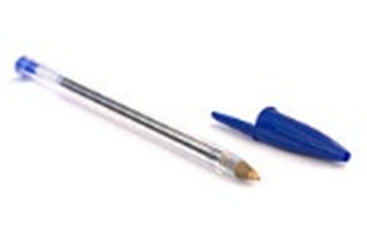
Reading & Writing
Pear Tree
Primary School
Reading Leaves – books you will cover, how the sessions work, skills
Writing Roots - books you will cover, how the sessions work, connection between reading & writing
Writing focuses:
Continue to punctuate accurately and write narratives
Use different sentences types
Making writing exciting for the reader –this will come through having a really good understanding of how stories work.
Writing in different genres
‘Being Our Best Selves’

Slide 8
Maths
Pear Tree
Primary School
White Rose Scheme
Concrete, Pictorial, Abstract approach
Daily lesson – 1 hour lessons
Chunked by experts into a series of progressive ‘units’
Each unit varies in length
Use of manipulatives for support
Opportunities in each lesson for challenge
Recommended - One minute Maths App designed by White Rose Maths
‘Being Our Best Selves’

Slide 9

Maths
Pear Tree
Primary School
Must have a solid basis in mental arithmetic
Times tables 2,5,10 and division facts
Problem solving links so closely to reading comprehension – what is the question asking you to do.
Times Table Rock Stars – log in is the diary
‘Being Our Best Selves’

Slide 10
Homework
Pear Tree
Primary School
Math's game link emailed on weekly email as a pre cursor
or follow up to the week’s or next week’s learning
Little Wandle reading daily
‘Being Our Best Selves’

Slide 11
Topics & Trips
Pear Tree
Primary School
KS1 Christmas Pantomime – Lyceum
Spring 1 – Nantwich Museum trip (The Great Fire of Nantwich)
Spring 2 – Burwardsley 1 night residential
Letters will get emailed out
Payments through Parent Pay app (advance notice given)
‘Being Our Best Selves’

Slide 12
Communication
Pear Tree
Primary School
Partnership
Open door policy
Emails – to admin
Social media – new facebook page, Instagram
Website page
Weekly emailed update and look ahead
‘Being Our Best Selves’

Slide 13
Rewards & Sanctions
Pear Tree
Primary School
Be ready, be respectful, be safe
River Family Points
1 – 2 – 3
Postcards – Friday assemblies linked to the week’s assembly on Monday) leads to afternoon tea with Mrs C
Pears (8 to be earnt across the half term the a whole class agreed reward)
Spotted Cards
‘Being Our Best Selves’

Slide 14
Wellbeing
Pear Tree
Primary School
ELSA
Nurture
KiVA
My Happy Mind
Calm Club
Buddies
Concerns:
Speak to class teacher in first instance.
SENCO,
Senior Mental Health Lead – Mrs Casey
‘Being Our Best Selves’

Slide 15
Pear Tree
Primary School
How can you support your child?
Working together approach
Daily reading
Communication
Encouragement – use the weekly email to discuss their learning
‘Being Our Best Selves’

Slide 16

Pear Tree
Primary School
Any Questions?
‘Being Our Best Selves’

