Slide 1


Meet the Teacher
Pear Tree
Primary School
10th September 2025
5pm – 5.30pm
‘Being Our Best Selves’

Slide 2
Meet the Year 4 Team
Pear Tree
Primary School
Mrs Whittingham – Class Teacher
Mrs Cliff – Teaching Assistant
Mrs Barker – Class cover Tuesdays and Fridays
Miss Oakley – PE teacher on Friday afternoons
‘Being Our Best Selves’

Slide 3
What the Children Need:
Pear Tree
Primary School
Each day the children will need to bring the following:
Water bottle
Coats
Reading diaries & books
Snack money/healthy snack (nut free)
Equipment is supplied – they have their own labelled pencil cases with their equipment in.
‘Being Our Best Selves’

Slide 4
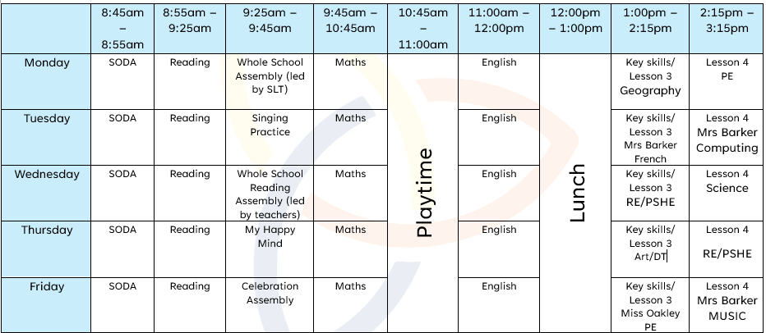
Routine:
Pear Tree
Primary School
‘Being Our Best Selves’

Slide 5
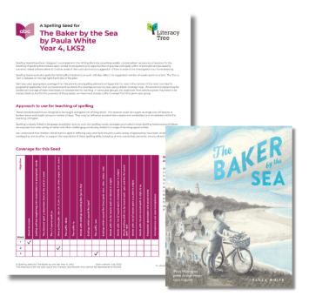
Spelling
Pear Tree
Primary School
One lesson per week using an 'investigate-practise-apply' structure.
First lesson focuses on statutory spellings- linked to the class writing text (Writing Root).
Following two lessons cover spelling objectives, but again link to the class writing text.
You can get the statutory 3/4 spelling list on our website.
‘Being Our Best Selves’

Slide 6
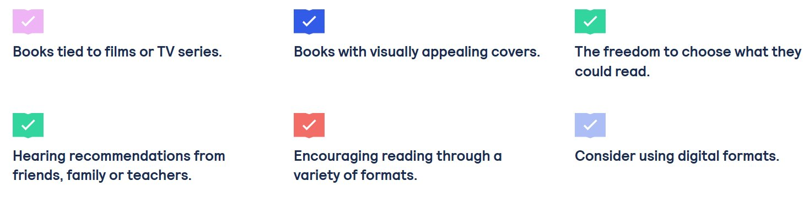
Reading
Pear Tree
Primary School
Reading Expectations:
Regular and consistent reading at home. We still encourage 'shared reading experiences' for Year Four children. Reading stamina and fluency is still a key skill.
Children (or yourselves) to regularly fill in reading diaries- page number reached, but also a comment about the story, characters, a section they've enjoyed, a new word they have learnt. Diaries are checked every Friday.
Reading for pleasure
(National Literacy
Trust).
‘Being Our Best Selves’

Slide 7

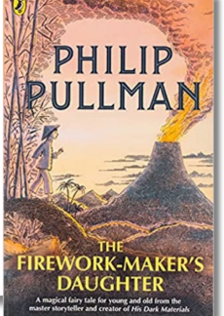
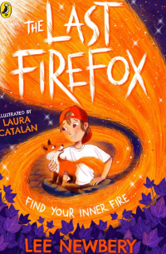

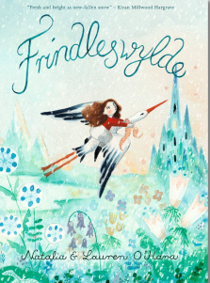

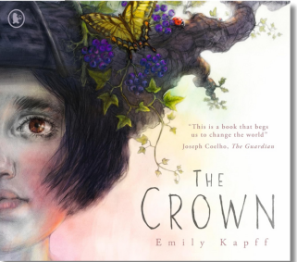
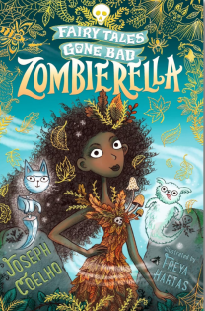
Reading & Writing
Pear Tree
Primary School
Literacy Leaves
Daily reading comprehension with sequenced activities that guide children through whole books, creating critical readers. We will be using novels, poetry collections, and high-quality non-fiction books connected to Writing Roots through Literary Themes
Writing Roots
Based on teach through a text pedagogy engaging children to write with a clear audience and purpose. Usually, a three-week sequence giving the children the opportunity to write in a variety of genres. Then ending with a 'published' piece of writing.
‘Being Our Best Selves’

Slide 8
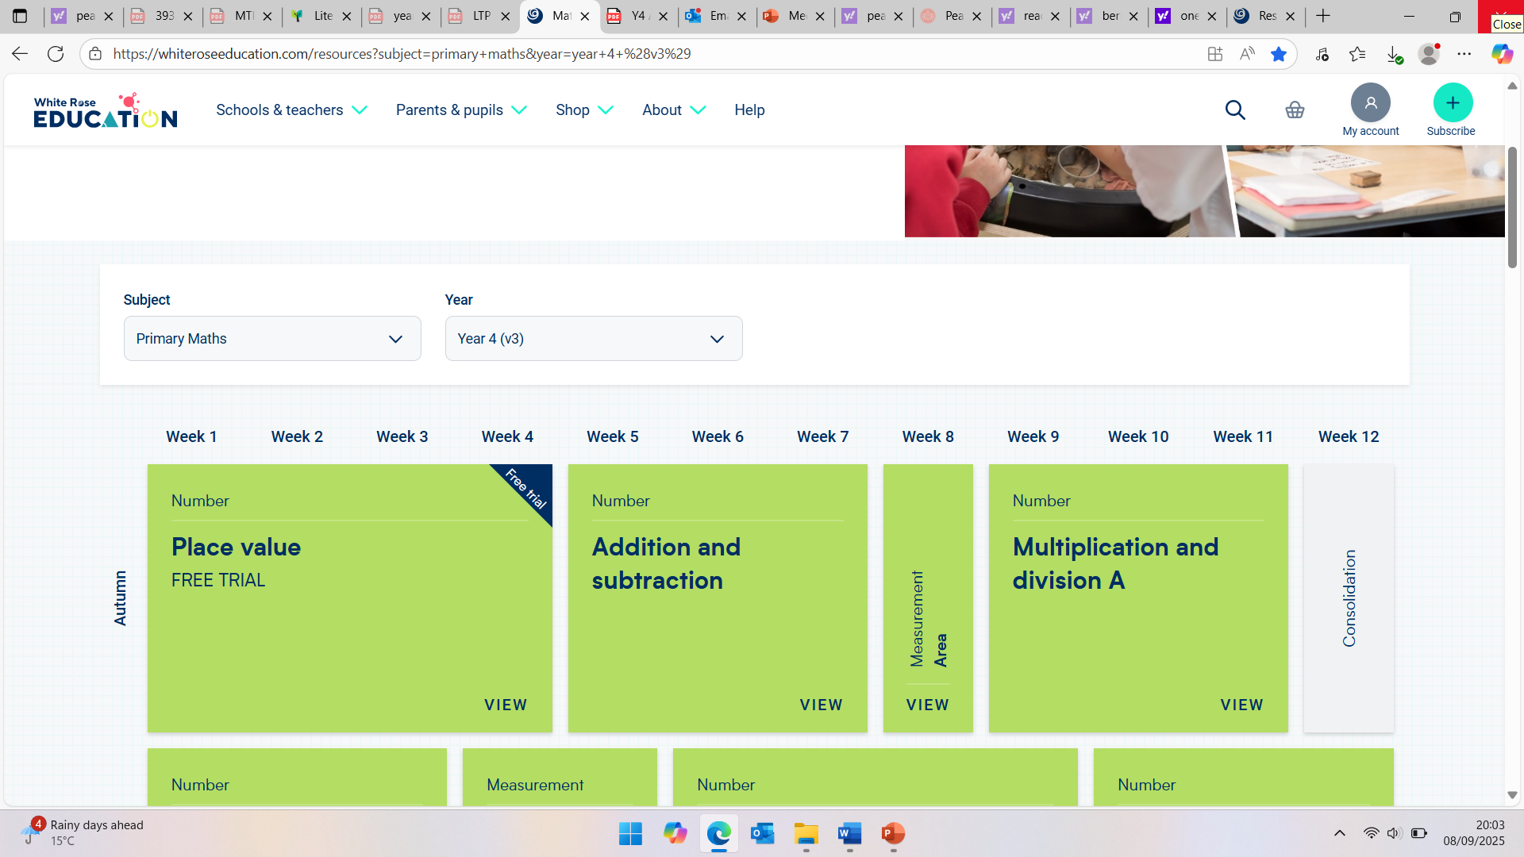
Maths
Daily Maths lesson.​
Daily retrieval activities.​
White Rose Maths:
Pear Tree
Primary School
https://www.topmarks.co.uk/maths-games/hit-the-button
https://www.bbc.co.uk/bitesize/articles/zdjkjfr
https://www.blooket.com/
https://kahoot.com/
‘Being Our Best Selves’

Slide 9

Pear Tree
Primary School
Times Tables
The multiplication tables check (MTC) is statutory for all year 4 pupils.
The purpose of the MTC is to determine whether pupils can recall their times tables fluently, which is essential for future success in mathematics.
This will happen in the summer term.
TTRS – available for you to login from home and please encourage children to play as much as they can. I can see their data and where their confident or need more practice.
I’m working on getting their logins and will stick them in their diaries.
‘Being Our Best Selves’

Slide 10
Homework
Pear Tree
Primary School
I am not planning on sending regular homework home. However, the expectation will be that children complete the reading we mentioned plus the TTRS regularly.
This will be the biggest support to their learning.
In year 5, regular homework will be set, so I may start sending some toward the end of the year to prepare them for this or if they have some specific areas to work on.
‘Being Our Best Selves’

Slide 11
Topics & Trips
Pear Tree
Primary School
Autumn Term – Rivers and the water cycle
We will be going to Nantwich Museum for ‘A story of a River’ experience.
New Vic Theatre for Christmas
Spring Term - Ancient Civilisations, Ancient Greece
Previous years have had a visitor in to do a theme day.
Swimming weekly.
Summer Term – Ancient Egypt – Residential at Robinwood for 2 nights
https://www.robinwood.co.uk/
‘Being Our Best Selves’

Slide 12
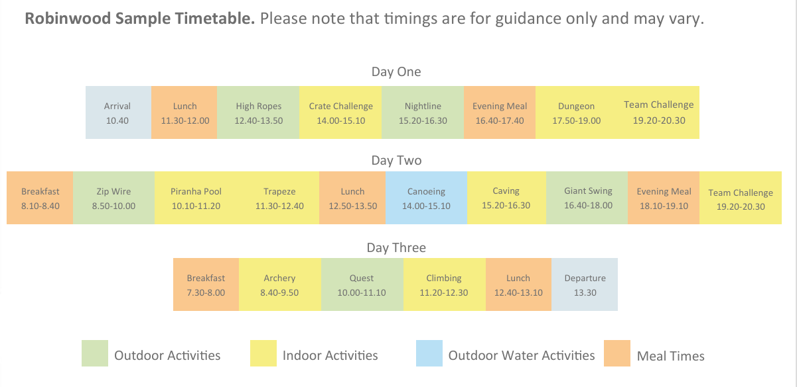
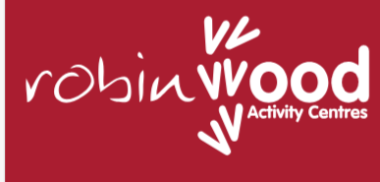
Topics & Trips
Pear Tree
Primary School
‘Being Our Best Selves’

Slide 13
Communication
Pear Tree
Primary School
Partnership- we want to work together as a home-school partnership.
Open door policy- please come in and discuss any issues.
Emails – please send to admin from Monday 15th September.
Social media – Facebook page, Instagram
Website - www.peartreeprimary.co.uk
Weekly Class email – Blue Class’s email will be sent home on a Friday.
‘Being Our Best Selves’

Slide 14
Rewards & Sanctions
Pear Tree
Primary School
Be ready, Be respectful, Be safe
River Points
1 – 2 – 3
Postcards
Pears
Class Rules
Stars for extra rewards
‘Being Our Best Selves’

Slide 15


Wellbeing
Pear Tree
Primary School
ELSA
Nurture
KiVA
My Happy Mind
Calm Club
Buddies
If you feel that your child is struggling with wellbeing and they have no current support at school, please speak to class teacher in the first instance.
‘Being Our Best Selves’

Slide 16
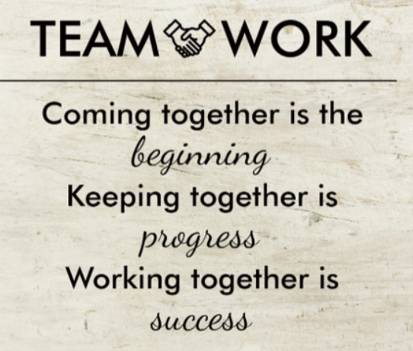
How can you support your child?
Pear Tree
Primary School
‘Being Our Best Selves’

