Slide 1
The big fat space quiz!
Do you want to play?
enter

Slide 2
How many planets are in the solar system?
5
8
12

Slide 3
Wrong Answer!
Return to the quiz

Slide 4
Correct Answer!
Return to the quiz

Slide 5
Which planet is named after the god of war?
Jupiter
Mars
Neptune

Slide 6
Wrong Answer!
Return to the quiz

Slide 7
Correct Answer!
Return to the quiz

Slide 8
What is the planet furthest away from the sun?
Uranus
Venus
Neptune

Slide 9
Wrong Answer!
Return to the quiz

Slide 10
Correct Answer!
Return to the quiz

Slide 11
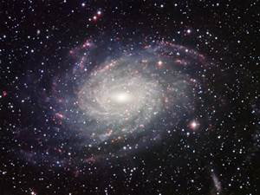
Follow the link to find out more about space

