Slide 1

Parent Welcome Meeting
Sept 2025
Year 5

Slide 2
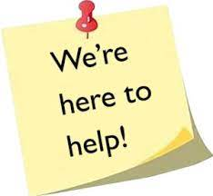
Meet the Team!
Class Teachers –
Miss Stringfellow (5P)
Mr Young (5F)
Classroom TAs –
Miss Asprey (5P)
Miss Dunn (5F)
Other important staff – Mrs Stevenson (Pastoral)

Slide 3
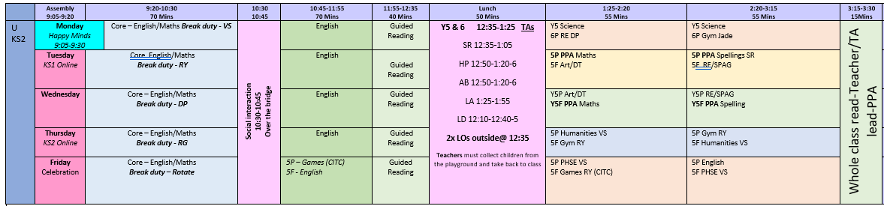
Timetable
PE – Thursday and Friday afternoons, children to get changed in school.
Theme weeks – Many of our foundation subjects (French, computing, music) are taught as a block, with our first topic being The Victorian Era.

Slide 4
Uniforms
Please put names in all items of clothing.
Please ensure child has coat just in case.
Please ensure that every item of your child’s uniform is labelled clearly with their name!
Please ensure that your child brings an appropriate coat to school every day – we all know hoe quickly the weather changes!
Footwear must be black and appropriate for the MUGA and the use of play equipment.

Slide 5


P.E. Kits
Coach Jade
CITC
PE Kit
Plain white t-shirt (moving away from yellow) no collar
Black shorts (not cycling)
Trainers suitable for outdoor sports
Black jogging bottoms and tracksuit tops (without logos) can be worn for outdoor games
Make-up, jewellery, sock trainers, leggings not permitted

Slide 6
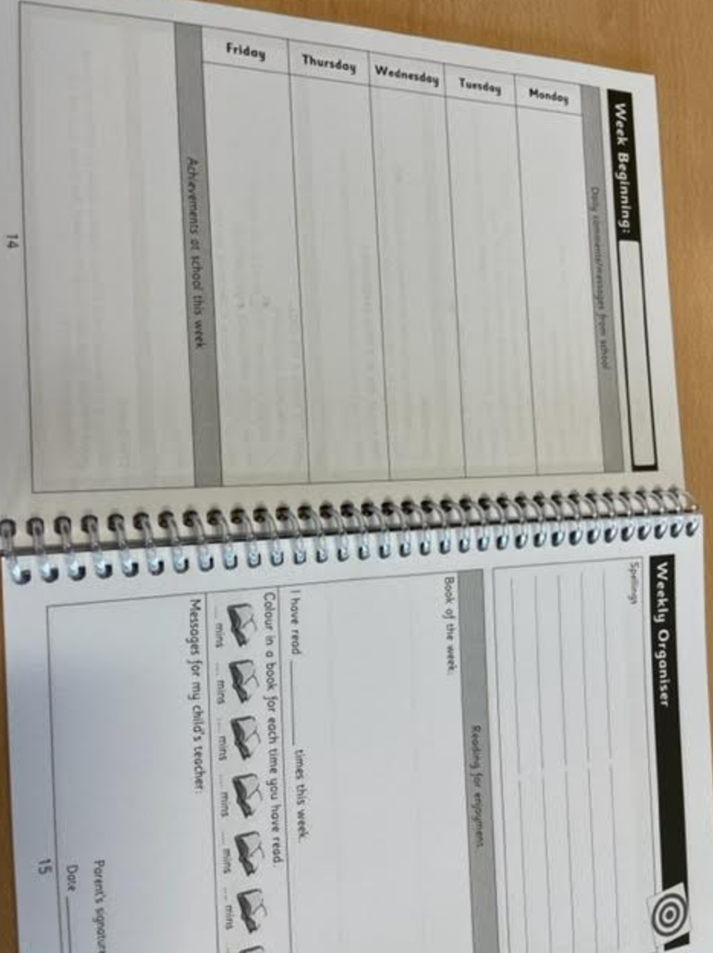
Homework and Spellings
Homework is set every Tuesday and due in by the following Tuesday.
Children will receive English and Maths homework on Century Learning. Children have a log-in for this.
Spellings are given out and tested every Tuesday.
Scores

Slide 7

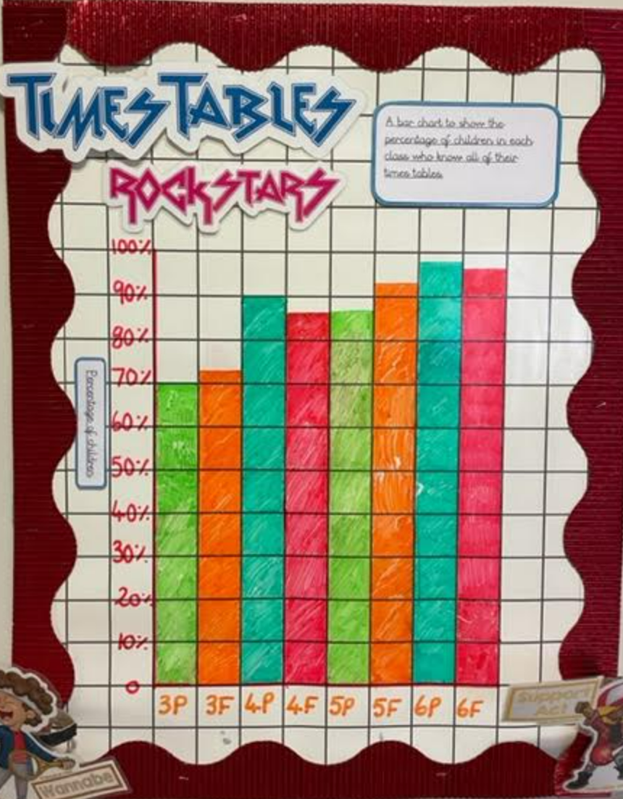
TTRS
The expectation for all children to be fluent by the end of Year 4.
All children have access to TTRS via app or website.
Children should practice everyday to ensure they are fluent and therefore able to access the Y6 curriculum.
Difference in speed between some of our Y5 pupils is significant.

Slide 8
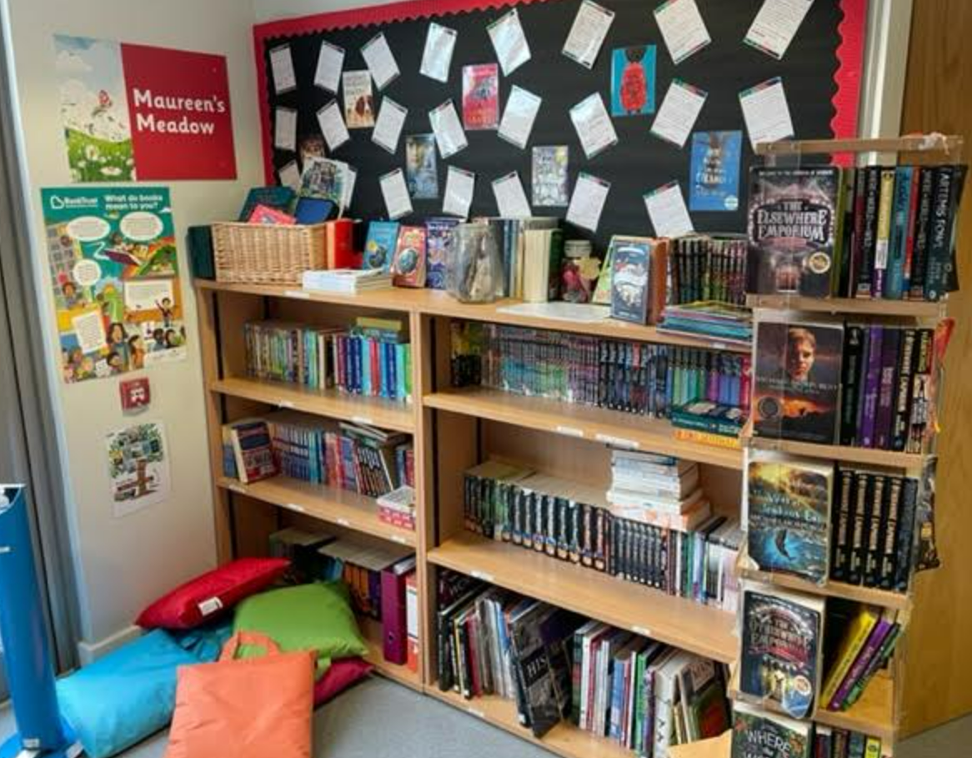
AR and Reading Records
Accelerated Reader is a measure of a child’s comprehension.
If your child is assigned an AR books, they will be able to choose from a level range, e.g. 2.2-3.2
Y5 children can update their own reading records.
Please make sure your child is reading for at least 20 minutes per night.

Slide 9
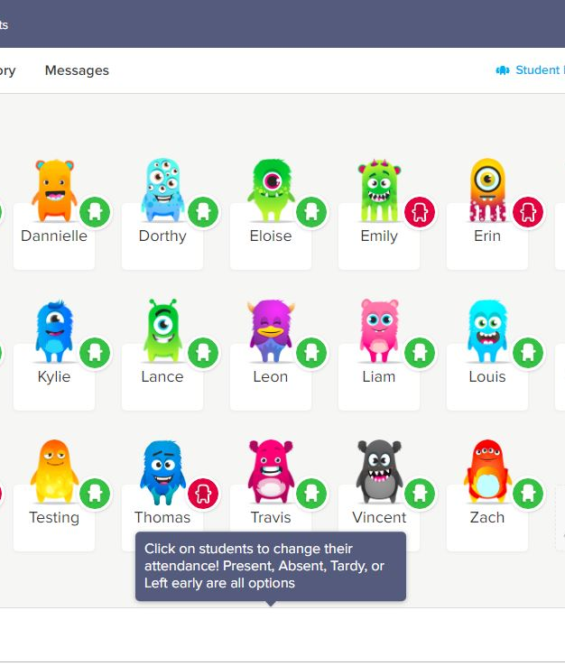
Class Dojo
Please make sure you are connected to Class Dojo and have notifications on!
We will share important information regarding class trips, after-school clubs, interventions and homework on Dojo.

Slide 10
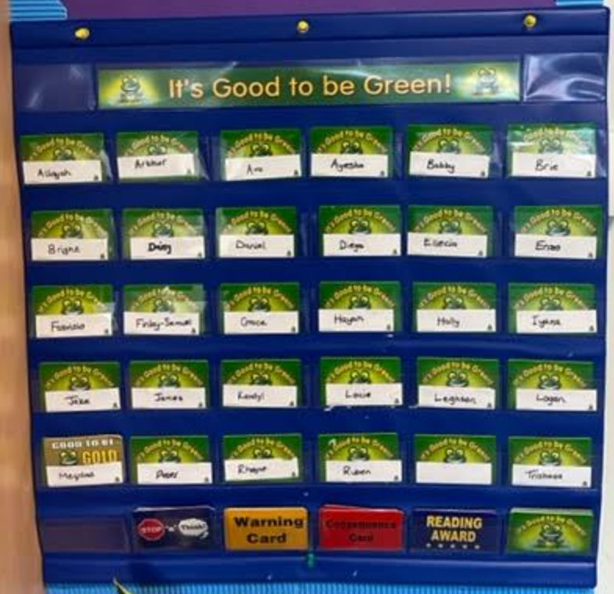
Behaviour- G2BG
Enrichment Time
Playground Pals

Slide 11
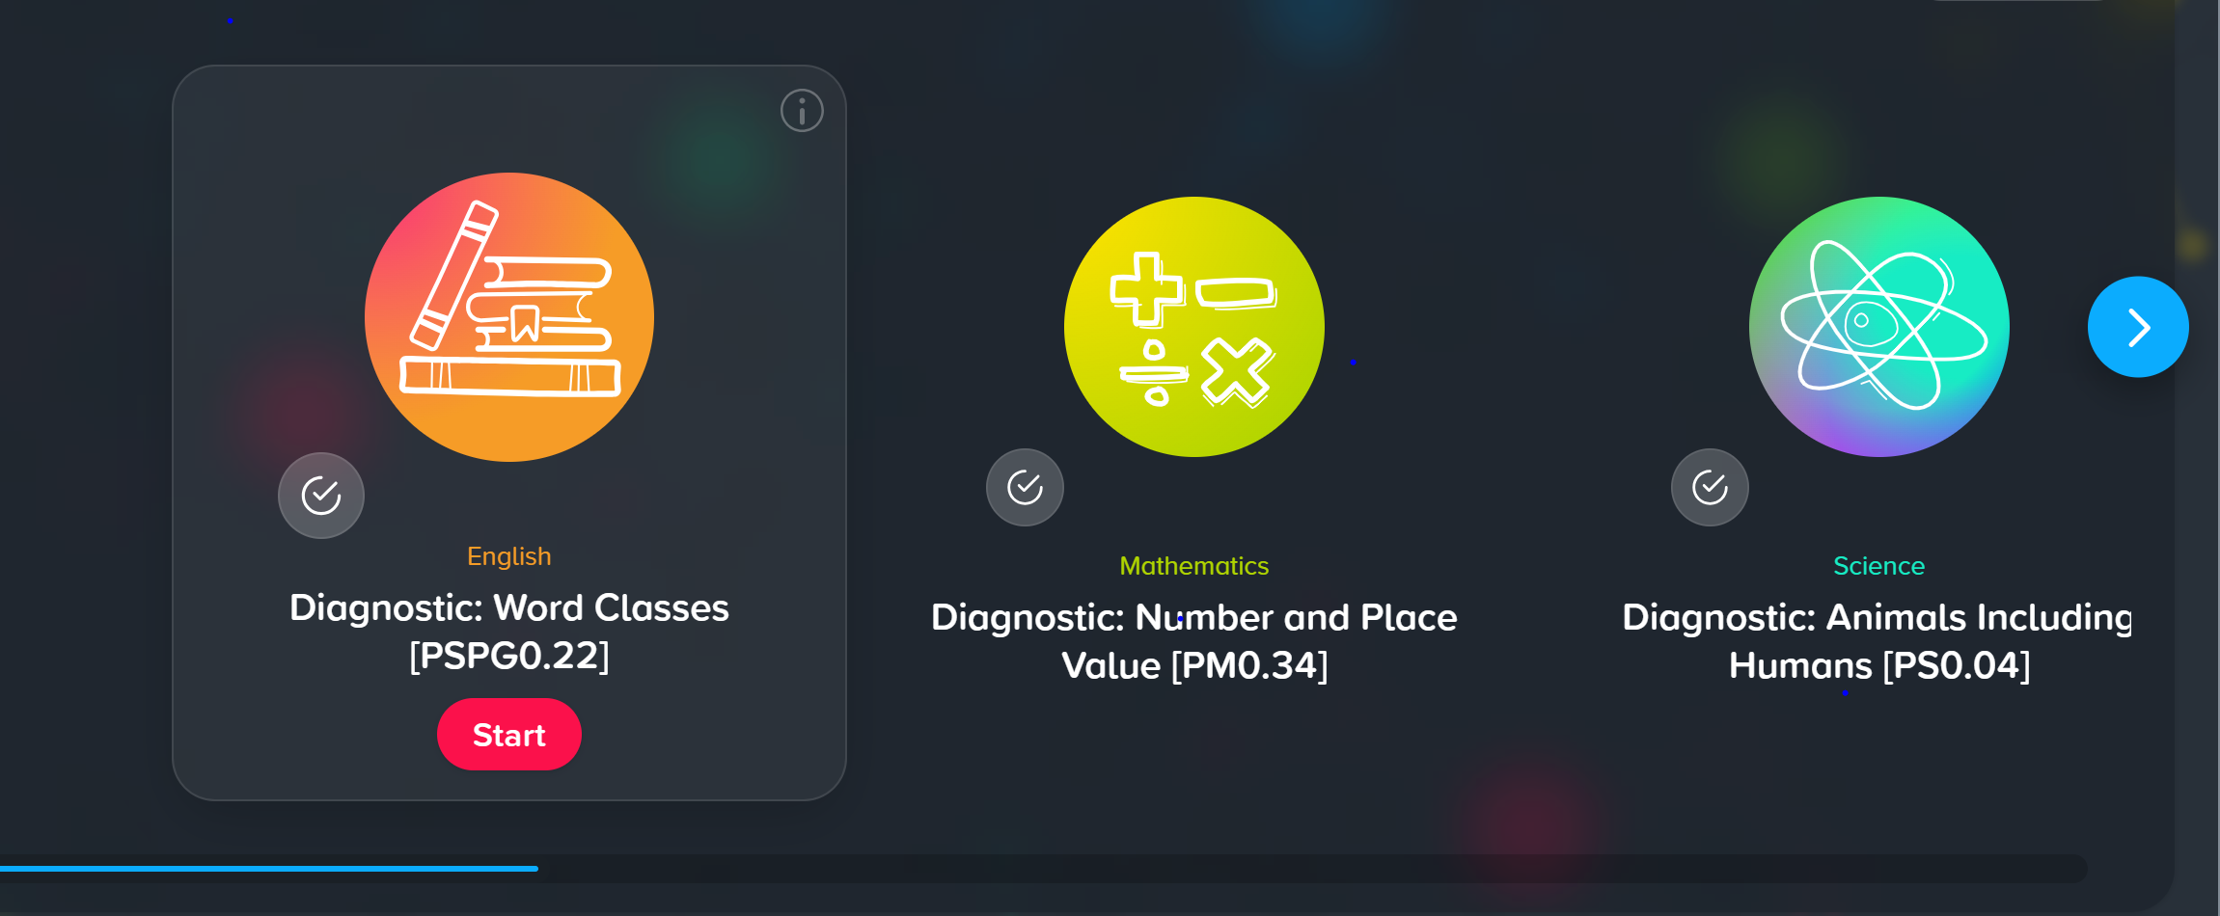
Century Learning

Slide 12
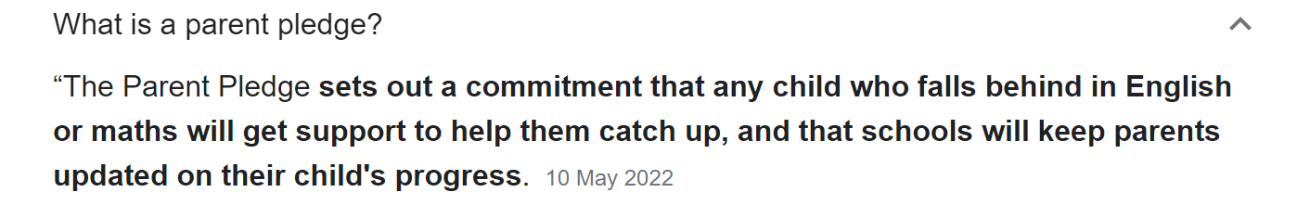
Parent Pledge
In-class interventions
Tutoring
Termly updates
Greater communication between parent and teacher

Slide 13
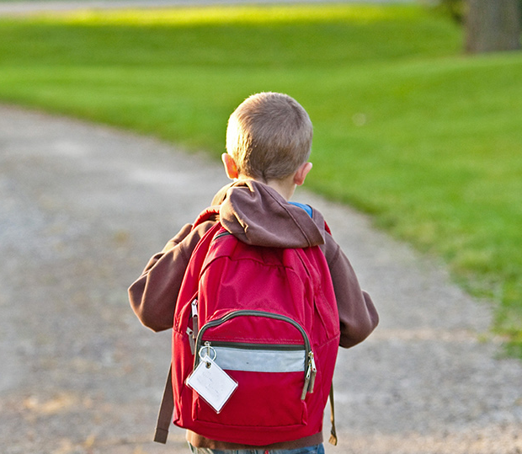
Thank You!
Any Questions?

