Slide 1

Parent Welcome Meeting
Sept 2025
Year One

Slide 2
Our Team
Sept 2025
Mr Marler
Miss Casey
Miss Jones
Miss Starkie
Mrs Thompson
Year One

Slide 3
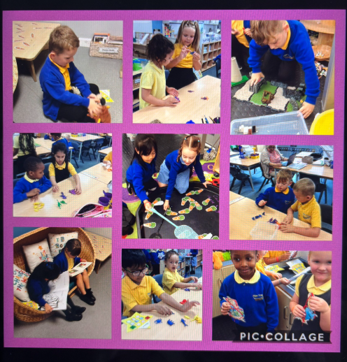
Transition
In year 1 we move to the national curriculum – Maths English and the Foundation subjects
We also carry on with Learn and Explore time like in EYFS – the children have challenge stars and each of our 10 areas have a challenge in which the children must complete over 2 weeks.
In the later terms we will move to a full structured day to get the children ready for the expectations of Year 2.

Slide 4
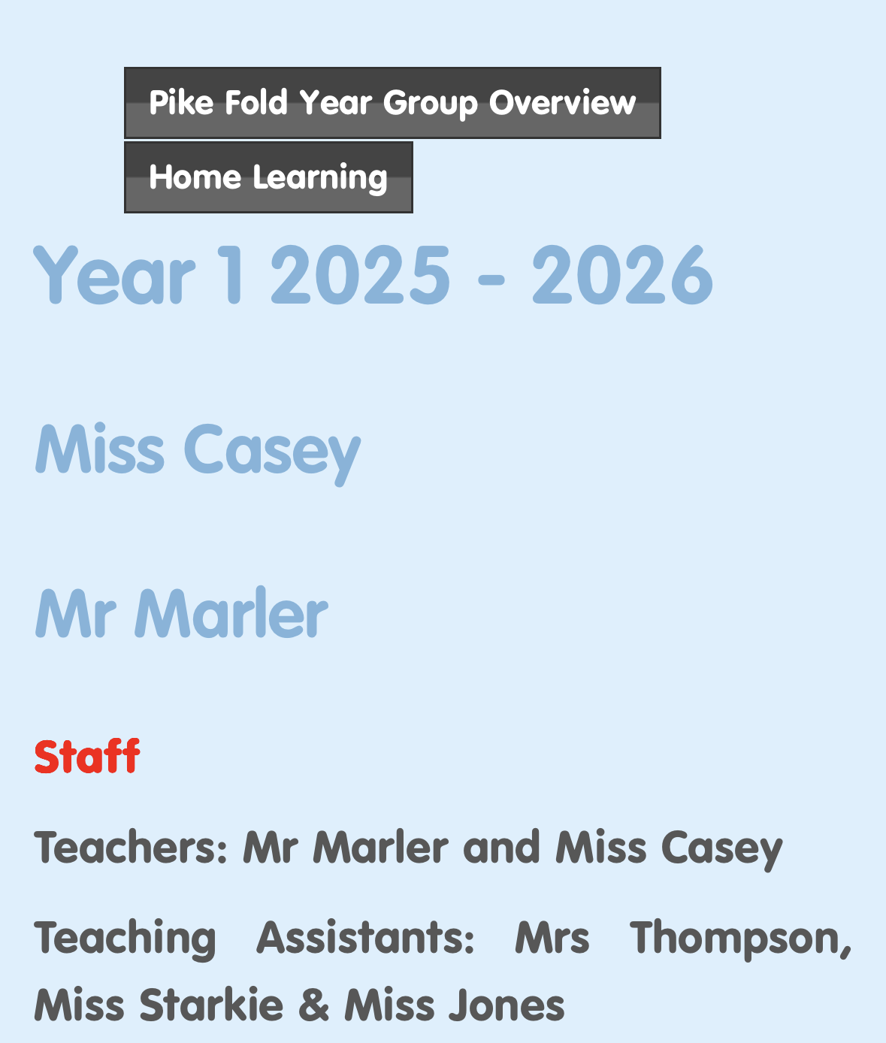
Website
We will constantly be uploading galleries
onto our class page on the website. This is a way you can keep up to date with what we have been doing in class.

Slide 5
Daily timetable
Times | Activities
8:50 | Register and whiteboard work
9:15 | Phonics Guided reading
10:15 | Morning Break time
10:30 | Literacy
11:30 | Lunch time
12:20 | Register
12:30 | Maths
1:15 | Foundation Subject
2:00 | Afternoon Break time
2:15 | Foundation Subject
3:00 | Story time

Slide 6
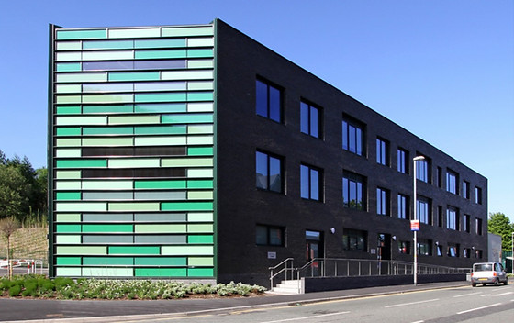
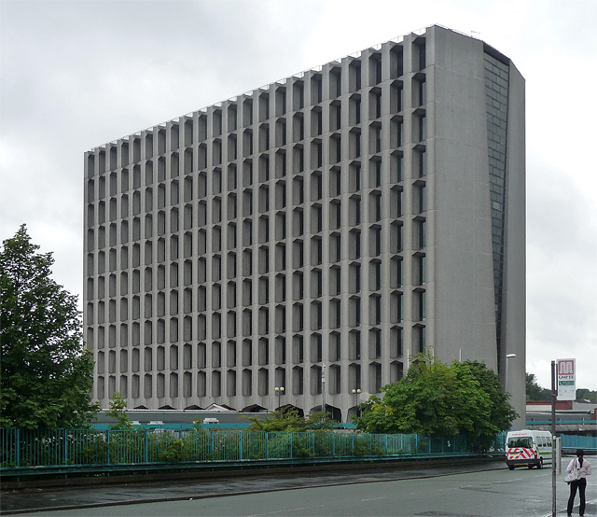
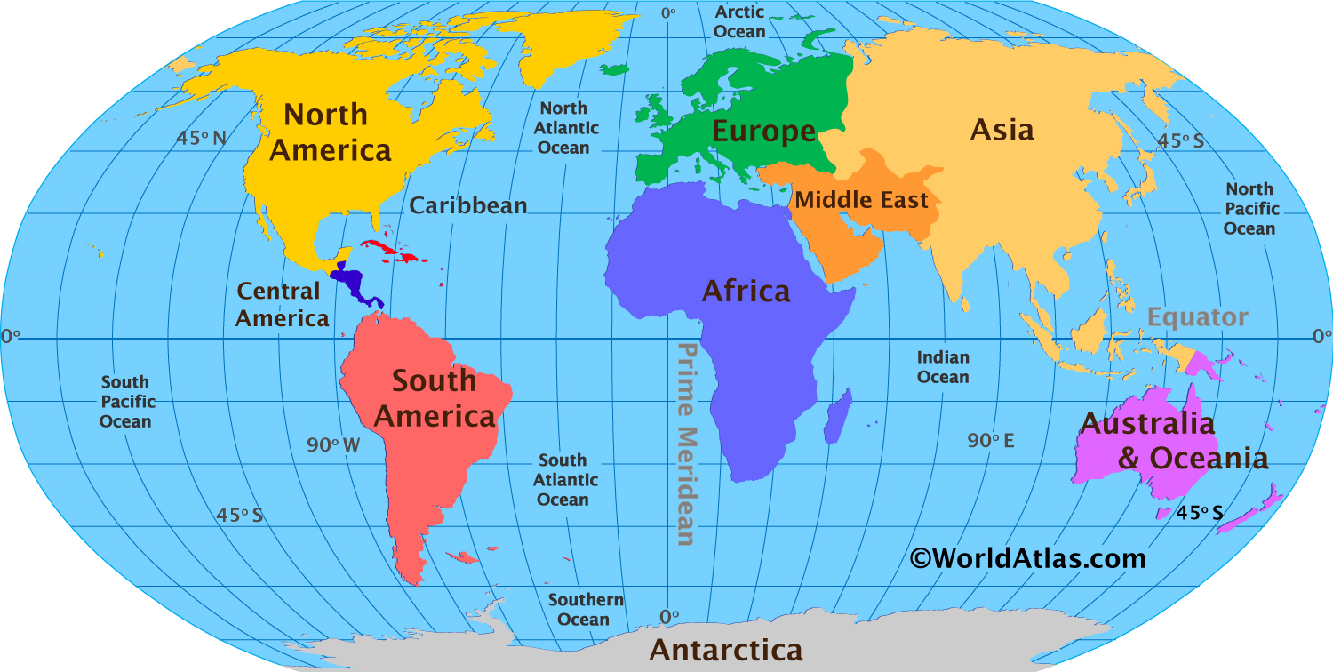

Our topics
Autumn 1 – Our local area & Everyday Materials
Autumn 2 – Changes in Living Memory - Grandparents
Spring 1 – Recycling & Animals including Humans
Spring 2 –Castles
Summer 1 – Hot and Cold places & Seasonal Changes
Summer 2 – Neil Armstrong & Plants

Slide 7
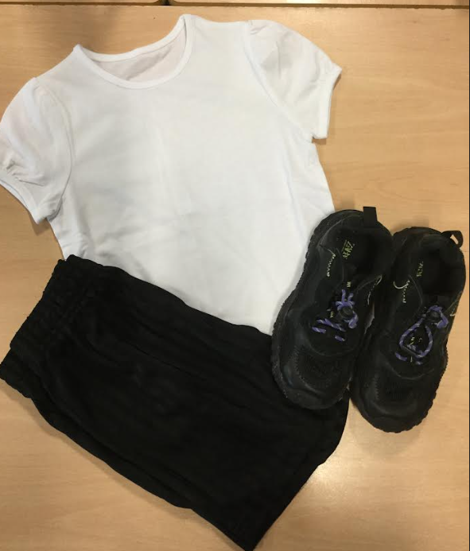
PE kits
PE Kit
Plain Yellow/white t-shirt
Black shorts (not cycling)
Trainers suitable for outdoor sports (Shoelaces tied independently)
Black jogging bottoms and tracksuit tops without logo can be worn for outdoor games
No jewellery and no leggings

Slide 8
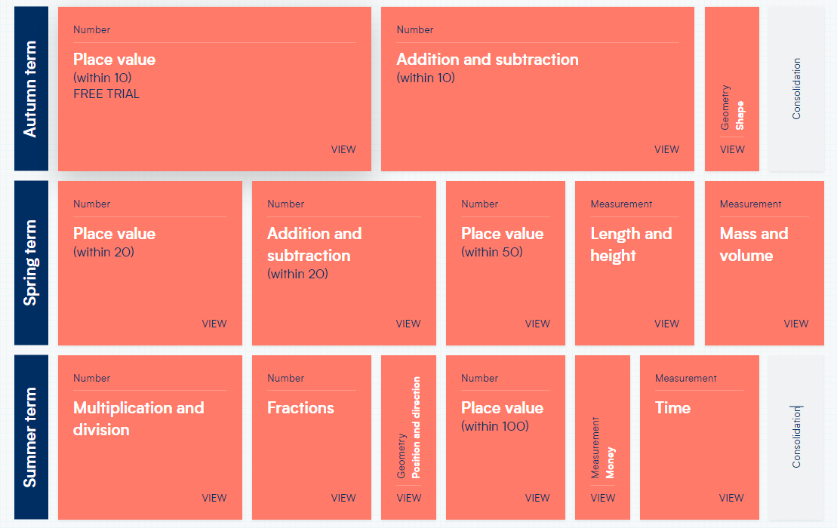
Maths yearly overview

Slide 9
Spellings
feel
food
sort
down
go
my
into
out
Spellings are given out on a weekly basis. The spellings will be posted on Dojo every Thursday.
Our spelling assessment will be the following Tuesday (1F) Wednesday (1P)

Slide 10


TTRS and Numbots
The expectation for all children to be fluent in her timetables by the end of Year 4.
All children have access to TTRS via app or website.
In year 1 our focus will be on using NUMBOTS at the beginning of the year.

Slide 11
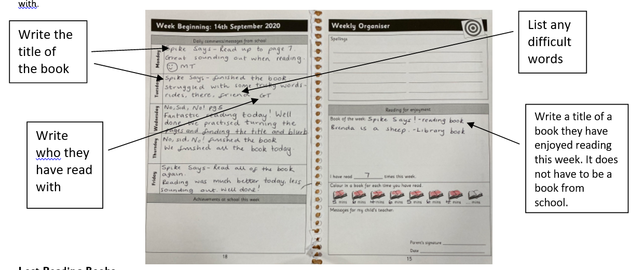
Reading books and reading records.
Children in Year 1 will bring home 3 books – a guided reading book, a phonics book and a library book.
Book bags will be given out on a Thursday and need to brought back by the following Tuesday at the latest so that we have time to change them.

Slide 12
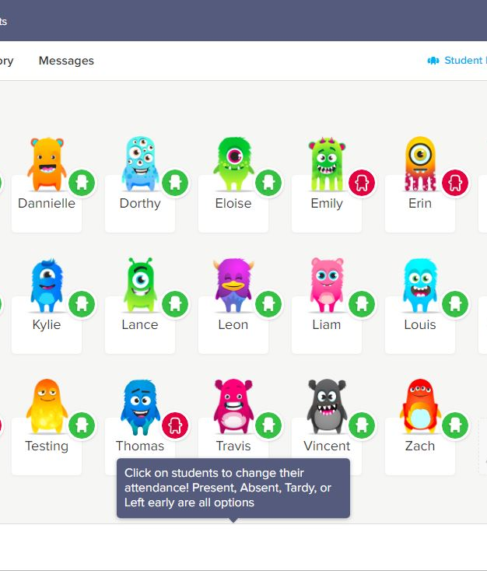
Dojo and School Spider
Please make sure you are connected to Class Dojo and have notifications on!
We will share important information regarding class trips, after-school clubs, interventions and homework on Dojo.
Ordering school dinners is now through School Spider.

Slide 13
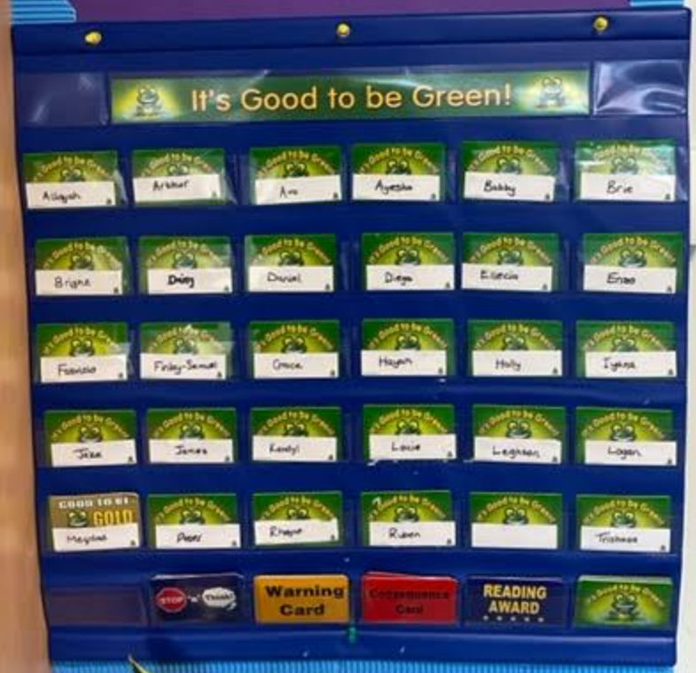
Behaviour- G2BG

Slide 14
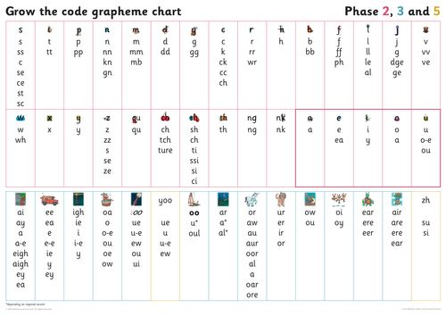
Phonics
At Pike Fold we follow the scheme Little Wandle.
The children are taught in 5 phases.
At the start of Year 1 each child will start at Phase 3 and work their way up to Phase 5 by the end of the year.
*We will be holding a phonics workshop and meeting in the future.

Slide 15
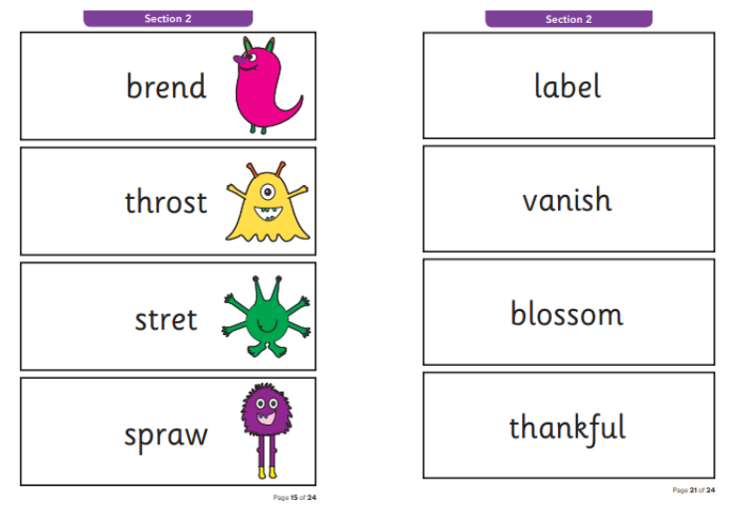
Phonics screening – 8th June 2026
The children are asked to read 40 words.
These words are real and alien words.
The pass mark for the last few years has been 32 however this could go up or down at any time.

Slide 16
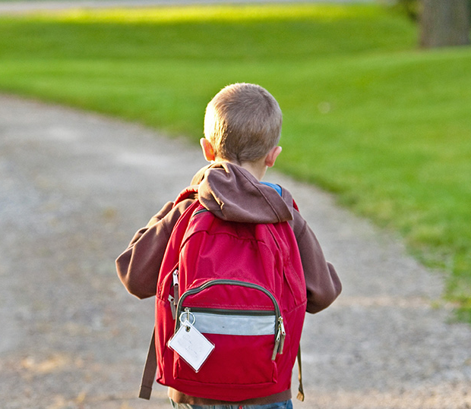
Thank You!
Any Questions?

