Slide 1

Parent Welcome Meeting
Sept 2024
Year Six

Slide 2

Meet the team
Mr Graham (Assistant Head)
Mr Pitts
Classroom TAs – Miss Taylor, Mr Reece and Miss Dunne
Other important staff – Mrs Stevenson

Slide 3
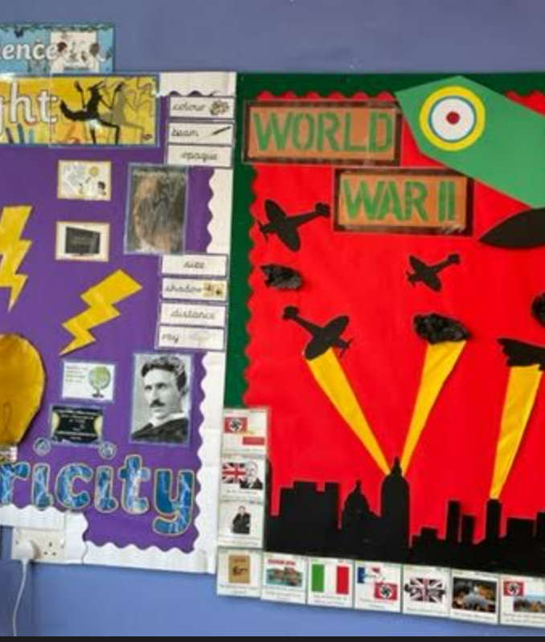
Class groups
Year 6 runs as one cohort of 60 children across 2 main groups
Children will move freely move between different groups and different classrooms for their core subjects of English and Mathematics.
Children will remain in register groups for most of their creative subjects and guided reading sessions.
How will we decide which group is best for your child?

Slide 4
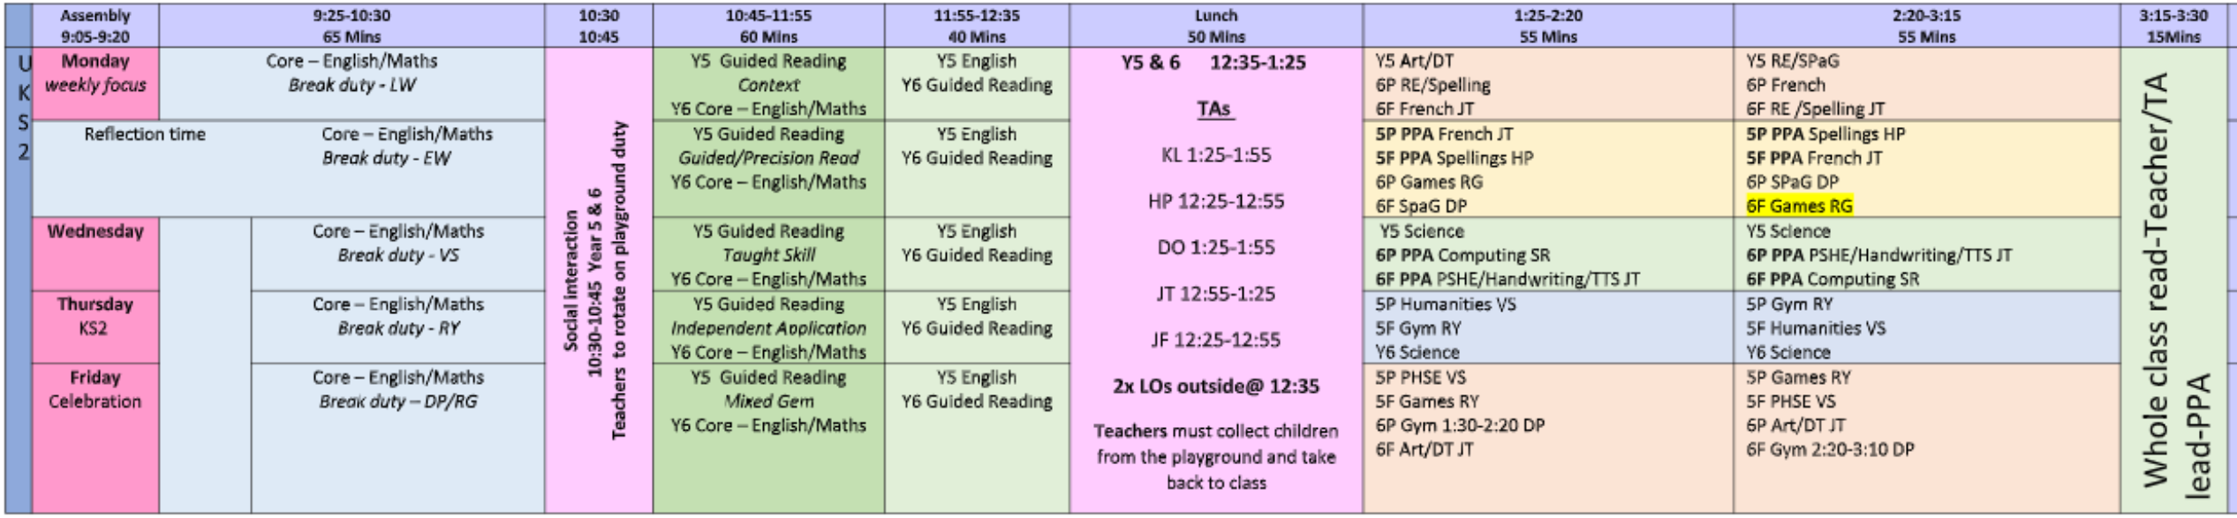
Timetable
PE – Tuesday and Friday children to get changed in school.
Theme weeks – Many foundation subjects are taught as a block with our first topic being WW2.

Slide 5
Uniforms
Please put names in all items of clothing.
Please ensure child has coat just in case.
Uniform has been perfect so far!
All long hair needs to be tied up.
Children are not permitted to bring a bag with them every day. Reading book bags will be provided.
All phones and smart watches must be handed to the teacher.
Footwear must be black and appropriate for the cage and equipment.

Slide 6
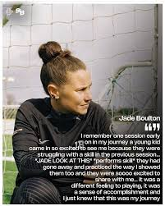
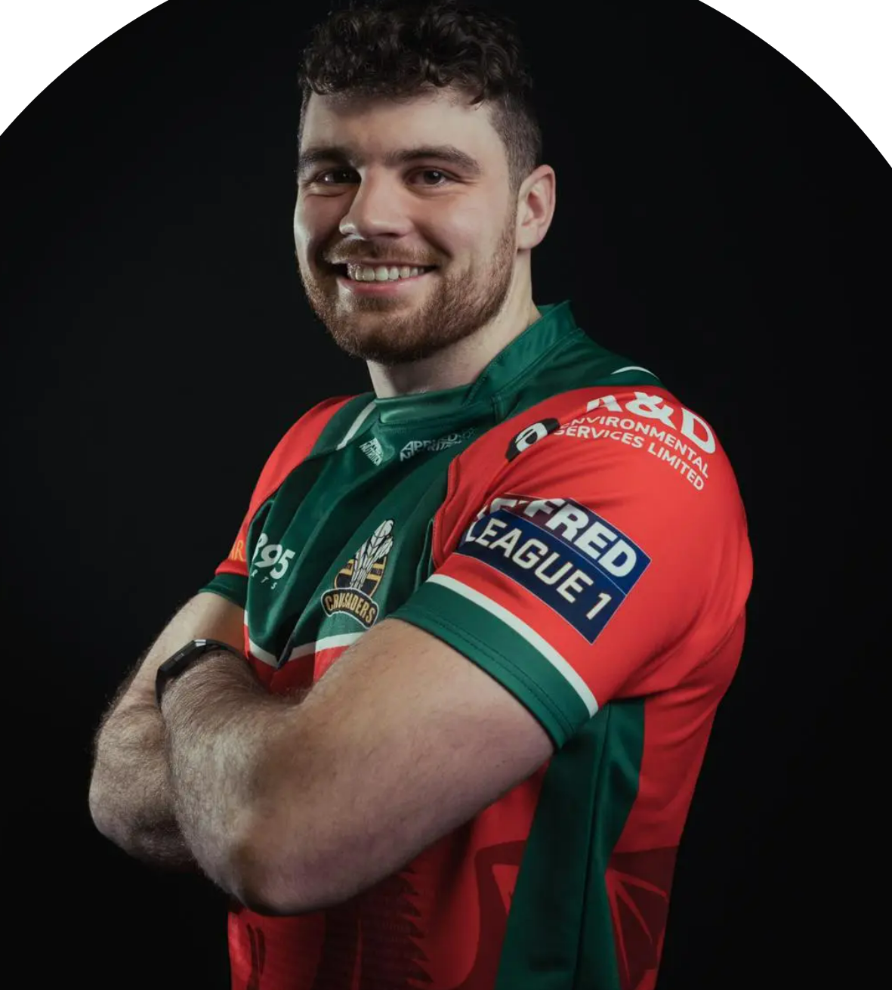
P.E. Kits
Coach Jade
Coach Mat
PE Kit
Plain Yellow/white t-shirt
Black shorts (not cycling)
Trainers suitable for outdoor sports
Black jogging bottoms and tracksuit tops without logo can be worn for outdoor games
Make-up, Jewellery, sock trainers, leggings

Slide 7

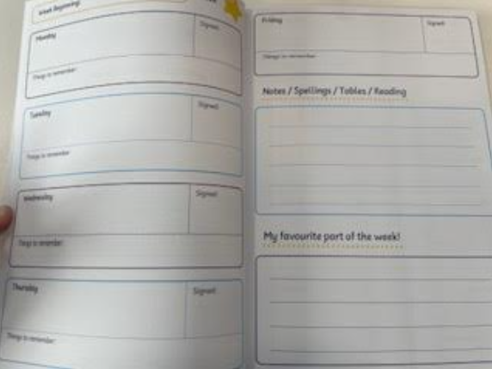
Homework and Spellings
Homework is set every Friday and due in by the following Wednesday.
Children will receive English homework and maths homework (Century Learning)
Spellings are given on a Friday and tested every Wednesday. The pass Mark is 15/20
Scores

Slide 8

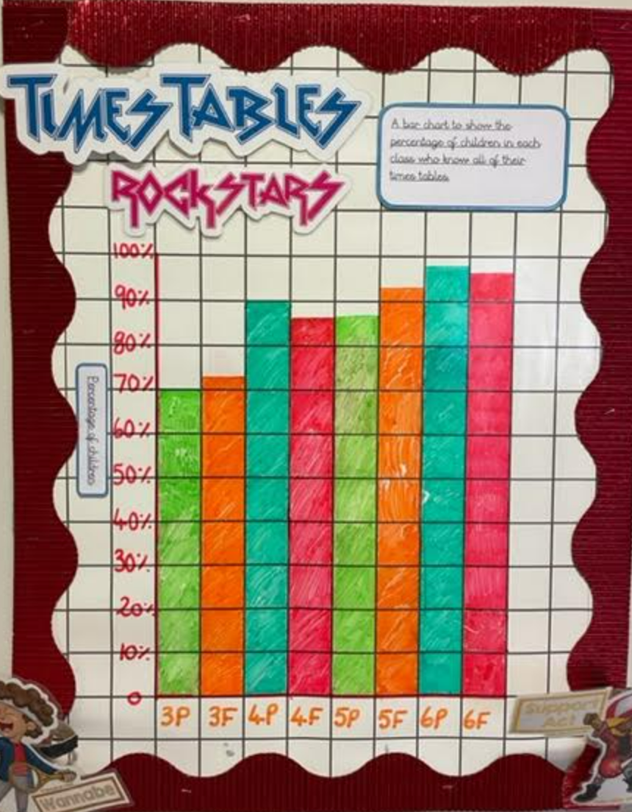
TTRS
The expectation for all children to be fluent by the end of Year 4.
All children have access to TTRS via app or website.
Children should practice everyday to ensure they are fluent and therefore able to access the Y6 curriculum.
Difference in speed between some of our Y6 pupils is significant.

Slide 9
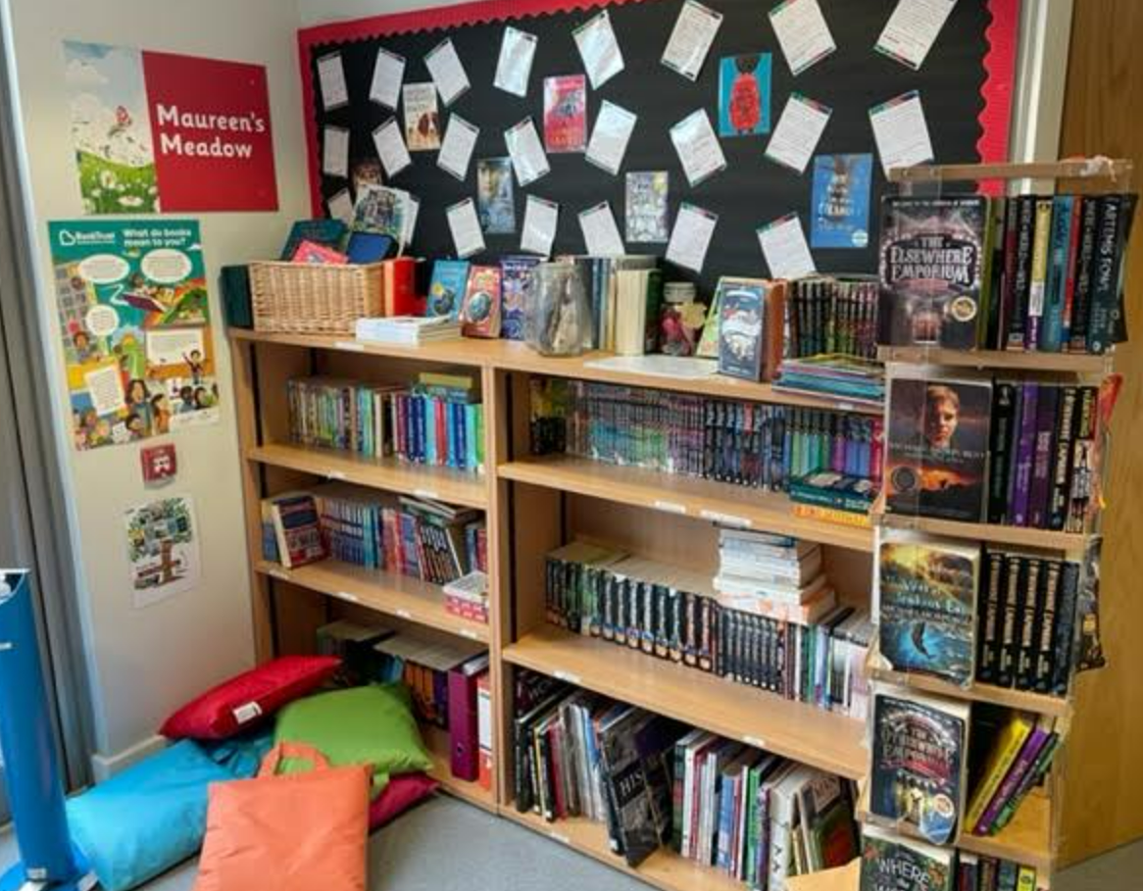
AR and Reading Records
Accelerated Reader is a measure of a child’s comprehension.
If they have AR books they will be able to choose from a level range, e.g. 2.2-3.2
Many Y6 children will be free readers and access the Y6 library.
Y6 children can update reading records. Please make sure your child is reading for at least 20 minutes per night.

Slide 10
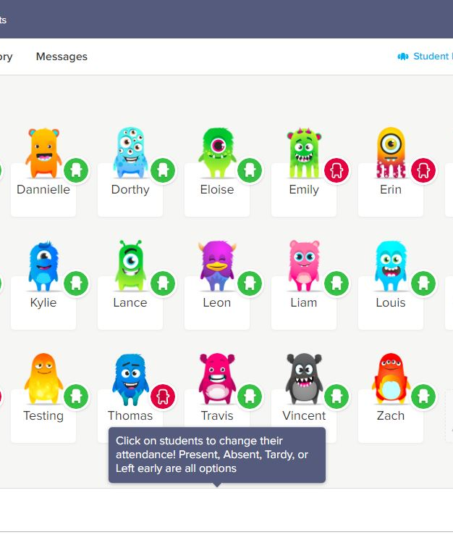
Class Dojo
Please make sure you are connected to Class Dojo and have notifications on!
We will share important information regarding class trips, after-school clubs, interventions and homework on Dojo.

Slide 11
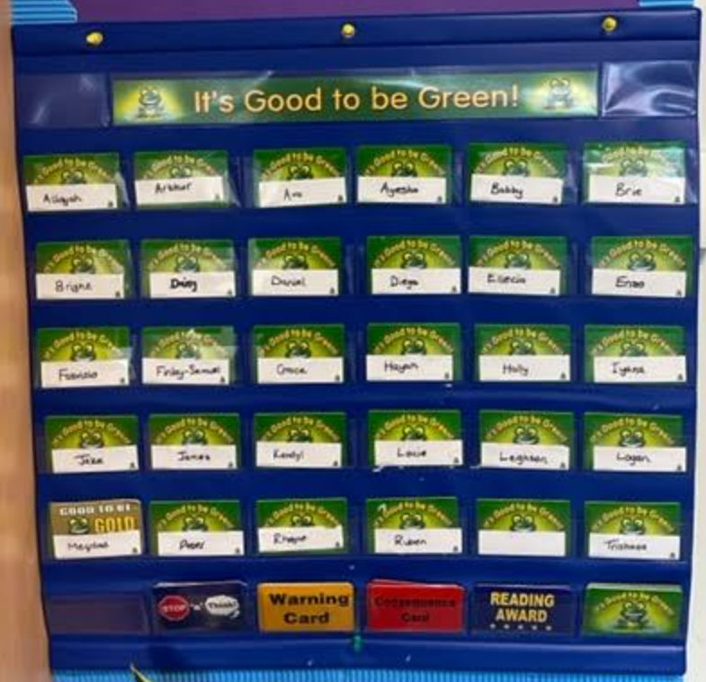
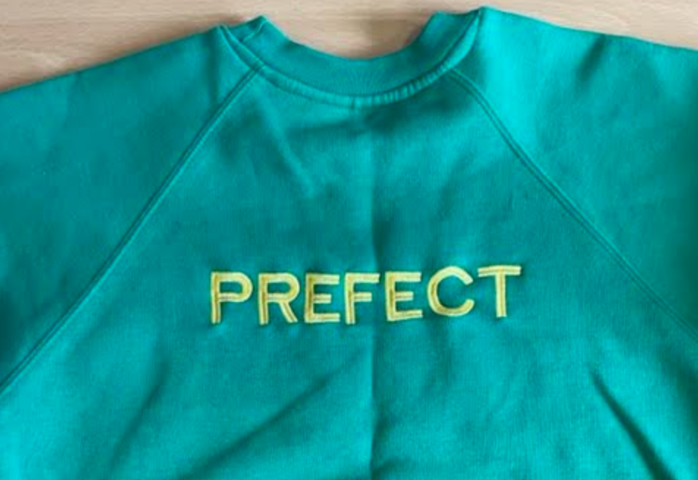
Behaviour- G2BG
Enrichment Time
Prefects

Slide 12
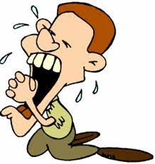
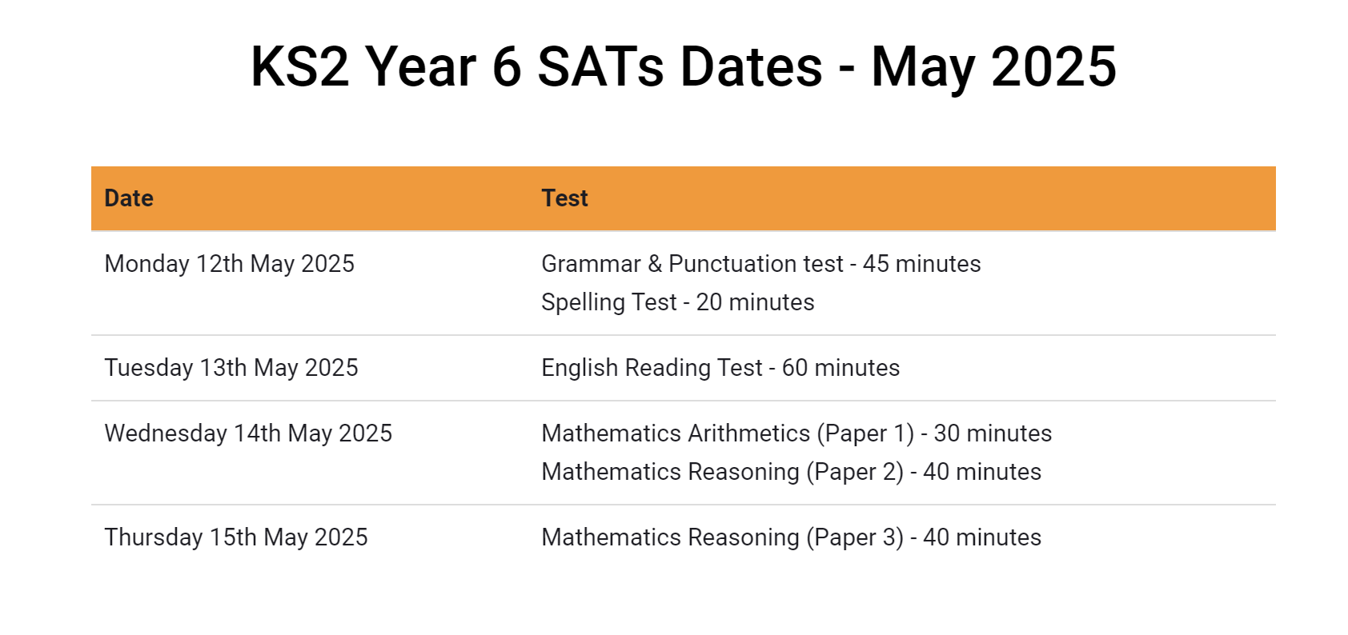
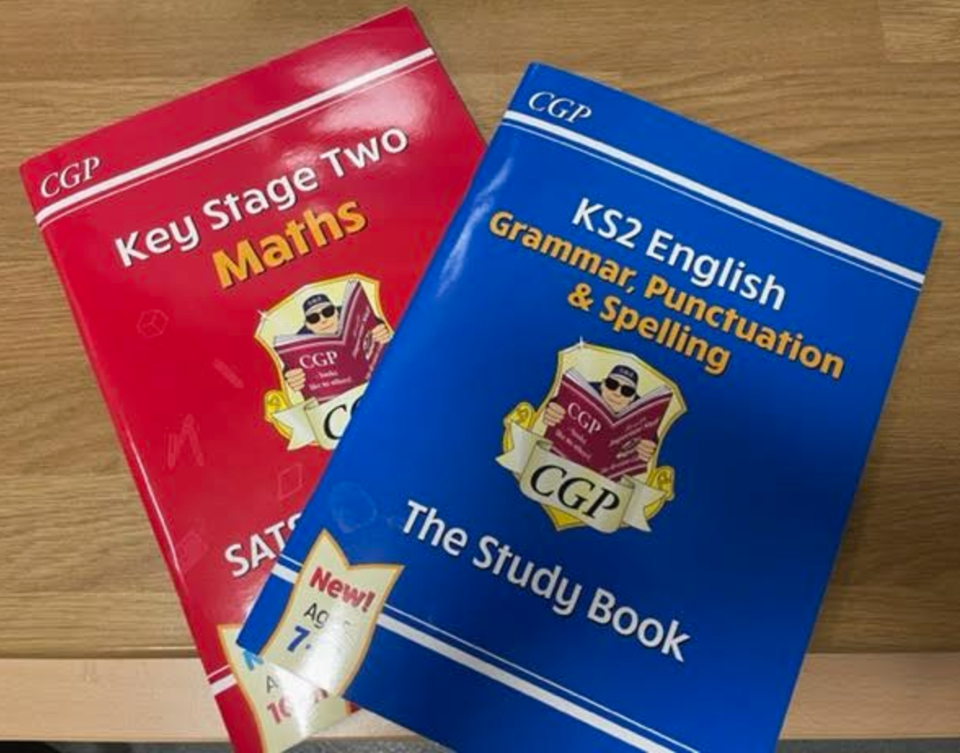
SATs
Please do not book a holiday
for this week

Slide 13
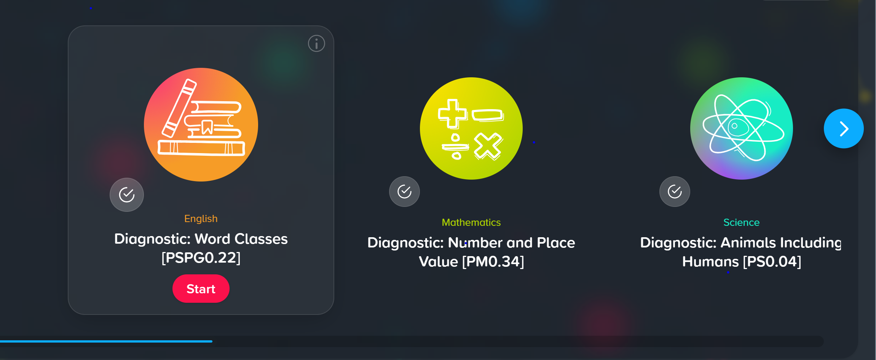
Century Learning

Slide 14
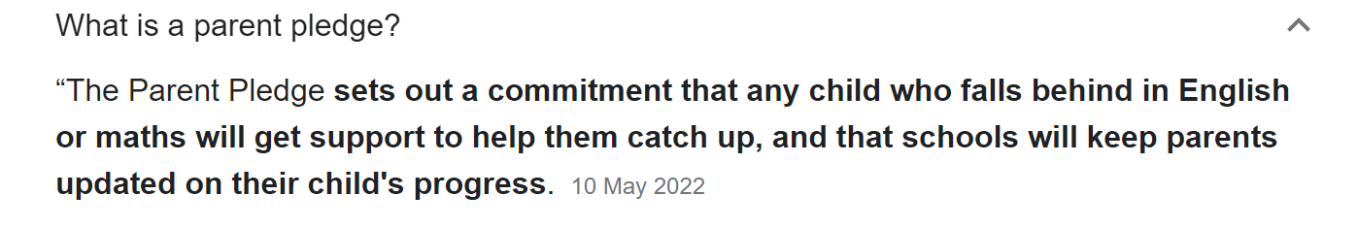
Parent Pledge
In-class interventions
Tutoring
Termly updates
Greater communication between parent and teacher

Slide 15
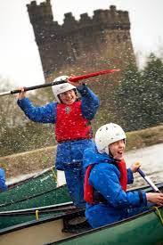
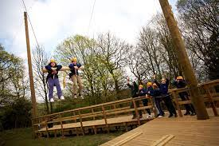
Residential Trip – Opportunity for those that missed out!

Slide 16
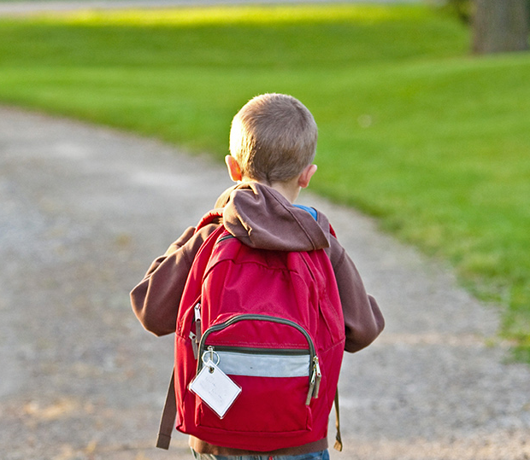
Thank You!
Any Questions?

