Slide 1

Parent Welcome Meeting
Sept 2025
Year Four

Slide 2

Meet the team
Year 4 Class Teachers-
Miss Fagan and Mrs Doran
Classroom TAs –
Miss Frances
PPA Cover- Mrs Phelan
Other important staff –
Mrs Stevenson

Slide 3
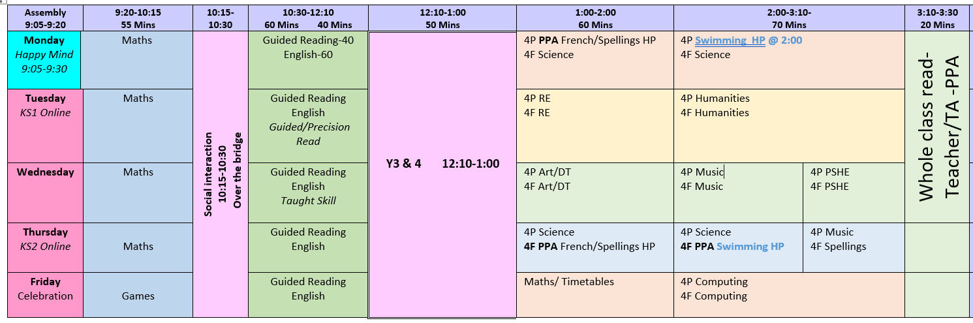
Timetable
Swimming:
4P Monday
4F Thursday
PE:
Friday

Slide 4
Uniforms
Please put names in all items of clothing.
Please ensure child has coat every day just in case.
Uniform has been perfect so far!
All long hair needs to be tied up.
Children are not permitted to bring a bag with them every day. Reading book bags will be provided.
All phones and smart watches must be handed to the teacher.
Footwear must be black and appropriate for the cage and equipment.

Slide 5
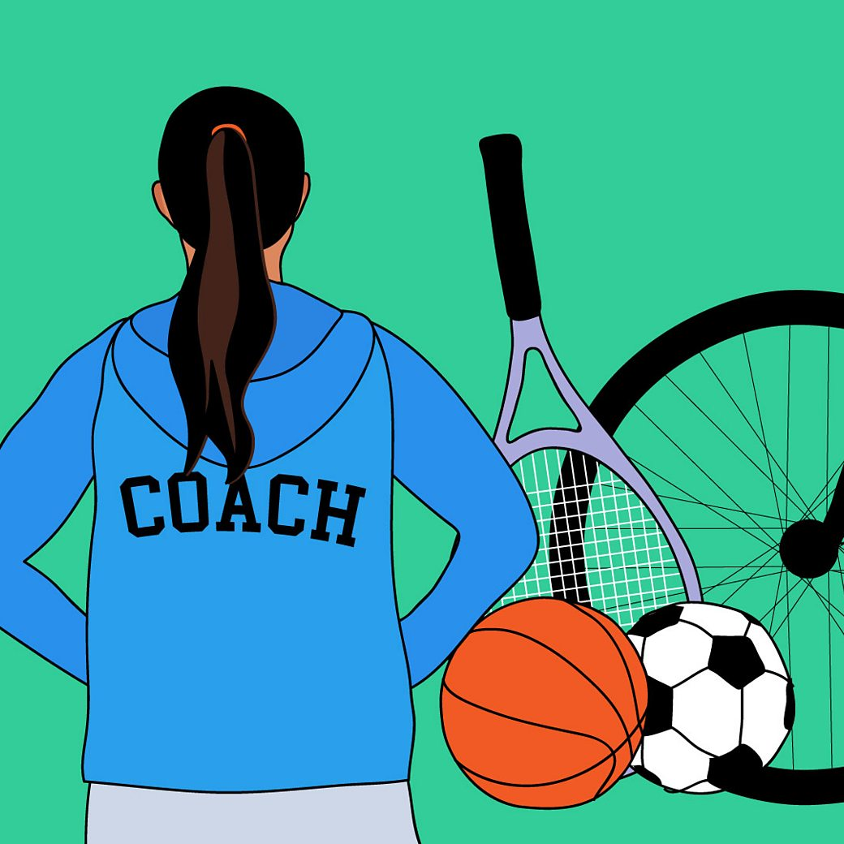
P.E. Kits and Uniforms
PE Kit
Plain Yellow/white t-shirt
Black shorts (not cycling)
Swimming trunks or costumes.
Prescription goggles only.
No jewellery (children must be able to take their own earrings out).

Slide 6
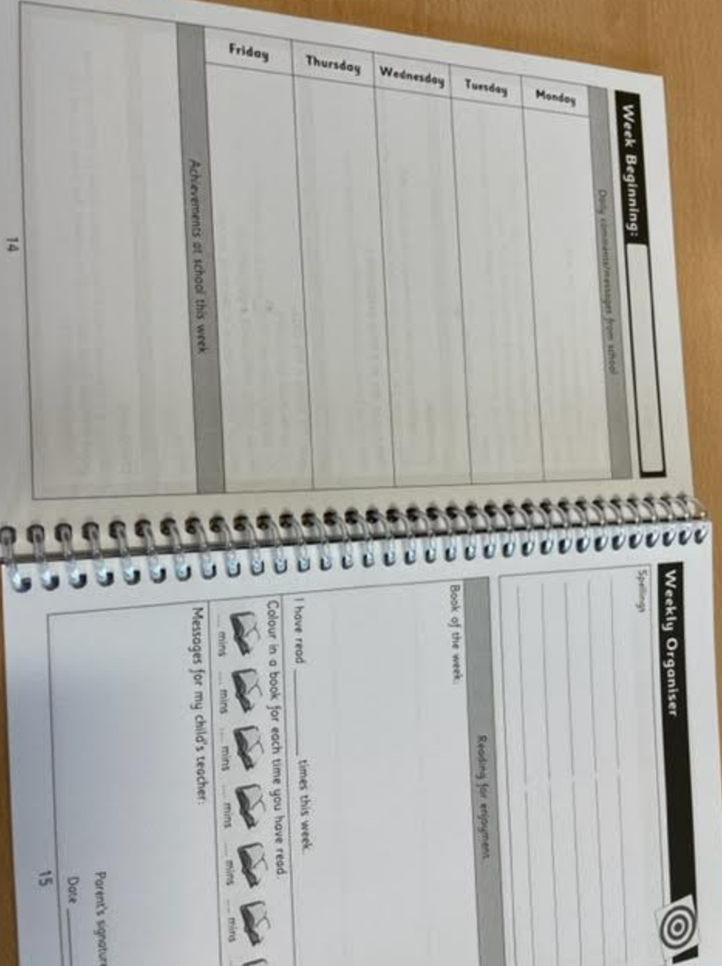
Homework and Spellings
Homework is set every FRIDAY and needs to be completed by WEDNESDAY. Homework will be tasks on TTRS, Spelling shed and Century.
Spelling will be provided weekly on a MONDAY for 4P and THURSDAY for 4F.
The school follows the Spelling shed system. You can download the app to support your children’s spellings- they have log in details.

Slide 7
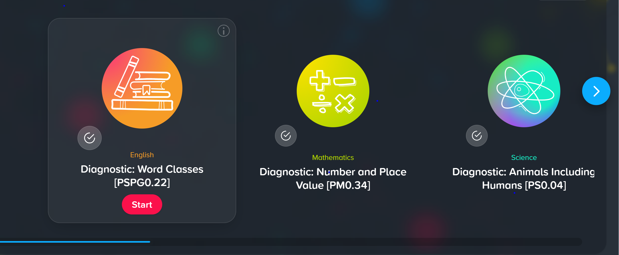
Century Learning

Slide 8
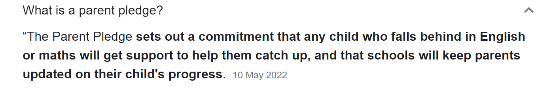
Parent Pledge
In-class interventions
Tutoring
Termly updates
Greater communication between parent and teacher

Slide 9

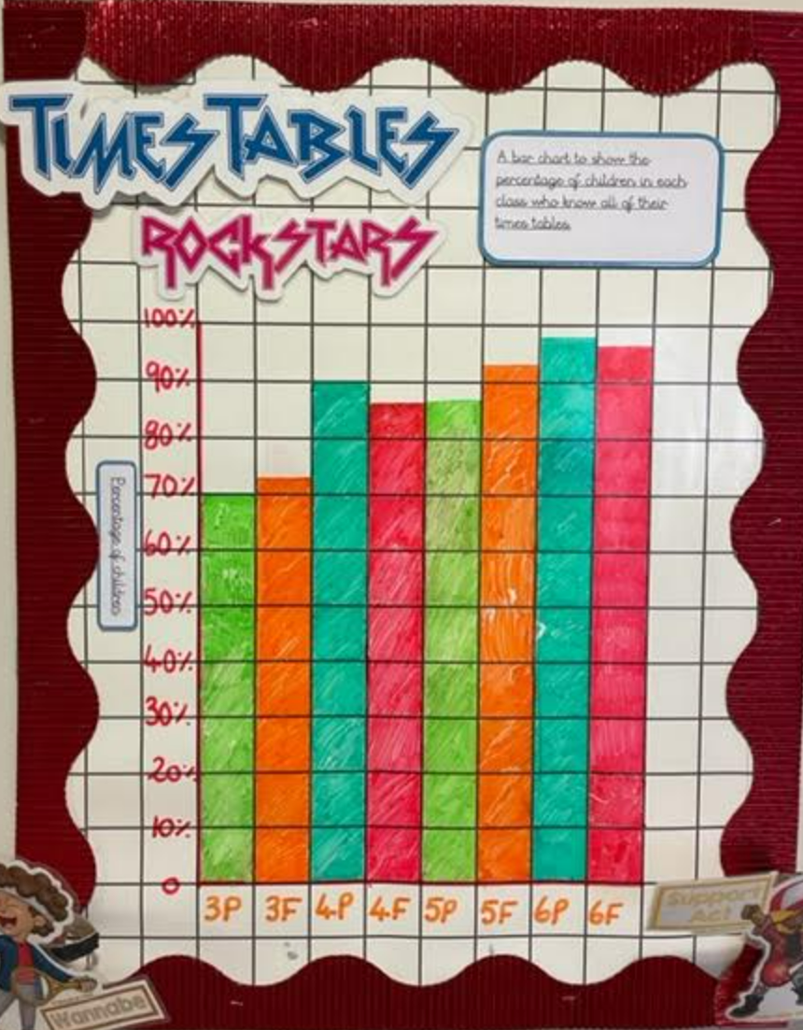
TTRS
The expectation for all children is to be fluent by the end of Year 4.
All children have access to TTRS via app or website.
Children should practice everyday to ensure they are fluent and therefore able to access the Y4 curriculum.
All children in Year 4 will sit a National Times Tables test in the Summer Term where they will need to know all of their times tables up to 12.

Slide 10
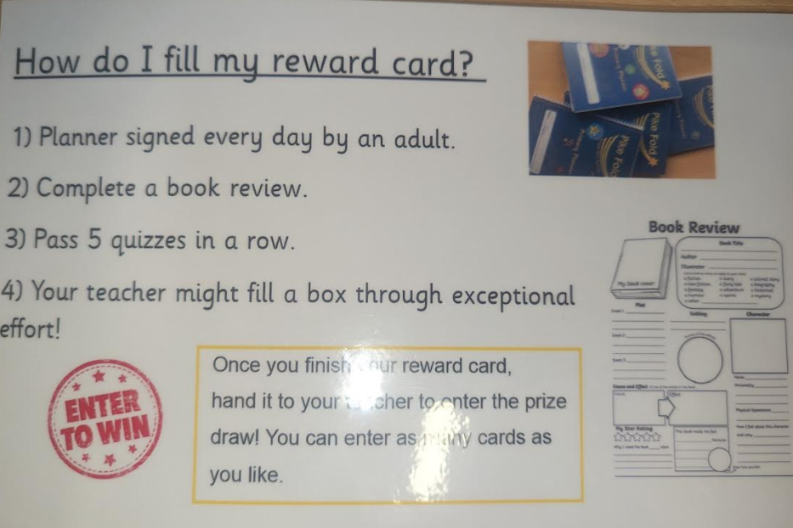
AR and Reading Records
Accelerated Reader is a measure of a child’s comprehension.
If they have AR books they will be able to choose from a level range, e.g. 2.2-3.2
After each book,your child will take a quiz and this will be recorded.
Please make sure your child is reading every night. If they do, please make sure their planner is signed.

Slide 11
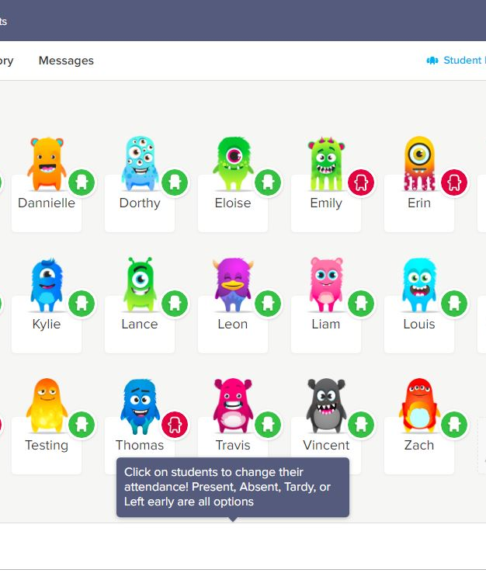
Dojo and Aspens
Please make sure you are connected to Class Dojo and have notifications on!
We will share important information regarding class trips, after-school clubs, interventions and homework on Dojo.
If you need to contact us, this is the easiest way.
Please order school dinners on the school spider wesbite by the 9:30am deadline each day if your child isn’t having a packed lunch.

Slide 12
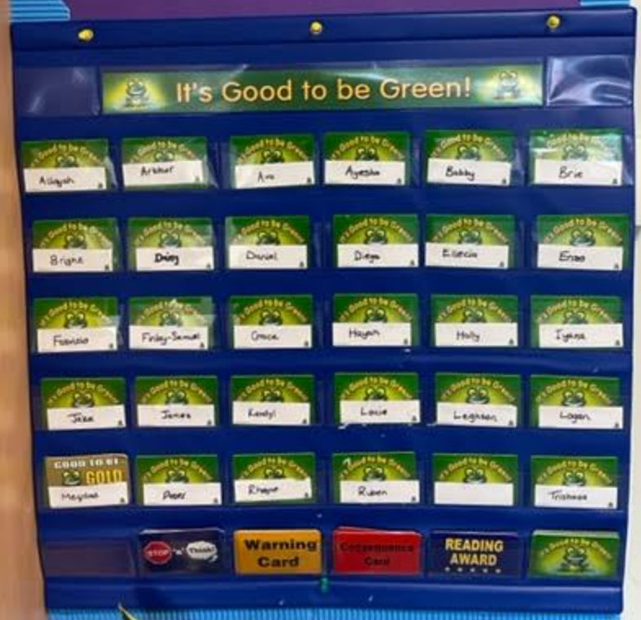

Behaviour- G2BG
To celebrate fantastic behaviour we use Good To Be Green cards and Class Dojo. The Dojo points are also added up at the end of each week to enter the House Points competition.

Slide 13
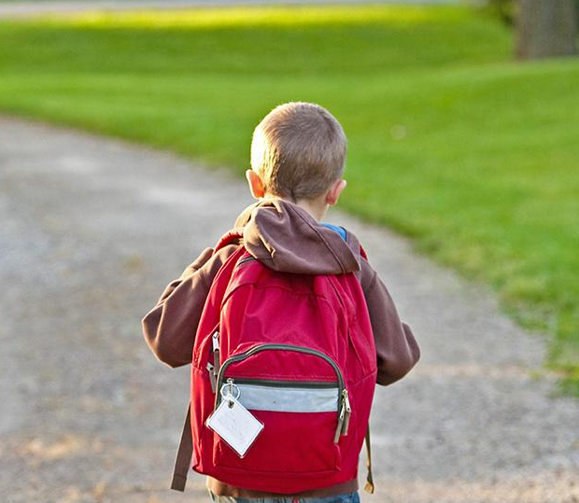
Thank You!
Any Questions?

