Slide 1

Welcome to Year 3
Owls and Falcons
What will Year 3 look like?

Slide 2
Year 3 Team
Owls Class Teachers:
Mrs Glendenning (Lower Key 2 Lead and History Lead)
Monday, Tuesday, Wednesday, Thursday
Mrs Rowland (SENCO)
Friday
Falcons Class Teacher:
Miss Bartley
Teaching Assistants:
Mrs Lovatt
Mrs Fox
Mrs Tracey

Slide 3
Senior Leadership Updates
Mrs Cade is Head of School and is the main point of contact for the day-to-day leadership of Hartford.
Miss Norris is Deputy Headteacher and deputises for Mrs Cade every Friday and on alternate Thursdays.
Mrs Hacking is Executive Headteacher, providing part-time strategic leadership, oversight and support across Hartford and Cuddington Primary Schools.
Mrs Cade, Miss Norris and Mrs Hacking work closely together to ensure consistent leadership across the week.

Slide 4
Forest Schools
Every Thursday after October half term.
Come into school in their forest school clothes. Please ensure these are warm and waterproof and bring a spare change of clothes and shoes for remainder of the day.
We will send comms again nearer the time.

Slide 5
Swimming
Falcons – Spring 1
Owls – Spring 2
On their swimming day they will need to bring their swimming kit in a named bag. They will be assessed during their first session and taught in their corresponding groups with a swimming teacher per group.
We will send comms again nearer the time.

Slide 6
Year 3 Trips
Autumn day trips will be – Beeston Castle 6th October
- St Johns Church
Spring day trip will be – Chester Zoo
Summer day trip will be – Thurstaston Beach

Slide 7
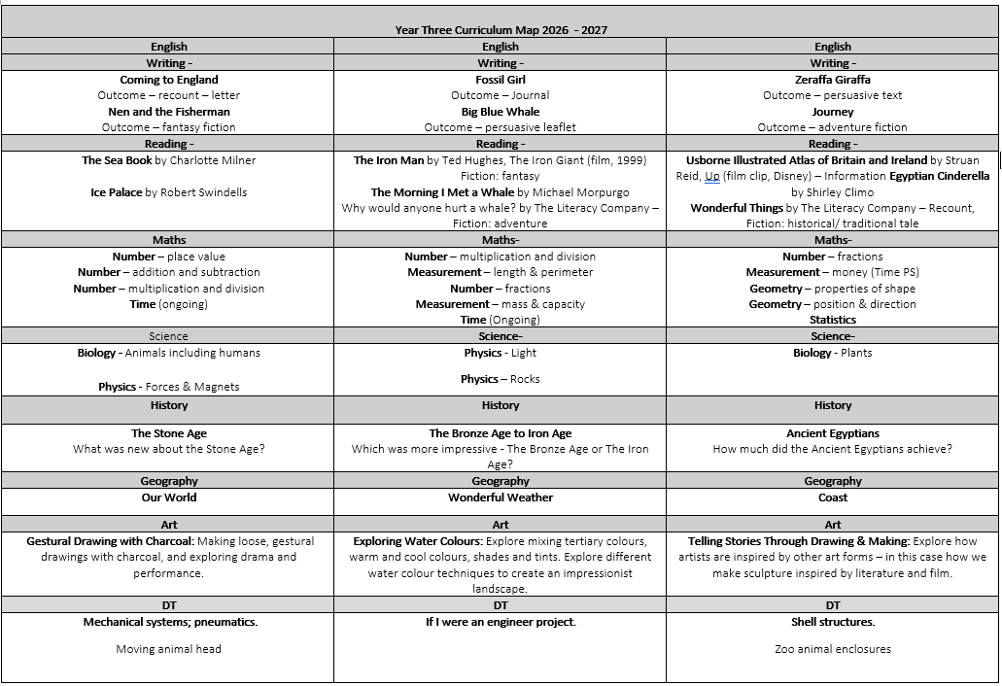
Our curriculum map

Slide 8
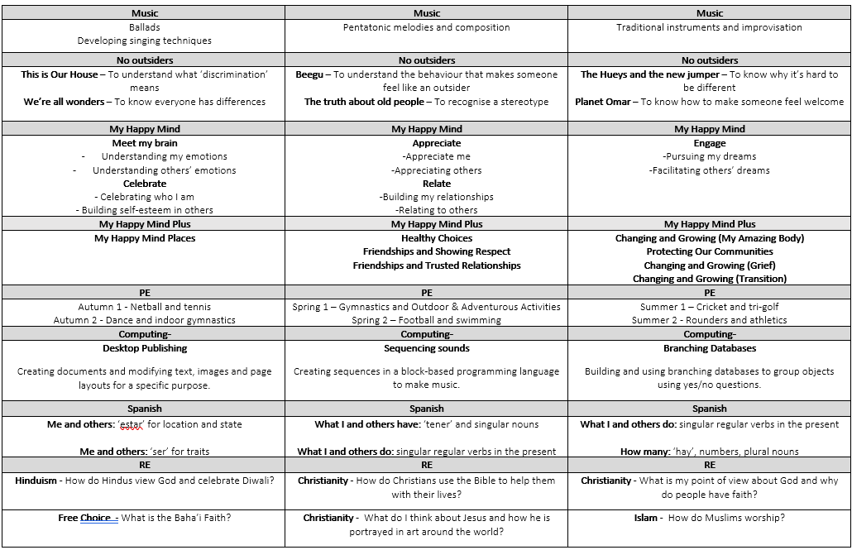
Our curriculum map

Slide 9
Reading
Please ensure that your child reads to you at least 3 times a week but every night is great. Children can also read for pleasure, books from home and borrowed books from school.
Please sign reading records every time your child has read with you (at least 3 times a week). This doesn’t need to be their school reading book.
Learning key words and asking questions about the books that they are reading are great ways to engage in your child’s reading.
We are in the process of benchmarking and over the next two weeks your child will have their new book band given to them.

Slide 10
Reading
We teach whole class reading in year 3. During these sessions we cover fluency, retrieval and inference.
Your child can change their reading book on any day when they need to.
We will give your child a day for their reading diary to be in school when we will communicate what we are doing in our reading sessions that week.

Slide 11
English
Areas of learning this half term are:
Punctuate using capital letters and full stops
Sequence sentences to form short narratives
Join words and clauses using and
Combine words to make sentences
Group related ideas into paragraphs
• Build a varied and rich vocabulary
• Use prepositions to express time, place and cause
• Introduce inverted commas to punctuate direct speech
Learning outcome:
Writing outcome: To write letters from Floella to her Grandmother telling her about settling into life in the UK.
Greater depth writing outcome: To include a letter from Grandmother in response to one of Floella’s letters.

Slide 12
Spellings
Your child will continue to have spelling and/or phonics sessions three times a week.
Your child will get spellings to take home to practice that can be found in the middle of their reading diaries.

Slide 13
Maths
Areas of learning this term are:
Place Value
Addition and Subtraction – mental and written
Real life problem solving
Written and mental strategies
Time
Presentation of work
If you could talk to your children when opportunities for maths present themselves in the real world. E.g. baking, shopping, distance. So they can see practical applications of maths.

Slide 14
Homework
Weekly times table practice on TTRockstars
Weekly reading x 3
Yr3/4 Spellings
Alternative weeks: Maths task
Alternative weeks: English task
Homework will be given out on a Friday and due in the following Friday. We mark this as a class together to develop the children’s ownership of work.

Slide 15
Physical Education
Owls – Thursday and Friday
Falcons – Wednesday and Thursday
This term, while the weather is nice, we will try and go outside where possible. Next half term, when the weather might be less favourable, we will do dance and gym.
Children are to come to school in their PE kit.
If your child has earrings in, on their PE/swimming days please either remove these or have them covered with tape or plasters when they come to school.

Slide 16



Reminder of our PE Kit at Hartford
Royal blue PE t-shirt with school badge or plain blue or white t-shirt.
Dark blue shorts, leggings or joggers with the school badge.
Blue hoodie with the school badge.
Trainers.
Equivalent kit without the school badge is acceptable as long as it is the same colour.
No jewellery.
If earrings have been in for less than six weeks, they can be taped up. Please provide your child with some medical tape or plasters and teach them how to do this. After six weeks, your child will be asked to take their earrings out.

Slide 17
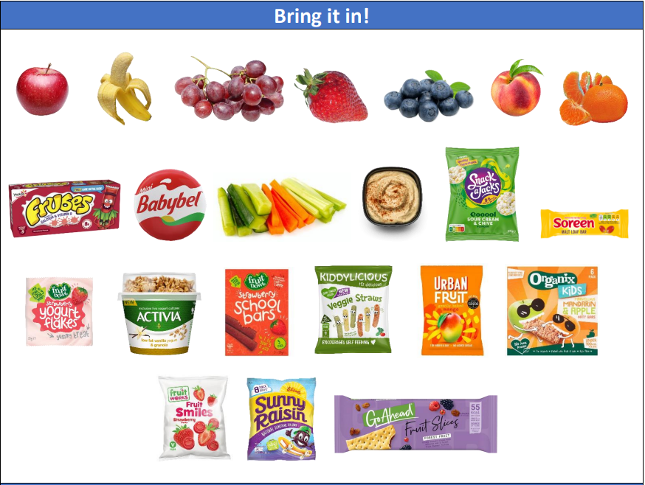
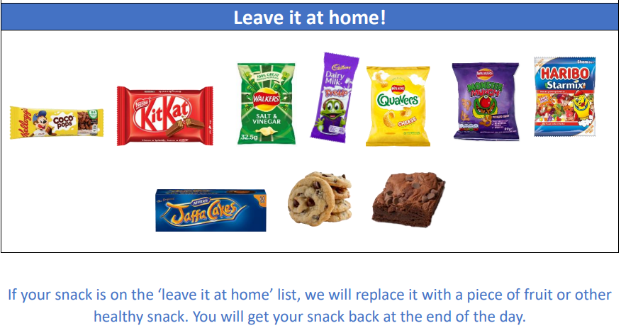
KS2 Snacks
Water bottles not juice (labelled) – access all day (but not during class inputs). Please remember to wash these every day to avoid illness.
A healthy morning snack – please no crisps or chocolate..

Slide 18
Year 3 Outcomes
Developing independence
Responsibilities to take care of their own belongings, homework and PE/ Games kit.
To ask for help whenever the children require it.

Slide 19
Behaviour and Discipline
High expectations
Positive discipline – Verbal praise, stickers, certificates and tokens.
Half termly class treat, in our classroom.
Count 1,2,3
Parental involvement when necessary

Slide 20
Medical
If there are any updates please inform the office.
See office for new medical forms.
A reminder that we are a nut and kiwi free school as we have several children with severe allergies.

Slide 21
Home Time Routine
3:20pm from outside our classroom door.
If your child is going home with someone else, please can you ensure that you have informed ourselves on the door in the morning, via email or the office as we can not release your child without consent.
To help keep all our children safe, we ask that you refrain from using your mobile phones whilst you are on the school premises.

Slide 22

Instagram: hartfordps2025
We are excited to share the Hartford Primary School
@hartfordps2025.
This account has been created to give people a window into daily life across our school. We will be sharing highlights from each class, celebrating achievements, showcasing learning experiences, and promoting upcoming events and activities.
Our aim is to provide greater insight into the rich and varied opportunities our children enjoy every day.
In the interest of safety, we are moving away from sharing images of children’s faces.

Slide 23
Contacting us
Please feel free to catch us on the door after we have dismissed the class.
Please get in touch any of us via our Year 3 email address: year3@hartfordprimary.cheshire.sch.uk
We aim to get back to you within 24 hours, during our working hours.

Slide 24
Thank You
Thank you for attending and we look forward to getting to know you all!
(If we don’t already).
Thank you,
Mrs Glendenning, Miss Bartley and Mrs Rowland
Year3@hartfordprimary.Cheshire.sch.uk

