Slide 1

Coronavirus Social Story
HOW TO KEEP MYSELF AND OTHERS SAFE

Slide 2
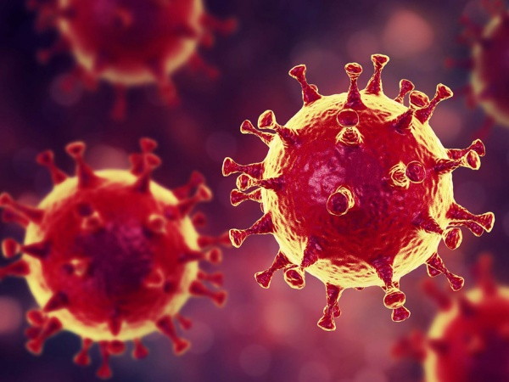
What is coronavirus?
Coronavirus is an illness that makes people poorly. You may get a cough and a temperature.
Most people will just feel like they have a cold and will soon feel better.
A small number of people will need to go to the hospital and will need the doctors and nurses to help them to get better.

Slide 3
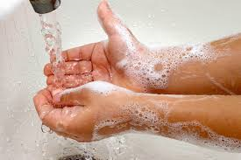
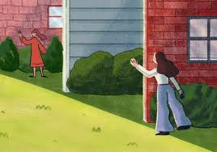
There are two very important things you can do to help...
Wash your hands regularly with soap and water
Stay away from others whenever you can

Slide 4

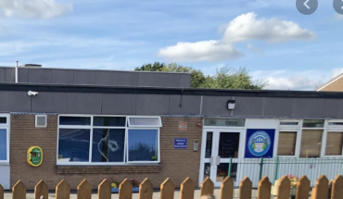

Things will be different for a while, school is closed for most children
You may need to be looked after in school if your parents need to go to work.
When you are not at school you must stay
at home.

Slide 5




What will happen if I need to go to school?
You will be looked after by adults that you know.
You may be with children that aren't in your class and will make new friends.
There will be fun activities.
It won't be a normal school day, there won't be any lessons.
This Photo by Unknown author is licensed under CC BY-SA.

Slide 6

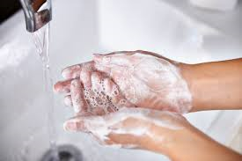

Before school and after school
Before you come to school you must make sure you are washed and clean
When you get home you must wash your hands, have a shower or bath and put your clothes in the wash
When you come into school the first thing you will do is wash your hands
Don't forget to wash your hair!

Slide 7

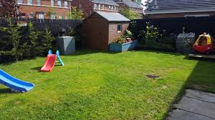
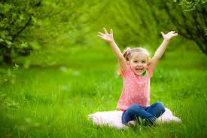
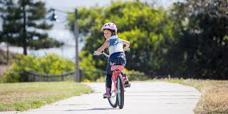
When you are at home...
Remember to keep a safe distance away from others when outside
You will stay with just the people you live with.
You can play in your garden.
You can go out for a walk or a bike ride.
You must not mix with any other people; this will help to stop others catching the virus
Enjoy the outdoors!

Slide 8



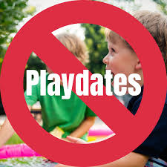
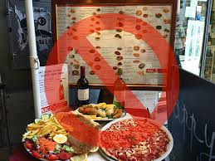
There are some things you won't be able to do for a while
As soon as it is safe for us, we will be able to do these things again
If we all stick to this, it will help to keep us all safe
Parties
We need to do this for as long as we are told to
Restaurants

Slide 9

When the virus stops spreading, we will be able to go back to normal and enjoy being with all our friends and family again
The end

