Slide 1

Welcome to Early Years
Mrs Rowland – Squirrels
Miss Hall - Hedgehogs

Slide 2
Leadership @ Hartford
Mrs Cade is Head of School and is the main point of contact for the day-to-day leadership of Hartford.
Miss Norris is Deputy Headteacher and deputises for Mrs Cade every Friday and on alternate Thursdays.
Mrs Hacking is Executive Headteacher, providing part-time strategic leadership, oversight and support across Hartford and Cuddington Primary Schools.
Mrs Cade, Miss Norris and Mrs Hacking work closely together to ensure consistent leadership across the week.

Slide 3
The EY Team
Teachers
Mrs K Rowland
Miss Hall
Teaching Assistants
Mrs E Lenton
Mrs V Walker (Mornings and 2 afternoons)

Slide 4

Phonics
We teach ELS Phonics at Hartford.
Essential letters and sounds. All children will be taught as a whole class. Within each lesson we will:
Introduce new learning – a new sound per day 4/5 days within a week.
Revisit sounds already learnt
Practise
Apply learning through reading or writing

Slide 5
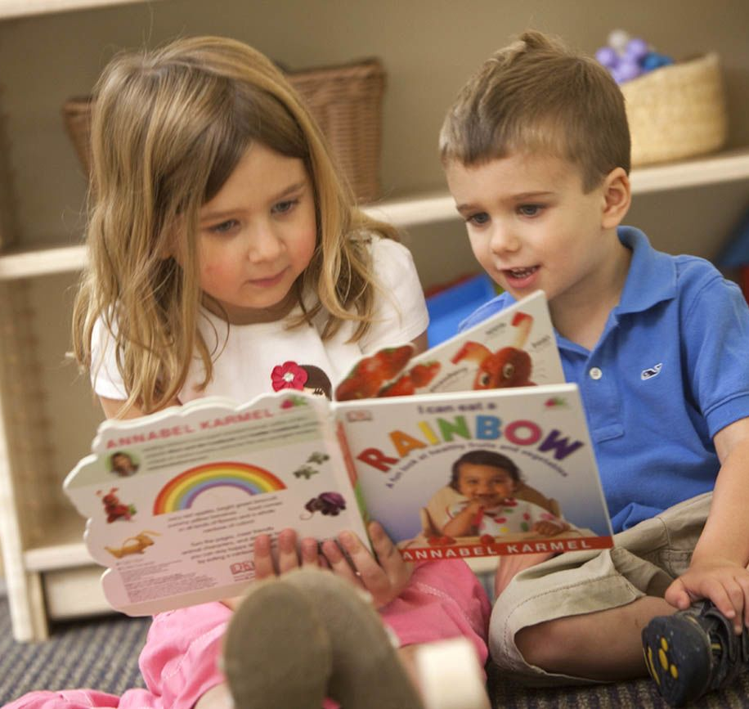
Reading
Phonics book – 1 per week - Friday
Reading for pleasure book - Monday
Shared reading
Guided reading
Independent reading

Slide 6
Your role
Model the strategies you want your child to use when reading:
  Point at words
  Picture cues
  Sound out single sounds (phonemes)
  Find words within words
  Pull the word apart (segment) and join it back together (blend)
  Read forward, read back
  Make an informed guess
  Question the meaning

Slide 7
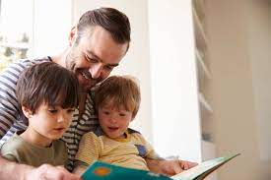
Reading at home
This should be and enjoyable experience for you and your children.
Please try to ensure that your child reads at least 3 times a week but every night is great. (10 minutes). Learning key words and asking questions about the books that they are reading.

Slide 8

Reading
Every Thursday we will check reading records for reading and parent/guardian signatures. There will also be a comment in your child's reading record when they have worked with an adult in class, this will be once a week.
New reading books will be sent home every Friday to be returned the following Thursday.
Reading for pleasure books to be exchanged on a Monday.

Slide 9
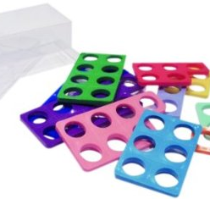
Maths
Daily structured whole class teaching
Warm up – songs
Introduce new learning
Practise
Weekly focus groups
Numicon

Slide 10

Thank you for activating your accounts – please let me know if you want an additional contact adding.
The app is also available as a free download for apple and android tablets and you log in the same way if you use the app.
Seesaw will only be used for recording ‘wow’ moments in school.
Newsletter and homework will be shared via Seesaw every Friday.

Slide 11

Homework
Homework will be given out on a Friday in the newsletter. This may be linked to any learning we have done throughout the week or may be Topic based.
Homework can be shared on Seesaw, emailed or handed in throughout the week.

Slide 12
Physical Education
Monday mornings
This term, while the weather is nice, we will try and go outside. Next half term, when the weather might be less favourable, we will do dance and gym.
Children are to come to school in their PE kit.

Slide 13


PE Kit
Blue T-shirt
Black or navy blue shorts
Trainers
Winter Games Kit
Plain tracksuit or joggers no football strips.
Trainers

Slide 14

Healthy Minds
Water bottles not juice (labelled) – access all day.
Snack is available in the morning.
Bring your own or have some fruit.
Please, no crisps or chocolate.

Slide 15

Teach me Tuesday
Each Tuesday we plan to complete ‘Teach me Tuesday’. Your child will be given a date and be asked to share or ‘Teach’ the class a skill they have learnt at home. Maybe they have baked cakes, learnt to ride their bike, gone under the water at swimming etc…
We welcome videos/photos or items to support the children in sharing their skill.
Each child will get a slot every half term – they do not have to complete if they don’t want too.
Dates are on Seesaw.

Slide 16
Medical
Any updates?
See office for new medical forms.
A reminder that we are a nut and kiwi free school as we have several children with severe allergies.
Toileting.

Slide 17
Behaviour and Discipline
Positive discipline – Verbal Praise, Stickers, and tokens.
Half termly class treat, in our classroom.
Count 1,2,3 Time out
Parental involvement.

Slide 18

Important dates
SALT and Phonics Evening – Thursday 17th September @ 5pm
Come dine with me – Friday 25th September @ 11.30 – more details from the admin team to follow
Come and play – Squirrels – Monday 19th October @ 2pm
Come and play – Hedgehogs – Tuesday 20th October @ 2pm

Slide 19
Contacting us
Please feel free to get in touch with any of us via our Early Years email address: earlyyears@hartfordprimary.cheshire.sch.uk
We will aim to get back to you within one day.

Slide 20

Instagram: hartfordps2025
We are excited to share the Hartford Primary School
@hartfordps2025.
This account has been created to give people a window into daily life across our school. We will be sharing highlights from each class, celebrating achievements, showcasing learning experiences, and promoting upcoming events and activities.
Our aim is to provide greater insight into the rich and varied opportunities our children enjoy every day.
In the interest of safety, we are moving away from sharing images of children’s faces.

Slide 21

Thank you for attending and we look forward to getting to know you all!
(If we don’t already).

