Slide 1


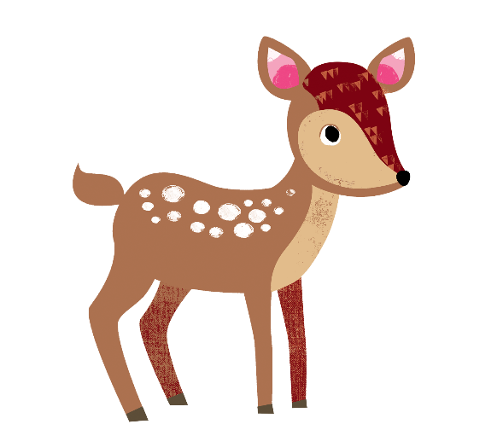

Getting all children to
read well, quickly.

Slide 2


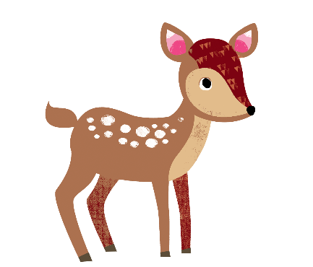

What are we going to cover?
What is Phonics?
What is Essential Letters and Sounds?
How we teach phonics
Getting children ready to read
Supporting your child with reading at home
Pronouncing pure sounds
Using the letter formations and spelling sequence to support writing at home
© Oxford University Press 2021
Notes:
Overview of Essential Letter and Sounds and how it works
Resources – what they are and how they are used
Assessment and Intervention – what does this look like and how is it implemented
Next Steps – what happens next!
We will check the questions in the chat box at the end of the session so there will be plenty of time to answer and queries then

Slide 3
What is Phonics?
A method of teaching beginners to read and pronounce words by learning to associate letters or letter groups with the sounds they represent.
There are 44 main sounds in the English Language. Each sound is represented by a grapheme (the written representation of a sound).
© Oxford University Press 2021
Notes:
Begin by explaining what Phonics is. Explain that learning to read the English language is complex and that this information session will give parents & carers the understanding of what Phonics is, the terminolgy used in Phonics and how ELS gives children the skills and knowledge to read well, quickly.

Slide 4
What is Phonics?
Phoneme: the smallest single identifiable sound in a word.
For example, in the word 'cat' there are three phonemes c/a/t.
Grapheme: the written representation of a sound.
Digraph: two letters making one sound. For example, /sh/ in the word 'shop'.
Trigraph: three letters making one sound. For example, /igh/ in the word 'night'.
Split digraph: two vowel letters split but are split by one or more consonants. For example, /a-e/ in the word 'cake'.
© Oxford University Press 2021
Notes:
Use flashcards to put this into context. Show parents examples of graphemes, digraphs, trigraphs and split digraphs. Where possible, make the link between same sound, different spelling.
Example:
<a>
acorn
<ai>
rain
<ay>
play
<a-e>
name
<eigh>
eight
<ey>
they
<ea>
great
<aigh>
straight

Slide 5
What is ELS?
Essential Letters and Sounds (ELS) is our chosen phonics programme
Children will experience the joy of books and language whilst rapidly acquiring the skills they need to become fluent independent readers and writers.
© Oxford University Press 2021
Notes:
We use phonemes and graphemes to teach children the code of our language.
English is one of the most challenging languages to learn as there are so many ways to spell the sounds of our language.
We teach children to decode words – by identifying each of the written sounds within the word before blending them together to read the word. This is a challenging process for children to learn and takes time to master. When they are able to decode and blend to....

Slide 6
How do we teach phonics?
We use a simple, consistent approach to teaching phonics.
We have mnemonics and rhymes to support learning and recall
We teach phonics every single day from the first days of Reception
© Oxford University Press 2021
Notes:
Phonics teaches the link between the spoken sounds of our language and the written version of that sound – the code of our language.
As systematic synthetic phonics programme breaks this down into tiny steps for children to piece together which allows them to decode to read and then spell using the sound to spelling correspondences they have learnt.
We use a simple, consistent approach to teaching phonics.
Your child will experience the same classroom routines within each lesson which reduces cognitive load and maximises the chances of success.
All children are supported within the lesson to use their new phonic knowledge independently.
In every single ELS lesson, your child will make the direct application to reading.

Slide 7
How do we teach phonics?
Phonics throughout the day to review new sounds & graphemes taught
Lots of opportunities for oral blending- /c/ /oa/ /t/
We teach the ‘code’ for reading, alongside teaching vocabulary.
© Oxford University Press 2021

Slide 8
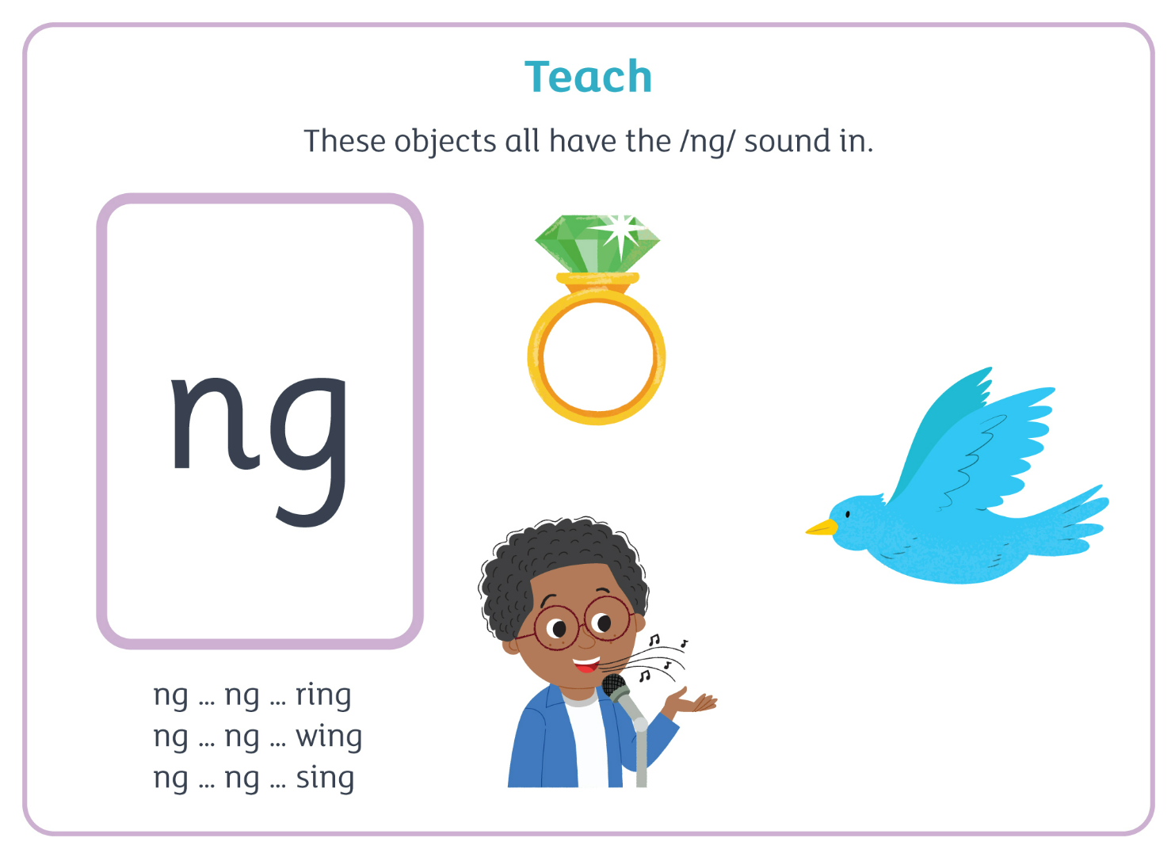
How do we teach phonics?
© Oxford University Press 2021
Notes:
In ELS we do not ask children questions before we have taught them.
For example, when teaching a new sound, rather than asking children if they know any words with the sound in - we give the children 3 words that contain that sound. You can try this with your children at home.

Slide 9
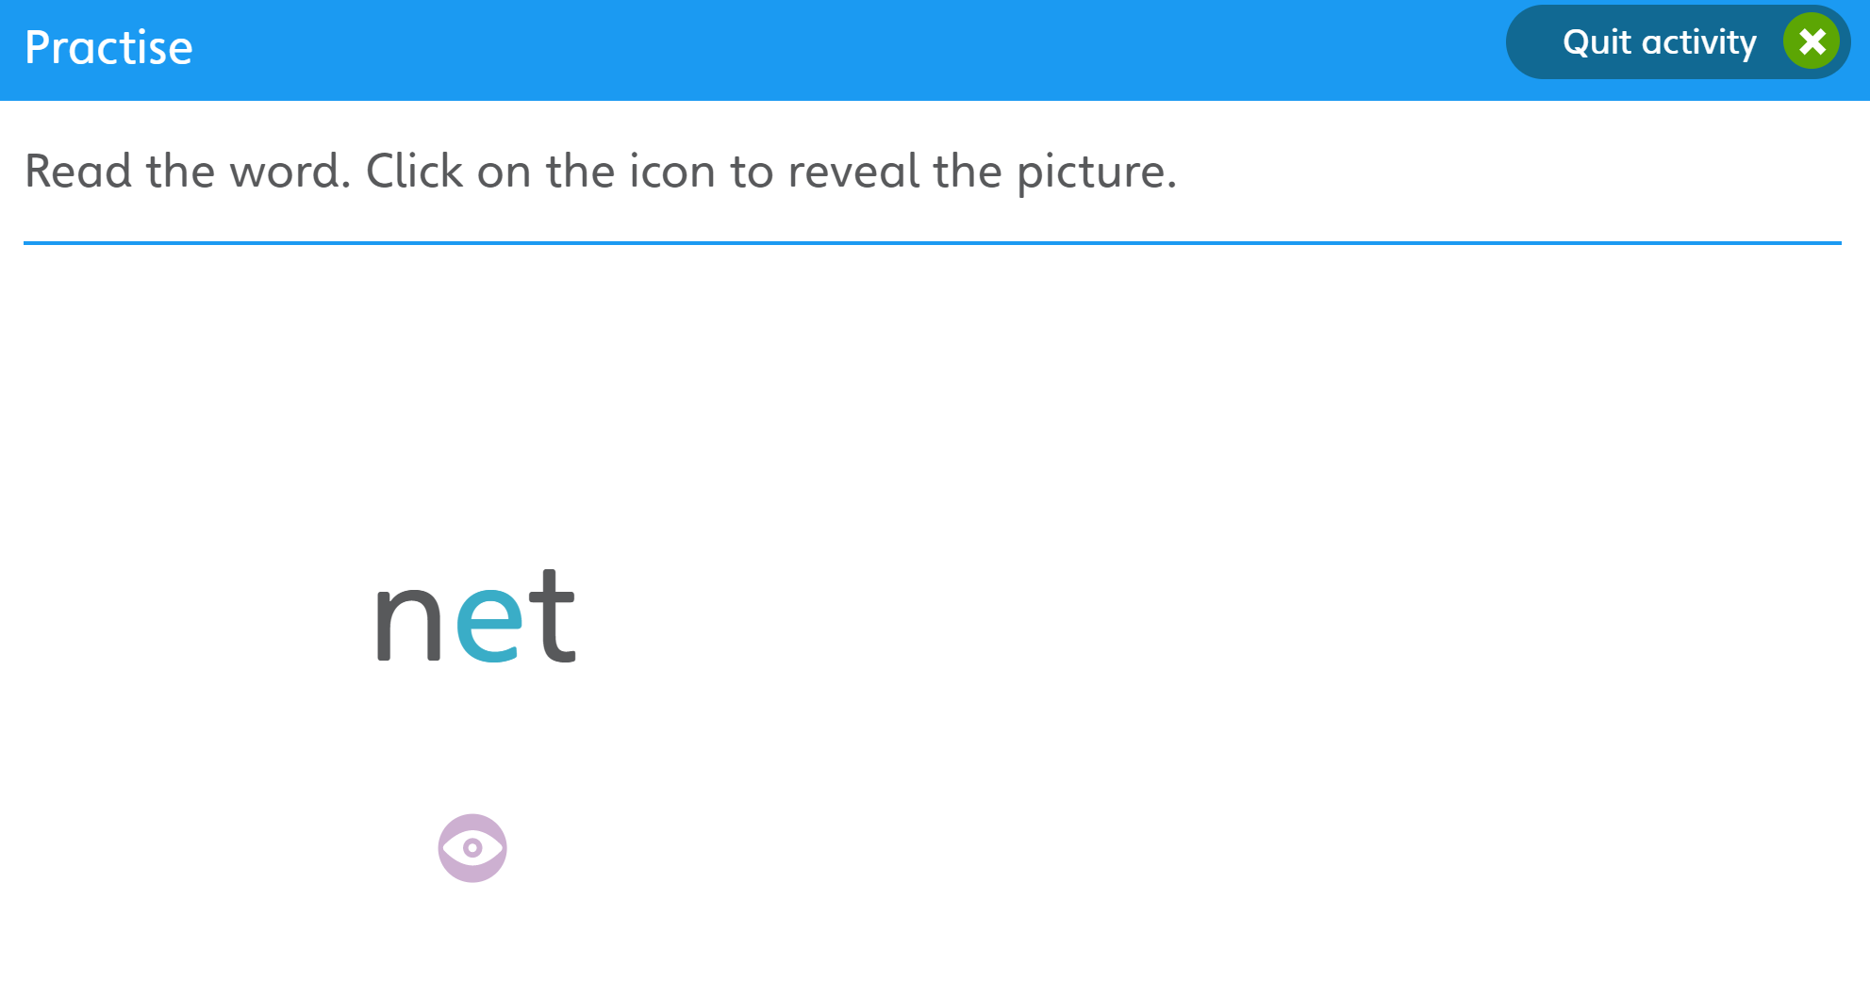
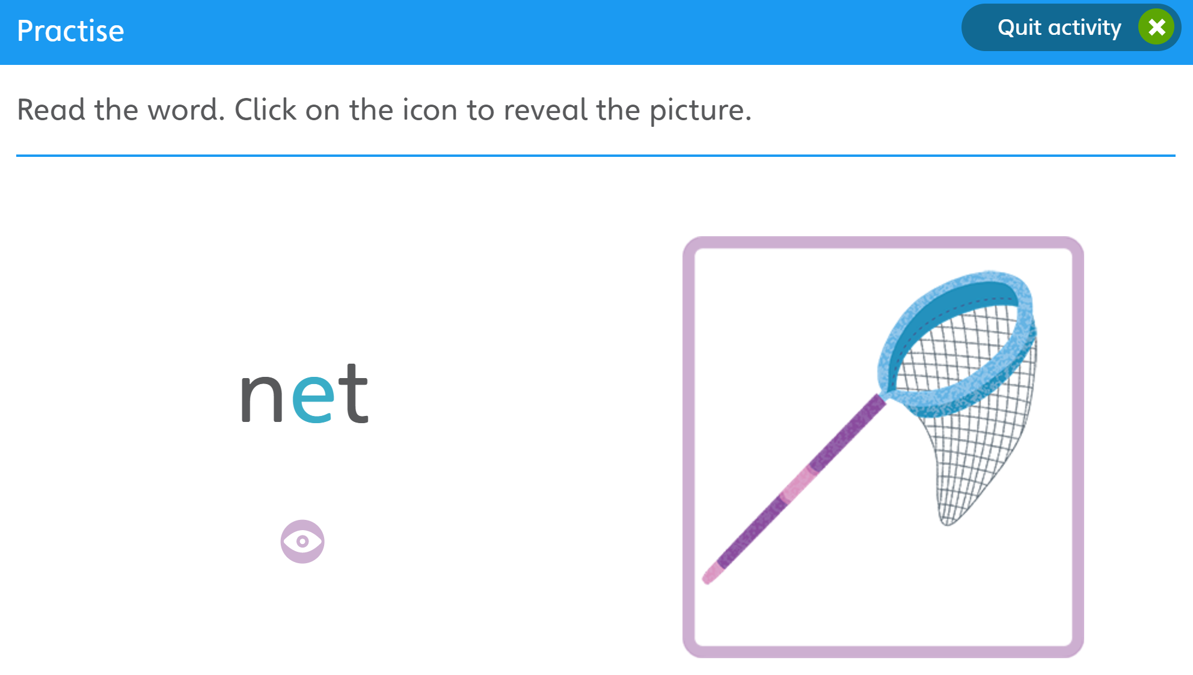
How do we teach phonics?
© Oxford University Press 2021
Notes:
The new teaching is always highlighted so that it is easy for all children to see where the new GPC they have been taught is located. First we say the new sound, then we find it in the word. Finally, we decode and blend. Children have as much or as little support as needed. We want every child to feel confident and successful at each step.

Slide 10
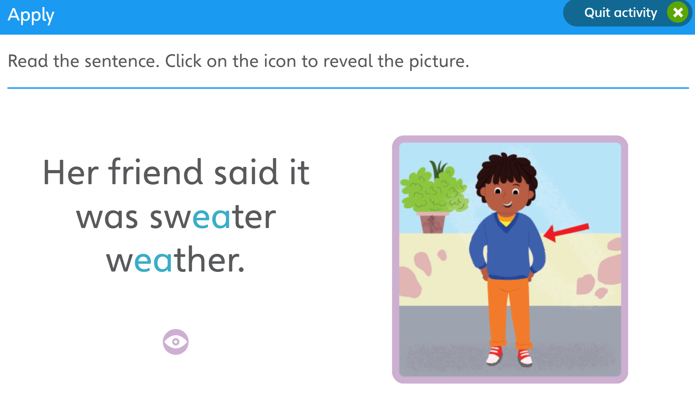
How do we teach phonics?
© Oxford University Press 2021
Notes:
In the beginning of Reception, we learn to read words and then captions, phrases and sentences. As children learn more of the code of our language we are able to build more complex sentences for them to read.
Here we have a sentence from Year One. We build the code for the children and as this knowledge grows we are able to read more complex sentences.

Slide 11
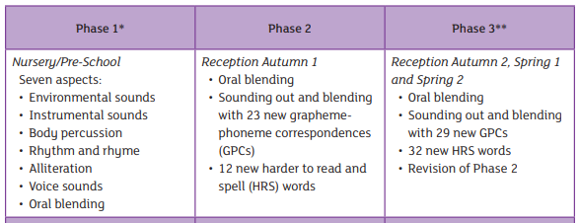
ELS Progression
© Oxford University Press 2021
Notes:
In Reception your children will learn all the single letter sounds and begin to learn diagraphs and trigraphs.

Slide 12
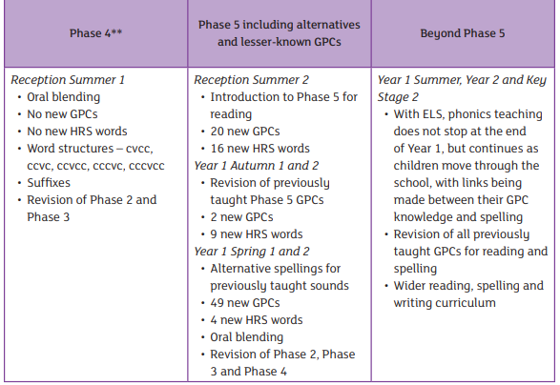
ELS Progression
© Oxford University Press 2021

Slide 13
Supporting your child with reading at home
Only 1 in 3 children are read a bedtime story night
Reading a bedtime story every night to your child improves their outcomes
If your child views themselves as a ‘good reader’ when they leave Primary School they are more likely to earn a higher salary in their 40s.
© Oxford University Press 2021
Notes:
Reading until they are 3 improves outcomes in YR, reading until they are 5 improves outcomes in Y6 and reading until they are 8 improves outcomes aged 16!
Children who achieved the Early Learning goals for literacy are 11 times more likely to achieve the expected outcomes in Maths at the end of KS2. Reading underpins everything.
We want all our children to leave primary school able to read well and confidently – you can support us in this journey.

Slide 14
Supporting your child with reading at home
Children are only reading from books that are entirely decodable
Your child should be able to read their book confidently
We only use pure sounds when decoding words (no ‘uh’ after the sound)
We want them to practise reading their book 4 times across the week working on these skills:
decode
fluency
expression
© Oxford University Press 2021
Notes:
We want children to only have success when learning to read
Decode – explain this meaning
Fluency – recognising the sound for spelling within the word and blending fluently
expression – model this for the children in school, when reading at home we want children to start to think about expression and intonation. For example, if someone is asking a question let’s get the children to make their voices sound like they are asking a question.

Slide 15
Supporting your child with reading at home
We want children to create a strong orthographic map. This means that they learn sounds spelt by the letters or groups of letters in each word.
To read fluently, or well, we need a strong orthographic map.
To consistently recognise that the <ea> in bread spells /e/ we need to read it at least 4 times. This means we need to read the word many times to build fluency for reading.
© Oxford University Press 2021

Slide 16
Pronouncing pure sounds
We must use pure sounds when we are pronouncing the sounds and supporting children in reading words.
c a t not cuh a tuh
If we mispronounce these sounds we will make reading harder for our children.
There are videos for this on our school website where you can hear the correct pronunciation of the sounds.
© Oxford University Press 2021
Notes:
If we use the ‘uh’ sound after the pure sound we are teaching the schwa.
For example instead of /c/ /a/ /t/ we teach /cuh/ /a/ /tuh/ - cuhatuh – not a word! IT makes blending harder if you teach or use a schwa after the initial sound.

Slide 17
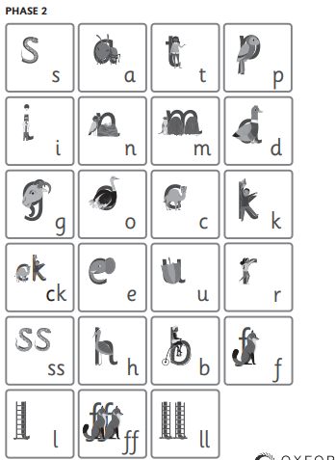
© Oxford University Press 2021

Slide 18
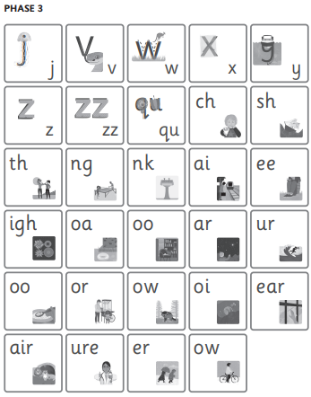
© Oxford University Press 2021

Slide 19

Supporting your child with writing at home
You can use the spelling sequence with your children at home to support them with their writing.
Let’s try this with the word: rain
We also practise saying our sentences before we write them to make sure we write the sentence we have planned and to ensure it makes sense!
© Oxford University Press 2021
Notes:
Use the spelling sequence to model rain
Say the word – warm it up – stretch the word – robot talk the word – blend the word – count the sounds within the word – say the word
You can talk about how you support your children with their writing in school.

Slide 20

Questions
https://home.oxfordowl.co.uk/reading/reading-schemes-oxford-levels/essential-letters-and-sounds/?fbclid=IwAR0XQsezraqQYfjxLeeM3lQ90MeQBGc1Z2_DIBDbYaw9WRXTvLELYHusggs
© Oxford University Press 2021

