Slide 1

How do I encourage my child’s language development?

Slide 2
Welcome!
What are we going to cover today?
This is a gentle introduction to early speech.
I hope to answer any questions you may have about your child’s early speech.
How do we encourage children to chat more?
Explain what is WellComm?
I am going to share some information for about 30 minutes and then you can have a look at the activities on the tables that are around the room if you are interested to see more.
Notes:
Great to see you all here and for some of you it’s all new with your first child moving into school and for others it’s all very familiar!
Who am I?
What we will do today? I lways like to know whats ha Please ask as I go along interruptions are very welcome!
Thanks to the staff who are have here, so let’s just quickly see who is here!

Slide 3
What is WellComm?
All of the children starting at this school will be part of a short screen to look at their language skills.
It will show any little gaps in their language that we can then all work together to support at school and home through fun activities.
Children need to have these language skills to help them to learn well so it’s great to have this in your school to pick up where they can help as early as possible.
Mrs Lenton and Mrs Walker have this to show you later, go and take a look.

Slide 4
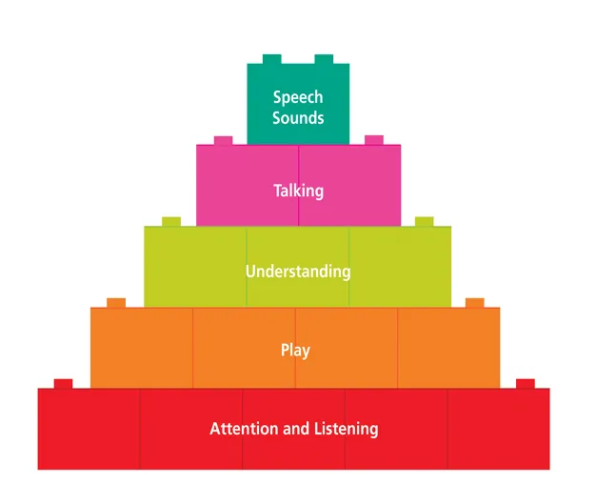
Pyramid of development.
Notes:
Ask learners to rate which comes first use flip chart board and then show pyramid.

Slide 5

Listening?
Notes:
So this skill is the foundation of all the chatting. So how can we help children to listen more! Been at that time where I used to be shouting my children to get ready done and there would always be one that was still playing/ watching TV how many times do I need to ask you , are you listening? That’s just my house!!

Slide 6
How can we help children listen more effectively?
No back ground noise, turn off music
Reduce distractions ….. Move away phones so I can focus
Use your child’s name
Gently touch them on the shoulder before speaking

Slide 7
Pyramid of development.
Notes:
Ask learners to rate which comes first use flip chart board and then show pyramid.

Slide 8
Play
My child is just playing?????
Develops the skills that will then help them to use more words alongside social skills
‘Play is really the work of childhood’. There’s no better time for your child to learn about communicating than when they're playing. It's during play that children learn about the objects in their world, as well as a lot about communication, including: how to take turns and have interactions’ (example home activities in pack).

Slide 9
Pyramid of development.
Notes:
Ask learners to rate which comes first use flip chart board and then show pyramid.

Slide 10
Understanding?
We need to understand words before we say them.
Slow down, repeat, use gesture.
Great system available in your reception with staff qualified in speech and language for precision teaching.
We can see where your child is up to and then make sure that we are using the right questions that they can understand now and know how to take them onto the next step.
(Blank levels handout in pack)
Notes:
Play clip at 8 seconds ask if they would feel ok about just using this word
Of course not we don’t know what we are saying

Slide 11
Pyramid of development.
Notes:
Ask learners to rate which comes first use flip chart board and then show pyramid.

Slide 12
Talking
Face to face
Repeating the same words over and over again
Adding some more words to what your child is already saying, building up to longer sentences in small steps.e.g.
car > car go
car go > mummy’s car go
mummy’s car go> mummy’s car goes to the garage
Mummy’s car go to garage> mummy’s car goes to the garage and the wheel is fixed.

Slide 13
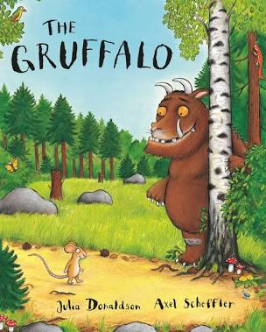

Slide 14
What words do you hear?
What?
Where?
How?
When?
4-1 Hand rule (hand out in pack)
Notes:
Show picture book and ask questions? Use teacher.

Slide 15
Pyramid of development.
Notes:
Ask learners to rate which comes first use flip chart board and then show pyramid.

Slide 16
Speech sounds
Speech sounds develop in steps there are easy and hard sounds. Children will still be learning to use some of the sounds at 4 years of age.
If your child needs some help with their speech sounds, as many children do, they need all the other skills in place first. Your child’s phonic development is underpinned by these skills.
https://speechandlanguage.org.uk/help-for-families/(Website in pack)

Slide 17
Bumpy talking - should I worry?
Lots of children repeat words and sounds as they start to chat. Come and ask more if you have any questions about your child repeating sounds or words.
I am available to discuss any questions you may have following this introduction.
Thank you for your time. I hope no matter which stage of development your child is at you feel confident you can approach staff and support your child’s next step.

