Slide 1
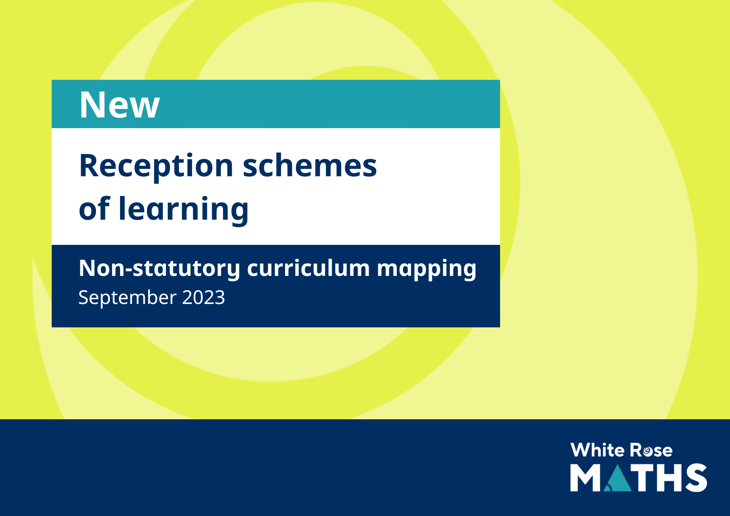
Nursery schemes of learning
April 2025

Slide 2

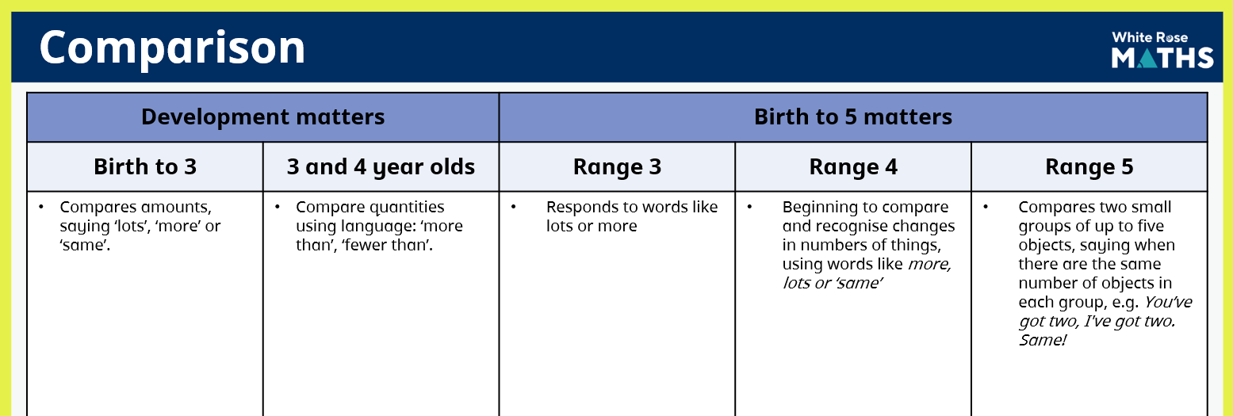
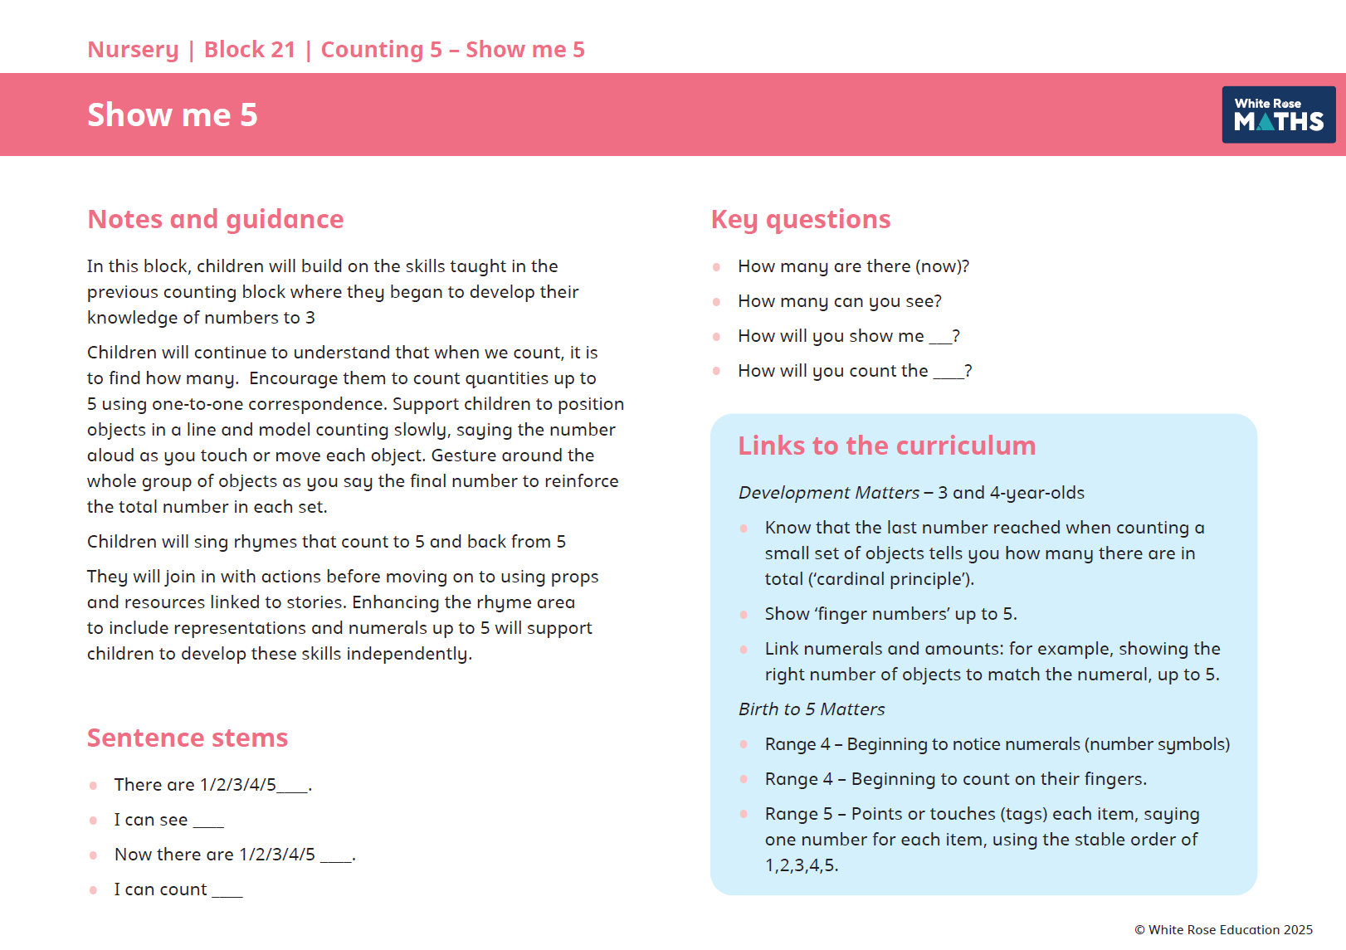
Introduction
The aim of this document is to give an at a glance guide to how the White Rose Maths Nursery schemes of learning link to the two forms of non-statutory curriculum guidance for the EYFS, Development Matters (DfE, 2021) and Birth to 5 Matters (Early Education, 2021) These statements are taken from documents that explicitly say they are suggestions of what "children will be learning to do” and "what children might be doing". They are not to be used or intended to be focused on as a tick list.
Within each block we reference the relevant links to the curriculum, from both Development Matters and Birth to 5 matters, so teachers can see this direct link as you teach each block.
Many settings require practitioners to show coverage, and this document is designed to support you with this. Each of the major topic areas have been broken down into key mathematical concepts so you can then see which statements from both documents are covered together with the term and block of the White Rose Maths Reception scheme. This document gives teachers confidence of the wide coverage given in the White Rose Maths Nursery scheme of learning.

Slide 3


Slide 4

Comparison
Development matters | Year 2 | Birth to 5 matters | Year 4
Birth to 3 | 3 and 4 year olds | Range 3 | Range 4 | Range 5
Compares amounts, saying ‘lots’, ‘more’ or ‘same’. | Compare quantities using language: ‘more than’, ‘fewer than’. | Responds to words like lots or more | Beginning to compare and recognise changes in numbers of things, using words like more, lots or ‘same’ | Compares two small groups of up to five objects, saying when there are the same number of objects in each group, e.g. You’ve got two, I've got two. Same!
 | Block 1, Block 16, Block 24 | Block 1 | Block 1, Block 16, Block 24 | Block 24

Slide 5
Counting
Development matters | Year 2 | Birth to 5 matters | Year 4
Birth to 3 | 3 and 4 year olds | Range 3 | Range 4 | Range 5
Take part in finger rhymes with numbers. Develop counting-like behaviour, such as making sounds, pointing or saying some numbers in sequence. Count in everyday contexts, sometimes skipping numbers – ‘1-2-3-5’. | Recite numbers past 5. Say one number for each item in order: 1,2,3,4,5. Show ‘finger numbers’ up to 5. Link numerals and amounts: for example, showing the right number of objects to match the numeral, up to 5. | Says some counting words May engage in counting-like behaviour, making sounds and pointing or saying some numbers in sequence | Begins to say numbers in order, some of which are in the right order (ordinality) | Points or touches (tags) each item, saying one number for each item, using the stable order of 1, 2, 3, 4, 5. Other statements covered in Reception
 | Block 4, Block 5, Block 9, Block 10, Block 13, Block 20, Block 21, Block 23 | Block 4 | Block 4, Block 5, Block 10, Block 13 | Block 21

Slide 6
Cardinality
Development matters | Year 2 | Birth to 5 matters | Year 4
Birth to 3 | 3 and 4 year olds | Range 3 | Range 4 | Range 5
React to changes of amount in a group of up to three items. | Develop fast recognition of up to 3 objects, without having to count them individually (‘subitising’). Know that the last number reached when counting a small set of objects tells you how many there are in total (‘cardinal principle’). Experiment with their own symbols and marks as well as numerals. Solve real world mathematical problems with numbers up to 5. | Uses number words, like one or two and sometimes responds accurately when asked to give one or two | In everyday situations, take or give two or three objects from a group Beginning to notice numerals (number symbols) Beginning to count on their fingers. | Subitises one, two and three objects (without counting) Counts up to five items, recognising that the last number said represents the total counted so far (cardinal principle) Links numerals with amounts up to 5 and maybe beyond Explores using a range of their own marks and signs to which they ascribe mathematical meanings
 | Block 6, Block 9, Block 13, Block 15, Block 20, Block 21, Block 23 |  | Block 5, Block 10, Block 13, Block 21 | Block 6, Block 9, Block 15,Block 20, Block 23

Slide 7


Slide 8
Spatial awareness
Development matters | Year 2 | Birth to 5 matters | Year 4
Birth to 3 | 3 and 4 year olds | Range 3 | Range 4
Climb and squeeze themselves into different types or spaces. | Understand position through words alone – for example, “The bag is under the table,” – with no pointing. Describe a familiar route. Discuss routes and locations, using words like ‘in front of’ and ‘behind’. | Enjoys filling and emptying containers Investigates fitting themselves inside and moving through spaces | Moves their bodies and toys around objects and explores fitting into spaces Begins to remember their way around familiar environments Responds to spatial and positional language Explores how things look from different viewpoints including things that are near or far away
Block 11 | Block 8, Block 11, Block 14, Block 18 | Block 11 | Block 8, Block 11, Block 14, Block 18

Slide 9
Shape
Development matters | Year 2 | Birth to 5 matters | Year 4
Birth to 3 | 3 and 4 year olds | Range 3 | Range 4 | Range 5
Combine objects like stacking blocks and cups. Put objects inside others and take them out again. Build with a range of resources. Complete inset puzzles. | Talk about and explore 2D and 3D shapes (for example, circles, rectangles, triangles and cuboids) using informal and mathematical language: ‘sides’, ‘corners’, ‘straight’, ‘flat’, ‘round’. Select shapes appropriately: flat surfaces for building, a triangular prism for a roof etc. Combine shapes to make new ones – an arch, a bigger triangle, etc. | Pushes objects through different shaped holes, and attempts to fit shapes into spaces on inset boards or puzzles Beginning to select a shape for a specific space Enjoys using blocks to create their own simple structures and arrangements | Chooses puzzle pieces and tries to fit them in Recognises that two objects have the same shape Makes simple constructions | Attempts to create arches and enclosures when building, using trial and improvement to select blocks Other statements covered in Reception
Block 11 | Block 2, Block 14, Block 18 | Block 2, Block 12 | Block 2, Block 8, Block 11, Block 12, Block 14, Block 18 | Block 22

Slide 10
Pattern
Development matters | Year 2 | Birth to 5 matters | Year 4
Birth to 3 | 3 and 4 year olds | Range 3 | Range 4 | Range 5
Notices patterns and arrange things in patterns. | Talk about and identify the patterns around them. For example: stripes on clothes, designs on rugs and wallpaper. Use informal language like ‘pointy’, ‘spotty’, ‘blobs’, etc. Extend and create ABAB patterns – stick, leaf, stick, leaf. Notice and correct an error in a repeating pattern. Begin to describe a sequence of events, real or fictional, using words such as ‘first’, ‘then…’ | Becoming familiar with patterns in daily routines Joins in with and predicts what comes next in a story or rhyme Beginning to arrange items in their own patterns, e.g. lining up toys | Joins in and anticipates repeated sound and action patterns Is interested in what happens next using the pattern of everyday routines | Creates their own spatial patterns showing some organisation or regularity Explores and adds to simple linear patterns of two or three repeating items, e.g. stick, leaf (AB) or stick, leaf, stone (ABC) Other statements covered in Reception
Block 3, Block 7 | Block 12, Block 17, Block 19, Block 22 | Block 3, Block 12, Block 17 | Block 7, Block 17 | Block 19

Slide 11
Measures
Development matters | Year 2 | Birth to 5 matters | Year 4
Birth to 3 | 3 and 4 year olds | Range 3 | Range 4
Compare sizes, weights etc. using gesture and language – ‘bigger/little/smaller’, ‘high/low’, ‘tall’, ‘heavy’. | Make comparisons between objects relating to size, length, weight and capacity.* | Shows an interest in size and weight Explores capacity by selecting, filling and emptying containers, e.g. fitting toys in a pram Beginning to understand that things might happen now or at another time, in routines | Explores differences in size, length, weight and capacity* Beginning to understand some talk about immediate past and future Beginning to anticipate times of the day such as mealtimes or home time
Block 8 | * Introduced in Reception Maths scheme of learning Block 2 | Block 1, Block 7, Block 16 | Block 22 * Introduced in Reception Maths scheme of learning Block 2

