Slide 1

Ground Rules
Please put your hand up if you have a question or want to say something.
We must all respect each other.
Do not mention any names when asking a question or telling a story.
If you want to speak to us then you can at the end in private.

Slide 2
Today we are going to learn about your personal safety and being safe whilst out and about.

Slide 3

Personal safety
Key Stage One

Slide 4

Staying safe at home
We should not give any personal details when answering the phone.
Is it a good idea to hide a key outside of your house? (like under a plant pot)
Never answer the door to someone you don’t know.
Never tell anyone that you are home alone.
Notes:
Go through each comment

Slide 5

Playing Out
Find a safe place to play.
Don’t stay out after dark or take short cuts home.
Always get your parents permission and let them know where you are and who you are with.
Don’t run across roads and remember The Green Cross Code.
Know how to contact your family or friends in case of an emergency.
Notes:
Go through each point and explain how important they are

Slide 6





Safety Around Water
When you need ‘HELP’ shout as loud as you can
On a very hot day, a body of water will be extremely cold & you could suffer “Cold Water Shock”
Never mess around in the water or by water
It only takes a small amount of water to drown
Places like canals, rivers, etc can hide many dangerous items, like shopping trollies that you could get your legs trapped in
Send for help to rescue a pet if it falls into water, never go in yourself, you could get into trouble yourself.
Notes:
Emphasize any amount of water can potentially be dangerous. Explain each point and the importance of staying safe near water.

Slide 7
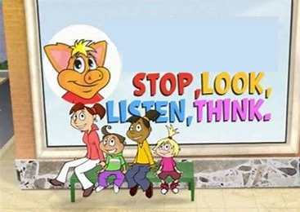
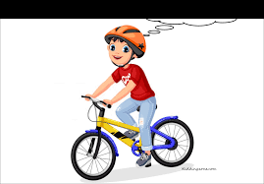
Road Safety
Always REMEMBER the
GREEN CROSS CODE
Stop, Look, Listen, Think
Always wear a helmet.
Check your bike is in good working order.
Wear reflective clothing.
Make sure you have lights.
If only one seat only one person.
Notes:
Go through the green cross code, STOP, LOOK, LISTEN & THINK, then on to bike safety and again go through each point and explain

Slide 8
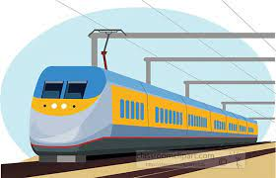
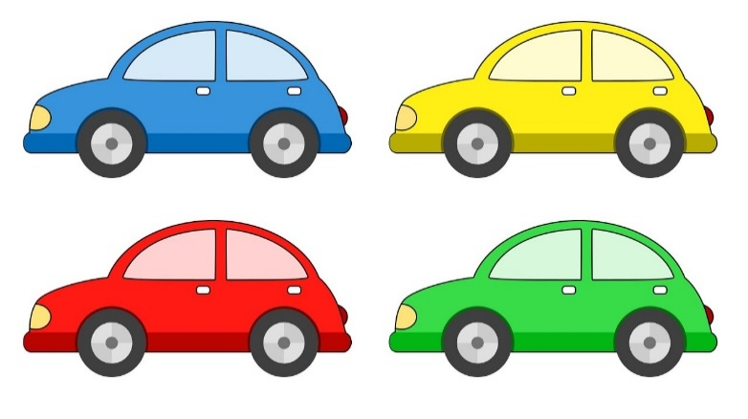
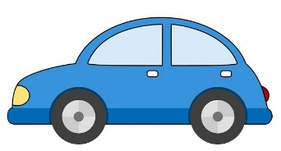
Where not to Play
You should never play in derelict buildings/building sites.
Don’t play on/near railway lines.
Don’t run or play on the road.
Please don’t play near parked cars.
Notes:
Explain each point and why is not safe

Slide 9
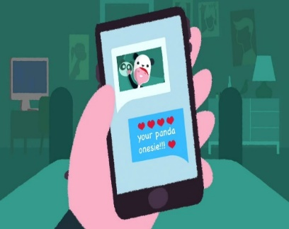
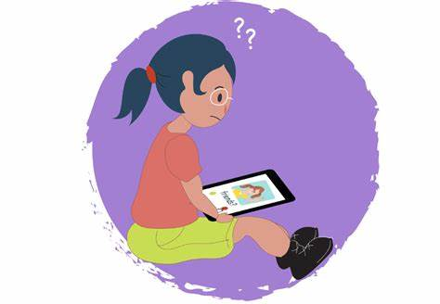
Internet safety what not to share online
Your Name.
Where you live.
Your passwords.
What school you go to.
Your phone number.
Anything private to you, including your body.
.

Slide 10

Stranger Danger
WHAT IS A STRANGER?
Someone we do not know, it can be a man or woman, or a boy or girl.
WHAT DOES A STRANGER LOOK LIKE?
Anyone
If you get lost or need help you can always ask a Police officer, PCSO, Shopkeeper or teacher.
Notes:
Talk to them about a stranger can be a man or woman, old or young

Slide 11

Always tell a trusted adult if ….
A stranger asks you to go somewhere with them.
NEVER go!
A stranger tries to give you something.
NEVER take anything!
A stranger asks you to do something that makes you feel uncomfortable.
It’s ok to say NO!
Notes:
Explain to the children how important it is to say no!

Slide 12


Information you should know
Your name and address.
Your parents name and contact numbers.
What number you should call in an emergency.
999 for emergencies
Notes:
Please explain the difference between an none emergency and an emergency. Encourage the children to learn their details

Slide 13

Who keeps you
safe?
Teachers
Family members
Friends
You
can keep yourself safe
Emergency services
Notes:
Talk about how the different groups can keep you safe, ie emergency vehicles fire, ambulance, police

Slide 14
Knowledge check
Who is the most important person to keep you safe?
What is a stranger?
Name two trusted adults?
What is the emergency telephone number?
Should you tell your parents/guardian where you are going?

Slide 15
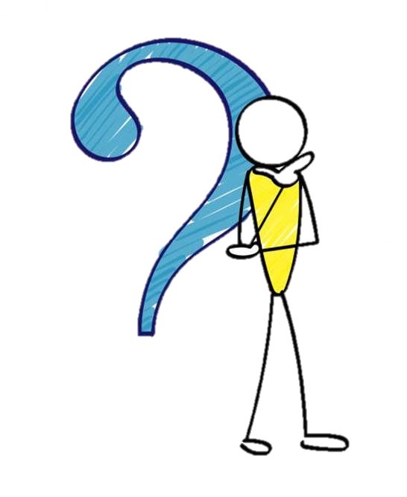
Any Questions

