Slide 1



Slide 2


Halloween and Bonfire Night
Personal Safety

Slide 3
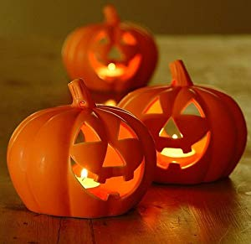
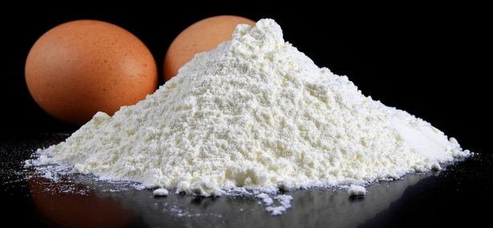

What kind of things Should we NOT do on Halloween?
Notes:
Class discussion – encourage the children to talk about what is and isn’t acceptable behaviour

Slide 4

Please Don’t play tricks or games like ‘knock a door run’ – people may get frightened or angry and the consequences could get you in trouble with either your family or the police!
Or go out on your own, you may get lost – Always stay with an adult
The Police have leaflets that members of the public can put in their windows or on doors if they don’t want to be disturbed on Halloween, It may be that they have a baby in the house or someone who is ill.

Slide 5



Anti-Social Behaviour
Throw Eggs and Flour
Smash windows
Damage to cars
Intimidate people
Notes:
Encourage the children to openly discuss what is and isn’t acceptable behaviour

Slide 6
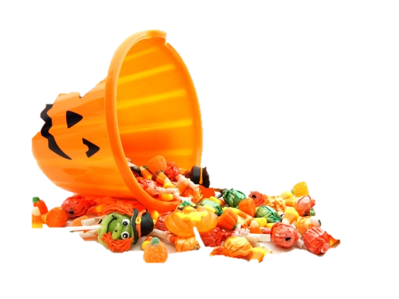
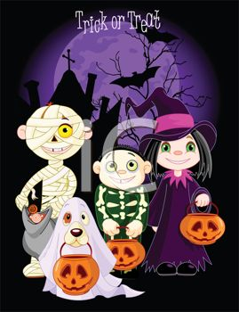
What kind of things
should we DO on Halloween?

Slide 7

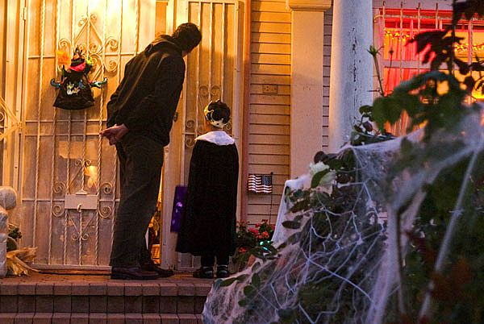
Go out with a parent
Wear bright reflective clothing
Carry a torch
Respect people’s property
Say please and thankyou

Slide 8

HOME BONFIRES
Make sure your bonfire is not too big for your garden
Don’t light you fire under hanging branches of trees and make sure it’s not close to any outbuildings like sheds
Stand well back from the fire
Don’t throw items into the fire
Always keep a bucket of water or sand close by
Fireworks should not be set off between 11pm & 7am

Slide 9

FIREWORKS
You cannot
Buy or carry any fireworks (under 18)
Throw a firework
Let fireworks off in a public place
Set off fireworks between 11pm and 7am on normal nights
Never go back to a firework which has not gone off, tell an adult.

Slide 10
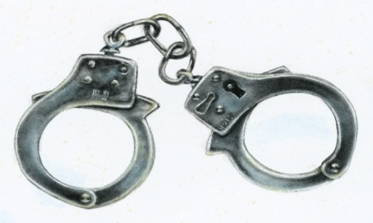
The Law
Using materials such as fencing and wheelie bins
for bonfires which belong to other people is
classed as theft & or damage to property.
Lighting bonfires is classed as arson and if it
endangers someone’s life it could lead to a
Prison sentence

Slide 11
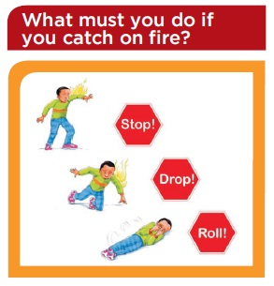
Do you know what to do if your clothes are on fire?
STOP!
DROP!
ROLL!
STOP, DROP, ROLL - https://www.youtube.com/watch?v=MySKfhQqens

Slide 12
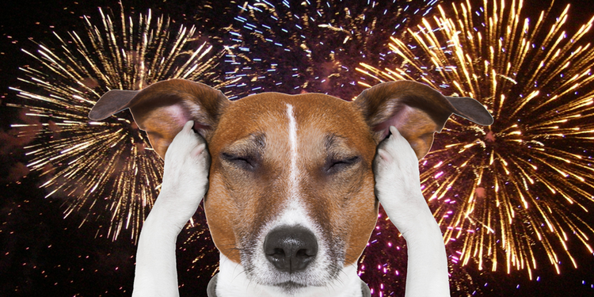
PETS
Always keep pets indoors as they get very frightened by the noise

Slide 13
Questions
Should we hold fireworks or keep them in your pocket, even if it isn’t lit!
If you see a firework on the floor, is it ok to pick it up?
Is it ok to give sparklers to your little brothers and sisters?
Would it be a good idea to copy older children who are being silly around fireworks, Would you tell an adult?
Would it be a good idea to wear gloves when holding a sparkler
Between what times should we not light Fireworks? on a normal night

Slide 14

ANY QUESTIONS

