Slide 1



Slide 2
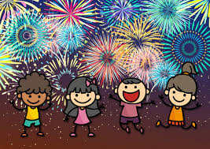
Halloween and Bonfire Night Personal Safety
  Be Safe, Be Seen, Be Secure
Notes:
Welcome to our presentation about Halloween, Bonfire and Firework Personal Safety.

Slide 3
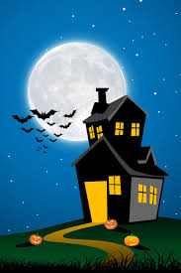
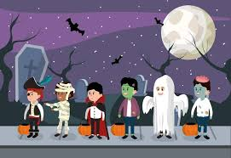
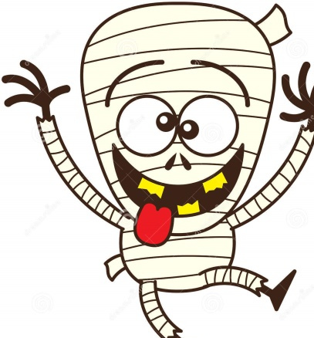
What kind of things should we DO on Halloween?
Notes:
Explain that we can still have fun on Halloween and this presentation is just on How to stay safe

Slide 4
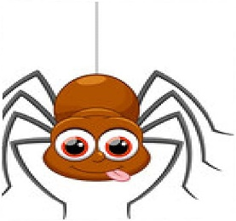
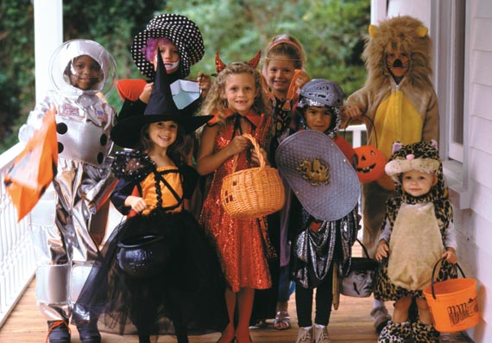
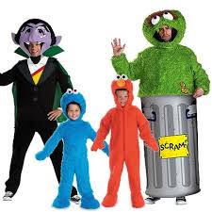
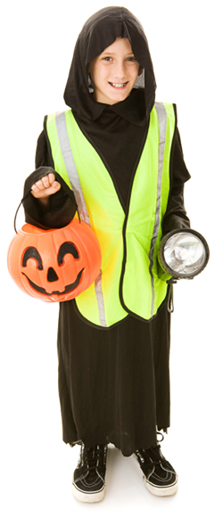
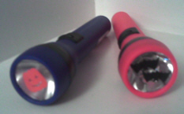
Halloween Do’s
Go out with an adult you trust
Wear bright reflective clothing
RESPECT peoples property
Carry a torch with you
Notes:
Make sure you…..
Go out with an adult you trust or in a group. Stay safe.
Wear bright reflective clothing. If you’re going out in the dark, make sure you can be seen by road users. How would you do that?
Carry a torch with you. If you go out in the dark, make sure you can see where you are going by using a torch.
Respect peoples’ property at all times. Don’t cause any damage by throwing eggs or flour, or squirting silly string. Think about how you would feel if somebody did that to your house.

Slide 5
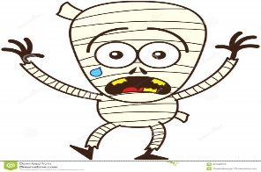

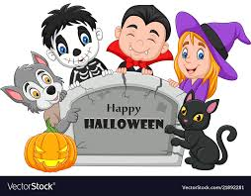
What kind of things should we NOT do on Halloween?
Notes:
Talk about what we should not do on halloween

Slide 6


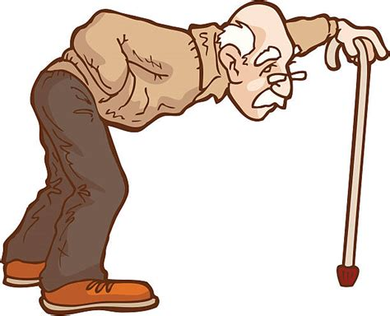
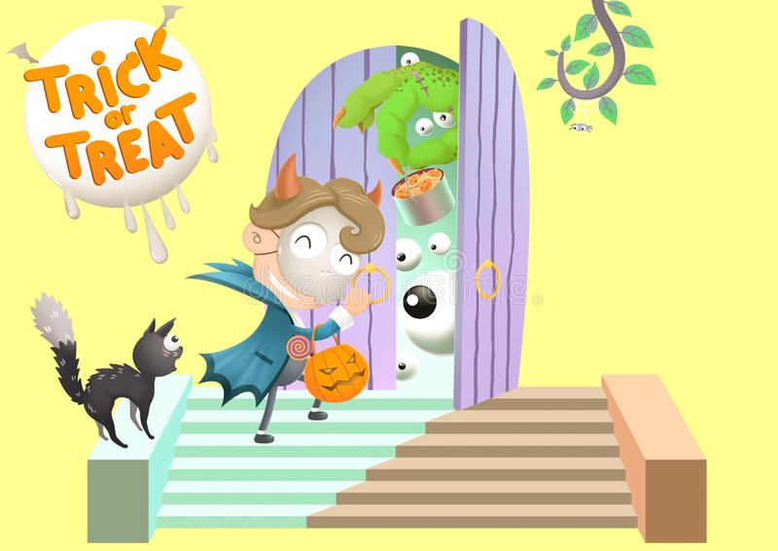
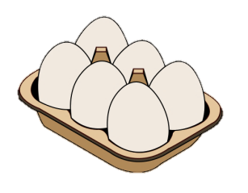
Please Don’t
Damage property
Throw eggs or flour at peoples property
Don’t go out on your own
Don’t knock on someone’s door more than once - they might be older or have a baby
Don’t Play games or tricks on anyone – this can make people feel scared and angry
Notes:
Explain about damage, throwing things at peoples property how is may make them feel, how would they like it if somebody did it to their family.

Slide 7



Home Bonfires
Make sure your bonfire is not too big for your garden
Make sure no trees are over hanging the bonfire, also make sure it’s not close to any outbuildings.
Stand well back
Don’t throw items into the fire
Always keep a bucket of water or sand close by

Slide 8


Fireworks
Never hold a firework or keep one in your pocket, even if it isn’t lit!
If you see a firework on the floor, leave it and tell an adult
Don’t give sparklers to your little brothers and sisters, they are too young for them
You might see older children being silly around fireworks, stay away from them and tell an adult
Always wear gloves when holding a sparkler
We should never light fireworks between the hours of 11pm and 7am on a normal night
Notes:
Speak about the dangers of fireworks, throwing them, picking them up when they haven’t gone off – might go off in their face. Wear gloves – to protect their hands,

Slide 9

Do you know what to do if your clothes catch fire?
STOP!
DROP!
ROLL!
STOP, DROP, ROLL - https://www.youtube.com/watch?v=MySKfhQqens
Notes:
Bonfires (left click)
Who knows what to do if your clothes catch fire? (left click)
STOP! - Don’t run around – you will fan the flames and make them burn faster (left click)
DROP! - lie down - this makes it harder for the fire to spread and reduces the effect of flames on your face and head (flames burn upwards)
(smother the flames - cover the flames with heavy material, like a coat or blanket; this blocks the fire's supply of oxygen ) (left click)
ROLL! - roll around – rolling smothers the flames (left click)

Slide 10
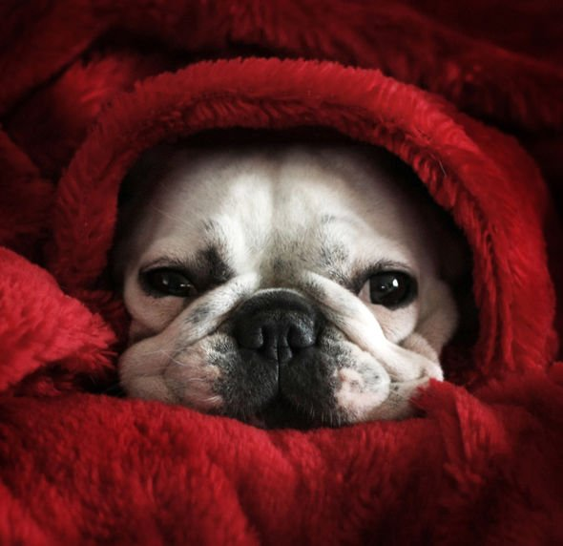

Pets
Always keep pets in
doors as they get very
frightened by loud noises.
This cat was hurt by
fireworks. It had terrible
burns and was in a lot of
pain. He is OK now.
Notes:
Pets (left click)
This cat was hurt by fireworks. It had terrible burns and was in a lot of pain. (left click)
Always keep pets indoors as they get very frightened by loud noises. Close windows and curtains and put on some music. If you can, get an adult to check under the bonfire before it is lit. Animals such as hedgehogs may have crawled under it and get hurt when it is lit. (left click)

Slide 11
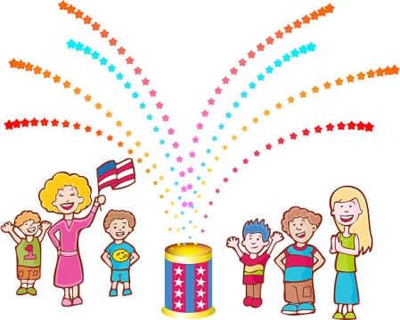
Quiz
Should we keep fireworks in our pockets?
Name something we like to eat on Bonfire night?
Tell us 2 ways we can stay safe.
Between what hours are we not allowed to set off fireworks on normal nights?
What should you do if you catch fire?
Notes:
No
Toffee apples – Hot dogs – Treacle
Never throw fireworks – Stand back from Bonfire
11pm and 7am
Stop Drop Roll

Slide 12

Any Questions?
Notes:
Any questions

