Slide 1
THE EYFS
An overview

Slide 2
What is the eyfs?
It’s the framework which sets the standard for the learning, development and care of children in England from birth to five years old.
It applies to all OFSTED-registered settings, including childminders, preschools, private nurseries, school settings.
It is based on the idea that children need to use concrete experiences to provide the building blocks of their learning.
It identifies seven areas of learning which link to KS1.

Slide 3
The four principles of the eyfs
The unique child
Children respond to different learning methods and bring their own experiences and preferences to the setting. Every child is capable being a strong, resilient learner with the right guidance.
Enabling environments
The environment in which a child learns should prompt and encourage good learning techniques. An enabling environment is one that caters to each individual child's needs and gives them the freedom to expand their knowledge and development.
Positive relationships
Children should be encouraged to be strong and independent when required, forming the basis for positive relationships that they will go on to have. They should also be given the safety and security to bolster the relationships they have with those closest to them
Learning and development
By following the EYFS Seven Areas of Learning, both Prime and Specific, each child will be taught a wide range of skills to aid their physical and mental development.

Slide 4
Seven areas of learning
COMMUNICATION & LANGUAGE
LITERACY
Listening, understanding and speaking.
Phonics, reading and writing.
specific areas
MATHS
prime areas
PERSONAL, SOCIAL & EMOTIONAL
Self-regulation, manging self and building relationships
Number, space, shape and measure.
UNDERSTANDING THE WORLD
PHYSICAL DEVELOPMENT
Past & present; People, culture & communities; The Natural World
Fine and gross motor skills.
EXPRESSIVE ARTS & DESIGN
Creating with materials; Being imaginative and expressive.
All areas are interconnected.

Slide 5
How does this link with ks1/2?
EYFS – PRIME AREAS | National Curriculum
These three areas underpin all areas of learning and also have specific links to… | Literacy
Communication & Language | English
Personal, Social & Emotional Development | PSHE RHE
Physical Development | Literacy (writing) P.E. DT Art & design
EYFS – SPECIFIC AREAS | National Curriculum
Literacy | English
Maths | Maths!
Understanding the World | Science Geography History RE Computing
Expressive Arts & Design | Art DT Drama Music

Slide 6
Characteristics of effective learning
Not “JUST PLAY”!
PLAYING & EXPLORING
ACTIVE LEARNING
Finding out & exploring
Being willing to have a go.
Playing with what they know.
Being involved and concentrating.
Keep on trying.
Enjoying achieving what they set out to do.
CREATIVE & THINKING CRITICALLY
Making links
Solving problems and having their own ideas.
Choosing ways to do things.

Slide 7
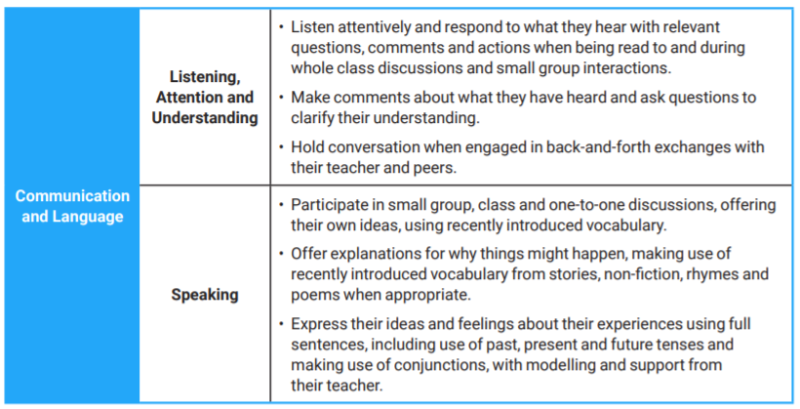
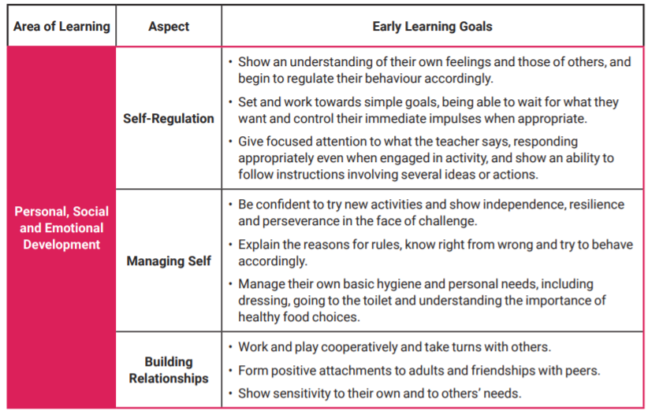
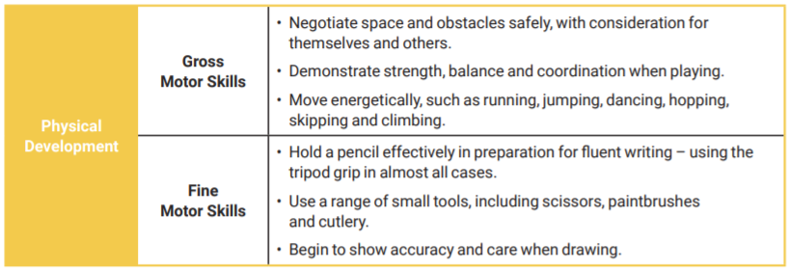
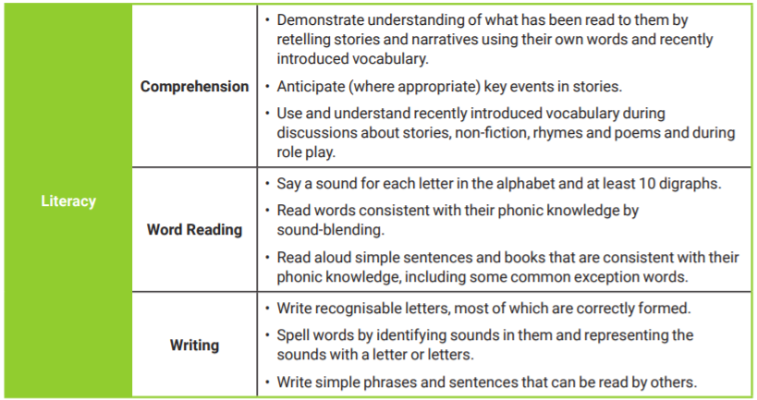
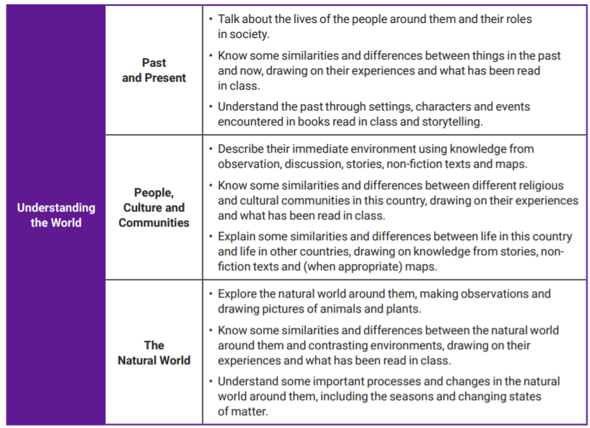
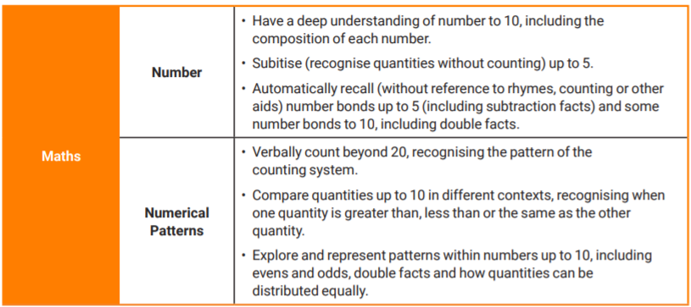
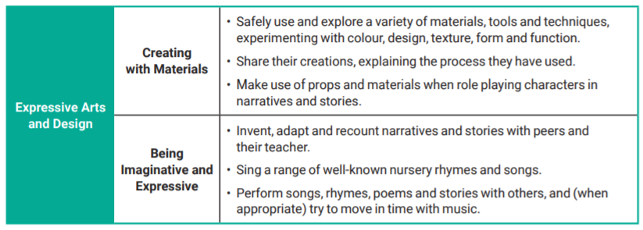
Early learning goals – new!

Slide 8
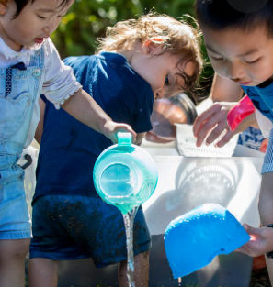



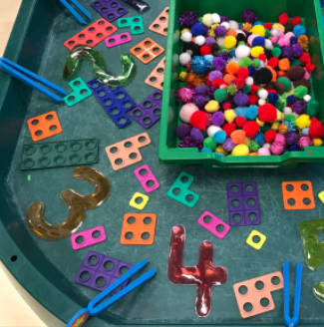
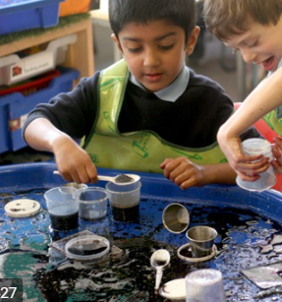


HOW MIGHT THIS LOOK?
Lots of play!
Open-ended activities to allow children to direct their learning
1:1 and small group activities led by an adult​
Whole class teaching
Areas of learning overlapping
Learning not going as intended…but great learning nonetheless!
Learning often not-recorded by the child.
Mess, chaos, noise…engagement!

Slide 9
ALL CHANGE!
WHAT?
ELGs changed/simplified/more connected to KS1.
Exceeding judgement is removed.
Children now judged as on track/not on track.
Greater focus on vocabulary and self-regulation.
No LA moderation.
Why?
Improve outcomes, particularly in language and literacy. Better prepare children for the Yr 1 curriculum.
Reduce unnecessary paperwork to spend more time with children.
Focus efforts on those children that need us most.

