Slide 1
Welcome to Bollington St. John’s Primary School

Slide 2
Introduction
This presentation aims to introduce you to our school and includes initial information which we hope you will find useful. Should you have any further questions, staff will be happy to discuss these with you.
The school website www.bollingtonstjohns.co.uk is kept up to date with the latest news and events and has lots more information about our schools.
We also have a very active twitter account. Details are on the website.

Slide 3
Staff at Bollington St. John’s Primary
Head Teacher: Mrs Walker.
Head of Teaching and Learning: Mrs Watson.
Early Years Coordinator: Mrs Jobbins.
Early Years Staff: Mrs Jobbins, Mrs Smith and Mrs Howarth.
Administration Staff: Mrs Green.

Slide 4
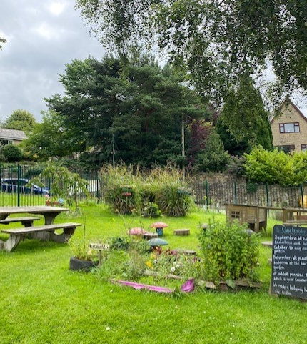
Our Class Details
The children in Reception will be supported by one class teacher and one member of support staff.
The children will be based in the Reception class and will have full free flow access to our secure outdoor area.
The Reception children can be dropped off and collected in the Reception playground.
Start of our day: 9.00am
End of our day: 3.30pm.
The first day of school will be Monday 6th September.

Slide 5
What To Expect
Play and exploration is key.
Daily phonics and maths teaching input.
Fine motor skill development.
Quality interactions with adults to support play, social and emotional skills and learning.
1:1 reading at least once a week.
Group/shared reading daily.
Handwriting sessions when the children are ready.
Planning through topics and always linked to the children’s interests.
Plenty of hands-on and practical experiences.
A nurturing environment focused on getting to know each child as an individual.

Slide 6
Useful Information
Trays and Pegs: All children will be provided with a named tray for storing their reading books and any items they create whilst at school.
All children will have a named peg in the cloakroom where they can store their personal belongings.
Objects from home: Children are welcome to bring in objects from home if they relate to our current topic (books, maps, leaflets etc).
The children are welcome to share any ‘work’ or experiences from home either via Tapestry or during our Show and Tell sessions on a Friday.
Children are always welcome to bring in and show any ‘work’ that they may have done at home or photos of themselves doing something special at the weekends. The show and tell sessions are on a Friday.

Slide 7
Clothing
Please can all uniform and PE kit be labelled with your child’s full name; this makes it much easier when trying to return items of clothing to the correct owner.
Please ensure that your child brings in sensible clothing for all weathers. We will be outside, even in the rain, so a waterproof coat is essential.
If there is a possibility of getting very muddy we do provide mud suits for the children.
In the Summer, we ask that children bring in a sunhat and sun cream.
We ask that all parents provide a pair of wellies that can be kept on site at all times.

Slide 8
Food and Drink
Lunch time is between 12 and 1:15pm. The children are all eligible to receive free school meals but can bring in a packed lunch if preferred. Please speak to our catering team for more information.
Snacks: Children are welcome to purchase a morning snack from the kitchen at a cost of 25p per day (this can be paid straight to the school office). The snacks available are croissants, waffles, cereal bars, raisins and fruit.
Children can bring in their own healthy snack if preferred.
In the afternoon, the children will receive a free piece of fruit or veg.
Drinks: We ask that all children bring in a NAMED water bottle each day. These can be refilled each morning and throughout the day at our water cooler.
We do ask that children only bring in water during the day.

Slide 9
Early Learning Goals
There are 7 areas of learning.
Communication and Language
Personal, Social and Emotional Development
Physical Development
Literacy
Mathematics
Understanding of the World
Expressive Arts and Design
There are 17 Early Learning Goals (ELG) within these areas that we aim to reach by the end of Reception.

Slide 10
Characteristics of Effective Learning
These help us to focus on and understand how a child is learning each day.
Playing and Exploring: How children engage with their learning.
Active Learning: Observing how children are motivated to learn.
Creating and Thinking Critically: Observing how children are thinking.
We will record the characteristics of learning to support our planning and develop the children’s next steps.

Slide 11
Baseline
The Reception Baseline Assessment (RBA) is a short, task based assessment of each child’s early literacy, communication and language and mathematics skills. This will take place in the first few weeks of school.
It is statutory in all schools from September 2021.
We carry out the assessment during 1:1 time with each child; this involves practical activities, asking questions and getting to know your child.
It is not a test!

Slide 12
Learning Journals
Throughout the year, we will record your child’s learning in their secure, online Tapestry Journal.
We encourage parents to add their own observations and photographs to their child’s journal via the app.
This will form a unique record of your child’s learning and development. It will contain samples of work, photographs and staff observations.
We also keep a paper journal of observations and learning; these books enable us to track your child’s progress and attainment, and also plan future activities.
We will invite you to join us for two parent’s evenings in the year.
We will send out final reports at the end of the Summer term.

Slide 13
Home Learning
We will send home reading books and diaries after the first few weeks at school or as we feel that your child is ready.
We ask that you share quiet reading time with your child several times each week and date and sign the reading diary each time.
Once a book has been read and understood we will then change the book.
We will also send home magnetic letters and simple word making activities for you to try at home. This will progress to high frequency word cards when your child is ready.
Children learn to read much faster and with a better understanding if they have the support at home.
We will send home more information regarding how you can support you child at home when we send home their first book.
After the first half term, we will send out practical activities that can be done at home via Tapestry.

Slide 14
We are so excited to welcome all of your children in September.
We understand that it can be an anxious time so please do not hesitate to get in touch if you have any questions over the Summer.

Slide 15
Questions and Answers

