Slide 2
Introducing Phonics
Phase One
Phase Two
Phase Three
Phase Four
Phase Five
Phase Six

Slide 3

Did You Know…?
The English language has:
over 100 ways to spell those sounds
26 letters
44 sounds
x
u
a
e

Slide 4
Phonics Terminology
systematic synthetic phonics - The teaching of reading and spelling by breaking down words into the smallest unit of sound.
phoneme - Any one of the 44 sounds which make up words in the English language.
grapheme – How a phoneme is written down. There can be more than one way to spell a phoneme. For example, the phoneme ‘ai’ is spelt differently in each of the words ‘way’, ‘make’, ‘fail’, ‘great’, ‘sleigh’ and ‘lady’.
blending – Putting together the sounds in a word in order to read it, e.g. ‘f – r – o – g, frog’.
segmenting – Breaking a word into its constituent sounds in order to spell them, e.g. ‘frog, f – r – o – g’.
Notes:
It can be interesting to see how many ways there are to spell other sounds – try ‘igh’, ‘ee’ or ‘ow’.
A fun way to learn blending with young children is to talk to them in segmented words, for example ‘Please g – e – t’ the ‘m – i – l – k’ out of the ‘f – r – i – dge’.
When children begin to segment to spell they will often use the wrong spelling of phonemes, for example ‘I luv yoo’ or ‘Migh naym is…’. This is not a problem, as the key skill at this stage is that they can hear the sounds in the words and have a go at writing them down.

Slide 5


What Is Phonics?
reading and spelling
hearing, recognising and using sounds
routine and familiarity
focus on breaking down and building up words (segmenting and blending)
tricky/common exception words
Notes:
Typically, children begin to develop the listening skills essential to phonics in their preschool years. Some children begin to learn letter sounds at preschool but most children will begin their main phonics learning once they start their reception year at primary school (age 4-5). This teaching continues through year 1 (age 5-6) and into year 2 (age 6-7) until the child is a confident and fluent reader.
Once children are fluent readers, the emphasis in reading teaching moves more towards comprehension and analysis skills.
Book skills include holding books correctly, turning pages right to left, recognising that print represents words, talking about pictures, retelling familiar stories, asking and answering questions about stories and non-fiction texts and treating books with respect.

Slide 6
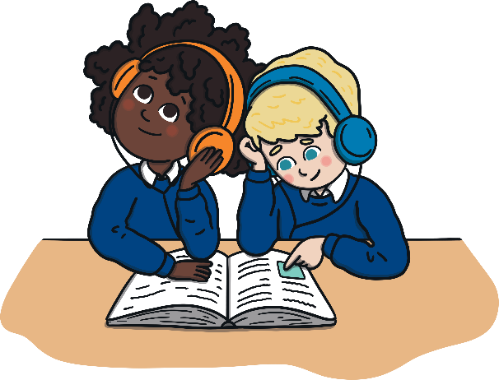
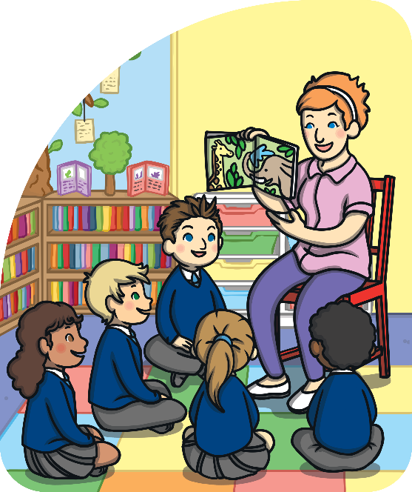
The Progression of Phonics
You may wish to change some of the wording in this section based upon the year groups that you cater for in your school as well as your chosen phonics scheme. Please delete this instruction.
Phase One – Nursery and/or Reception
Phase Two - Reception
Phase Three - Reception
Phase Four - Reception
Phase Five - Year 1
Phase Six - Year 2
Notes:
Phonics is taught in phases and typically is taught between Nursery/Reception and Year 2. However, some children in older years might take part in phonics interventions if there are any gaps in their knowledge.
Typical progression in Phonics is as follows:
Phase One - Nursery/F1- Reception/F2
Phase Two - Reception/F2
Phase Three - Reception/F2
Phase Four - Reception/F2
Phase Five - Year 1
Phase Six - Year 2

Slide 7
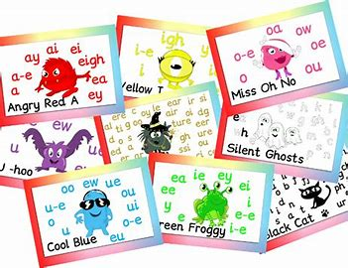
Our Phonics Scheme
Monster Phonics
Why did we choose Monster Phonics?
Follows alongside the original Letters and Sounds scheme.
The characters help the children’s recall.
The colour coding makes it easier for children to recognise the trickier graphemes.

Slide 8
Teaching Phonics
Children are taught reading and spelling daily throughout the week and each session will follow a structured format.
Revisit & Review
The activities used to teach will vary and can be adapted. They are multisensory and appeal to different learning styles. They involve games and individual and group activities as well as teacher-led sessions.
Teach
Practise
We will assess children’s understanding throughout each session and will also assess knowledge of sounds to see whether each child is ready to move on to the next phase.
Apply
Notes:
Assessment at the end of a phase will usually involve asking children to name sounds to check that they know all of the Phase 2 sounds before they move on to Phase 3. Teachers may also assess ability to blend sounds to read words.

Slide 9



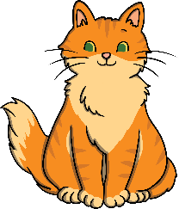



Phase One
Phase 1 has seven aspects, with a focus on listening skills.
Environmental sounds
Instrumental sounds
Body percussion
Rhythm and rhyme
Alliteration
Voice sounds
Oral blending and segmenting
Notes:
Environmental sounds – sounds we hear around us every day; listening to and imitating sounds; how to be a good listener. Ideas – make sounds to copy, e.g. sh sh sh, zzzzzz, p-p-p-p; go on a ‘listening walk’ – what can you hear?; talk about how to be a good listener; sing songs that require repetition and response, e.g. ‘Old MacDonald’.
Instrumental sounds – listening to and discriminating the sounds made by different instruments. Ideas – make sounds with a range of different instruments (non-musical instruments such as pots, pans, home-made shakers will all do); play an echo game where children have to copy a rhythm; hide an instrument behind a box or screen and play it, children have to say which instrument you are playing.
Body percussion – using the body to create sounds and follow a song, rhyme or beat. Ideas – sing songs that require actions, such as ‘Wind the Bobbin Up’, ‘Heads, Shoulders, Knees and Toes’, ‘If You’re Happy and You Know It, Clap Your Hands’; pass a body percussion sound around a group, e.g. sit in a circle or opposite one another, take turns to produce a body percussion sound which is then passed on, e.g. tap on shoulders, clap hands, stamp feet.
Rhythm and rhyme – recognising rhythms and rhymes in songs, speech and nursery rhymes. Ideas – sing and chant rhyming songs; read stories with repetition and rhyme, e.g. ‘The Gingerbread Man’, ‘Each Peach Pear Plum’; play a matching game with pictures of rhyming objects, e.g. frog/dog, hat/cat, mouse/house; clap the rhythm of phrases and rhymes or the syllables in words or names; play ‘I Spy’ – ‘I spy, with my little eye, something that rhymes with….’ Example game on next slide.

Slide 10
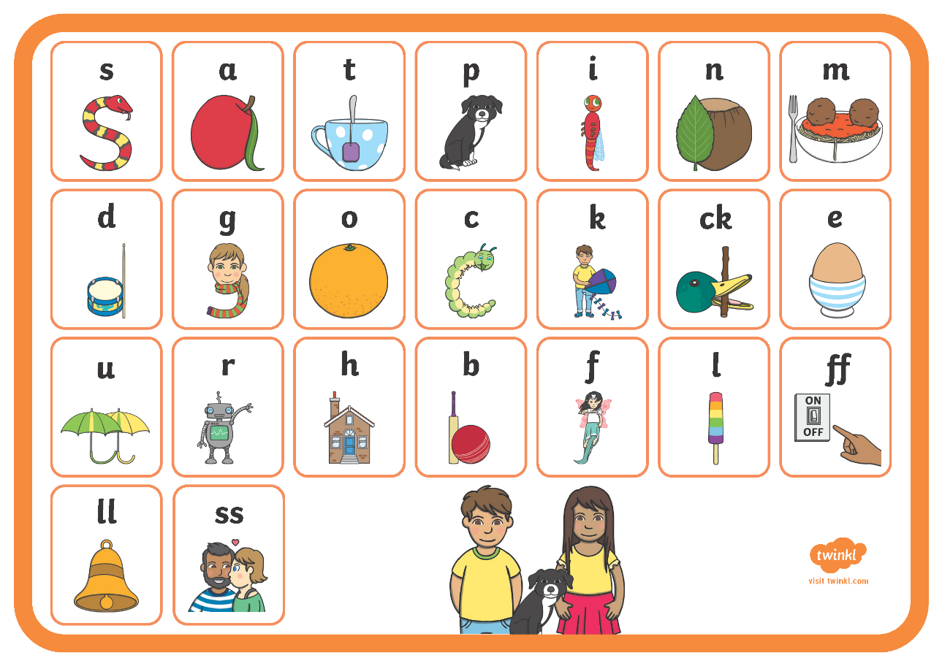
Phase Two
Notes:
Set 1: s, a, t, p
Set 2: i, n, m, d
Set 3: g, o, c, k
Set 4: ck, e, u, r
Set 5: h, b, f, ff, l, ll, ss
Phase 2 usually begins when children start their formal education in reception, though some preschools may also begin to teach letter sounds.

Slide 11
Phase Two
V = vowel
C = consonant
VC words are those that consist of a vowel and then a consonant (am, on, it). CVC words are those that consist of a consonant then a vowel and then a consonant (cat, dog, pen). Some words such as bell, are also CVC words because they only have three sounds. b-e-ll
The children will use magnetic letters to make and spell words, read words on the whiteboard and on flashcards as well as beginning to write words.
Useful Tip
Pure sounds should be used when children are saying sounds. This means, where possible, the ‘uh’ sounds after consonants should not be said.
E.g. the sound ‘f’ should be pronounced ffff rather than fuh.

Slide 12
Tricky Words
During this phase, the children will also be exposed to tricky words; words that cannot be sounded out.
the
to
I
go
no
Ways You Can Support Your Child at Home
Using flashcards, expose children regularly to the sounds they have learnt. Remember to use pure sounds.
Magnetic letters - Using magnetic letters on the fridge or any type of magnetic surface, children can practise making words.
Ask children to spell out CV and CVC words both orally and on paper.

Slide 13
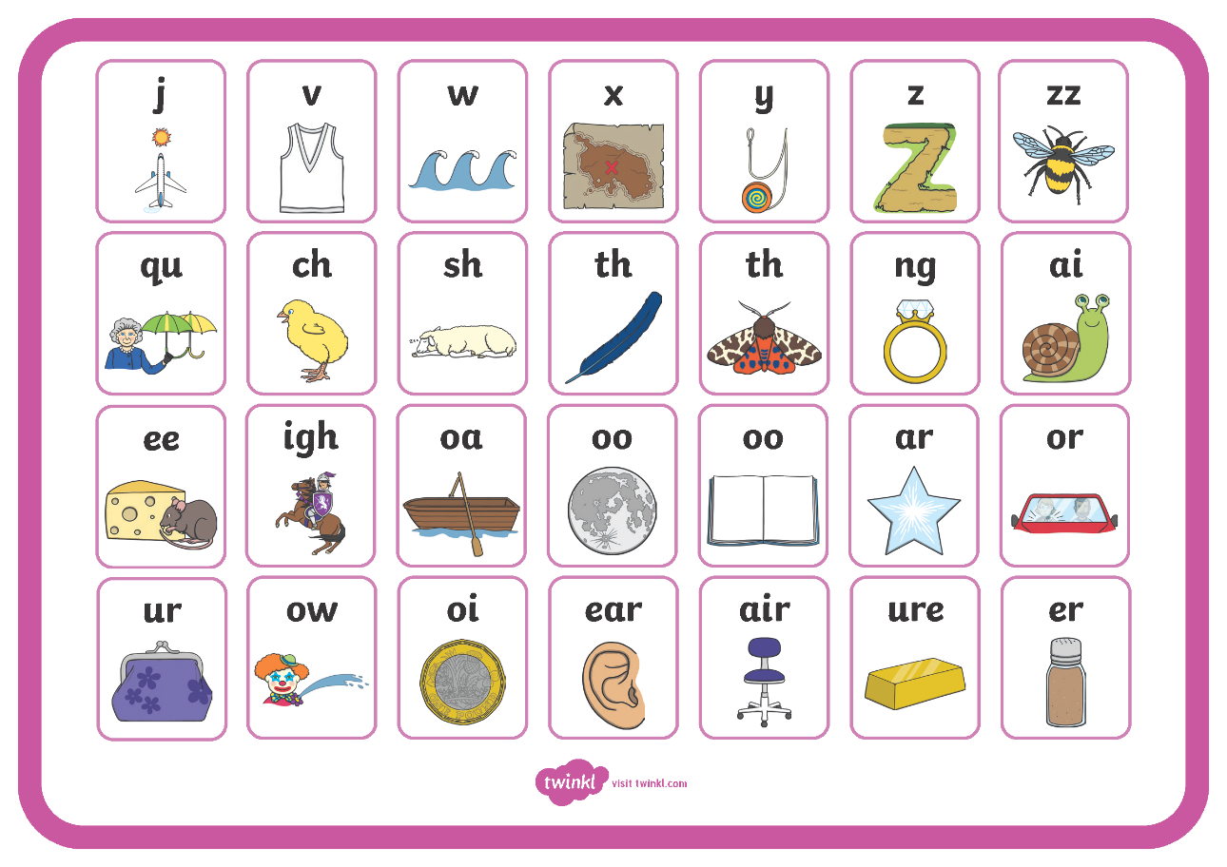
Phase Three
Notes:
Set 6: j, v, w, x
Set 7: y, z, zz, qu
Consonant digraphs: ch, sh, th, ng
Vowel digraphs: ai, ee, igh, oa, oo, ar, or, ur, ow, oi, ear, air, ure, er

Slide 14
Phase Three
The purpose of this phase is to:
Teach more graphemes; the remaining letters of the alphabet and some sounds of which are made up of two or three letters, known as digraphs and trigraphs. E.g. ‘ee’ as in bee
Practise blending and segmenting a wider range of CVC words.
Read more tricky words and begin to spell them.
To read familiar words on sight, rather than decoding them.
CVC Words Containing Digraphs and Trigraphs
ship
cook
fork
beard
high
chair
Useful Tip
It is important children quickly learn to recognise digraphs and trigraphs as one sound, rather than as separate letters.
E.g. rain should be read as r-ai-n not r-a-i-n

Slide 15
Tricky Words
During this phase, the children will also be exposed to tricky words; words that cannot be sounded out.
he
she
we
me
be
was
my
you
her
they
all
Ways You Can Support Your Child at Home
Using flashcards, expose children regularly to the sounds they have learnt. Remember to use pure sounds. Try to increase the speed at which children are shown the sounds.
Continue to use magnetic letters to make and spell words.
Write tricky words on flashcards and stick them around the house. How many can they read in a set amount of time?

Slide 16
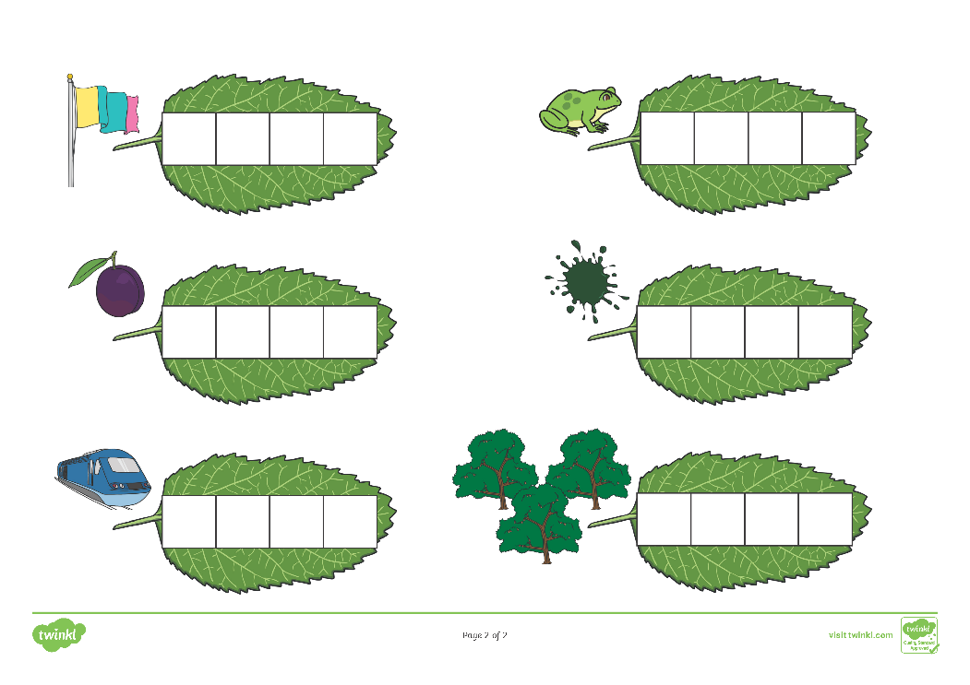
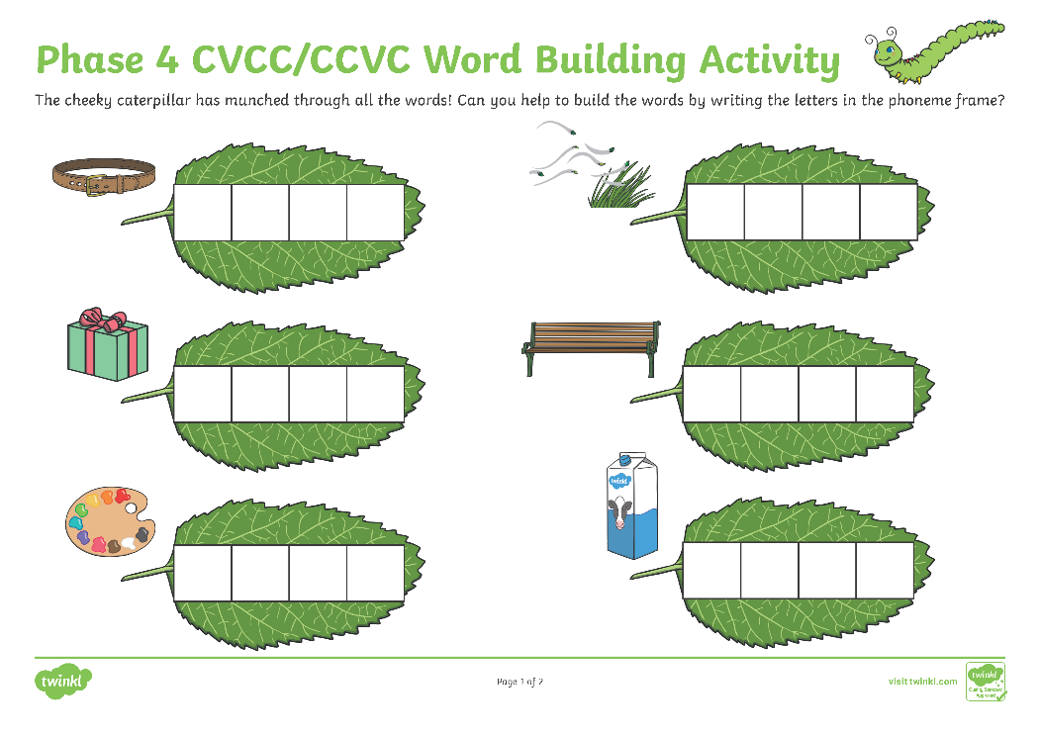
Phase Four
Notes:
Set 6: j, v, w, x
Set 7: y, z, zz, qu
Consonant digraphs: ch, sh, th, ng
Vowel digraphs: ai, ee, igh, oa, oo, ar, or, ur, ow, oi, ear, air, ure, er

Slide 17
Phase Four
The purpose of this phase is to consolidate the sounds already taught. Children are also exposed to adjacent consonants (consonant blends and consonant clusters) and multisyllabic words.
Useful Tip
It is important children learn to read words without blending as soon as possible. Children progress from blending out loud, to blending in their head before reading on sight. The sooner they can read on sight, the quicker their fluency will improve.

Slide 18
Phase Four
CVCC and CCVC Words
Blends and clusters such as the following are taught:
‘nt’ as in tent
‘st’ as in toast
‘pl’ as in plum
‘sp’ as in spoon
Tricky Words
During this phase, the children will also be exposed to tricky words; words that cannot be sounded out.
said
so
do
have
like
some
come
were
there
little
one
when
out
what

Slide 19
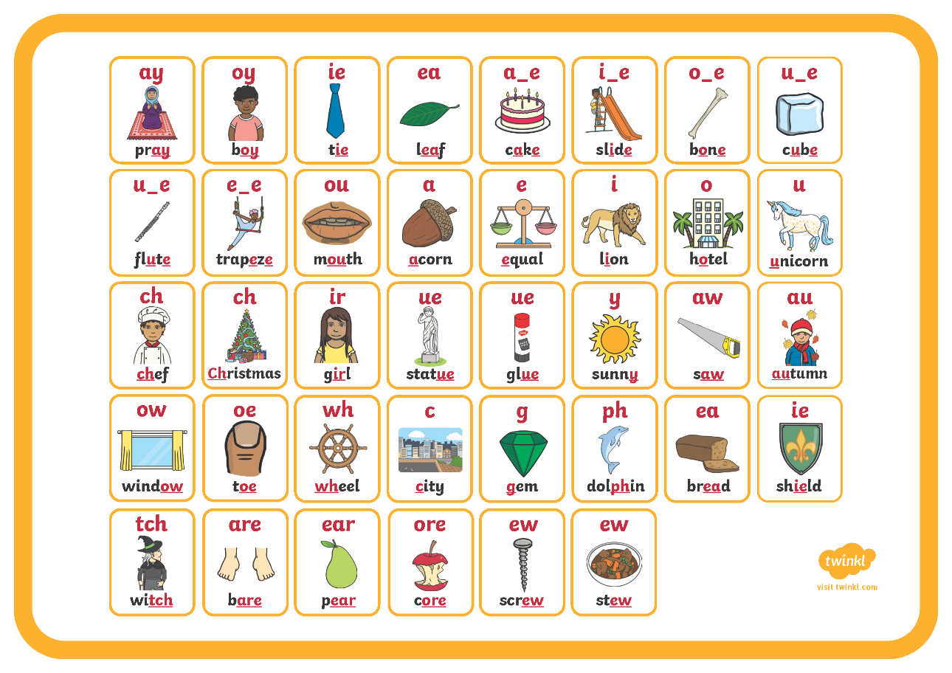
Phase Five
Notes:
Children will be taught new graphemes and alternative graphemes for the sounds they already know. They will begin to learn to choose the appropriate grapheme when spelling. The children will be automatically decoding a large number of words for reading by this point.

Slide 20
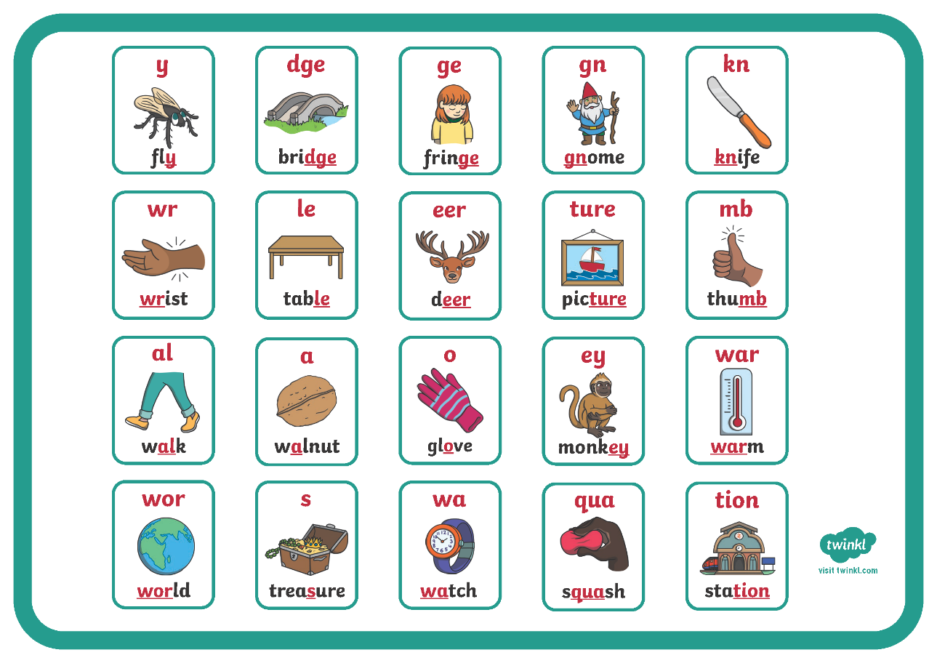
Phase Six
Notes:
In Phase 6, children will be reading longer and less familiar texts independently and fluently. It is crucial that, at this point, children are now reading to learn and reading for pleasure.
Children should be able to read the 300 high-frequency words. At this point, it is important that comprehension strategies are developed so that children clarify meaning, ask and answer questions about the texts that they are reading, construct mental images during reading and summarise what they have read.
In spelling, children are introduced to the adding of suffixes and how to spell longer words. Throughout the phase, children are encouraged to develop strategies for learning spellings.

Slide 21
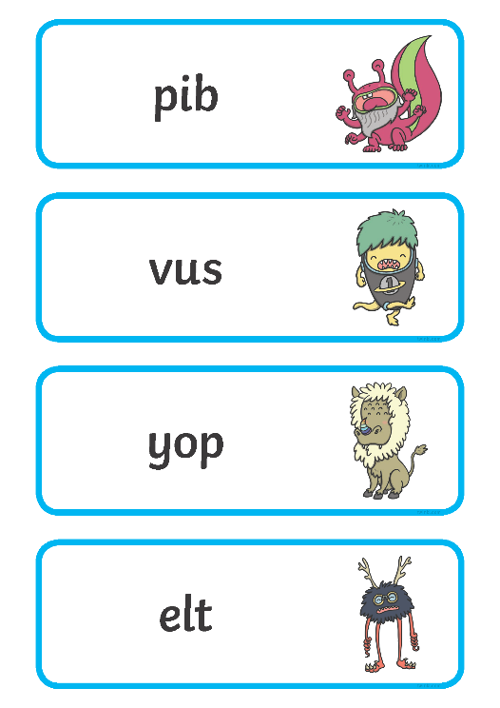
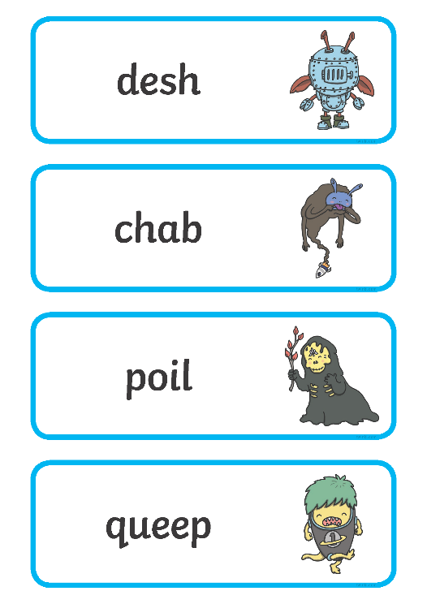
The Year 1 Phonics Screening Check
In June, all year 1 children are expected to complete the year 1 Phonics Screening Check.
The aim is to check that a child is making progress in phonics. They are expected to read a mixture of real words and ‘nonsense’ words.
The outcome of this check enables practitioners to see if any children may need additional support to help them make progress in year 2.
Notes:
Pupils who have achieved the expected standard at the end of year 1 will have experience of decoding all of the types of words that appear in the year 1 phonics screening check. They will know the correct grapheme to go with most sounds and be able to blend phonemes in words in the screening check.
‘Nonsense’ words or ‘alien’ words are designed to test pure phonic ability rather than knowledge of words. Examples might include ‘baf’, ‘gip’, ‘leet’, ‘stoof’.
For more information about the format of the phonics check, see Twinkl’s ‘Year 1 Phonics Screening Check’ Powerpoint.

Slide 22
Pre-Writing Skills
It is essential that a child begins to write when they are ready. In order to prepare your child there are many activities that can be done in various settings, including at home.
Writing readiness can be defined in a number of ways:
hand and finger strength
upper limb strength
hand dominance
pencil grasp
hand-eye coordination

Slide 23
Handwriting
Ways You Can Support Your Child at Home
From an early age, allow your child access to various writing materials of all shapes and sizes. (paint brushes, crayons, pencils, pens)
Encourage participation in skills that involve manipulating objects.
(jigsaws, threading)
Encourage activities to promote finger strength. (tweezers, building bricks, playdough)
Encourage activities to promote gross motor skills. (painting walls outside with water, using a wheelbarrow, climbing ladders)
Encourage activities to promote hand-eye coordination.
(ball games, skipping, throwing a frisbee, throwing stones into the sea)

Slide 24

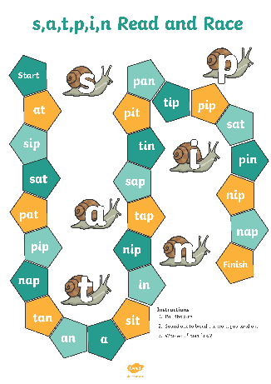
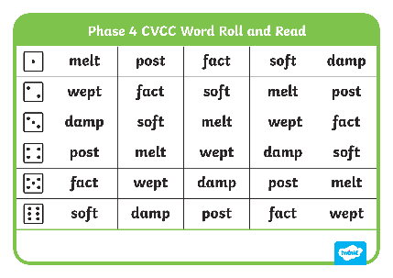


Helping Your Child at Home
play games
provide opportunities for writing
      provide opportunities for reading

