Slide 1
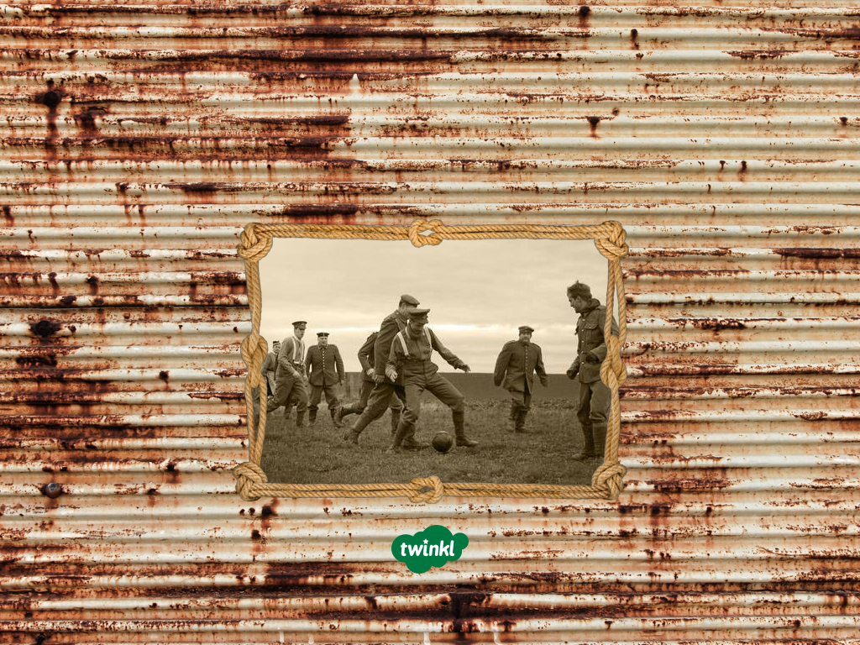
The Christmas Truce
See page for author [CC BY-SA 4.0 (http://creativecommons.org/licenses/by-sa/4.0)], via Wikimedia Commons

Slide 2
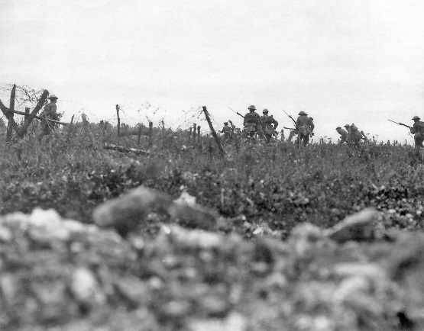
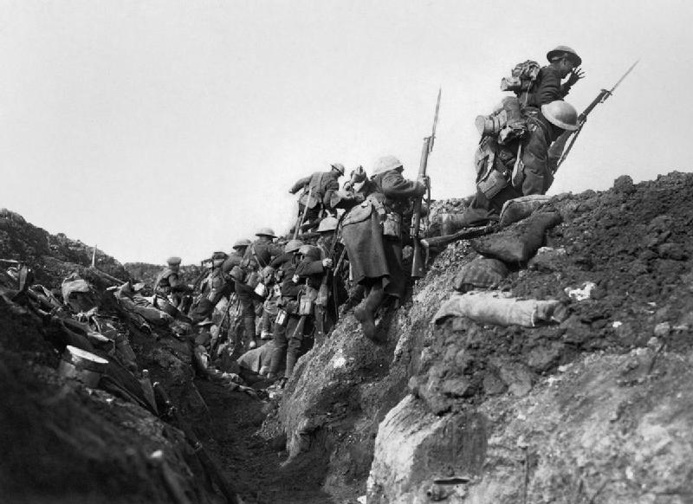
Life on the Western Front
In August 1914, the First World War began. It was to be one of the worst wars in history and when it ended in 1918, it was sometimes known as ‘The Great War’ or ‘the war to end all wars.’
During the First World War, men fought on
the Western Front in trenches that stretched for over 1000 miles, from the English Channel to the Swiss border.
The land in between the two opposing sides was called ‘No Man’s Land'.

Slide 3

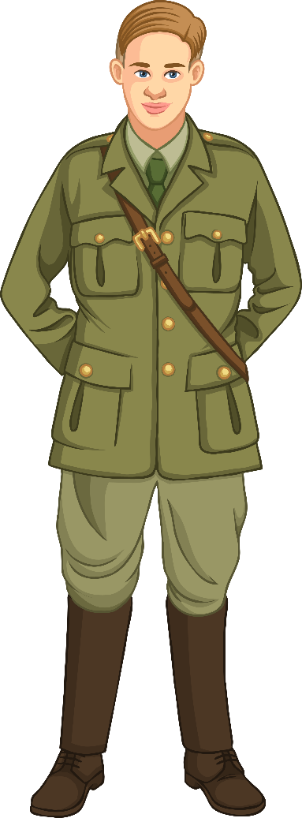
The Christmas Truce
As Christmas drew near, a desire for a truce grew as care packages began arriving from home. Surrounding towns, villages, and support associations generously gave warm clothes and letters of thanks. Common gifts included chocolate, butterscotch, cigarettes and tobacco.
With boosted morale and more than usual to eat, the Christmas spirit entered the trenches and a truce began on 24th December 1914.
In some areas, German soldiers decorated their trenches with small Christmas trees with candles in them. This prompted carol singing
and even some meetings in no man’s land.
This was the first time that opponents had met, even if just briefly,
in no man’s land. In one instance, a note was sent asking for a
ceasefire so the Germans could celebrate their captain’s birthday.
The British accepted and offered some tobacco in return.

Slide 4
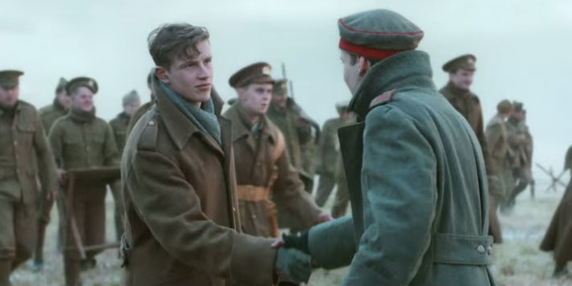


Source Analysis
Watch this well-known supermarket Christmas advert from 2014.
Do you think the video is
a reliable representation of what happened at Christmas in 1914?
Give reasons to explain
your answer.
Source B
Unknown author [CC BY-SA 4.0 (http://creativecommons.org/licenses/by-sa/4.0)], via Wikimedia Commons

Slide 5
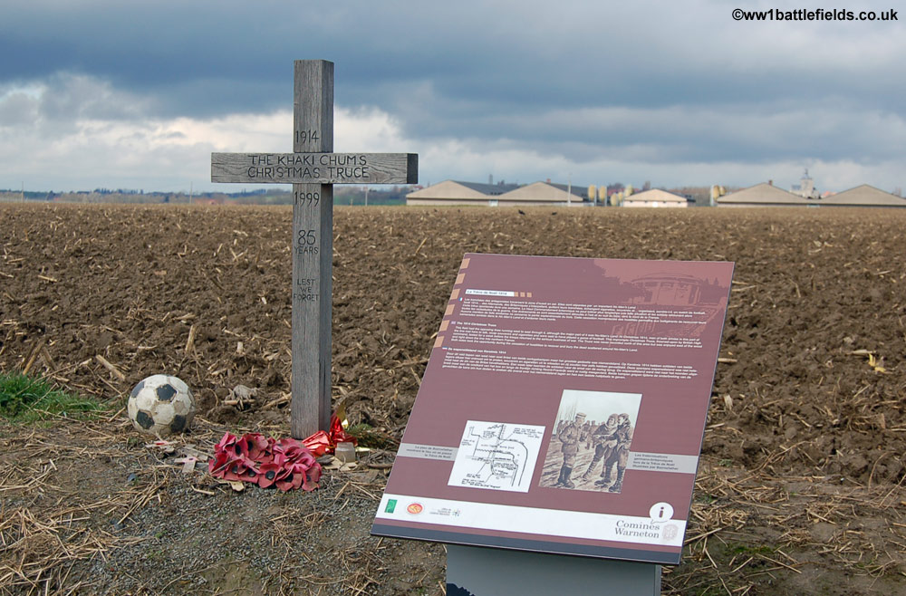
The Khaki Chums Xmas Truce 1914
The Khaki Chums Xmas truce memorial sits in a field by the village Saint Yvon 16 kilometres from Ypres.
This is the main site of the famous Xmas truce football game in December 1914.

Slide 6
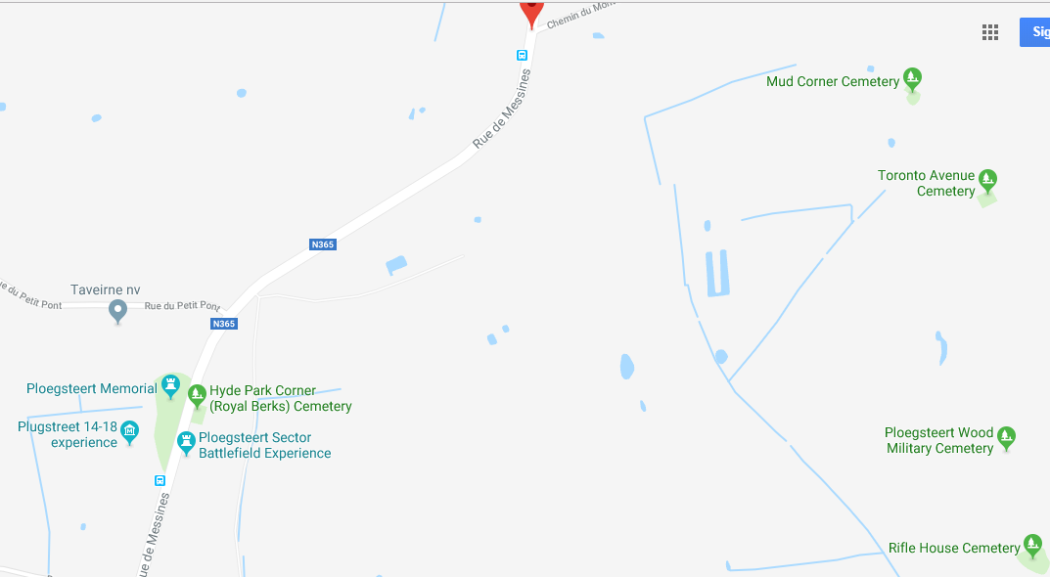
Cemeteries Around the Famous Truce
Allies Front Line Trench 1914

Slide 7
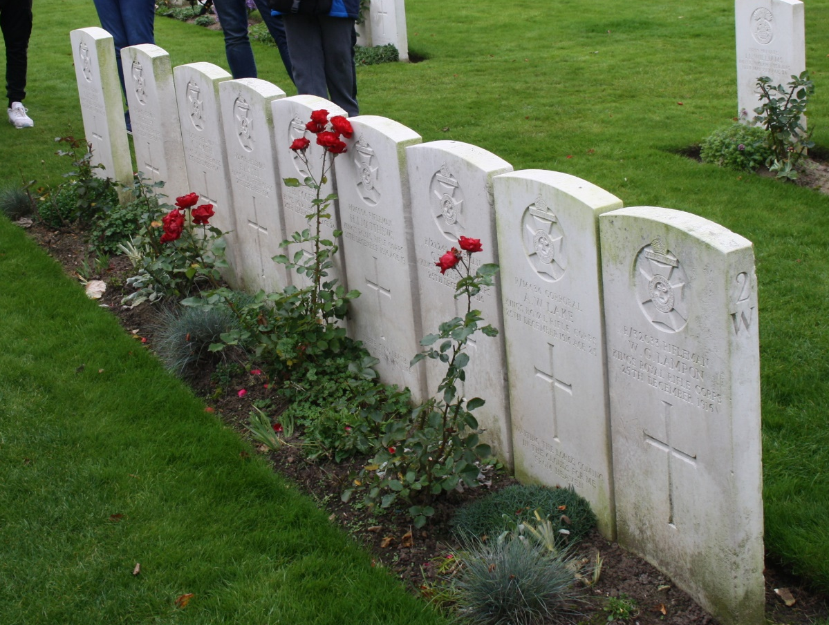
Why did the Truce not happen every year?
The picture shows 9 marked graves of men who died on the 25th December 1915.
Why did this happen?
Why was their not a truce every year?

