Slide 1

ANCIENT GREECE
B

Slide 2
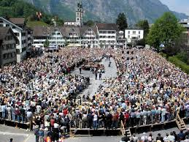
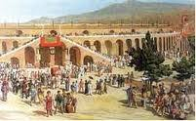
Democracy
. Democracy started around 510BC.
.Women under 18 and people are not Metic can not vote.
.The different groups of people are Dikasteria,Boule and Ekklesia.
The Dikasteria is more like the police.
Democracy started in Greece

Slide 3

Olympics
Only men were allowed to compete.
Married women were not allowed to watch.
Men have to compete naked.
Men have to go to war or athletics.
The events are Pankration, Pentathlon, Stade, Dolichos, Hoplitdromos, boxing, wrestling and Chariot racing.
The first Olympics was 776bc.
The winner wins an olive branch.

Slide 4
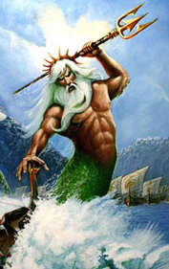
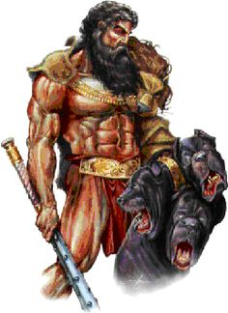
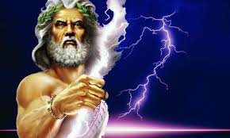
Greek Gods
Zeus
Poseidon
Hades
Leader of the gods and rules the weather. Also Rules Mount Olympia.
Poseidon rules the seas and the island of Atlantis.
Hades rules the underworld. Hades owns a pet dog with three heads.

Slide 5
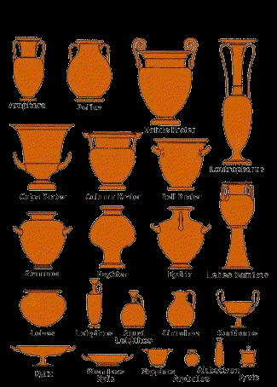
Vases
Mostly all Greek vases have handles and are painted brown.
Some of the types of vases are amphora, necked amphora and Pyxis.
These are Greek vases

Slide 6
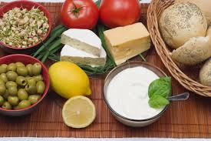
Food
In ancient Greece they eat bread ,cheese olives and even snails.
These are some of the foods the ancient Greeks use to eat.

Slide 7

Differences
The differences from the ancient Greek times to the UK democracy now is that anybody can vote if they are over 18.
The differences from the UK Olympics is that any gender can compete. Also anybody can watch.
The differences are that in the UK that they don’t make vases in the UK.

Slide 8
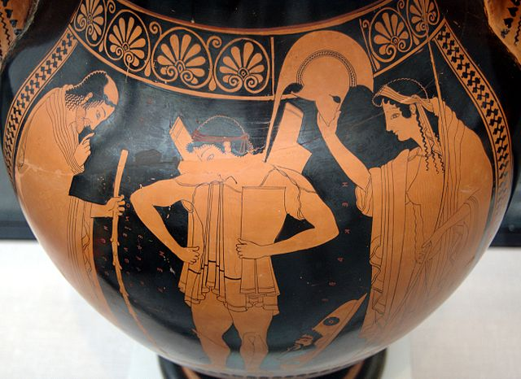
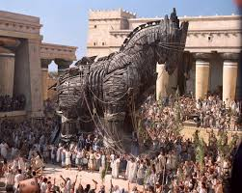
Arts
Greece is very famous for there art.

Slide 9
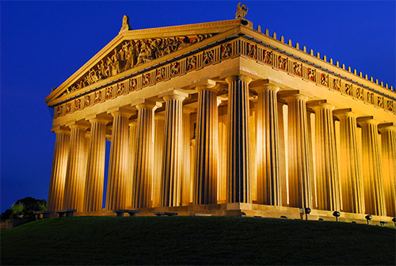
Ancient Greek building
This ancient Greek building is named the Parthenon. It is one of the oldest Greek building. The building is mostly destroyed after a war.

