Slide 1
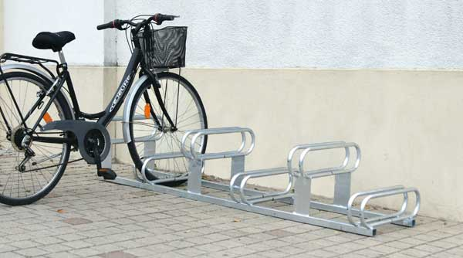
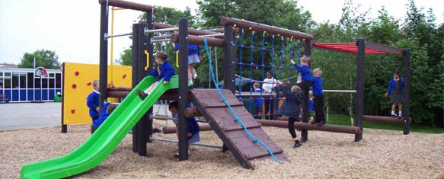


Next ->

Slide 2
Pitch Statement
We are St George and we want better quality equipment and bike racks. This is good because it will bring the fun back. It will also be good for the environment and it will keep you fit and healthy.
So do you want to ride to school?
Do you want to have more fun?
VOTE FOR ST GEORGE!

Slide 3
Our Aim
Our aim is to get bike/scooter racks and more playing equipment for children to play with.
This means that children have:
A better attitude
More fun
Safety
More things to play with
They can ride their bikes/scooters to school
Fix the equipment we already have

Slide 4
Current Equipment
Next ->
Currently we have:
Footballs and balls
Skipping ropes
Hula hoops
Bean bags
Climbing frame – metal and wooden
Tyres
We are going to get even better equipment!
We asked four Year 2 children if they were happy with our equipment.
They said:
‘It is boring. We want more than just football.’
They said they would like basketball nets and rugby posts.

Slide 5
The current problems
Next ->
People argue over things however when we get more equipment it’ll be fine.
People can be more active and more fun.
You can’t go on the grass very much because of the footballs shooting everywhere.
There isn’t enough things for girls and people who don’t like to play football

Slide 6
Bike/Scooters Rack Rota
You will need a bike lock.
This will be safer because then nobody can get your bike.
You can also bring your scooters as the bike racks we are going to buy are multi-purpose

Slide 7
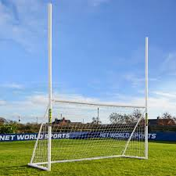
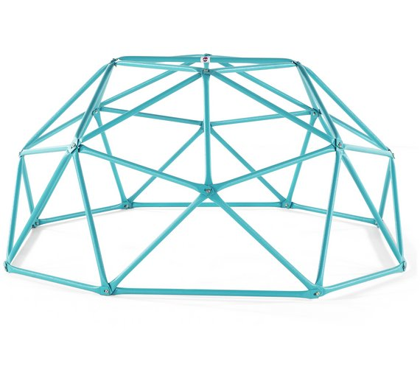
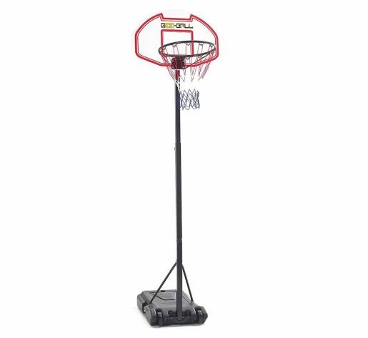
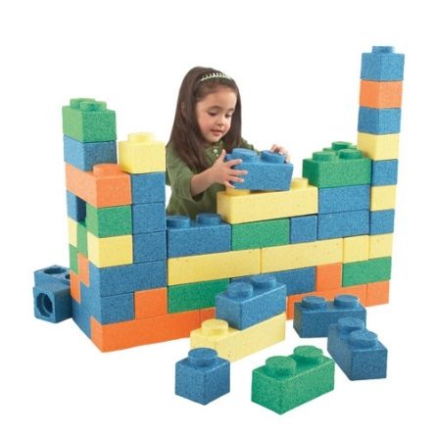
What we are going to buy
Next ->
Climbing dome- £91
2 in 1 football / rugby net x2 - £240
60 wall mount bike racks - £300
Big foam dice - £ 8.60
Foam Jenga - £49
25 plastic counters £25
Tin can target shooting
Big garden dominos
Rope quoits and wooden pegs £25
20 assorted chalk
See saw £34
Basketball nets for infants and juniors - £136

Slide 8
The Cost
Next ->
Only £918.60!

Slide 9
How we will afford this
Next ->
We will have non-uniform days. One of these days will raise approximately £200. If we hold three of these over the next 2 years we would have raised around £600.
We will hold cake sales and ask parents to buy the cakes.
We have wrote letters to parents to bring spare/unwanted things, so we can sell these to raise money.
We also wrote to Halfords asking for a donation of bike racks in exchange for advertisement in our school.

Slide 10
What impact will it have?
Happier children at playtimes
Children will look forward to coming to school
Will give children things to do
Children will be more awake of a morning
Children will be safer during home time
Children will be healthier
Improve our results in local competitions
Ready for Bikeability
Stop children arguing over equipment
Next ->

Slide 11
Vote for St. George!

