Slide 1

St.David’s Manifesto
Daffodils attract, Saint David reacts!

Slide 2
What is the problem?
Colours attract insects.
You work with the same people every single PE lesson.
Children argue about what colour team they are on.

Slide 3
Our Manifesto
White t-shirts with a logo for each child in the school.
We will use colour bands to mix up groups in PE so that children can work in teams with different children.
We will have a phasing out period so that parents don’t have to buy new t-shirts immediately.

Slide 4
Why We Are Doing This
If people argue in the same team you can change the colour bands.
Teachers can't say yellows together or any other colour team so you get to work with different people.
Everyone can have new teams every session; you can be with you friends.
It will help everyone!
We ALL get to work together.

Slide 5
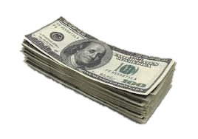
Costings
T-shirts will cost exactly the same as our current ones but they won’t fade when they are washed.

Slide 6
Summary
Starting from September 2018, we can promise a change for the better no matter what team you are on.
Changes from our old coloured PE kit to a fabulous new style.
This will cause less arguments about colour.

Slide 7
Thanks for listening

