Slide 1

E-Safety
Awareness
Steve Ford Strategic ICT Manager & CEOP Ambassador

Slide 2
2024 - 25
In 2024, Over 90% of children aged 4-10 went online. Laptops, tablets and mobiles were the most used devices for going online,
25% of children aged 4-5 have their own device (tablet or smartphone) and use it for online activities, such as watching videos or playing games. (Ofcom, 2022)
Over 30% of children aged 8-10 are using social media, despite most platforms being restricted to users aged 13 and over. The most popular platforms among young children are YouTube, TikTok, and Instagram. (Ofcom, 2022).
A significant number of children under 10 may be exposed to social media indirectly, such as through watching videos or interacting with online content from older siblings or friends.

Slide 3
One in five children aged 8-10 have reported seeing content that they found disturbing or inappropriate while using the internet. This includes exposure to violent or explicit content, either through search results or shared media. (NSPCC, 2022)
58% of parents say they have rules in place about how long their children can spend online. However, a significant number of parents struggle to enforce these rules, and children’s screen time is often determined by the availability of devices. (Ofcom, 2022)
More than 50% of kids aged 4-10 play with others online, which can expose them to interaction with strangers. Understanding game settings and parental controls is crucial for limiting these risks.

Slide 4
Social Media for Children Under 11
Inappropriate Content: Even though platforms have age restrictions, children may encounter explicit or violent content. A study by NSPCC found that 1 in 5 children have come across inappropriate or explicit content while using social media.
Cyberbullying: Pre-teens are at risk of cyberbullying, especially as they begin to use social media. Children aged 9-10 may be exposed to harmful interactions or peer pressure online.
Privacy Concerns: Children may not fully understand the importance of keeping personal information private. Sharing too much personal information (like locations, names, or photos) can put them at risk of exploitation or online predators.
Screen Addiction: Excessive use of social media and screen time can impact physical health, emotional well-being, and social development.

Slide 5
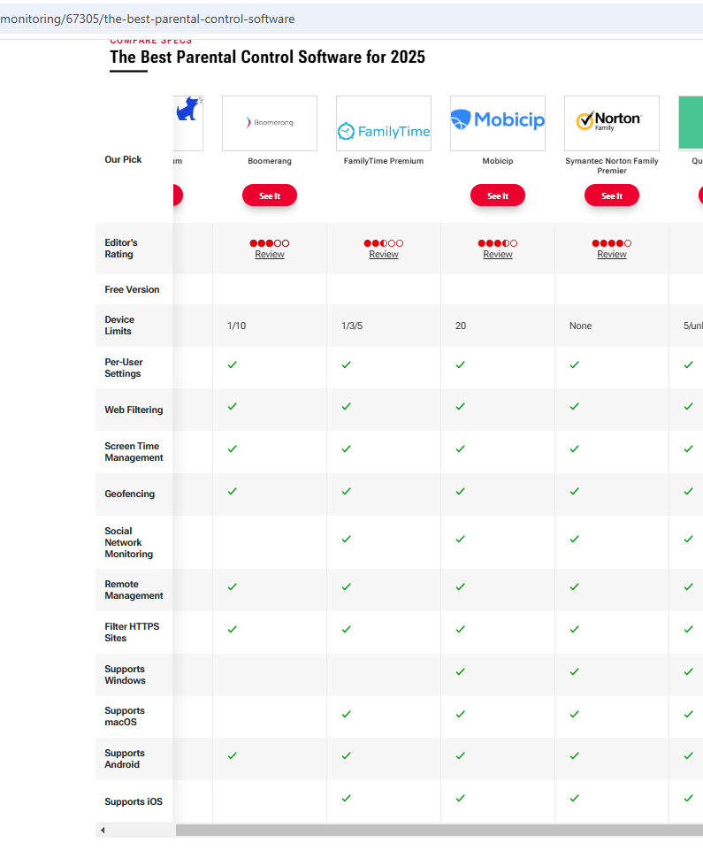
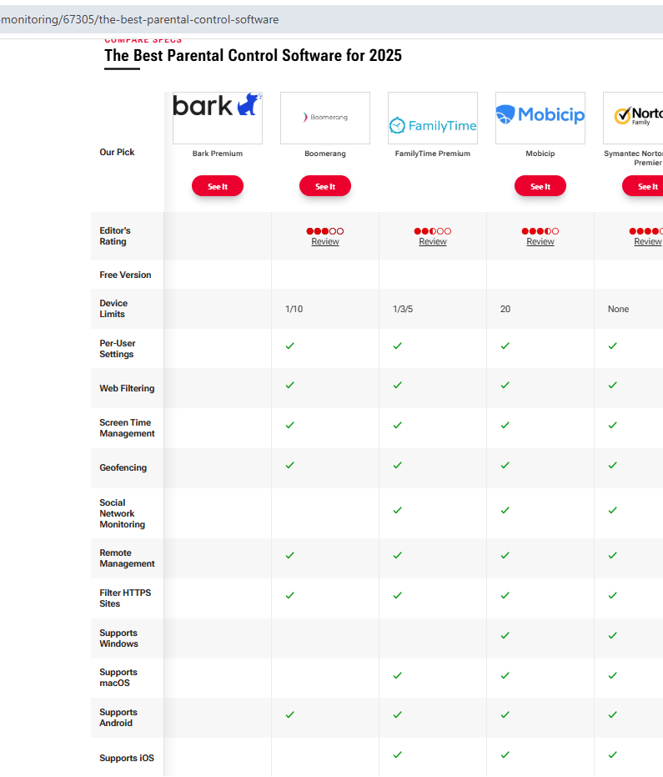
The best parental Control software 2025

Slide 6
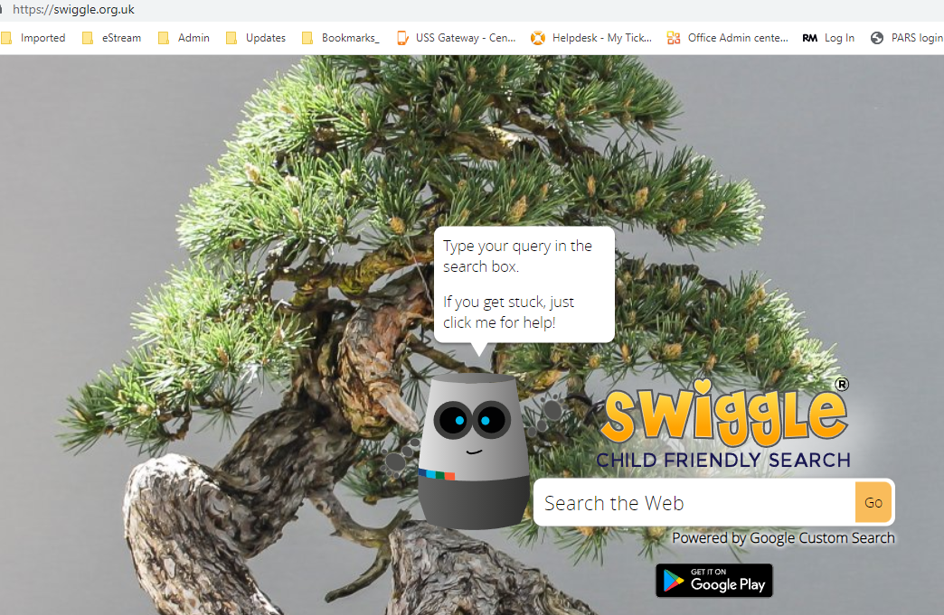
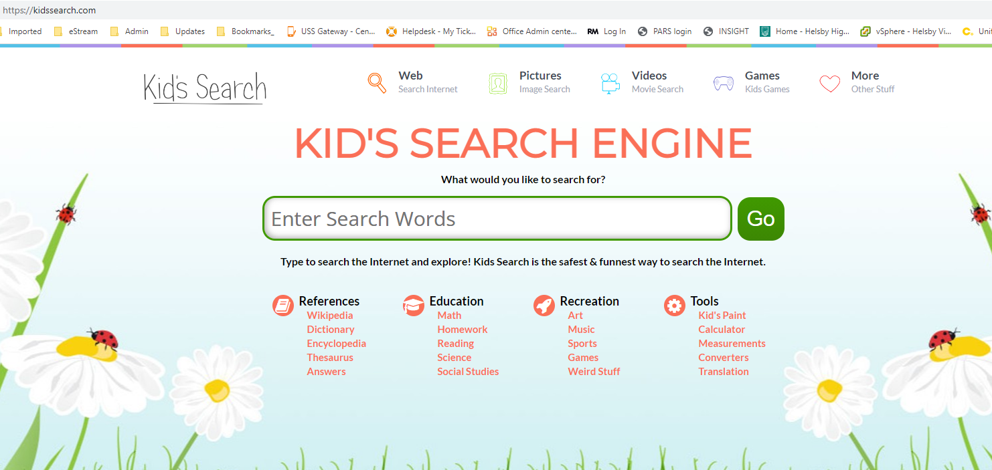
Search safely
Use safe search engines such as Swiggle or Kids-search.
You can save time by adding these to your ‘Favourites’. Safe search settings can also be activated on Google and other search engines, as well as YouTube.

Slide 7
Games
Roblox is an amateur game-maker/-player system for Xbox, PC, tablets and smartphones. (PEGI 7 & 13)
  Parents should watch out for user created games that fall outside the ratings and do include more blood and violence than the rating suggests.
Fortnite leapt to greater popularity with its Battle Royale mode that can be played for free and pits up to 100 players against each other. (PEGI 12)
  Parents should be aware that children can talk to strangers in the game and that swearing and racists language do occur.
Overwatch is a multiplayer shooting game in which two teams of six players compete to capture and defend various objectives. (PEGI 12)
  Parents should be aware of the online nature of the game and how players can interact with others.

Slide 8
Sexting & Digital Footprint
27 police forces in England and Wales revealed 306 cases of children under 10, including some as young as four, being investigated on suspicion of taking or sharing indecent images of themselves or other minors.
Digital footprint - A digital footprint is the user trail of data, created as a result of your online activity. This includes websites visited, searches made, social media posts, as well as any other interactions that are recorded by digital devices

Slide 9
Cyber Bullying Facts
27% of children between the ages of 8-15 who use some form of social media have experienced cyberbullying.
In 74% of parents identified classmates as the main cyberbullies of children they knew.
71% of children between 5-15 have seen hateful content online.
In the UK, 17% of parents report that their child has been a victim of cyberbullying.
One in five 9-12 year olds has either experienced, witnessed or participated in cyberbullying.
Less than three in ten parents of 3-17 year old children believed the benefits of their child using social media, messaging and video sharing apps outweighed the risks.
One study found that 9 in 10 people experienced bullying while playing video games online.
66% of children between 10-15 say they did not report cyberbullying because they did not think it was important.

Slide 10
Parents………..
Around six in ten parents of 5-15s, who had fixed broadband at home and a child who went online, were aware of certain technical tools and controls, around half of these actually used the tools and controls available.
Talking to children about online safety is a key mediation strategy, and nine in ten parents of children who went online said they had never done this.
Parents also sought or had received advice about online safety; the child’s school was the most used source of information or advice for this (used by two-thirds of parents of children who went online)

Slide 11
Things that keep your children safe Online are often similar to the things that keep them safe Offline

Slide 12
Encourage them to talk about their activities and relationships.
Be open and supportive to let them know they can
come to you

Slide 13
Talk about what they think is normal online
and what behaviour to expect from others and from themselves

Slide 14
Encourage them to
think critically
Talk about fake news, fake followers and scams.
Help them to develop a
healthy suspicion
Share your knowledge and experience of relationships

Slide 15
For example. Sometimes people seem nice at first
Let them know that you know this and that they
can talk to you about it

Slide 16

Show them how to report online for example
CEOP

Slide 17
Parent conversation starters
What do you like to use technology for?
What things make you happy when you use technology?
What things make you unhappy/angry/sad when you use technology?
How long do you think you spend using technology each day/ week?
What happens when you’ve been using technology for too long? to your body? to your mood? to your device?

Slide 18
Key Tips for parents
Monitor Online Use: Regularly check which apps and websites your children are using, and be aware of any social media or gaming apps they may have access to.
Parental Controls: Utilize parental control settings on devices and apps, and consider using content-blocking software.Establish boundaries
Open Dialogue: Encourage an open conversation with your child about what they do online, who they interact with, and how to handle uncomfortable situations.
Set Time Limits: Establish guidelines for daily screen time to prevent excessive use and encourage a balanced lifestyle
Stay informed
Notes:
Discuss how using technology makes us feel - As a family discuss how using technology and going online can make you feel. Discuss how you know you have been online for too long, considering physical, emotional and device-level factors, eg headaches, feeling grumpy, device battery is now low.
Give techology a purpose - It is important that we use technology for a purpose rather than unconscientiously engaging with it which may lead to extended use. A good example of this would be using a tablet to find a recipe online and then putting it down to cook instead of looking for a recipe and ending up scrolling through endless pages online.
Establish boundaries - Why not try using our family agreement to create a set of rules or boundaries to help keep your whole family safe online. At this age children can contribute their own ideas for safe use of technology and may respond more positively to rules which have been created in partnership with them. For more information on how to put the family agreement into practice with children of different ages please visit our family agreement blog.
Use parental controls - Make use of the controls available to ensure that the internet is a safer space for your child to explore. You can set up parental controls on devices, on your home internet connection and even on a mobile phone network. Visit Internet Matters for more detailed information per service, app and device. Remember that parental controls should form part of a wider approach to keep children safe online and not be a used as a replacement for discussion and involvement.
Be supportive - It's important that children know who they can turn to for support and that they feel listened to and supported if anything ever does worry or upset them online. Make sure children know who all the trusted adults are that they can ask for help, whether it's at home or at school.
Stay informed - It's important that you know what to do or where to go to find out if ever your child does need help with something that is worrying or upsetting them online. Visit our 'Need help?' page for parents and carers for more advice, support and reporting routes.

Slide 19
On the Radar!
AI Technologies and fake images and videos – (Don’t copy any images etc. found)
https://haveibeenpwned.com/ - checks for data breaches
Carrots & Cake
Manage screen time
  Create daily screen time schedules for your kids. Select their favourite educational apps Carrots- they must complete before free screen time - Cake.
  Choose how much learning time & free time kids get. Customize screen time schedules around your family's routine.

Slide 20
Q & A

